Slide 1

Predicting Hotel Booking Canacelation
By Pushpinder Raghu

Slide 2
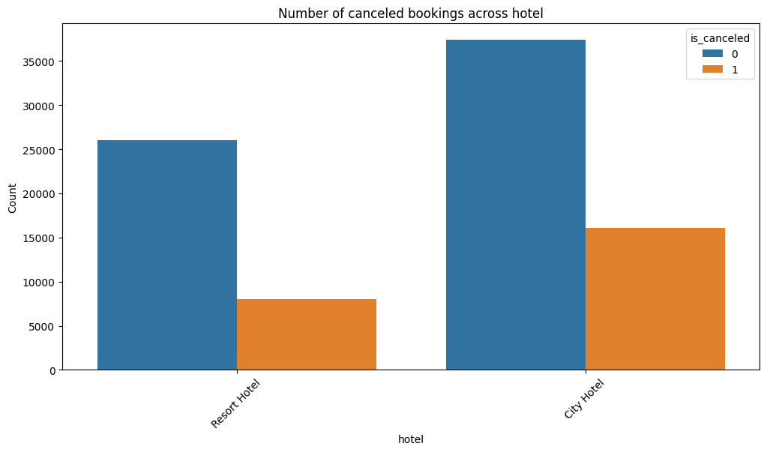
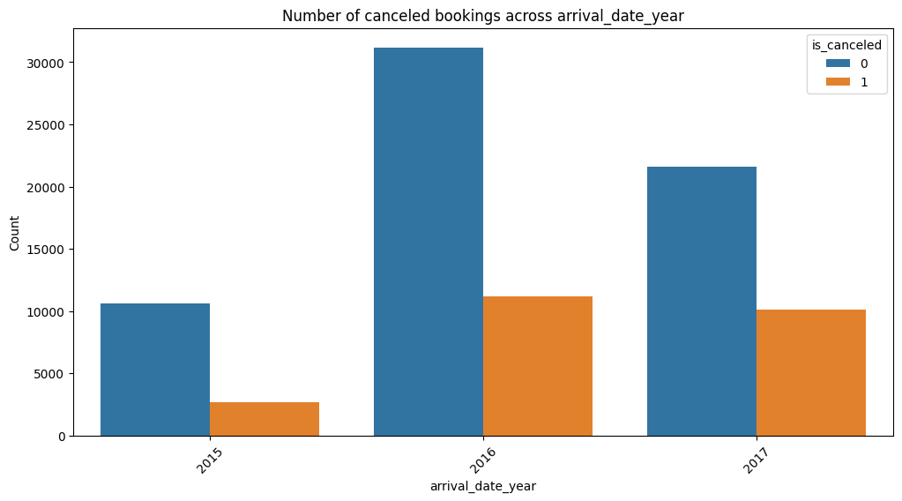
Dataset Summary:
Dataset has 119,390 samples and 32 features
There are 31994 duplicates in the database. which is 26.8%
There are 651(0.74%) records where stays_in_weekend_nights and stays_in_week_nights marked as zero.
There are 166(0.18%) records where adults, children and babies marked as zero
Dataset has imbalanced class of cancellation with 24025(24.49%) records
Cancelations in resort hotel= 23.48 %
Cancelations in city hotel= 30.04 %

Slide 3
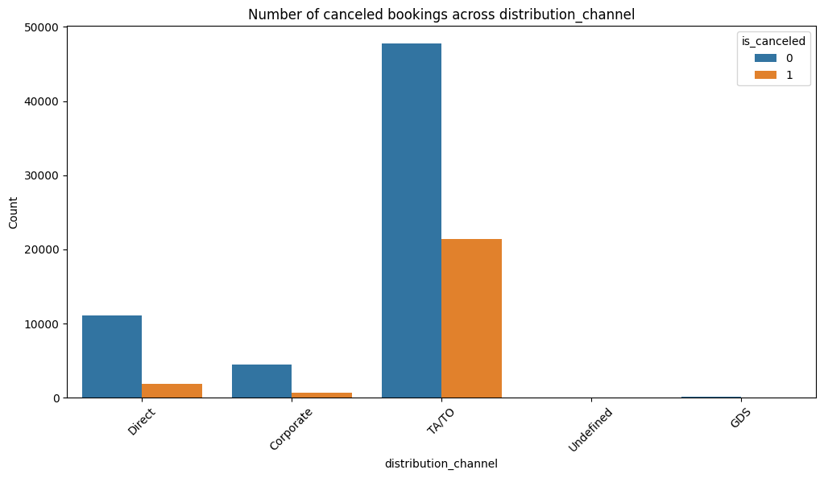
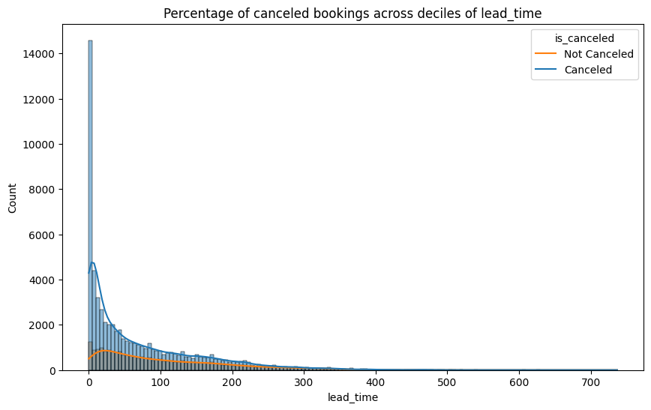
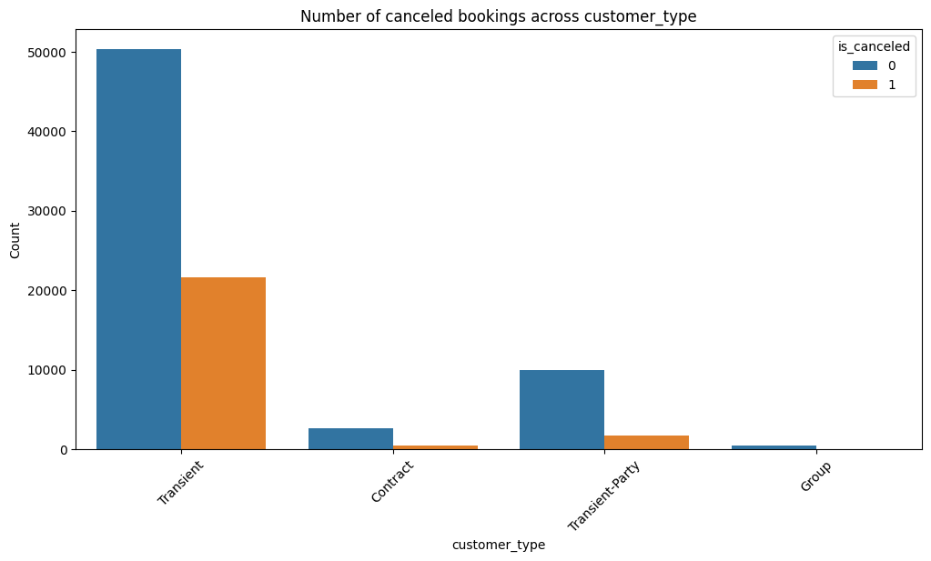
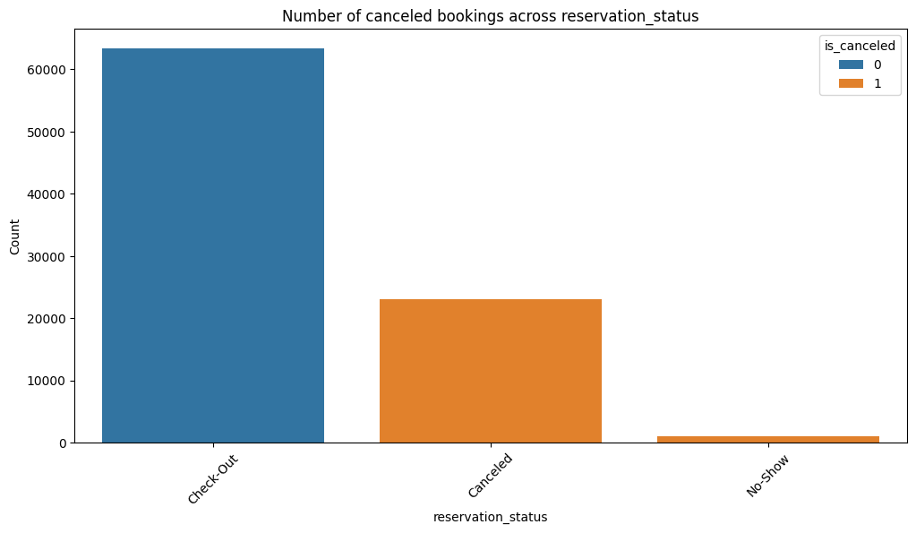

Slide 4
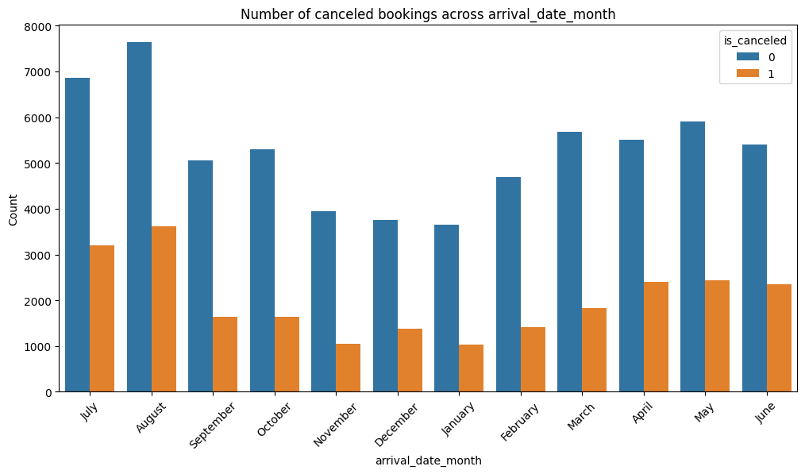
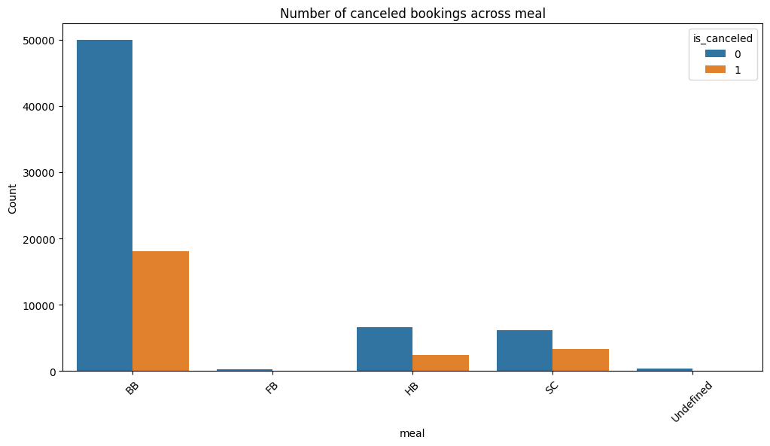
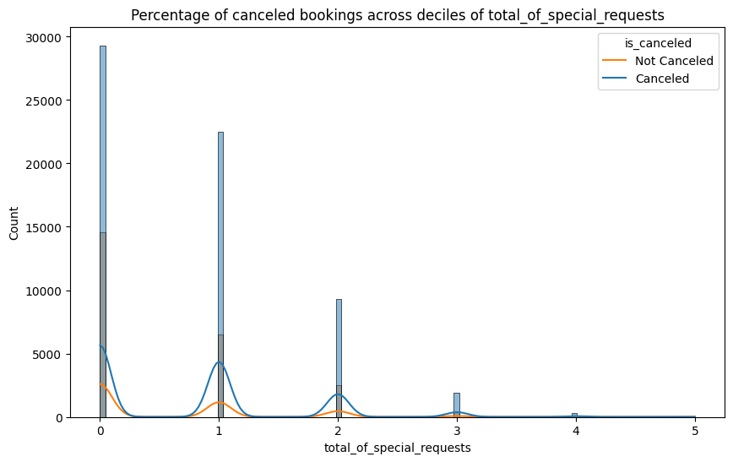

Slide 5
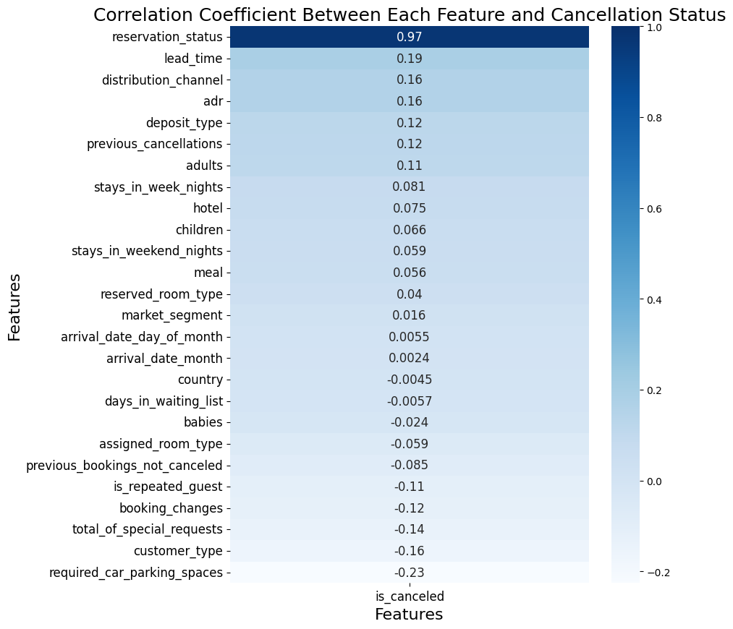

Slide 6
Model Pipeline
Load Data
Remove duplicates
Train-Test Split
Train-Test Split
Preprocess Data
Save the Model
Model train and evaluation
SVC HyperTuning
Catagorical Mapping
Imputing Missing values using KNN
Date feature Mapping
Outlierdetection and removal
Normalisation
Feature drop

Slide 7
Model Performance
Accuracy: 1.0
Precision: 1.0
Recall: 1.0
AUC: 1.0
Confusion Matrix:
[[18053 0]
[ 0 18053]]
F1 Score: 1.0
Training time: 0.7110714912414551
Inference time: 0.16512537002563477

