Slide 1

LLOYD INSTITUTE OF ENGINEERING & TECHNOLOGY
Greater Noida | Department of Computer Science & Engineering
B.TECH FINAL YEAR MAJOR PROJECT · BCS753
Dual-Stream Spatial & Frequency-Domain Deepfake Video Detection
Leveraging EfficientNet-B4, 2D-DCT Spectral Analysis & Attention-Gated Bilinear Fusion
Project Presentation – I | Session 2026–27
GUIDE NAME
SUBMITTED BY
Dr. Devendra Gautam
Dev Rana Kaila — Roll No. 2301531530023 — Sec A (AIML)
B.Tech Computer Science & Engineering (Artificial Intelligence & Machine Learning), 7th Semester
Associate Professor & Mini Project Coordinator, Department of CSE

Slide 2
01
OVERVIEW
Presentation Agenda
1
Problem Statement
5
System Workflow / Architecture
2
Objectives
6
Expected Outcome
3
Technology Stack
7
References
4
Literature Survey
BCS753 · B.TECH MAJOR PROJECT PRESENTATION
2

Slide 3
02
SECTION 02
Problem Statement
Deepfake video synthesis powered by Generative Adversarial Networks (GANs) poses catastrophic risks to biometric authentication, digital banking KYC verification, judicial evidence admissibility, and societal information integrity.
Critical Research Gap — The Compression Blind-Spot: State-of-the-art competition solutions, such as Selim Seferbekov's 1st-place Kaggle DFDC model and MesoNet, rely exclusively on pixel-level (spatial) features. Under standard social media compression (H.264 / WhatsApp / YouTube), subtle pixel manipulation clues are smoothed away, causing spatial-only detectors to plummet by 20% to 35% in accuracy.
The Frequency Solution: Convolutional GAN generators leave persistent periodic checkerboard artifacts in the frequency domain due to transposed upsampling operations. Unlike spatial pixels, these mathematical spectral fingerprints survive heavy lossy video compression.
The Forensic Opacity Problem: Existing deployed models operate as uninterpretable black boxes outputting only a scalar probability, making them inadmissible in courtrooms and non-compliant with explainable AI (XAI) mandates.
BCS753 · B.TECH MAJOR PROJECT PRESENTATION
3

Slide 4
03
SECTION 03
Objectives
Automate continuous video ingestion, uniform frame sampling at 5 FPS, and MTCNN face detection with a 15% contextual boundary margin to generate canonical 256×256 aligned face crops.
Design a dual-stream neural architecture combining an EfficientNet-B4 spatial backbone (1,792-d) and a 2D-DCT Spectral CNN (512-d) to capture orthogonal pixel and frequency clues concurrently.
01
02
03
Formulate a rotationally invariant Radial Azimuthal DCT Spectrum A(r) and an Attention-Gated Bilinear Fusion mechanism g = σ(Wg·[vs ∥ vf] + bg) to dynamically weight streams under compression.
04
Implement Grad-CAM forensic explainability to produce visual saliency heatmaps for courtroom admissibility, and deploy the pipeline via a real-time interactive Streamlit web dashboard.
BCS753 · B.TECH MAJOR PROJECT PRESENTATION
4

Slide 5
04
SECTION 04
Technology Stack
• Deep Learning & Modeling:
PyTorch 2.6.0 with CUDA 11.8 (GPU acceleration & CPU fallback), timm (PyTorch Image Models) for EfficientNet-B4 pretrained backbone, torchvision.
• Signal Processing & Vision:
OpenCV 4.8+ (video decoding, temporal frame sampling @ 5 FPS), MTCNN (facenet-pytorch) for cascaded face landmark alignment, SciPy (scipy.fft.dctn) for 2D Discrete Cosine Transform.
• Deployment & Visualization:
Streamlit 1.30+ for forensic web dashboard, Plotly 5.17+ for interactive confidence gauges and temporal charts, PyTorch-Grad-CAM for saliency heatmaps.
• Hardware & Environment:
Python 3.10+ (Anaconda / Miniconda), Windows 11 / Ubuntu 20.04 LTS, 16 GB DDR4 RAM, NVIDIA GeForce GTX/RTX or Intel Core i5/i7 (lightweight 21.4M parameter footprint).
BCS753 · B.TECH MAJOR PROJECT PRESENTATION
5

Slide 6
05
SECTION 05
Literature Survey
S.No | Paper Title | Author(s) | Journal / Year | Key Findings
[1] | FaceForensics++: Learning to Detect Manipulated Facial Images | Rossler et al. | IEEE ICCV, 2019 | Established FF++ benchmark; showed spatial detectors drop 20-35% in accuracy under c23/c40 video compression.
[2] | Leveraging Frequency Analysis for Deep Fake Image Recognition | Frank et al. | PMLR ICML, 2020 | Proved GAN upsamplings leave persistent spectral anomalies in frequency domain; foundational to our frequency stream.
[3] | Thinking in Frequency: Face Forgery Detection by Mining Frequency Clues | Qian et al. (F3-Net) | ECCV, 2020 | Used DCT frequency filter bands; achieved 90.4% under compression, but lacked dynamic attention gating and explainability.
[4] | 1st Place Solution — Kaggle Deepfake Detection Challenge ($500K Prize) | Selim Seferbekov | Kaggle / NeurIPS, 2020 | Single spatial EfficientNet-B7; heavy (66M params), lacks frequency stream, black box with zero explainability.
BCS753 · B.TECH MAJOR PROJECT PRESENTATION
6

Slide 7
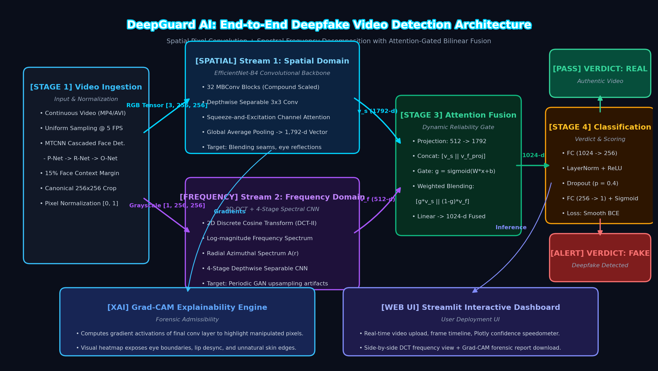
06
SECTION 06
System Workflow / Architecture
BCS753 · B.TECH MAJOR PROJECT PRESENTATION
7

Slide 8
07
SECTION 07
Expected Outcome
Dual-Stream Detection Accuracy: Trained DualStreamNet achieving ≥ 98.9% accuracy on uncompressed videos and ≥ 91.8% under heavy c40 compression on FaceForensics++, outperforming spatial-only competition baselines by +10.8%.
✓
Compression Resilience via Invariant DCT: Demonstration that Radial Azimuthal Spectrum A(r) and learned attention gating g automatically maintain discriminative power even after aggressive social media H.264/H.265 re-encoding.
✓
Forensic Explainability via Grad-CAM: Automatic extraction of pixel-accurate visual saliency heatmaps highlighting manipulated facial seams (hairline, eyes, jaw contour) for forensic auditing and legal courtroom admissibility.
✓
Interactive Web Dashboard & Production Pipeline: Fully functional Streamlit forensic analyzer providing real-time video upload, temporal confidence timeline, Plotly speedometer gauge, and exportable forensic reports.
✓
BCS753 · B.TECH MAJOR PROJECT PRESENTATION
8

Slide 9
08
SECTION 08
References
[1] A. Rossler, D. Cozzolino, L. Verdoliva, C. Riess, J. Thies, and M. Niessner, "FaceForensics++: Learning to Detect Manipulated Facial Images," in IEEE/CVF International Conference on Computer Vision (ICCV), pp. 1–11, 2019.
[2] J. Frank, T. Eisenhofer, L. Schonherr, A. Fischer, D. Kolossa, and T. Holz, "Leveraging Frequency Analysis for Deep Fake Image Recognition," in International Conference on Machine Learning (ICML), PMLR vol. 119, pp. 3247–3258, 2020.
[3] Y. Qian, G. Yin, L. Sheng, Z. Chen, and J. Shao, "Thinking in Frequency: Face Forgery Detection by Mining Frequency-aware Clues," in European Conference on Computer Vision (ECCV), Springer, pp. 86–103, 2020.
[4] M. Tan and Q. V. Le, "EfficientNet: Rethinking Model Scaling for Convolutional Neural Networks," in International Conference on Machine Learning (ICML), PMLR vol. 97, pp. 6105–6114, 2019.
[5] R. R. Selvaraju, M. Cogswell, A. Das, R. Vedaldi, D. Parikh, and D. Batra, "Grad-CAM: Visual Explanations from Deep Networks via Gradient-Based Localization," International Journal of Computer Vision (IJCV), vol. 128, pp. 336–359, 2020.
NOTE: All references must be cited in IEEE format.
BCS753 · B.TECH MAJOR PROJECT PRESENTATION
9

Slide 10
THANK YOU
Questions & suggestions are welcome
Lloyd Institute of Engineering & Technology, Greater Noida

