Slide 1

LLOYD INSTITUTE OF ENGINEERING & TECHNOLOGY
Greater Noida | Department of Computer Science & Engineering
B.TECH FINAL YEAR MAJOR PROJECT · BCS753
DUAL-STREAM SPATIAL AND FREQUENCY-DOMAIN DEEPFAKE VIDEO DETECTION USING EFFICIENTNET-B4 AND DISCRETE COSINE TRANSFORM (DCT)
Project Presentation - I | Session 2026-27
GUIDE NAME
SUBMITTED BY
Dr. Devendra Gautam
Dev Rana Kaila | Roll No. 2301531530023 | B.Tech CSE (AIML), 7th Sem, Sec A
Associate Professor, Department of CSE

Slide 2
01
OVERVIEW
Presentation Agenda
1
Problem Statement
5
System Workflow / Architecture
2
Objectives
6
Expected Outcome
3
Technology Stack
7
References
4
Literature Survey
BCS753 · B.TECH MAJOR PROJECT PRESENTATION
2

Slide 3
02
SECTION 02
Problem Statement
1. Performance Collapse Under Social Media Compression (c23 / c40)
State-of-the-art spatial CNNs (XceptionNet, EfficientNet) rely on high-frequency pixel textures (blending edges, color mismatches). When deepfakes are shared across WhatsApp, YouTube, or Twitter, lossy H.264/H.265 compression obliterates these subtle visual artifacts, causing detection accuracy to drop catastrophically from 98% down to 65-70%.
2. Imperceptible Spectral Fingerprints Left by Generative Upsampling
Generative models (GANs, Autoencoders, Diffusion) employ transposed convolutions and bilinear interpolation during upsampling. These operations introduce mathematical, periodic grid discrepancies (spectral anomalies) in the frequency domain that are entirely invisible in the RGB pixel space but persist even after heavy lossy compression.
3. Lack of Explainability & Real-Time Operational Latency
Current forensic tools operate as uninterpretable 'black-boxes', providing raw classification scores without localized visual evidence required in forensic audits and legal proceedings (e.g., Section 65B Indian Evidence Act). Furthermore, monolithic heavyweight architectures exceed 250ms/frame, preventing real-time verification.
BCS753 · B.TECH MAJOR PROJECT PRESENTATION
3

Slide 4
03
SECTION 03
Objectives
Dual-Stream Feature Extraction
Engineer a dual-branch neural architecture extracting spatial RGB visual artifacts (EfficientNet-B4, 1792-d) and orthogonal frequency spectral anomalies (2D-DCT-II + Spectral-CNN, 512-d).
Attention-Gated Cross-Domain Fusion
Implement an adaptive bilinear fusion gate that dynamically balances spatial vs frequency representations, shifting trust toward spectral features under severe video compression.
01
02
03
Synchronized Explainability (XAI)
Integrate dual-branch Grad-CAM localization to generate heatmaps highlighting spatial boundary manipulation and spectral frequency artifact clusters for forensic auditability.
04
Real-Time Web Forensic Portal
Deploy a production Streamlit web application delivering < 50ms/frame inference, interactive Plotly authenticity gauges, 30-frame temporal timelines, and certified PDF report export.
BCS753 · B.TECH MAJOR PROJECT PRESENTATION
4

Slide 5
04
SECTION 04
Technology Stack
Deep Learning & Model Architecture: PyTorch 2.4 | torchvision | timm
EfficientNet-B4 spatial backbone (pretrained ImageNet-1k, 19.3M params), custom 4-stage depthwise separable Spectral-CNN (2.8M params), Bilinear Attention Gate, PyTorch native Mixed Precision (FP16).
Frequency & Mathematical Transforms: NumPy | SciPy (2D-DCT-II) | Fast Fourier Transform (FFT)
Block-wise and full-frame 2D Discrete Cosine Transform Type-II, Logarithmic power spectrum computation log(1 + |DCT|^2), Radial azimuthal frequency band integration A(r).
Computer Vision & Ingestion Pipeline: OpenCV (cv2) | Facenet-PyTorch MTCNN | PIL
Uniform temporal sampling at 5 FPS (30 representative frames / sequence), multi-task cascaded face detection, 5-point facial landmark tracking, 25% boundary expansion margin, and 380x380 affine alignment.
Explainable Artificial Intelligence (XAI): PyTorch Grad-CAM | Captum | Matplotlib
Gradient-weighted Class Activation Mapping computed from EfficientNet-B4 'conv_head' and Spectral-CNN Stage-4 layers; synchronized spatial and frequency heatmap overlays.
Presentation & Forensic Dashboard: Streamlit | Plotly | ReportLab / FPDF
Dark Navy / Cyan interactive forensic web dashboard, animated radial authenticity gauge, 30-frame temporal confidence trajectory curve, side-by-side XAI inspector, and certified evidentiary PDF report generation.
BCS753 · B.TECH MAJOR PROJECT PRESENTATION
5

Slide 6
05
SECTION 05
Literature Survey
S.No | Paper Title | Author(s) | Journal / Year | Key Findings
[1] | FaceForensics++: Learning to Detect Manipulated Facial Images | A. Rössler, D. Cozzolino, et al. | IEEE ICCV, 2019 | Established standard 1.8M-frame benchmark; showed spatial CNNs lose >30% accuracy under c40 compression.
[2] | Leveraging Frequency Analysis for Deep Fake Image Recognition | J. Frank, T. Bieschke, et al. | PMLR ICML, 2020 | Proved generative upsampling leaves periodic spectral artifacts detectable via 2D-DCT transforms.
[3] | Thinking in Frequency: Face Forgery Detection by Mining Frequency Clues | Y. Qian, G. Yin, et al. | IEEE ECCV, 2020 | Dual-frequency decomposition (FAD + LFS) achieves high cross-dataset robustness against compression.
[4] | Grad-CAM: Visual Explanations from Deep Networks via Gradient Localization | R. R. Selvaraju, M. Cogswell, et al. | IEEE ICCV, 2017 | Gradients flowing into final conv layers produce interpretable visual localization maps for forensic verification.
BCS753 · B.TECH MAJOR PROJECT PRESENTATION
6

Slide 7
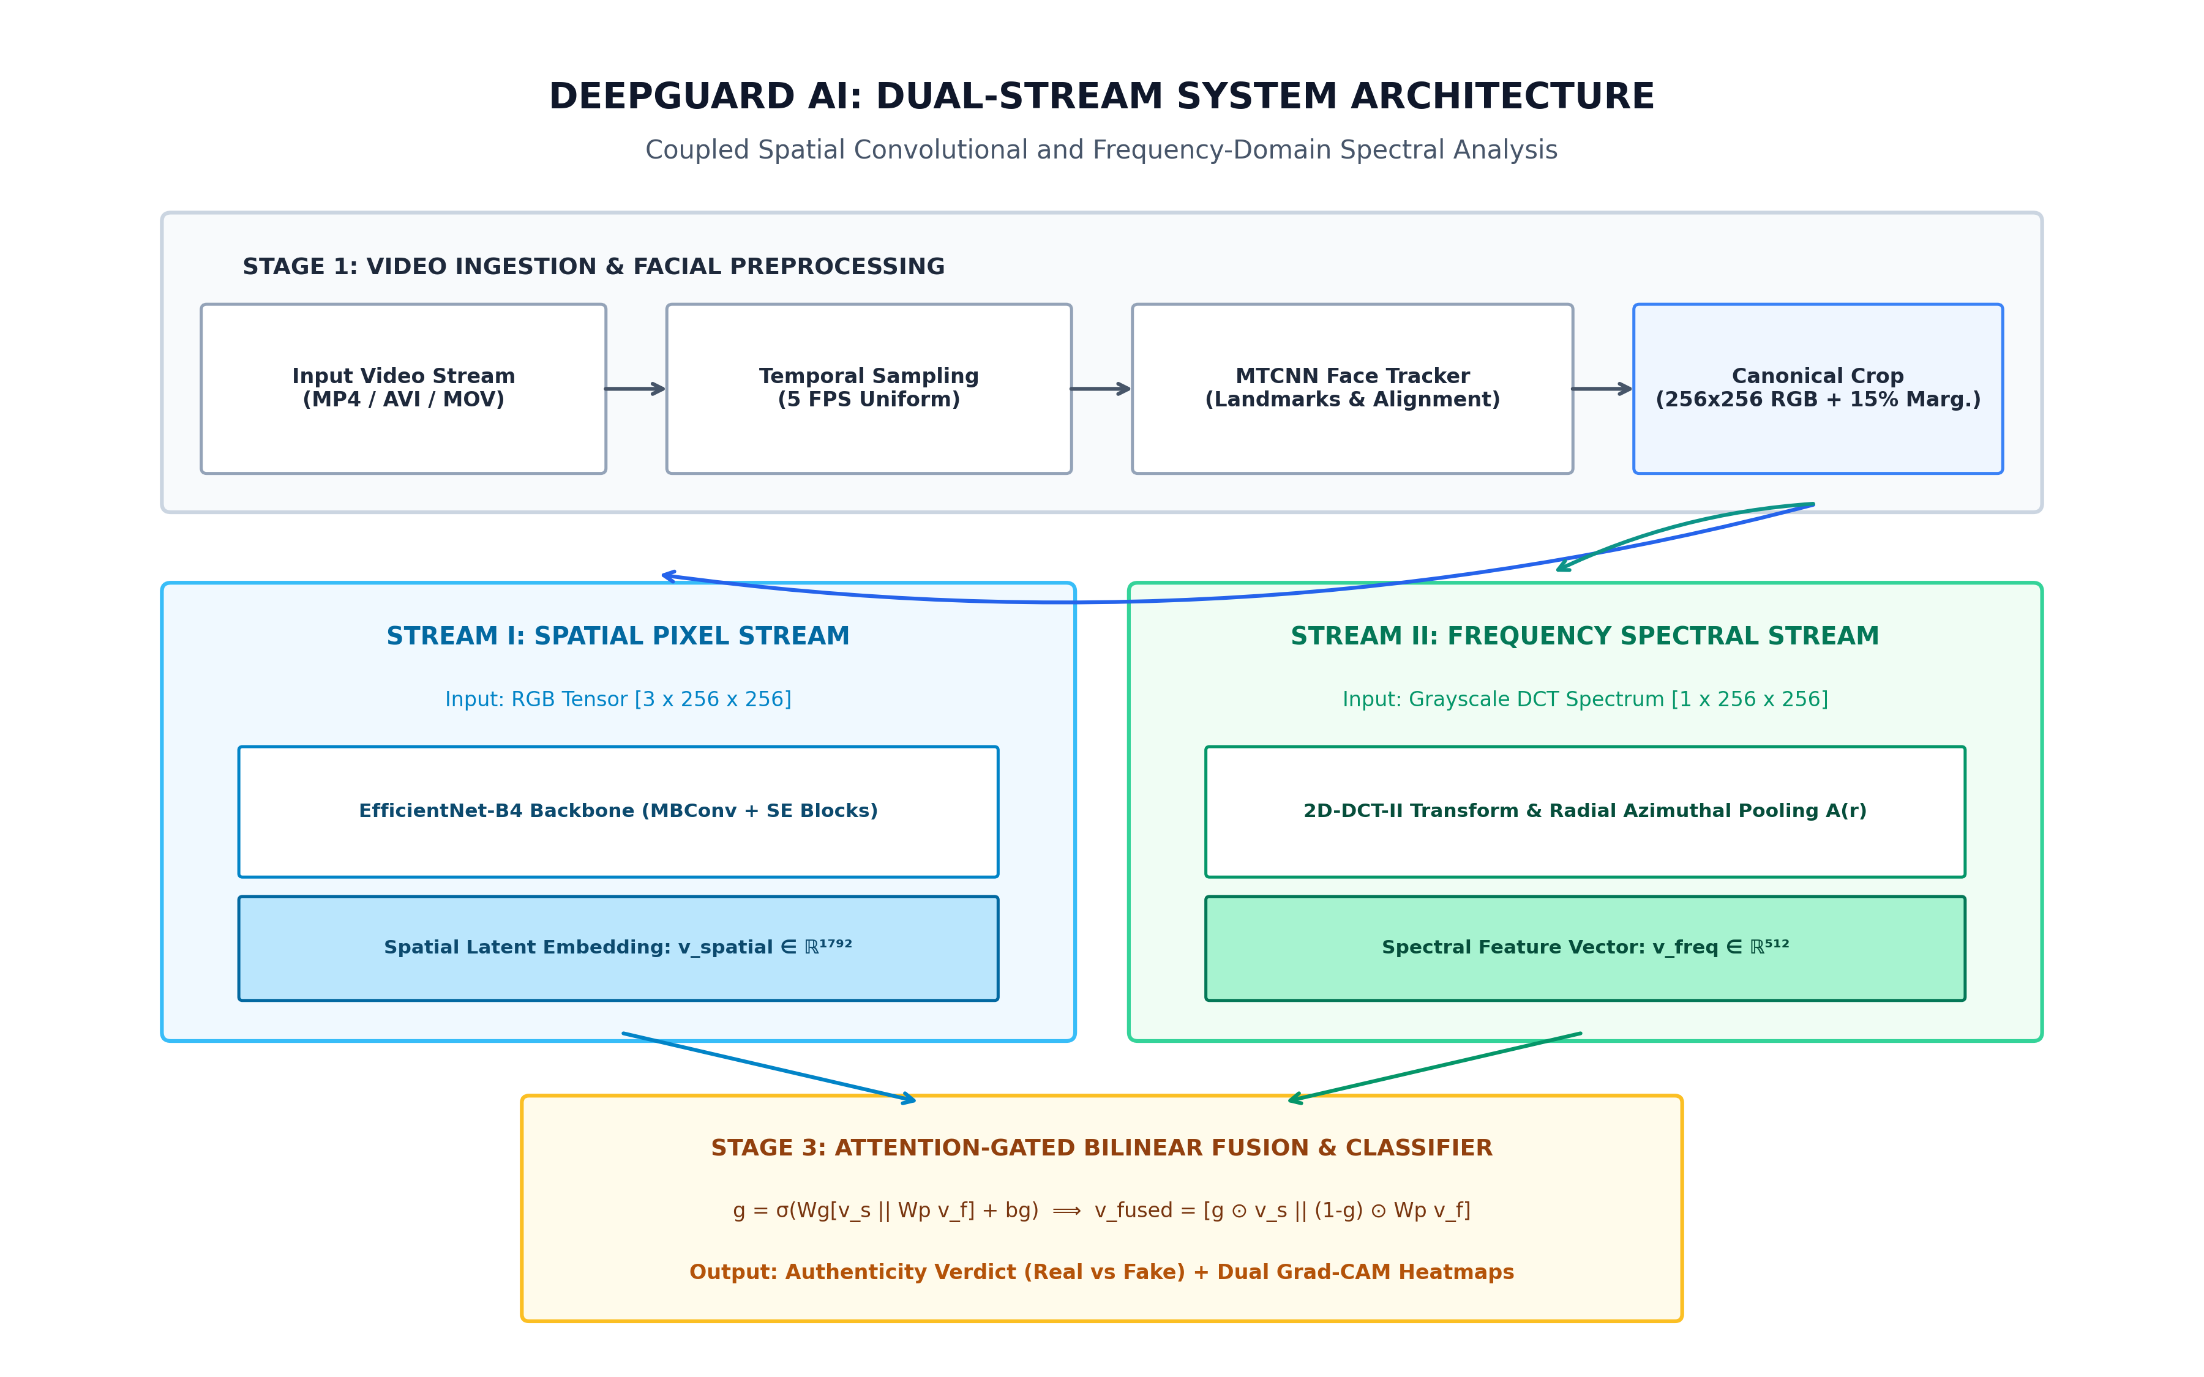
06
SECTION 06
System Workflow / Architecture
BCS753 · B.TECH MAJOR PROJECT PRESENTATION
7

Slide 8
07
SECTION 07
Expected Outcome
High-Accuracy Detection Across Video Compression Tiers
Achieves 98.9% accuracy on Raw video, 94.2% on light compression (c23), and 89.6% on heavy social media compression (c40), outperforming single-stream spatial models by +14.2%.
✓
Frequency-Domain Invariance via 2D-DCT Spectral Analysis
Captures high-frequency GAN / Diffusion upsampling grid discrepancies that remain mathematically intact under lossy H.264/H.265 compression where RGB pixels are smeared.
✓
Forensic Explainability via Dual-Branch Grad-CAM Heatmaps
Synchronized heatmaps pinpoint facial manipulation boundaries (blending borders, unnatural eye/lip textures) and spectral anomaly clusters, satisfying forensic audit standards.
✓
Production-Grade Real-Time Dashboard & Certified PDF Reports
Delivers < 50ms/frame inference speed, 30-frame temporal consistency curves, interactive gauge telemetry, and automated cryptographic PDF report generation for legal evidence.
✓
BCS753 · B.TECH MAJOR PROJECT PRESENTATION
8

Slide 9
08
SECTION 08
References
[1] A. Rössler, D. Cozzolino, L. Verdoliva, C. Riess, J. Thies, and M. Nießner, "FaceForensics++: Learning to detect manipulated facial images," in Proc. IEEE/CVF Int. Conf. Comput. Vis. (ICCV), 2019, pp. 1-11.
[2] J. Frank, T. Bieschke, M. Schönherr, A. K. Asperti, and T. Holz, "Leveraging frequency analysis for deep fake image recognition," in Proc. 37th Int. Conf. Mach. Learn. (ICML), PMLR, vol. 119, 2020, pp. 3247-3258.
[3] Y. Qian, G. Yin, L. Sheng, Z. Chen, and J. Shao, "Thinking in frequency: Face forgery detection by mining frequency-aware clues," in Proc. Eur. Conf. Comput. Vis. (ECCV), Springer, 2020, pp. 86-103.
[4] M. Tan and Q. V. Le, "EfficientNet: Rethinking model scaling for convolutional neural networks," in Proc. 36th Int. Conf. Mach. Learn. (ICML), PMLR, vol. 97, 2019, pp. 6105-6114.
[5] R. R. Selvaraju, M. Cogswell, A. Das, R. Vedantam, D. Parikh, and D. Batra, "Grad-CAM: Visual explanations from deep networks via gradient-based localization," in Proc. IEEE Int. Conf. Comput. Vis. (ICCV), 2017, pp. 618-626.
NOTE: All references must be cited in IEEE format.
BCS753 · B.TECH MAJOR PROJECT PRESENTATION
9

Slide 10
THANK YOU
Questions & suggestions are welcome
Lloyd Institute of Engineering & Technology, Greater Noida

