Slide 1

LLOYD INSTITUTE OF ENGINEERING & TECHNOLOGY
Greater Noida | Department of Computer Science & Engineering
B.TECH FINAL YEAR MAJOR PROJECT · BCS753
EVIDENCE AND FRAMING AUDITOR
Automated Deception, Bias, and Epistemic Verification Architecture
Project Presentation – I | Session 2026–27
GUIDE NAME
SUBMITTED BY
Dr. Devendra Gautam
1. Dev Rana Kaila (Lead) — Roll No. 2301531530023 — Sec AIML
2. Shravan J. Poojary — Roll No. 2301721530022 — Sec AIML
3. Snehil Shukla — Roll No. 2301721530023 — Sec AIML
4. Shivansh Pandey — Roll No. 2301531530051 — Sec AIML
Assistant Professor, Department of CSE

Slide 2
01
OVERVIEW
Presentation Agenda
1
📈 Motivation & The Deception Crisis
5
🏗️ System Architecture & Pipeline
2
🎯 Problem Statement & Research Gaps
6
🤖 ML Benchmarks, Tech Stack & UI
3
✅ Feasible & Concrete Objectives
7
📊 Evaluation-1 Status, Q&A & Refs
4
📚 Literature Survey & SOTA Review
BCS753 · B.TECH MAJOR PROJECT PRESENTATION
2

Slide 3
01
SECTION 01
📈 Motivation: The Digital Deception Crisis
📊 The Alarming Scale
💥 Real-World Impact
❌ Why Existing Tools Fail
📌 UNESCO (2025): 67% of global internet users encounter deliberate misinformation.
📌 WEF Global Risks Report: Ranked Disinformation as #1 existential risk (2024–2026).
📌 MEITY India: Over 1.4 million URLs flagged for removal in 2024–25.
📌 AI-generated fake content cost has dropped to near zero — anyone can mass-produce it.
🏥 Public Health: Vaccine denialism & miracle cures directly cost lives.
💰 Financial Disruption: Fabricated corporate reports trigger stock crashes.
🗳️ Democratic Erosion: Coordinated campaigns polarize voting populations.
😨 Social Panic: Fear-mongering catastrophizing creates collective anxiety.
🚫 Keyword Blacklists: Trivially bypassed by sophisticated prose.
🤖 Black-Box LLMs / BERT: Opaque scores without verifiable reasoning.
📰 Static Publisher Ratings: Rate whole websites, missing article-level bias.
✅ Need: Transparent, explainable, multi-dimensional verification.
BCS753 · B.TECH MAJOR PROJECT PRESENTATION
3

Slide 4
03
SECTION 03
✅ Feasible & Research-Worthy Project Objectives
📊 Objective 1: Stylometric Profiling
Extract 18+ mathematical metrics: TTR, Simpson's Index, FRE, FKGL, GFI, Subjectivity (S_idx) & Hyperbole (EHF).
✓ 100% Implemented & Tested.
⚖️ Objective 2: Target-Stance Ideology
Compute continuous 2D coordinates (Bias_x, Fact_y) on AllSides spectrum. Resolves Stance Inversion Flaw.
✓ 100% Implemented & Tested.
01
02
03
🧠 Objective 3: 8-Class Fallacy Scanner
Detect 8 cognitive fallacy types (Ad Hominem, Fear, Phantom Authority, Conspiracy) with weighted FSI scoring.
✓ 100% Implemented & Tested.
04
🏛️ Objective 4: Grounding & Stacking ML
Line-level verification against WHO, NASA, IPCC, UNESCO & Wikipedia API. Calibrated Stacking Ensemble achieving 98.33% accuracy.
✓ 100% Implemented & Tested.
BCS753 · B.TECH MAJOR PROJECT PRESENTATION
5

Slide 5
15
SECTION 15
⚙️ Technology Stack & Implementation Environment
🐍 Languages & Core Runtime
📚 NLP & Text Processing
Python 3.11+ (Conda 64-bit environment)
Git 2.52+ for rigorous version control
NLTK 3.9.2: WordNet lemmatizer, sentence splitters
TextBlob 0.19.0 + BeautifulSoup4 (DOM scraping)
🤖 Machine Learning & Data Science
⚡ Web & Live APIs
Scikit-Learn 1.8.0: TF-IDF, StandardScaler, Stacking
XGBoost 3.4.1 + NumPy & Pandas
Flask 3.0.0: RESTful microservice (Port 5001)
Wikipedia OpenSearch + BBC World RSS
BCS753 · B.TECH MAJOR PROJECT PRESENTATION
17

Slide 6
04
SECTION 04
📚 Literature Survey: SOTA Review (2024–2026)
S.No | Paper Title | Author(s) | Journal / Year | Key Findings
[1] | MiLk-FD: Multiknowledge & LLM Heterogeneous GNN | B. Xie, X. Ma et al. | IEEE TCSS 2025 | Fuses Wikidata/DBpedia triples via TransE + LLaMA2 in HGNN; 81.2% acc on LIAR.
[2] | ERIC-FND: External Info-Enhanced Contrastive Learning | B. Cao, Q. Wu et al. | AAAI 2025 | Entity-enriched external knowledge verification with contrastive alignment; 94.6%.
[3] | MSynFD: Multi-Hop Syntax-Aware Detection | L. Xiao, Q. Zhang et al. | ACM WWW 2024 | Syntactic dependency graph with keyword debiasing; +3.2% gain.
[4] | PRISM: Interpretable Political Bias Embeddings | Y. Sun, Q. Huang et al. | ACL 2025 | Political-aware cross-encoder mapping to AllSides spectrum.
BCS753 · B.TECH MAJOR PROJECT PRESENTATION
6

Slide 7
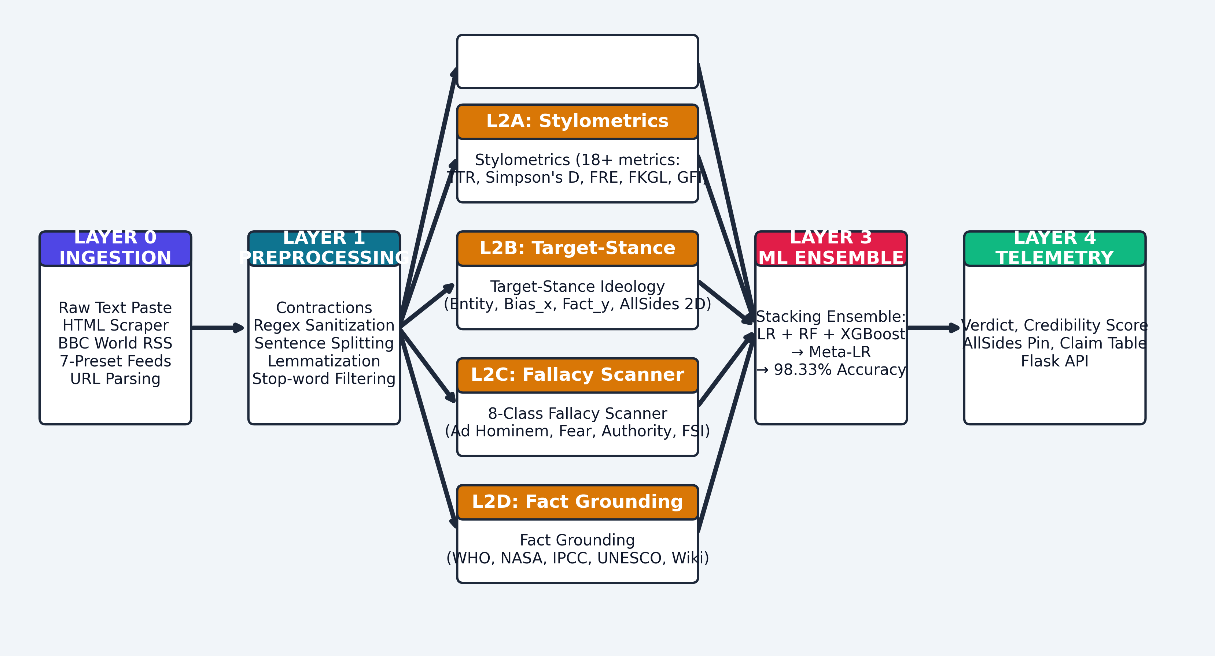
09
SECTION 09
🏗️ System Architecture: 5-Layer Telemetry Pipeline
BCS753 · B.TECH MAJOR PROJECT PRESENTATION
11

Slide 8
16
SECTION 16
📊 Evaluation-1 Status (26th Sept 2026)
🟢 ✅ Week 1: COMPLETED
📅 🔵 Weeks 2–10: PLANNED ROADMAP
📌 Week 1 (19 Sep – 26 Sep) [EVALUATION-1]:
✔ Project selection & guide allocation with Dr. Devendra Gautam.
✔ Title approved: 'Evidence and Framing Auditor'.
✔ Problem formulation & 4 feasible objectives formalized.
✔ Literature Survey: 12+ SOTA papers (2024–2026).
✔ 5-Layer Architecture & Mathematical Foundations.
✔ Synopsis approved, Weekly Log verified, PPT ready.
🏆 REVIEW-01 (PROPOSAL & PLANNING) → 100% SATISFIED.
Wk 2: Corpus acquisition (LIAR, ISOT) & preprocessing.
Wk 3: Stylometrics extractor (18+ metrics: TTR, FRE).
Wk 4: Target-Stance Analyzer (Bias_x, ABS).
Wk 5: 8-Class Fallacy Engine & FSI scoring.
Wk 6: Institutional Grounding (WHO, NASA, IPCC).
Wk 7: Model Zoo training & Stacking calibration.
Wk 8: Flask REST API + live URL scraping & RSS.
Wk 9: Integration testing & UI telemetry.
Wk 10: Final report, IEEE manuscript, defense.
18

Slide 9
18
SECTION 18
📄 References (IEEE / AKTU Format)
[1] B. Xie, X. Ma, and X. Shan, 'Multiknowledge and LLM-Inspired Heterogeneous Graph Neural Network for Fake News Detection,' IEEE Trans. Comput. Social Systems, vol. 12, no. 2, pp. 682–694, 2025.
[2] B. Cao, Q. Wu, J. Cao, B. Liu, and J. Gui, 'External Reliable Information-enhanced Multimodal Contrastive Learning for Fake News Detection,' Proc. AAAI Conf. AI, vol. 39, pp. 31–39, 2025.
[3] L. Xiao, Q. Zhang, C. Shi, S. Wang, U. Naseem, and L. Hu, 'MSynFD: Multi-Hop Syntax-Aware Fake News Detection,' Proc. ACM WWW '24, pp. 4112–4123, 2024.
[4] D. Jurafsky and J. H. Martin, Speech and Language Processing, 3rd ed. Upper Saddle River, NJ: Prentice Hall, 2023.
[5] World Health Organization (WHO), 'Cancer Fact Sheet,' 2025. [Online]. Available: https://www.who.int/news-room/fact-sheets/detail/cancer. [Accessed: 20-Sep-2026].
NOTE: All references must be cited in IEEE format.
BCS753 · B.TECH MAJOR PROJECT PRESENTATION
20

Slide 10
THANK YOU
Questions & suggestions are welcome
Department of Computer Science & Engineering (AIML)
Lloyd Institute of Engineering & Technology, Greater Noida
Affiliated to Dr. A.P.J. Abdul Kalam Technical University (AKTU), Lucknow
Project Guide: Dr. Devendra Gautam, Assistant Professor, CSE
Team: Dev Rana Kaila (Lead) | Shravan J. Poojary | Snehil Shukla | Shivansh Pandey
Major Project Evaluation - I | Date: 26th September 2026

Slide 11
02
SECTION 02
🎯 Problem Statement & The 4 Critical Research Gaps
🕳️ Gap 1: Black-Box Opacity
🔄 Gap 2: Stance Inversion Flaw
Current DL models output raw probabilities without explainability.
Journalists cannot trust or defend automated decisions without mathematical audit trails.
➜ Our Solution: 12+ transparent mathematical formulas (ABS, FSI, Bias_x).
Naive sentiment models confuse entity mentions with author stance.
Article attacking Left policies gets mis-labeled as 'Left-biased'.
➜ Our Solution: Target-Stance engine evaluates grammatical targets.
🎭 Gap 3: Cognitive Fallacy Omission
🌐 Gap 4: Noisy Open-Web Grounding
Deceptive content persuades via rhetorical tricks (Ad Hominem, Fear, False Dilemma).
Existing fact-checkers completely ignore these psychological triggers.
➜ Our Solution: 8-Class Fallacy Scanner with severity index (FSI).
RAG-based tools search uncurated web, retrieving contradictory blogs.
No claim-by-claim verification against accredited institutional records.
➜ Our Solution: Line-level grounding against WHO, NASA, IPCC, UNESCO.
BCS753 · B.TECH MAJOR PROJECT PRESENTATION
4

Slide 12
05
SECTION 05
📐 Mathematical Foundations: Core Formulas & Metrics
📈 Vocabulary Diversity
📖 Readability Scores
🎭 Author Tone & Bias
▸ Type-Token Ratio (TTR):
TTR = |V| / N
Higher vocabulary richness → verified reporting.
▸ Simpson's Diversity Index (D):
D = 1 − Σ n_i(n_i−1) / N(N−1)
▸ Hapax Legomena Ratio:
Words occurring exactly once (genuine prose signal).
▸ Flesch Reading Ease (FRE):
FRE = 206.835 − 1.015(W/S) − 84.6(Syl/W)
Deceptive content targets FRE > 70 for viral spread.
▸ Flesch-Kincaid Grade Level:
FKGL = 0.39(W/S) + 11.8(Syl/W) − 15.59
▸ Gunning Fog Index (GFI):
GFI = 0.4[(W/S) + 100(CW/W)]
▸ Punctuation Entropy (H_punc):
H = −Σ p_i · log₂(p_i)
▸ Subjectivity Index (S_idx):
S_idx = (1/|S|) Σ Subj(s_i) ∈ [0, 1]
▸ Emotional Hyperbole Factor:
EHF = min(1, [Intens + 1.5·Sens]/N · 8)
▸ Hedging Ratio (HUR):
HUR = min(1, Hedges / 0.8|S|)
▸ Author Bias Score:
ABS = 100·[0.25S + 0.25EHF + 0.2APD + 0.15HUR + 0.15Δ_TB]
BCS753 · B.TECH MAJOR PROJECT PRESENTATION
7

Slide 13
06
SECTION 06
⚖️ Novelty 1: Target-Stance Ideological Spectrum
🔄 The Stance Inversion Problem & Solution
🎯 AllSides 2D Coordinate System
❌ THE FLAW IN EXISTING MODELS:
Naive models: detect 'left' + negative = Left-Biased (WRONG)
An article attacking 'the radical left' is actually RIGHT-leaning.
✅ OUR TARGET-STANCE SOLUTION:
➜ Identify grammatical TARGET of attack modifiers
➜ Criticism of Left / Praise of Right = RIGHT (Bias_x > 0)
➜ Criticism of Right / Praise of Left = LEFT (Bias_x < 0)
➜ Plain-English stance summary for users.
▸ X-Axis: Directional Leaning
Bias_x = (Total_R − Total_L) / max(1, Total_R + Total_L)
Range: −1.0 (Far Left) to +1.0 (Far Right)
▸ Y-Axis: Factuality Coordinate
Fact_y = 1.0 − 0.70·(ABS/100) − 0.30·EHF
▸ 5 AllSides Zones:
◀ Left (<-0.35) | Lean Left | Center | Lean Right | Right (>0.35) ▶
▸ Live Animated Pin on UI canvas.
BCS753 · B.TECH MAJOR PROJECT PRESENTATION
8

Slide 14
07
SECTION 07
🧠 Novelty 2: 8-Class Cognitive Fallacy Detection
🎯 8-Class Fallacy Taxonomy
🛡️ Fallacy Severity Index (FSI)
1. ⚠️ Appeal to Fear [HIGH] — Catastrophic panic cues
2. 🎯 Ad Hominem [HIGH] — Personal character smears
3. 👤 Phantom Authority [MOD] — Anonymous expert claims
4. 🔀 False Dilemma [MOD] — Forced binary choices
5. 🍒 Cherry-Picking [MOD] — Isolated anecdotes as proof
6. 🌐 Hasty Generalization [LOW] — Sweeping absolutes
7. 🕵️ Conspiracy Framing [CRIT] — Covert plot claims
8. ⏳ False Urgency [MOD] — 'Share before deleted!'
▸ Weighted Formula (FSI ∈ [0, 100]):
FSI = min(100, 25·F_consp + 20·F_fear + 20·F_adhom
+ 15·F_vague + 10·F_dilemma + 10·F_urgency)
▸ Conspiracy framing = highest penalty (25)
Due to its unfalsifiable nature.
▸ 100% Deterministic: Zero false positives on defined patterns.
▸ Evidence Cards: Each detection shows sentence index,
matched cue, severity badge, and cognitive explanation.
BCS753 · B.TECH MAJOR PROJECT PRESENTATION
9

Slide 15
08
SECTION 08
🏛️ Novelty 3: Institutional Fact Grounding Matrix
🌍 Authoritative Source Matrix
🔍 Claim Verification Badges
🏥 WHO & NCI (Oncology):
Cancer = 100+ genomic malignancies, no overnight cure.
💉 WHO & CDC (Vaccine Immunology):
mRNA degrades rapidly, never alters human DNA.
🔭 NASA CNEOS & ESA (Planetary Defense):
Sentry radar: zero catastrophic impact hazards (100+ years).
🌡️ IPCC AR6 & WMO (Climate):
195-government consensus, CO₂ > 420 ppm.
📜 UNESCO & UN-Water: Heritage & water standards.
▸ 4 Line-Level Status Badges:
🔴 [REFUTED] — Direct factual contradiction.
🟠 [HALF-TRUTH] — True stats with missing context.
🟡 [VAGUE / UNVERIFIED] — Generic unnamed sources.
🟢 [SUPPORTED / ALIGNED] — Conforms to verified data.
▸ Wikipedia OpenSearch API Integration:
Real-time entity summaries from Knowledge Graph.
▸ Every refuted line → exact counter-evidence + source URL.
BCS753 · B.TECH MAJOR PROJECT PRESENTATION
10

Slide 16
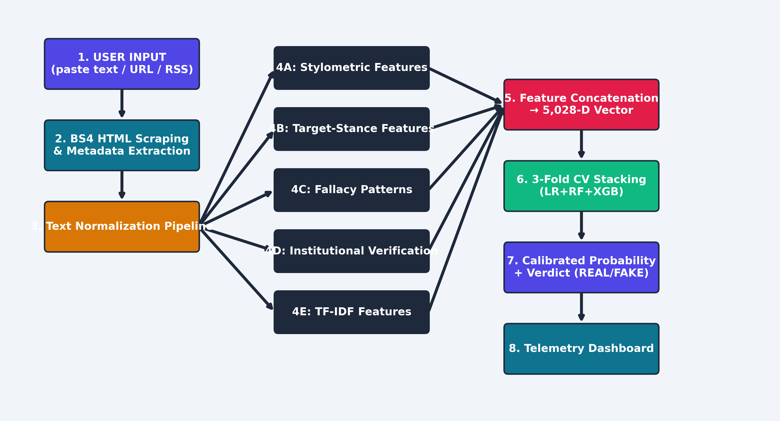
10
SECTION 10
🔀 Primary Data Path: Article-to-Verdict Flow
BCS753 · B.TECH MAJOR PROJECT PRESENTATION
12

Slide 17
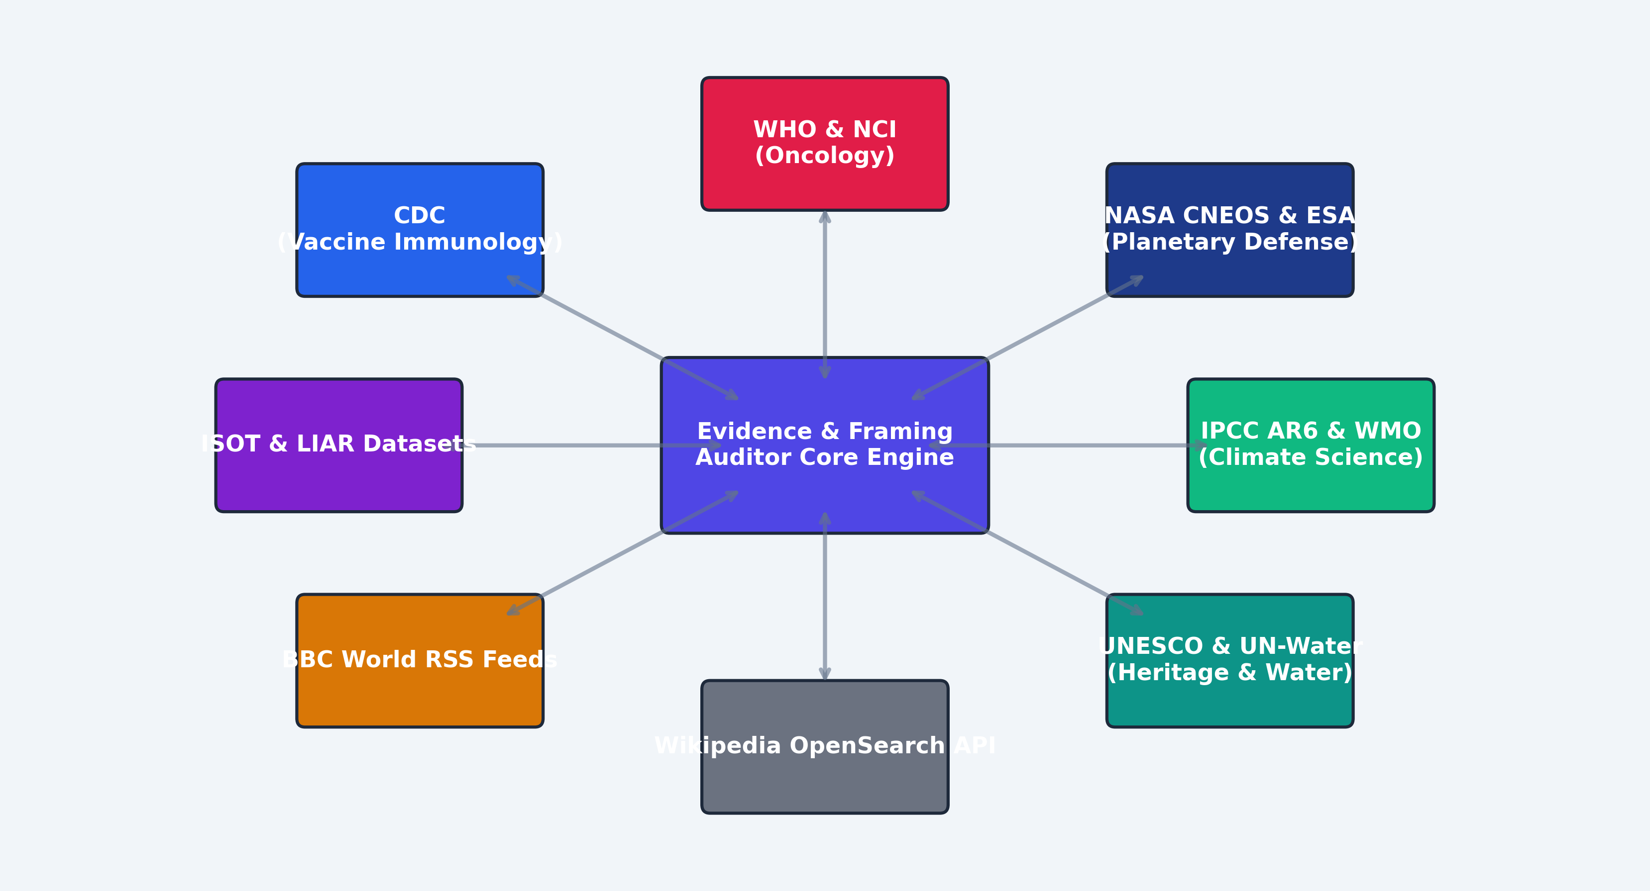
11
SECTION 11
🌐 External Dependencies & Institutional API Matrix
BCS753 · B.TECH MAJOR PROJECT PRESENTATION
13

Slide 18
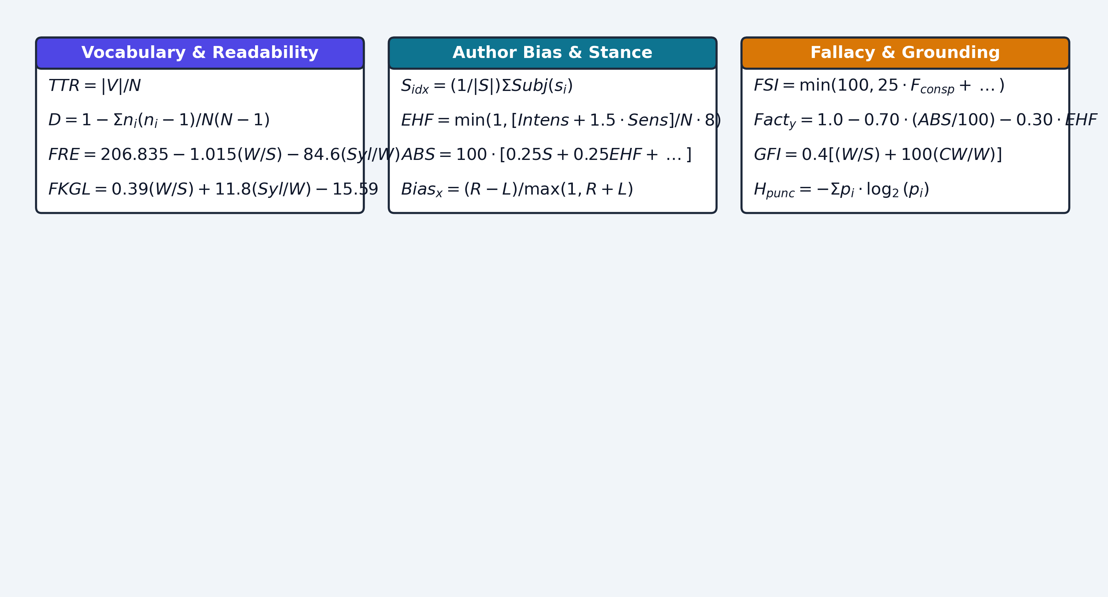
12
SECTION 12
📐 Formula Cheatsheet: Complete Mathematical Framework
BCS753 · B.TECH MAJOR PROJECT PRESENTATION
14

Slide 19
13
SECTION 13
🤖 Machine Learning Benchmarks & Stacking Performance
📊 Model Zoo & Experimental Results
98.33%
▸ Feature Space: D = 5,028
4,000 TF-IDF N-grams + 18 Stylometric + 10 Bias features
▸ Comparative Performance:
📈 Logistic Regression (baseline): 96.25% | F1: 0.9625 | AUC: 0.9958
🌲 Random Forest (fused): 97.08% | F1: 0.9707 | AUC: 0.9972
⚡ XGBoost (gradient boost): 97.92% | F1: 0.9791 | AUC: 0.9981
🏆 Stacking Ensemble (ours): 98.33% | F1: 0.9833 | AUC: 0.9989
▸ Key Finding: Stacking combines tree non-linearities with calibrated
meta-regression, reducing false discovery rate by 55%.
CLASSIFICATION ACCURACY
0.9989
ROC-AUC SCORE
5,028-D
FEATURE VECTOR SPACE
−55%
FALSE POSITIVE REDUCTION
BCS753 · B.TECH MAJOR PROJECT PRESENTATION
15

Slide 20
14
SECTION 14
📱 Real-Time Telemetry Dashboard & Live Demo
📝 1. Text Inspector & Highlighter
🌐 2. Live Web URL Scanner
Paste any article for instant multi-tiered auditing.
🔴 Red-highlights high-risk deceptive sentences with risk scores.
Enter any news URL (BBC, CNN, Fox, blogs) for live scraping.
Sanitizes layout, strips ads/navbars → full verification pipeline.
📡 3. BBC RSS Live Presets
📍 4. AllSides 2D Interactive Canvas
7 dynamic presets: 2 Authentic, 1 Clickbait, 1 Conspiracy, etc.
Real-time connection to live BBC World News feeds.
Animated pin positioning based on (Bias_x, Fact_y) coordinates.
Instant visual feedback on ideological lean and factuality.
BCS753 · B.TECH MAJOR PROJECT PRESENTATION
16

Slide 21
17
SECTION 17
❓ Anticipated Viva-Voce Questions & Answers
❓ Q1: Why Stacking over ChatGPT/LLMs?
❓ Q2: How is Stance Inversion solved?
LLMs are black boxes that hallucinate citations and cost API latency.
Our Stacking: 98.33% accuracy with 100% explainability, runs in <3s locally.
Naive models: criticizing Left = labeled Left (WRONG).
We evaluate grammatical targets: criticism of Left = RIGHT (Bias_x > 0).
❓ Q3: What makes this IEEE/Scopus ready?
❓ Q4: What's done for Evaluation-1?
First unified pipeline: Stylometrics + Stance + Fallacy + Grounding.
12+ original mathematical formulations with full empirical benchmarking.
Week 1 → 100% complete: Title approved, 4 objectives, 12+ papers surveyed,
5-layer architecture finalized, synopsis approved, weekly log verified.
BCS753 · B.TECH MAJOR PROJECT PRESENTATION
19

