Slide 1

Problem Statement and Team Details
Problem Statement: Without real-time speech analysis, flaws go unnoticed, confidence crumbles, and personality downgrades with every uncorrected mistake.
Team Name: Vibers
Team Leader Name: Ranbir Khurana Institute Name: Chandigarh University Theme Name: AI/ML
Team Leader Email ID: Ranbirkhurana195@gmail.com

Slide 2
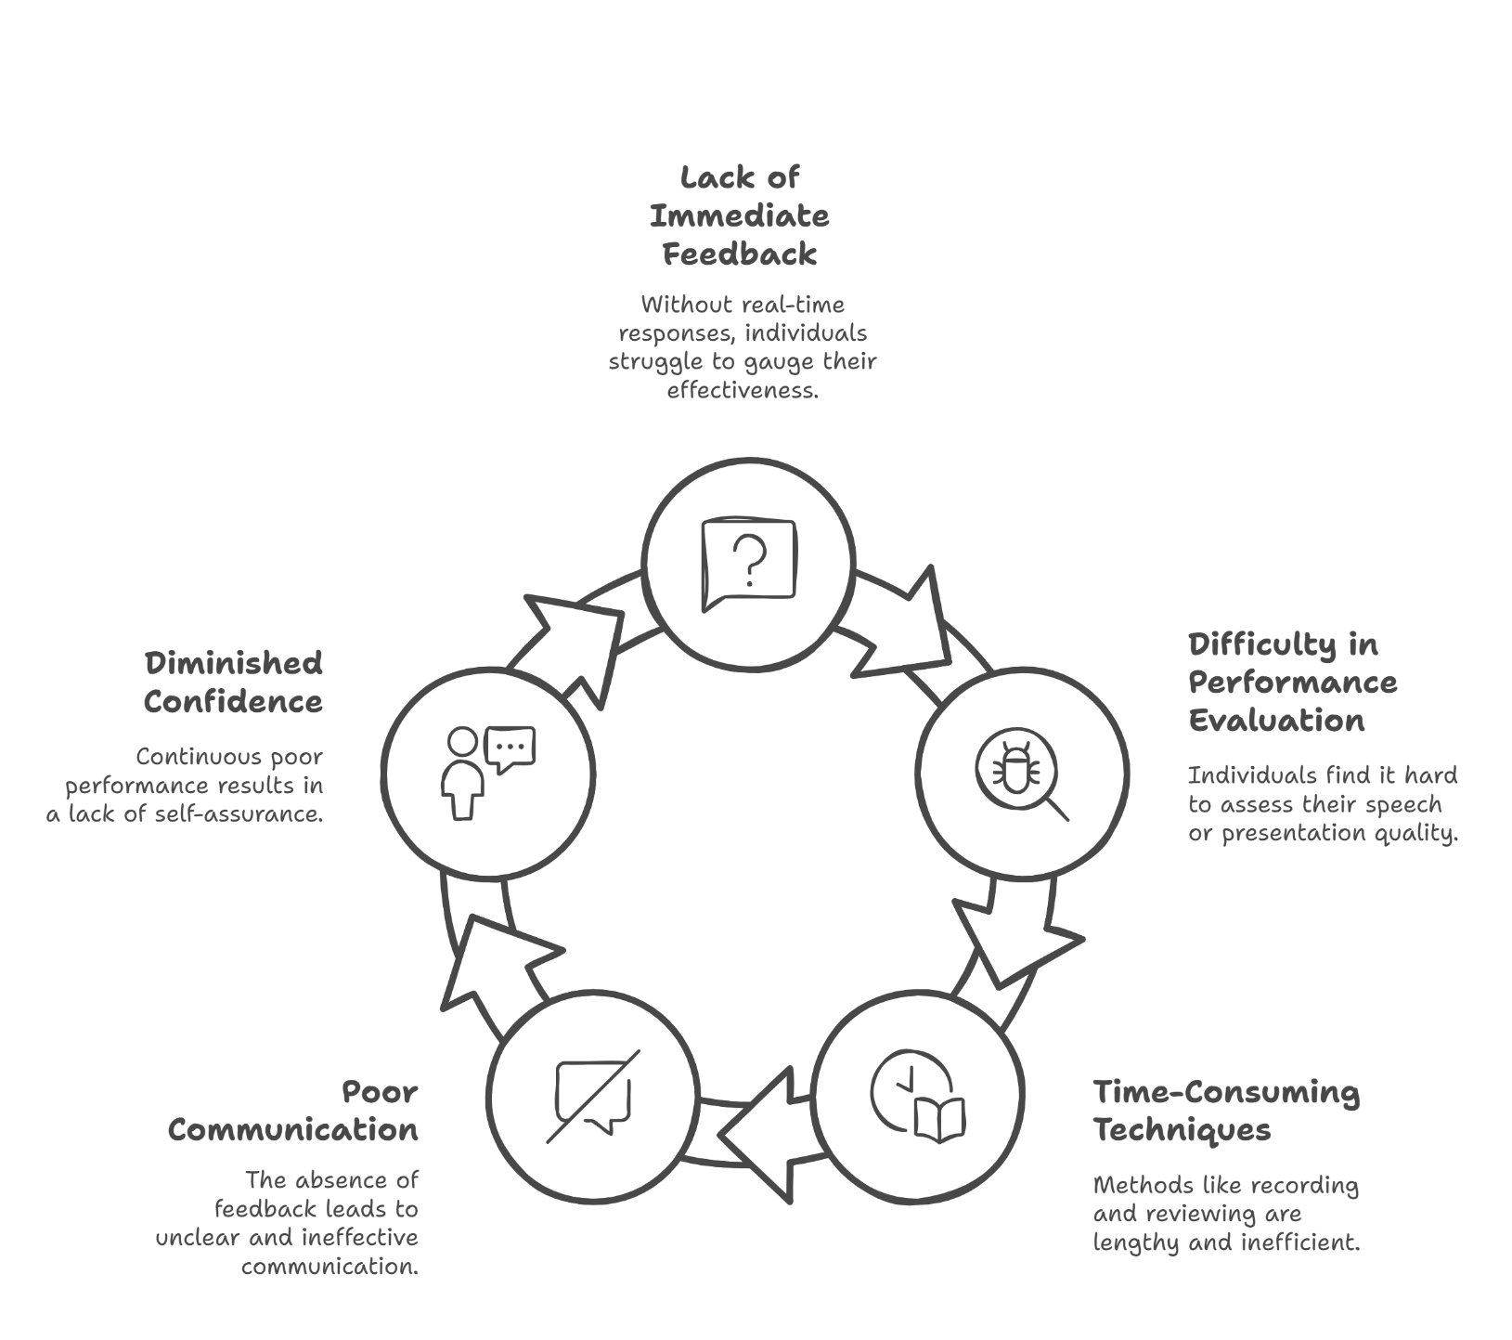
Problem Statement
Typical methods like recording and reviewing speeches are time-consuming and fail to provide immediate insights, leading to ineffective communication and reduced confidence. Without real-time feedback, individuals struggle to assess their weaknesses and improve their performance in speeches, presentations, and interviews.
This highlights the need for a dedicated platform that offers instant evaluation, helping users identify their shortcomings and refine their speaking skills effectively.

Slide 3
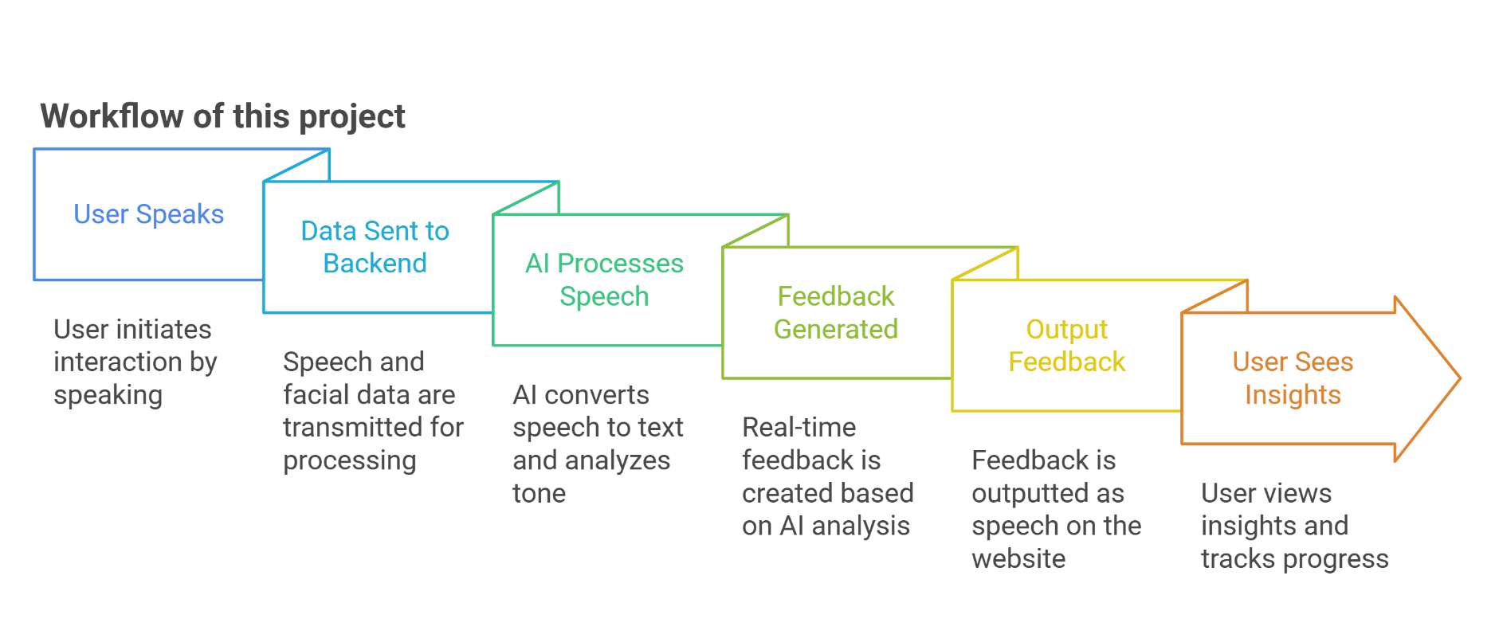
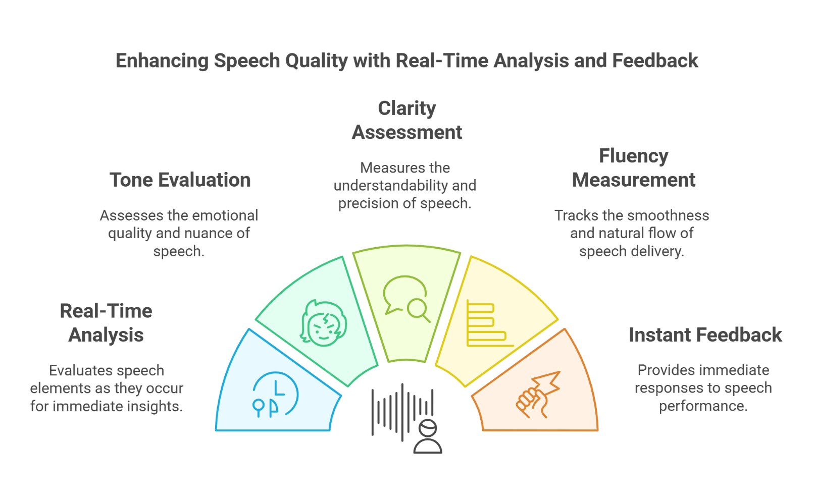
Solution
“SpeechViber”,
is an AI-powered speech assessment tool that analyzes tone, clarity, and fluency in real time. It provides instant feedback, live transcription,
and progress tracking to help users improve their speaking skills. With customizable modes for confidence and performance analysis, SpeechViber makes speech practice interactive
and effective.
Idea Approach

Slide 4
Tech Stack
For Front-End:
Framework: React.js
UI Styling: Tailwind CSS
Speech Input Handling: Web Speech API
Visualization: Chart.js
Hosting: GitHub Pages
For Back-End:
Server Framework: Node.js with Express.js
Speech-to-Text Processing: OpenAI Whisper
Database: SQLite (If required)
Serverless Option: Netlify Functions or Firebase Functions
Miscellaneous :
Physical Components: microphone, camera
Permissions Required:
Microphone access
Storage Alternatives(if required):
localStorage (For small-scale data storage)

Slide 5
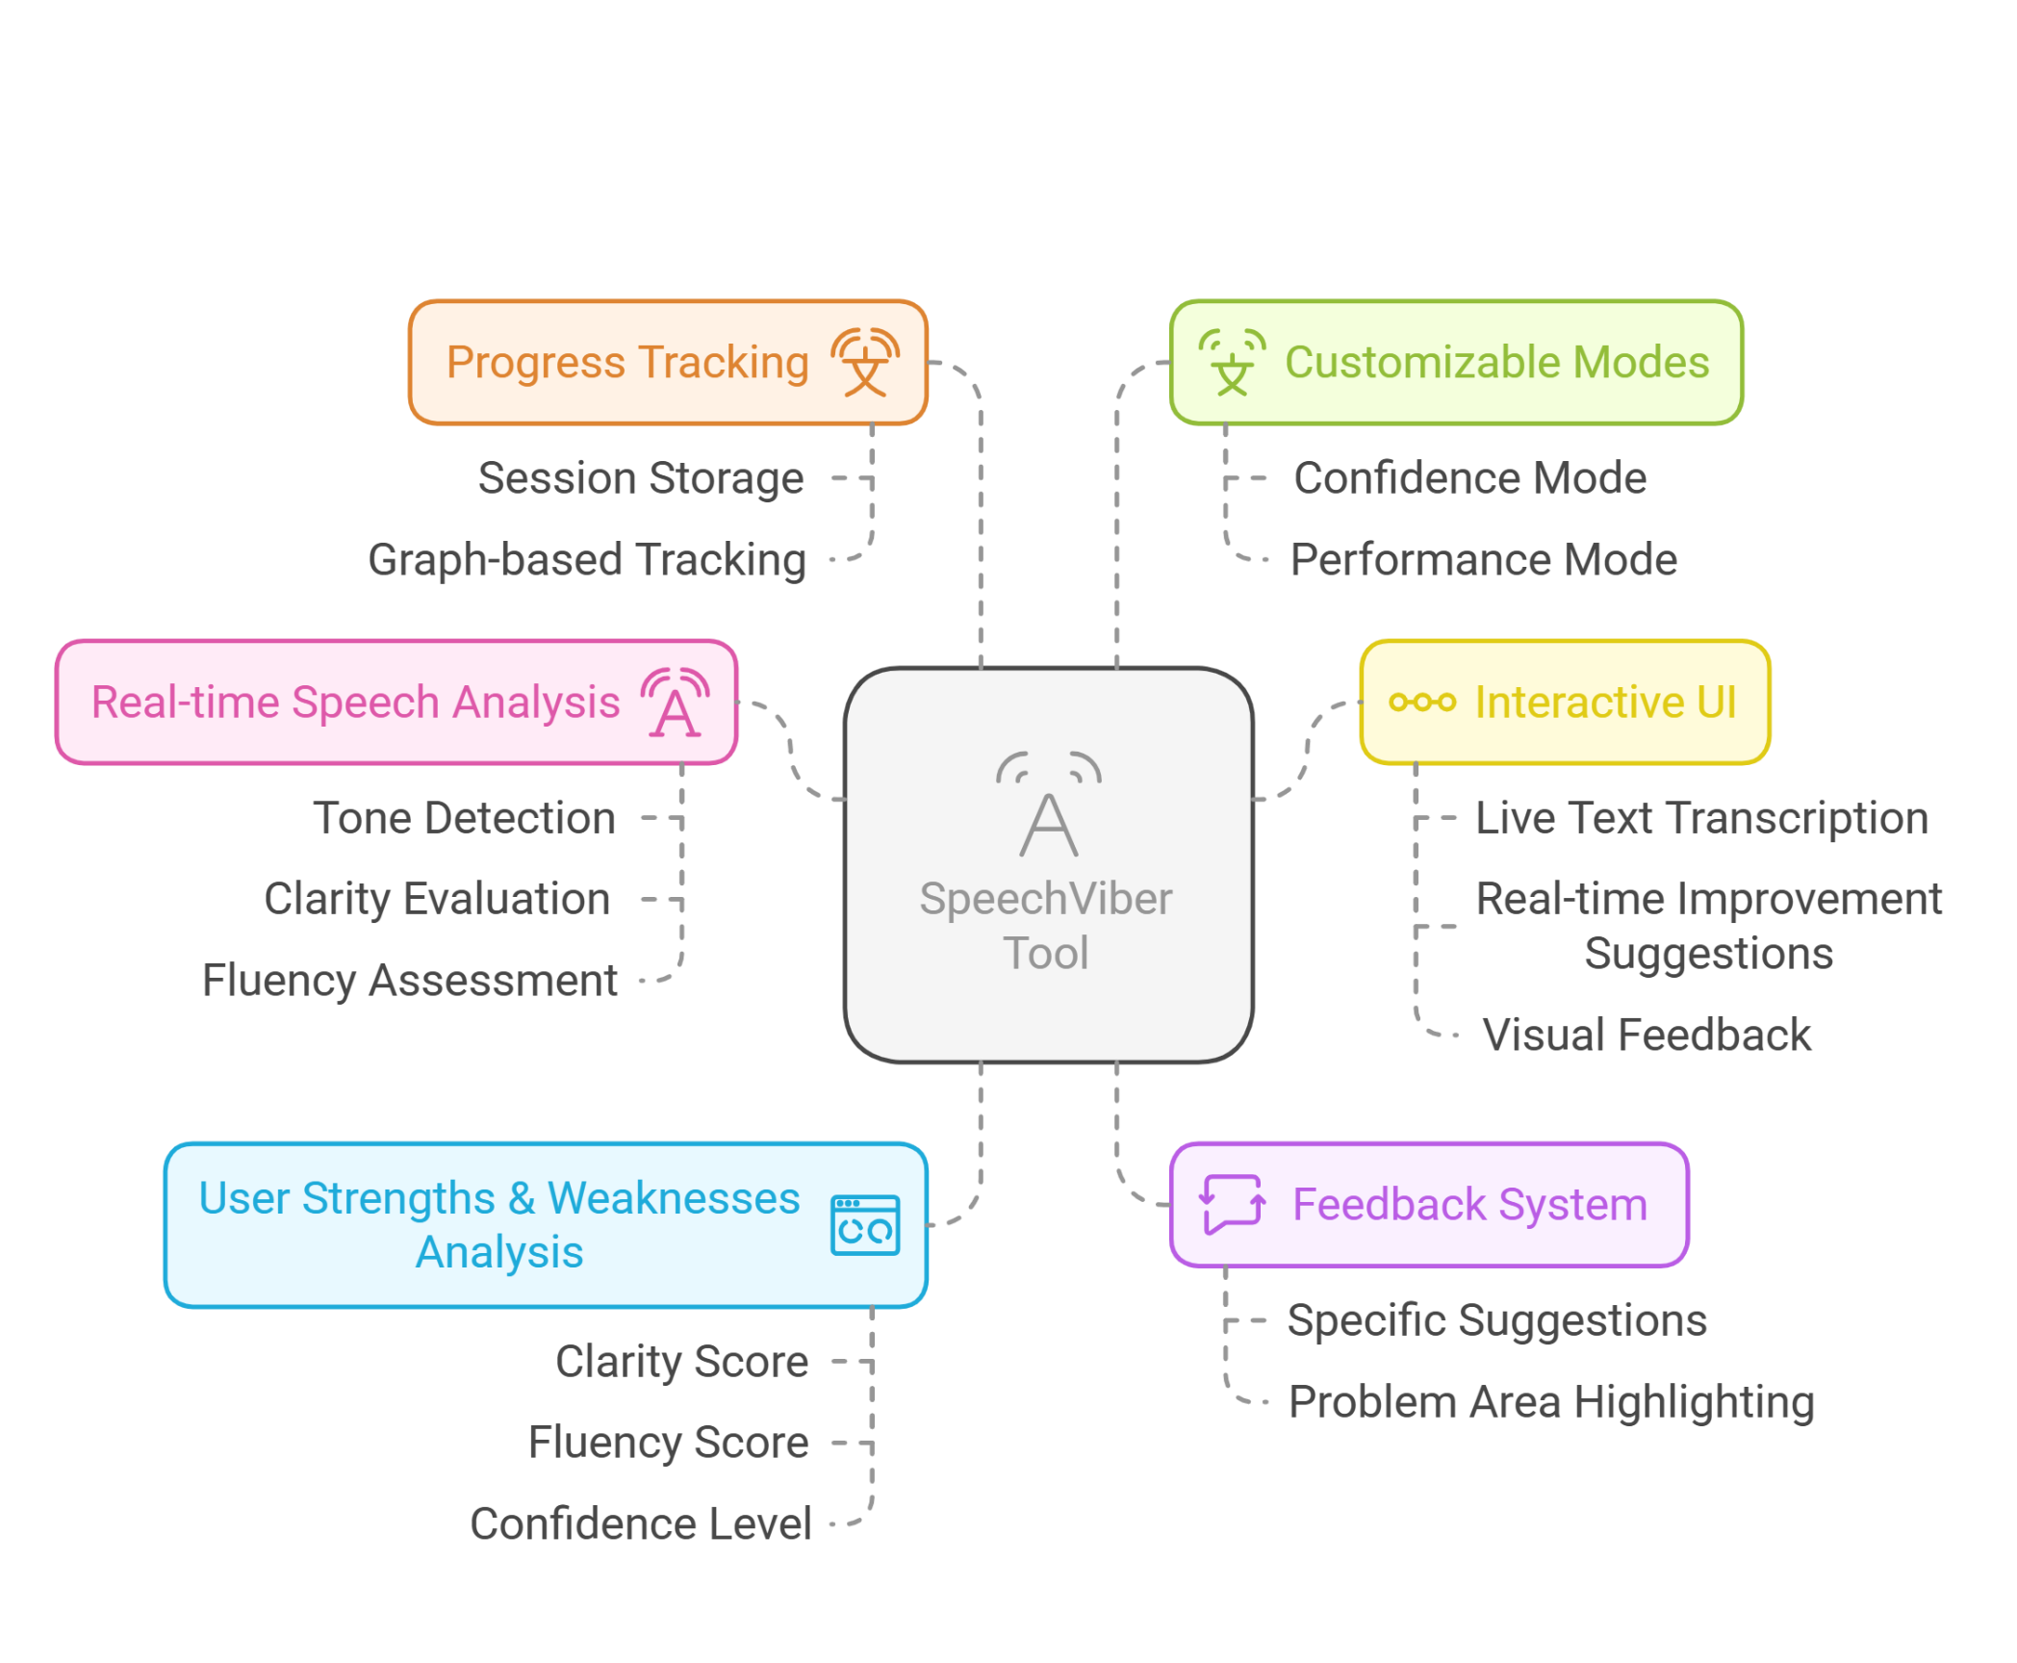
Use Cases And Market Reach
Use Cases:
Ideal for public speakers, professionals, and language learners to improve speech clarity, fluency, and confidence.
Market Reach:
Applicable healthcare, therapists.
in education, corporate training, and
and
benefiting students, businesses,

