Slide 1

Blockchain Technology: The Future of Secure Transactions
By Mridul Aggarwal
From: 406A

Slide 2

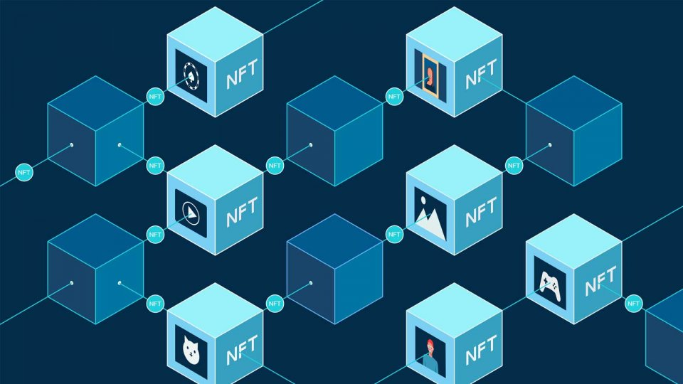
What is Blockchain?
Blockchain is a secure, decentralized digital ledger where data is stored in linked blocks. It ensures transparency, security, and immutability in transactions.

Slide 3
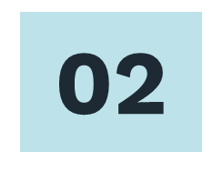
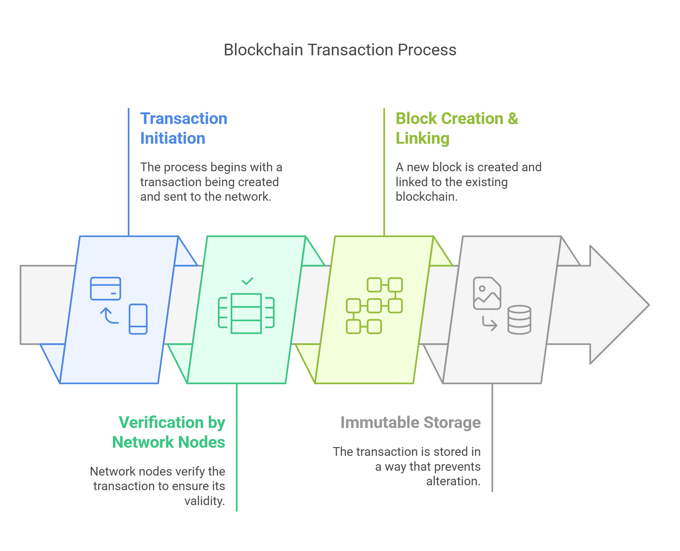
How Does Blockchain Work?
Process:
Transaction Initiation
Verification by Network Nodes
Block Creation & Linking
Immutable Storage

Slide 4

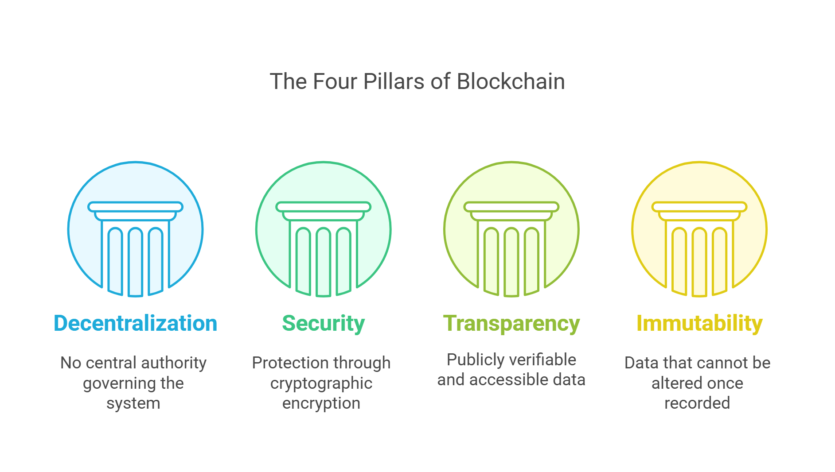
Key Features of Blockchain

Slide 5

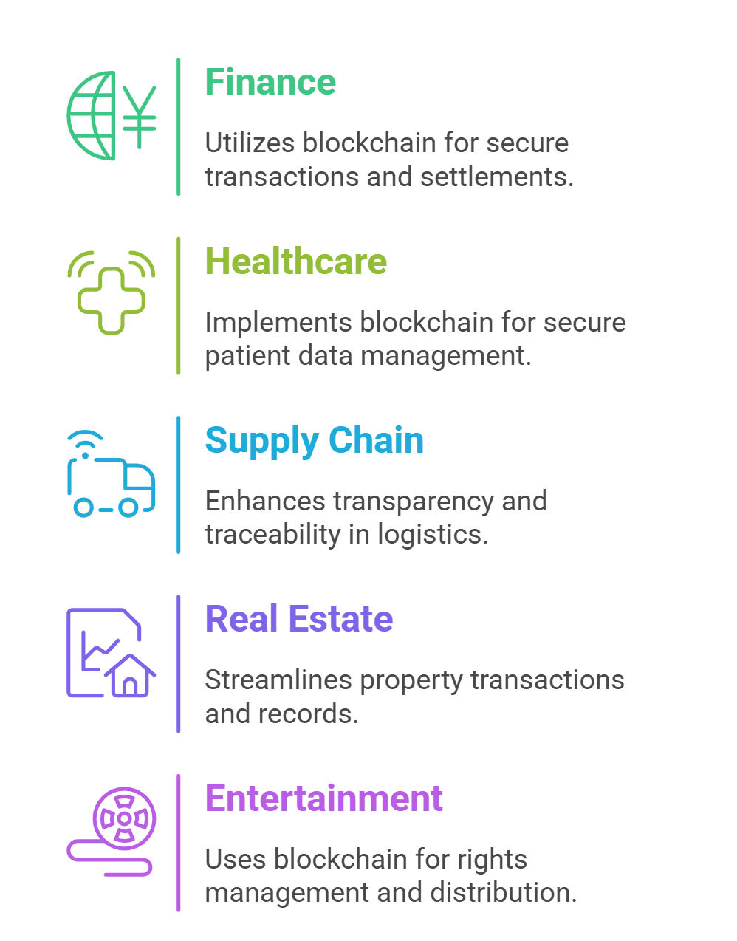
Applications of Blockchain
Blockchain enhances security and transparency across industries. It powers cryptocurrencies, secures health records, enables e-voting, ensures supply chain authenticity, and automates transactions through smart contracts.

Slide 6
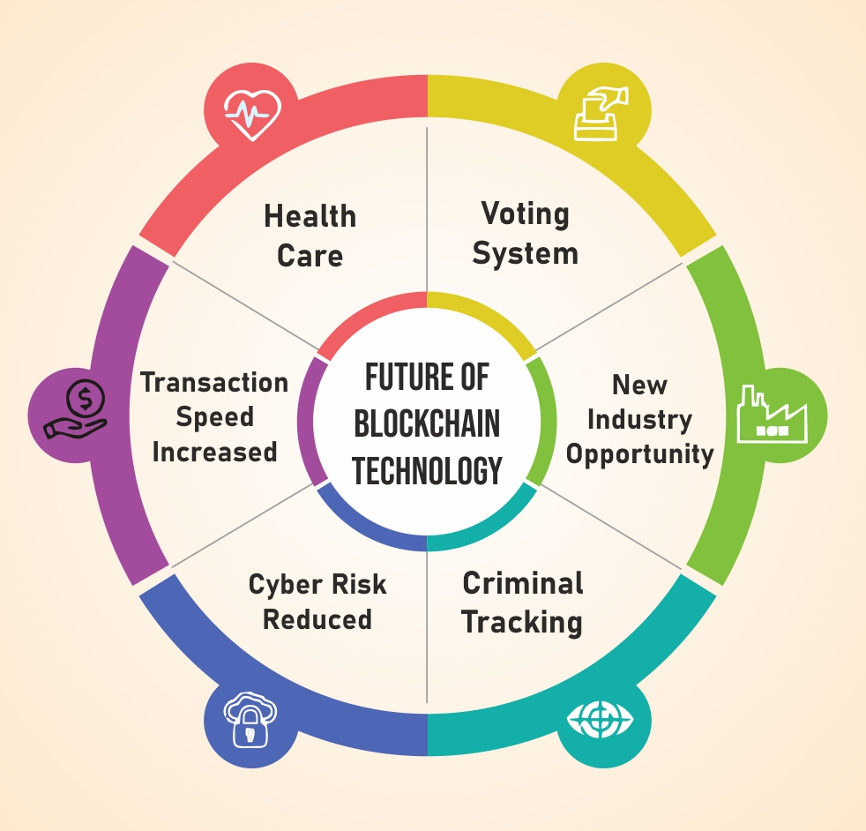
05
Future of Blockchain
The future of blockchain is limitless. As industries adopt decentralized solutions, we can expect faster transactions, enhanced security, and smarter automation. With innovations like Web3, AI integration, and sustainable blockchains, this technology is set to redefine trust and efficiency in the digital world.

Slide 7
Thank You!
Follow on:

