Slide 1

AI Neural Network versus The Nervous System
507-B
A Deep Dive into Intelligence—Biological vs. Artificial
By Ranbir Khurana – 24BCS11076
Sarabdeep Singh Bilkhu – 24BCS10751

Slide 2






Table of Contents
01
03
02
Introduction
Conclusion
Learning about Intelligence, AI Neural network and Human Nervous System
Concluding the presentation
Comparisons
Learning key similarities and differences

Slide 3
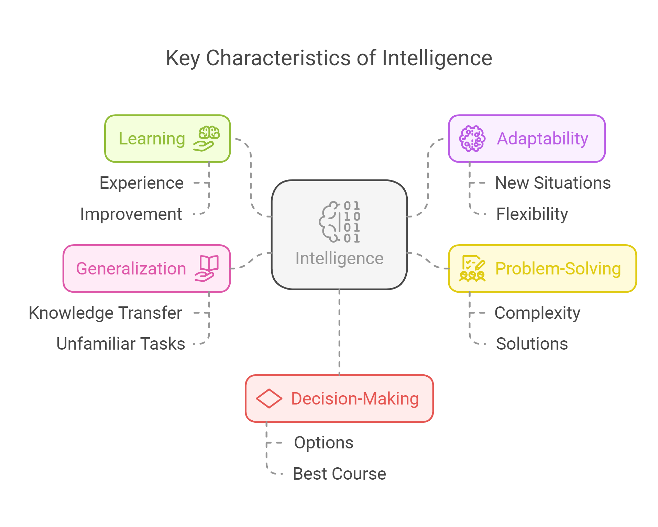
- Introduction to Intelligence -
01
Intelligence:
Intelligence is the ability to learn, adapt, reason, and solve problems using acquired knowledge and experiences.
It allows entities—whether biological (humans, animals) or artificial (AI systems)—to process information, make decisions, and respond effectively to their environment.

Slide 4
- Introduction to Types of Intelligence -
Types of Intelligence:
Biological Intelligence (Human & Animal Intelligence)
Emerges from the nervous system, particularly the brain.
Involves memory, reasoning, learning, problem-solving, and emotions.
Adapts dynamically through experience and neuroplasticity.
Uses abstract thinking, creativity, and intuition.
Artificial Intelligence (Machine Intelligence)
Simulated using algorithms and neural networks.
Learns from data, detects patterns, and makes predictions.
Optimizes problem-solving through mathematical models.
Lacks consciousness, emotions, and self-awareness.

Slide 5

- Introduction to AI Neural Network -
Introduction to AI Neural Networks:
An Artificial Neural Network (ANN) is a computer model
inspired by the human brain. It helps machines learn
patterns and make decisions.
Structure of an ANN:
Input Layer: Receives data (e.g., images, numbers).
Hidden Layers: Process and learn from the data.
Output Layer: Gives the final result (e.g., classification, prediction).

Slide 6
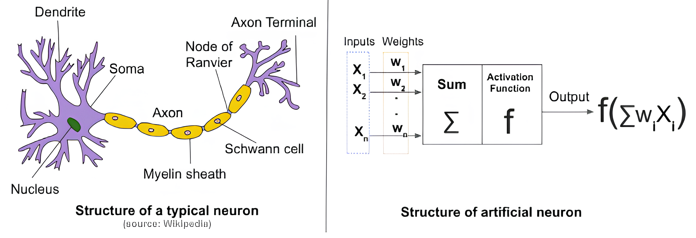

- Introduction to AI Neural Network -
How a Neuron Works:
Inputs (X_1,X_2,... )enter the neuron.
Weights (W_1,W_2,...) determine input importance.
The weighted sum is calculated: $\backslash sigmaW_iX_i​.$
An activation function processes the sum.
The output is passed to the next layer.
Key Idea:
ANNs learn by adjusting weights, improving their predictions over time. They are used in AI
applications like image recognition, speech processing, and self-driving cars.

Slide 7
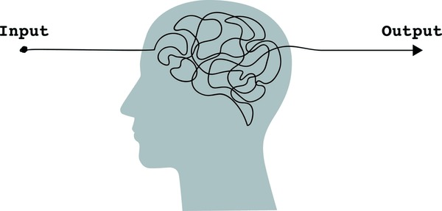
- Introduction to H. Nervous System -
Introduction to the Human Nervous System:
The human nervous system is the body's communication network, responsible for processing information and controlling actions. It consists of the brain, spinal cord, and neurons.
How It Works:
Input: The brain receives signals from the senses.
Processing: The brain interprets and processes information.
Output: The brain sends signals to muscles or organs to react.

Slide 8
- Introduction to H. Nervous System -
Structure of a Neuron:
Dendrites: Receive signals from other neurons.
Soma (Cell Body): Processes incoming signals.
Nucleus: Controls cell activities.
Axon: Transmits signals over long distances.
Myelin Sheath: Speeds up signal transmission.
Axon Terminal: Sends signals to the next neuron.
Key Idea:
The nervous system helps humans' senses, thinking, and reaction, similar to how AI neural networks process data and make decisions.

Slide 9
- Key Comparison -
02
Based on properties- | AI Neural System | Human Nervous System
Structural Comparison | Composed of nodes (neurons) and layers Uses weights & biases for learning | Composed of biological neurons Uses electrochemical signals to process information
Learning Mechanism Comparison | Learns through backpropagation and gradient descent Requires large datasets for training | Learns through experience, reinforcement, and adaptation Can learn from a few examples
Processing Speed & Efficiency | Processes data much faster (milliseconds) Uses parallel processing in GPUs | Slower (reaction time: 200-500ms) More energy-efficient
Adaptability & Creativity | Excels at pattern recognition Struggles with true creativity & abstraction | Adapts to new environments quickly Generates new ideas & emotions
Memory & Storage | Stores data exactly as it was trained Forgetfulness happens with catastrophic overwriting | Memory is associative, flexible, and reconstructive Can retrieve memories based on context and emotions

Slide 10
-Basic Similarities-
 | Ai Neural System | Human Nervous System | Similarities
Learning & Adaptation | Learns by adjusting weights using algorithms like gradient descent and backpropagation. | Learns through experience by strengthening or weakening neural connections. | Both improve performance over time based on past experiences.
Neuronal Structure | Built using artificial neurons (nodes) that mimic biological neurons. | Consists of billions of neurons connected through synapses. | Both systems rely on interconnected neurons to process information.
Activation Mechanism | Artificial neurons activate based on mathematical activation functions. | Neurons activate when signals exceed a certain threshold. | Both follow a threshold-based activation process.
Parallel Processing | Uses multiple layers and nodes to process information in parallel. | Processes multiple signals simultaneously through distributed neural networks. | Both can handle complex tasks efficiently by processing multiple data points at once.
Generalization and Transfer Learning | Can fine-tune pre-trained models to adapt to new tasks. | Once a skill is learned, it can be transferred to related tasks with minimal effort. | Both can apply previous knowledge to new, related problems.

Slide 11
-Strengths & Weaknesses-
📌 AI Strengths:
✅ High-speed processing
✅ Can analyze massive datasets
✅ No fatigue or emotional influence
📌 Human Strengths: ✅ Emotional intelligence & creativity ✅ Learns with fewer examples ✅ Can make decisions based on morality
Ai
Human
📌 AI Weaknesses: ❌ Lacks creativity & common sense ❌ Needs large amounts of data ❌ Struggles with real-world adaptability
📌 Human Weaknesses: ❌ Prone to biases and fatigue ❌ Slower computation speed

Slide 12
Conclusion: AI vs. Human Nervous System
03
While Artificial Neural Networks (ANNs) are inspired by the human nervous system, they are fundamentally different. The human brain is highly adaptive, creative, and capable of emotions, whereas AI processes data based on mathematical models. “The brain learns through experience and neuroplasticity, while ANNs learn through training and weight adjustments”.
Despite these differences, AI has successfully mimicked some cognitive functions, enabling advancements in speech recognition, image processing, and decision-making. However, true human-like intelligence, including reasoning, emotions, and intuition, remains beyond AI’s reach.
As research continues, bridging the gap between biological and artificial intelligence could unlock new possibilities in medicine, robotics, and problem-solving, shaping the future of both AI and neuroscience.

Slide 13
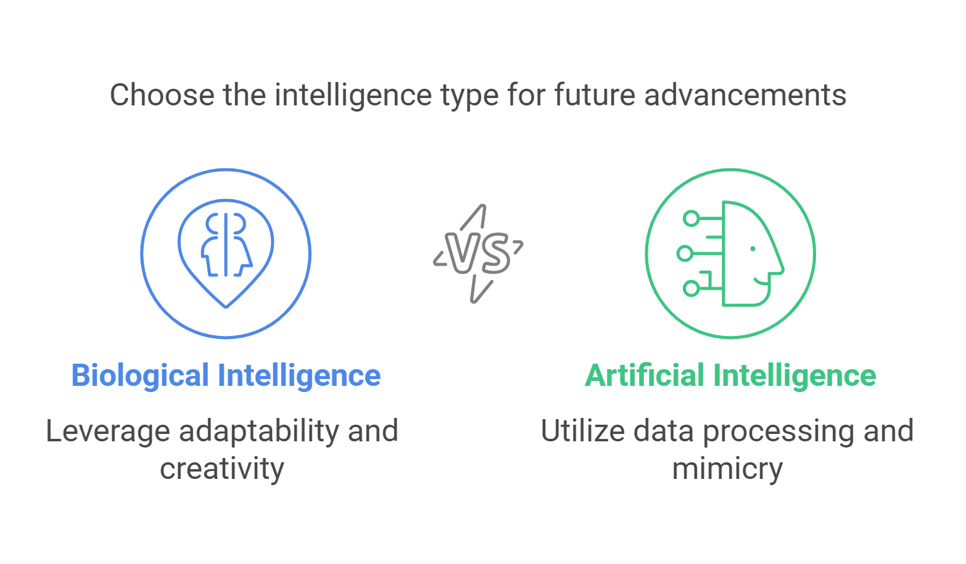

Slide 14
Resources & References
Books:
"On Intelligence" – Jeff Hawkins
Links:
https://medium.combrain-and-artificial-neural-networks-differences-and-similarities
https://aiforsocialgood.ca/blog/the-distinction-between-artificial-intelligence-and-human-brain
Research Papers:
Roza Dastres, Mohsen Soori. Artificial Neural Network Systems. International Journal of Imagingand Robotics (IJIR), 2021, 21 (2), pp.13-25. hal-03349542
A. Sayal et al., "Neural Networks And Machine Learning," 2023 IEEE 5th International Conference on Cybernetics, Cognition and Machine Learning Applications (ICCCMLA), Hamburg, Germany, 2023, pp. 58-63, doi: 10.1109/ICCCMLA58983.2023.10346612.

Slide 15
Thanks!
Do you have any questions?
Contact at:
24bcs11076@cuchd.in
24bcs10751@cuchd.in

