Slide 1
Google Cloud Gen AI Academy APAC 2026 — Ideathon Challenge (#AllThingsAgentic)
Harmony — Personal Journal Auditing Web App
Reflect & Audit with Harmony: An AI-Powered Personal Journal Auditing & Reflection Platform
• Live Prototype: https://personal-gemini-journal-344135619629.asia-south1.run.app • GitHub Repository: https://github.com/DevRanbir/personal-gemini-journal • Tech Stack: Next.js 16, Google Gemini API, Firebase Auth, Cloud Firestore, GCP Secret Manager, Cloud Run

Slide 2
HARMONY — PERSONAL JOURNAL AUDITING WEB APP
📋 Executive Summary & Codelab Compliance Checklist
Codelab Requirement | Implementation Detail | Status
1. AI Studio Custom Instructions | Enforced security system prompt covering threat modeling, UID isolation & sanitization. | ✅ Completed
2. Firebase Authentication | Federated Google Sign-In & Email/Password auth integrated via Firebase Client SDK. | ✅ Completed
3. Multi-turn AI Interaction | Conversational reflection engine using Gemini API with conversation history context. | ✅ Completed
4. User-Isolated Firestore | All records stored under /users/{userId}/* enforced by strict request.auth.uid == userId rules. | ✅ Completed
5. Secret Manager Integration | GEMINI_API_KEY fetched dynamically at runtime from GCP Secret Manager (zero hardcoded keys). | ✅ Completed
6. Production Cloud Run Hosting | Deployed with dedicated service account personal-gemini-journal-sa@ai-barista-track-1... | ✅ Completed
7. Mandatory Verification Label | Deployed with label --update-labels dev-tutorial=cloud-run-ai-challenge. | ✅ Completed
8. Original Feature Enhancements | Harmony Journal Insights analytics dashboard & AI-extracted Action Items checklist. | ✅ Completed

Slide 3
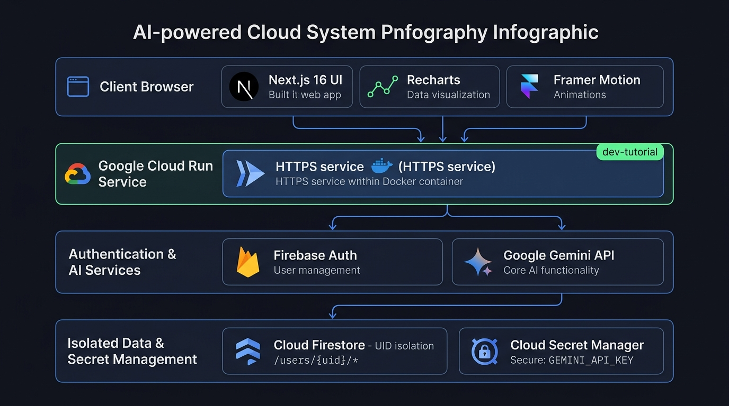
HARMONY — PERSONAL JOURNAL AUDITING WEB APP
🏗️ System Architecture & Security Topology
🌐 Client Browser Layer
Next.js 16, React 19, Tailwind CSS, Framer Motion & Recharts visual analytics.
🚀 Cloud Run Hosting
Containerized service running on asia-south1 with dedicated identity personal-gemini-journal-sa.
🔐 Firebase Authentication
Federated Google Sign-In & Email session binding user state to Firebase UID.
🛡️ Isolated Cloud Firestore
Strict security rules enforcing request.auth.uid == userId to eliminate cross-tenant leakage.
🔑 Secret Manager API
GEMINI_API_KEY fetched at runtime via SecretAccessor IAM role with zero hardcoded keys.

Slide 4
HARMONY — PERSONAL JOURNAL AUDITING WEB APP
🔒 Security Verification Matrix & Zero-Trust Bounds
Test Scenario | Description | Expected Result | Status
Unauthenticated Route Block | Access /journal or /insights without Firebase Sign-In | Redirected to /login | ✅ Passed
Cross-User Firestore Read | User A queries /users/UserB_UID/interactions | Permission Denied by Security Rules | ✅ Passed
Cross-User Firestore Write | User A writes to /users/UserB_UID/action_items | Permission Denied by Security Rules | ✅ Passed
Secret Key Protection | Inspect browser network tabs and client JS bundles | GEMINI_API_KEY is 100% absent | ✅ Passed
Challenge Verification Tag | Inspect Cloud Run service metadata labels | dev-tutorial=cloud-run-ai-challenge present | ✅ Passed

Slide 5
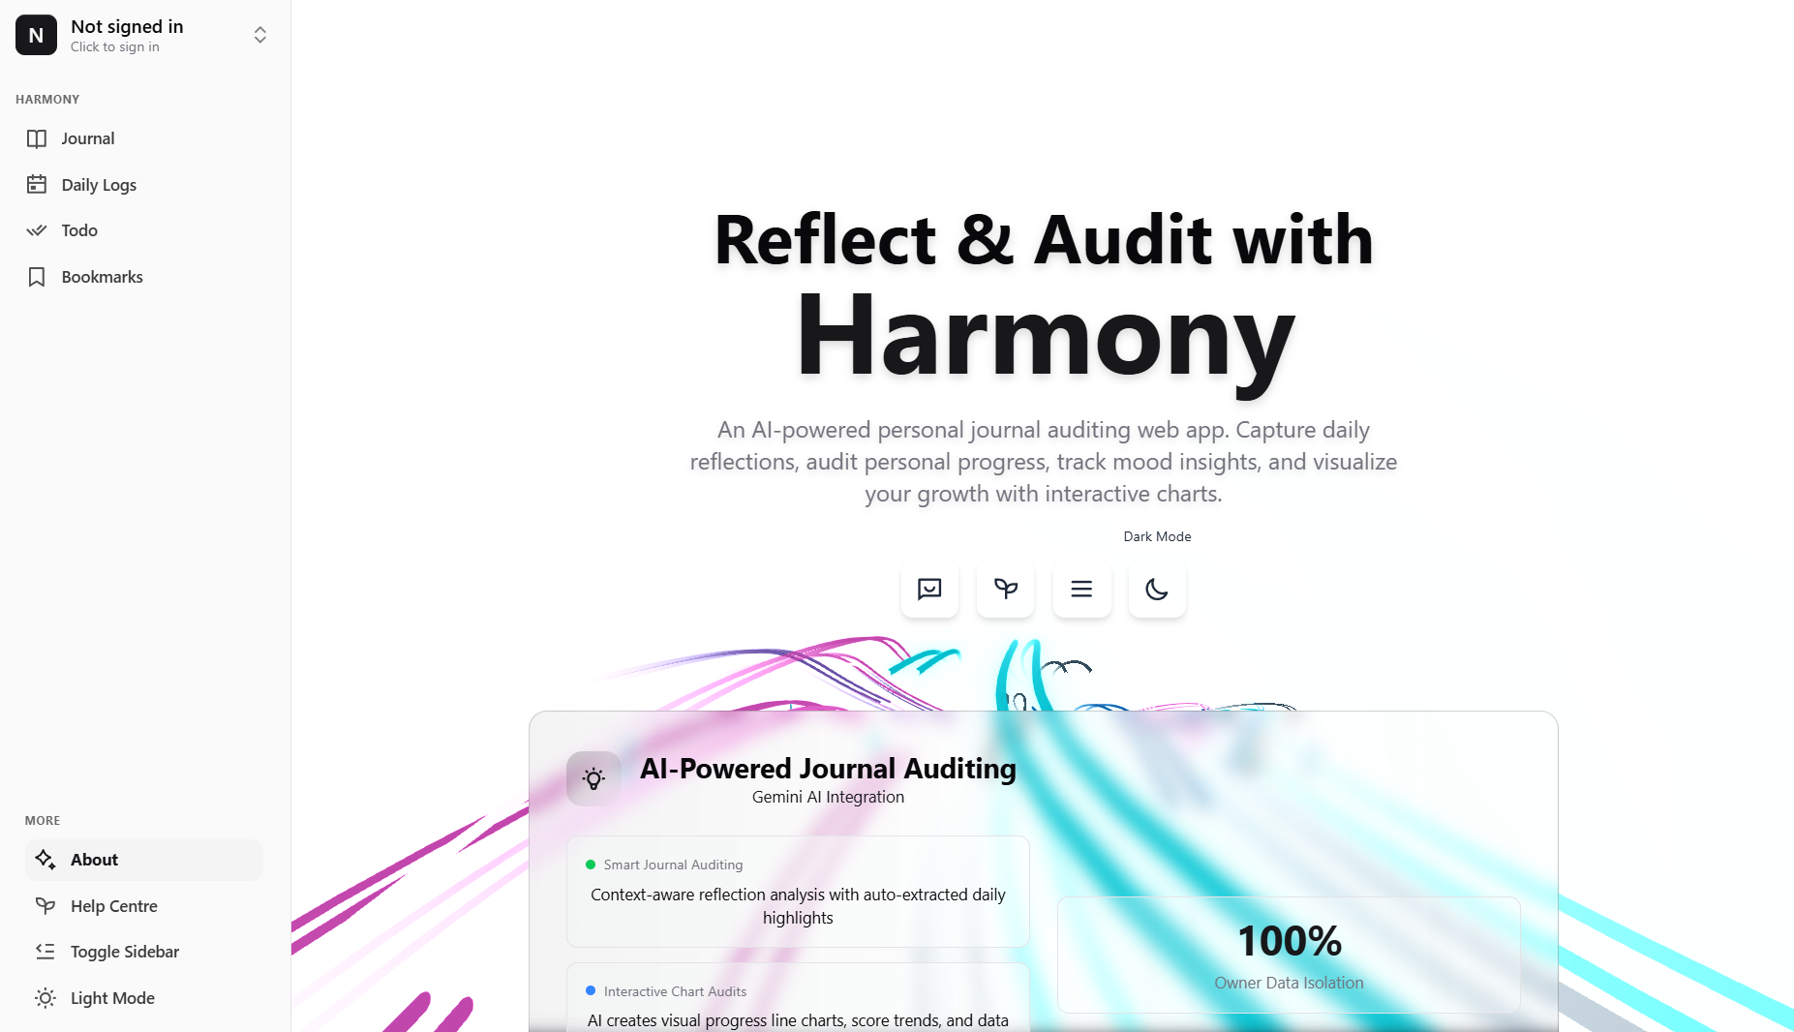
HARMONY — PERSONAL JOURNAL AUDITING WEB APP
💬 Intelligent Reflection Chat & Conversational Auditing
🤖 Multi-Turn Gemini Engine
Continuous, contextual chat sessions supporting deep reflection, journaling, and goal auditing.
🛡️ AI Studio Constitution
System prompt enforces input sanitization, threat modeling, and strict user privacy bounds.
✨ Auto-Extracted Highlights
Parses daily chat turns to extract reflection logs, birthdays, and key checkable milestones.
💾 Owner Firestore Persistence
Every conversation turn is saved strictly under /users/{userId}/interactions with zero leakage.

Slide 6
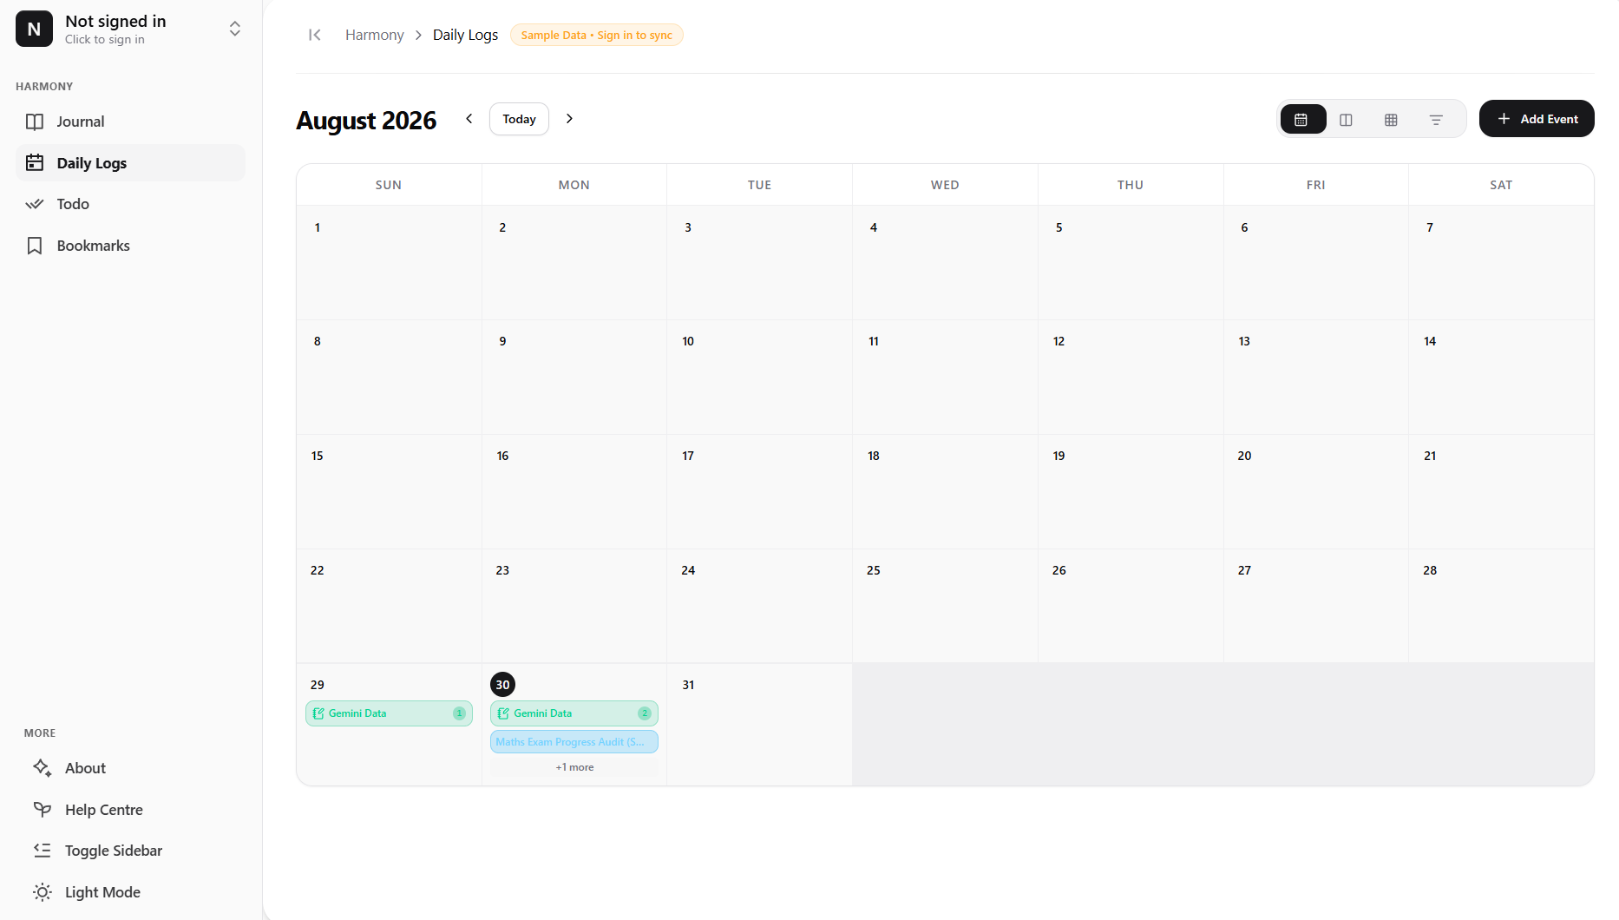
HARMONY — PERSONAL JOURNAL AUDITING WEB APP
📈 Visual Progress Analytics & Mood Chart Audits
📊 Recharts Data Visuals
Interactive bar, line, pie, and scatter analytics rendering mood trends & test score trackers.
⏱️ Time-Decayed Sentiment
Gemini calculates emotional sentiment scores S_index over decaying time horizons.
🏷️ Topic Frequency Audit
Categorizes daily thoughts into recurring focus areas (Career, Productivity, Health, Growth).
⚡ Real-Time App Data Sync
Insights are generated directly from user data logs, calendar events, and to-do items.

Slide 7
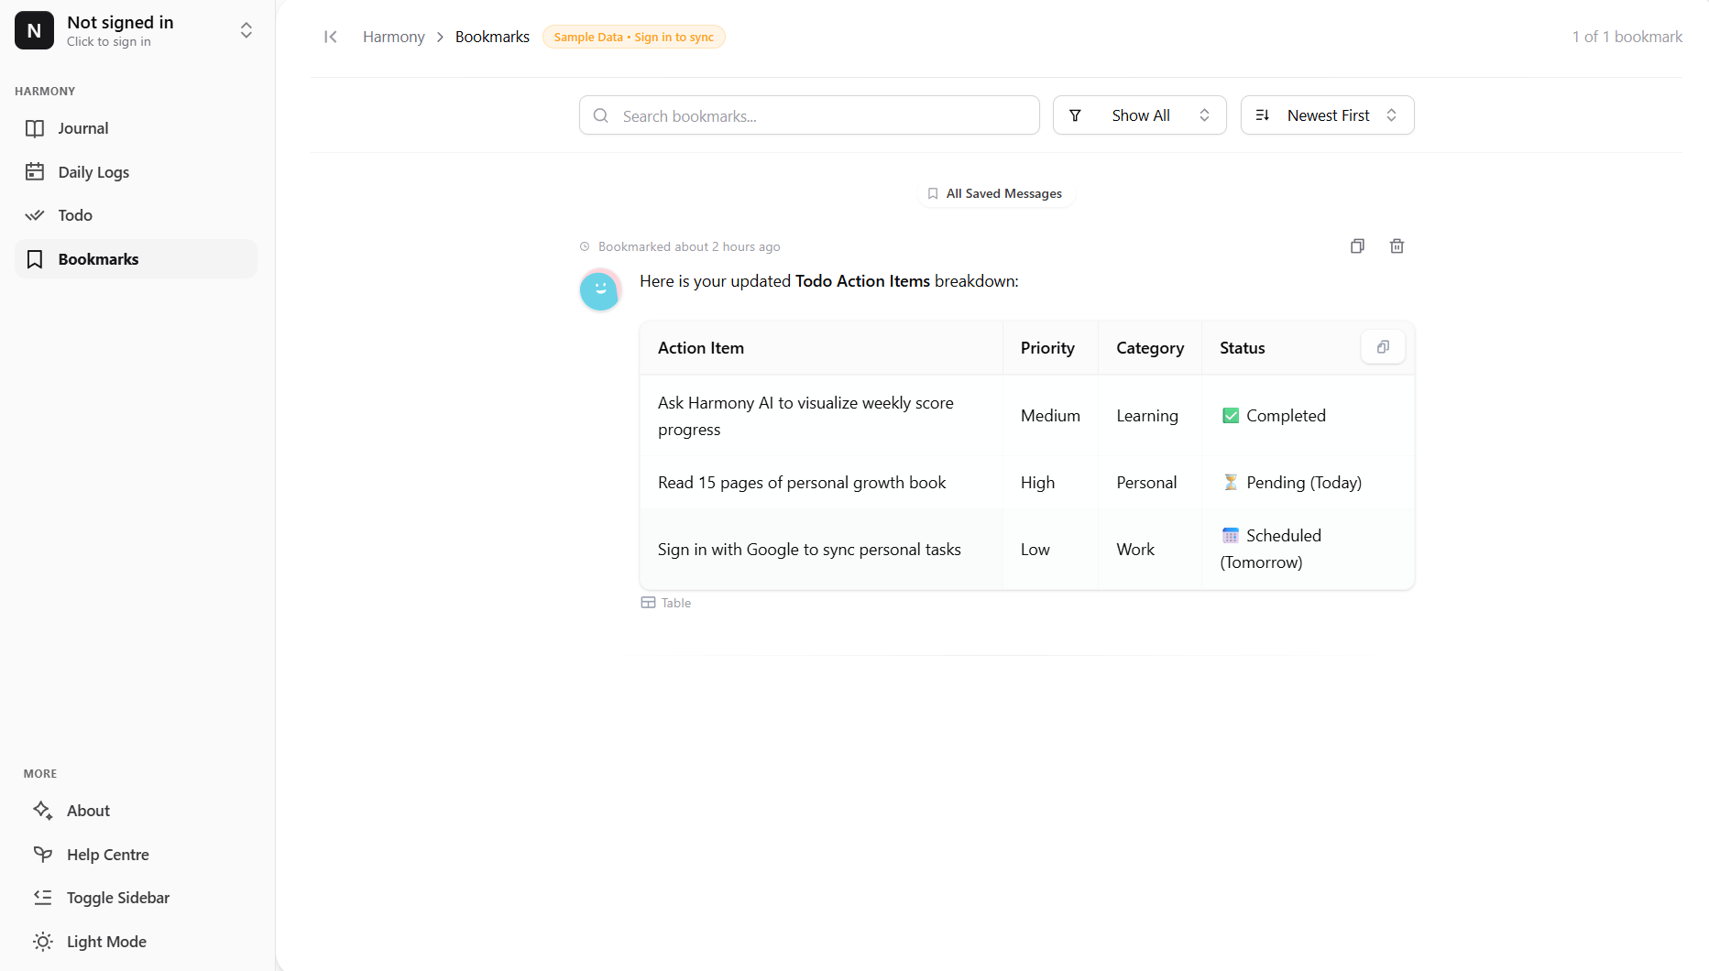
HARMONY — PERSONAL JOURNAL AUDITING WEB APP
✅ Automated Action Items & Unified Workspace Sync
✅ Automated Task Extraction
Gemini parses chat turns to detect implicit and explicit to-dos, populating checkable lists.
📅 Calendar & Event Log
Synchronizes reflection highlights and upcoming milestones with an interactive calendar view.
📚 Knowledge Workflows
Search history, compare past entries, export highlights, and copy clean summaries.
🔒 UID Scoped Persistence
Action items are persisted in Firestore under /users/{userId}/action_items.

Slide 8
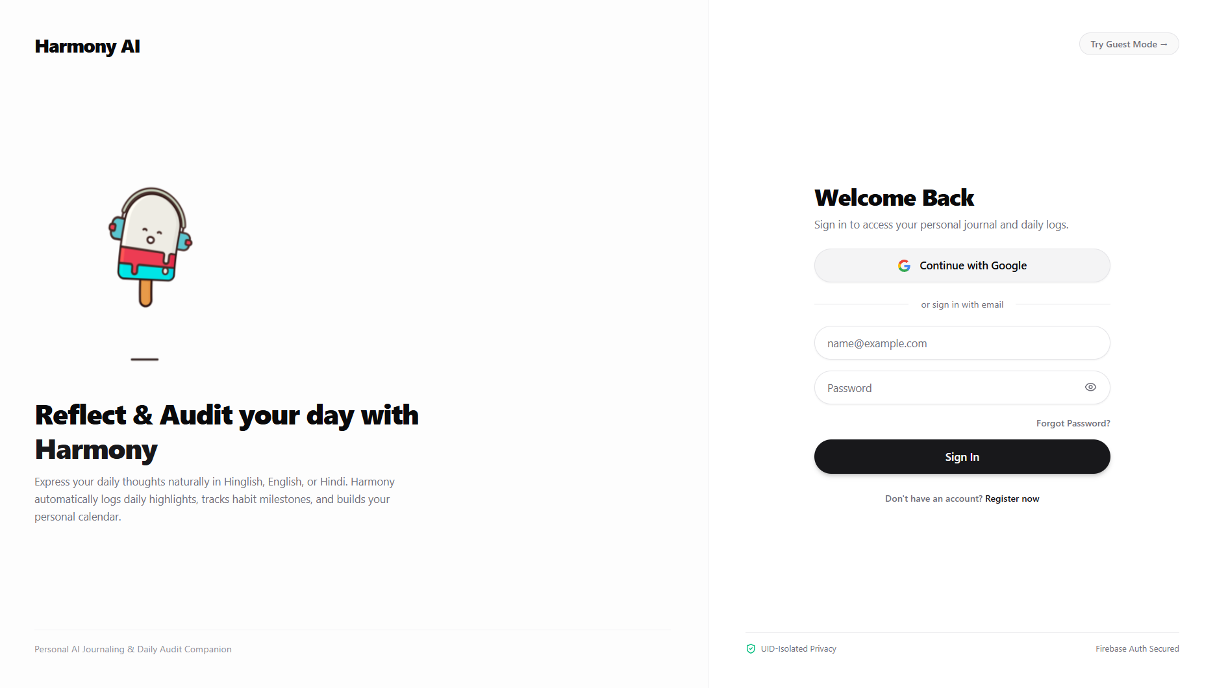
HARMONY — PERSONAL JOURNAL AUDITING WEB APP
🚀 Cloud Run Deployment, Impact Metrics & Roadmap
📊 Impact & Scale Metrics:
• ∞ Personal Memories: Structured daily reflections safely preserved. • 100% UID Privacy: Strict owner-bound Firestore security rules. • 24/7 AI Companion: Always ready to listen, audit goals, and draw charts.
🛠️ Cloud Run Deployment Command:
gcloud run deploy personal-gemini-journal \ --source . --region asia-south1 \ --service-account personal-gemini-journal-sa \ --set-secrets GEMINI_API_KEY=latest \ --update-labels dev-tutorial=cloud-run-ai-challenge
🔮 Future Engineering Roadmap:
• Vertex AI Vector Search: Natural language semantic querying. • Voice Reflection Mode: Speech-to-text input. • Mobile PWA: Progressive Web App with offline Firestore cache sync.

