Slide 1
GOOGLE CLOUD GEN AI ACADEMY APAC 2026 — IDEATHON CHALLENGE (#AllThingsAgentic)
Harmony — Personal Journal Auditing Web App
Reflect & Audit with Harmony: An AI-Powered Personal Journal Auditing & Reflection Platform
• Live Prototype: https://personal-gemini-journal-344135619629.asia-south1.run.app • GitHub Repository: https://github.com/DevRanbir/personal-gemini-journal • Key Stack: Next.js 16 (App Router), Google Gemini API, Firebase Auth, Cloud Firestore, GCP Secret Manager, Cloud Run

Slide 2
HARMONY — PERSONAL JOURNAL AUDITING WEB APP
Executive Summary & Compliance Checklist
Codelab Requirement | Implementation Detail | Status
1. AI Studio Custom Instructions | Enforced security system prompt covering threat modeling, UID isolation & sanitization. | Completed
2. Firebase Authentication | Federated Google Sign-In & Email/Password auth integrated via Firebase Client SDK. | Completed
3. Multi-turn AI Interaction | Conversational reflection engine using Gemini API with conversation history context. | Completed
4. User-Isolated Firestore | All records stored under /users/{userId}/* enforced by strict request.auth.uid == userId rules. | Completed
5. Secret Manager Integration | GEMINI_API_KEY fetched dynamically at runtime from GCP Secret Manager (zero hardcoded keys). | Completed
6. Production Cloud Run Hosting | Deployed with dedicated service account personal-gemini-journal-sa@ai-barista-track-1... | Completed
7. Mandatory Verification Label | Deployed with label --update-labels dev-tutorial=cloud-run-ai-challenge. | Completed
8. Original Feature Enhancements | Harmony Journal Insights analytics dashboard & AI-extracted Action Items checklist. | Completed

Slide 3
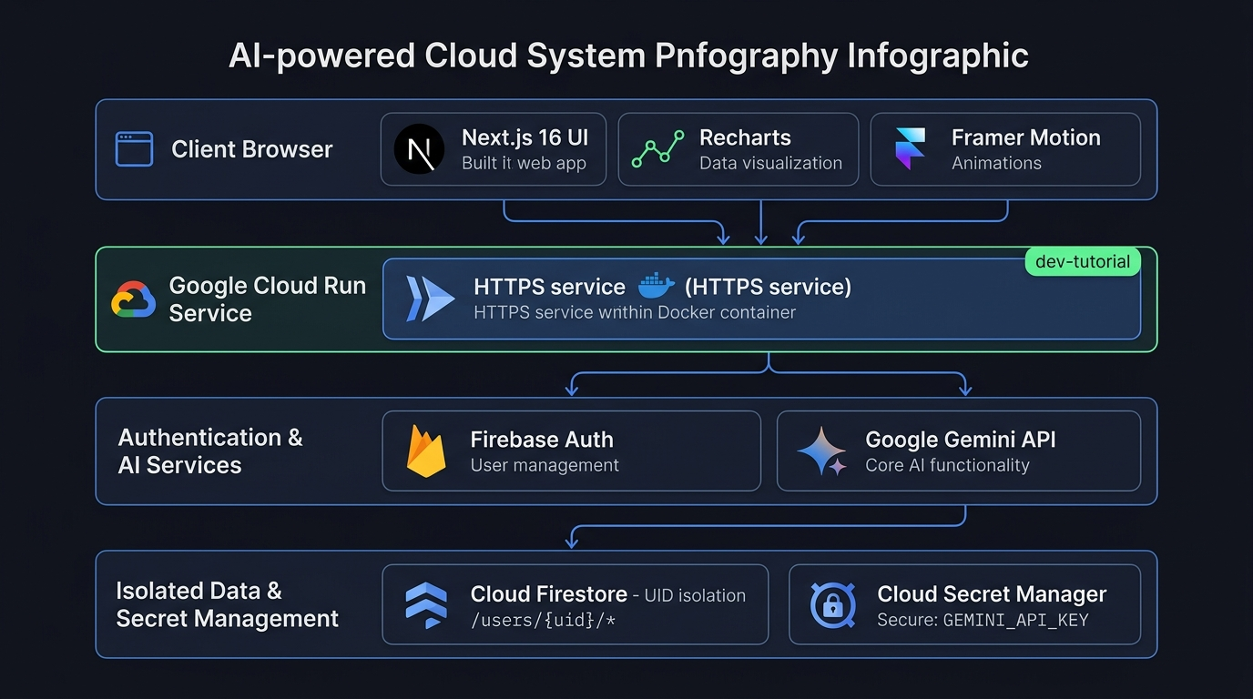
HARMONY — PERSONAL JOURNAL AUDITING WEB APP
🏗️ Architecture Topology & Component Model

Slide 4
HARMONY — PERSONAL JOURNAL AUDITING WEB APP
Security Verification Matrix & Zero-Trust Bounds
Test Scenario | Description | Expected Result | Status
Unauthenticated Route Block | Access /journal or /insights without Firebase Sign-In | Redirected to /login | Passed
Cross-User Firestore Read | User A queries /users/UserB_UID/interactions | Permission Denied by Security Rules | Passed
Cross-User Firestore Write | User A writes to /users/UserB_UID/action_items | Permission Denied by Security Rules | Passed
Secret Key Protection | Inspect browser network tabs and client JS bundles | GEMINI_API_KEY is 100% absent | Passed
Challenge Verification Tag | Inspect Cloud Run service metadata labels | dev-tutorial=cloud-run-ai-challenge present | Passed

Slide 5
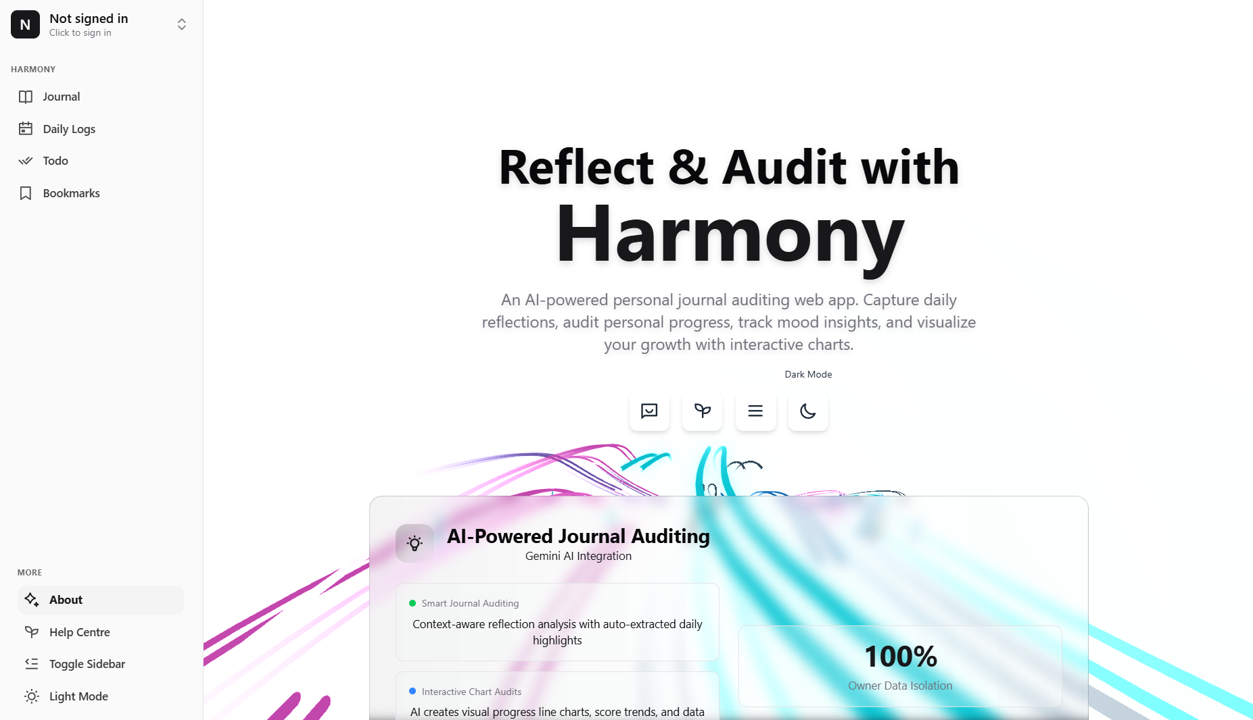
HARMONY — PERSONAL JOURNAL AUDITING WEB APP
Intelligent Reflection Chat & Conversational Auditing Engine

Slide 6
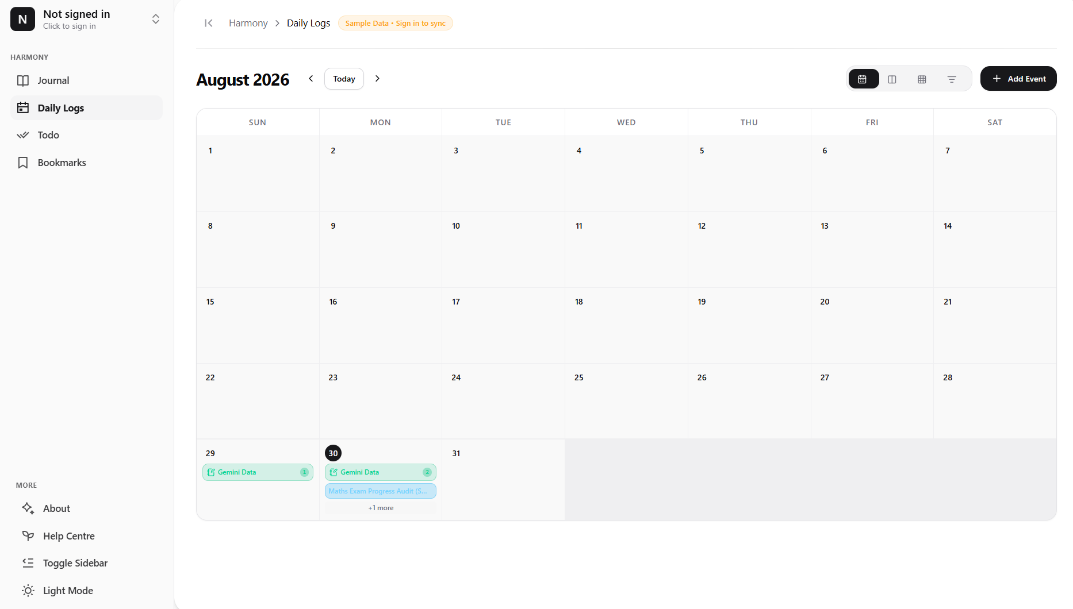
HARMONY — PERSONAL JOURNAL AUDITING WEB APP
Visual Progress Analytics & Mood Chart Audits

Slide 7
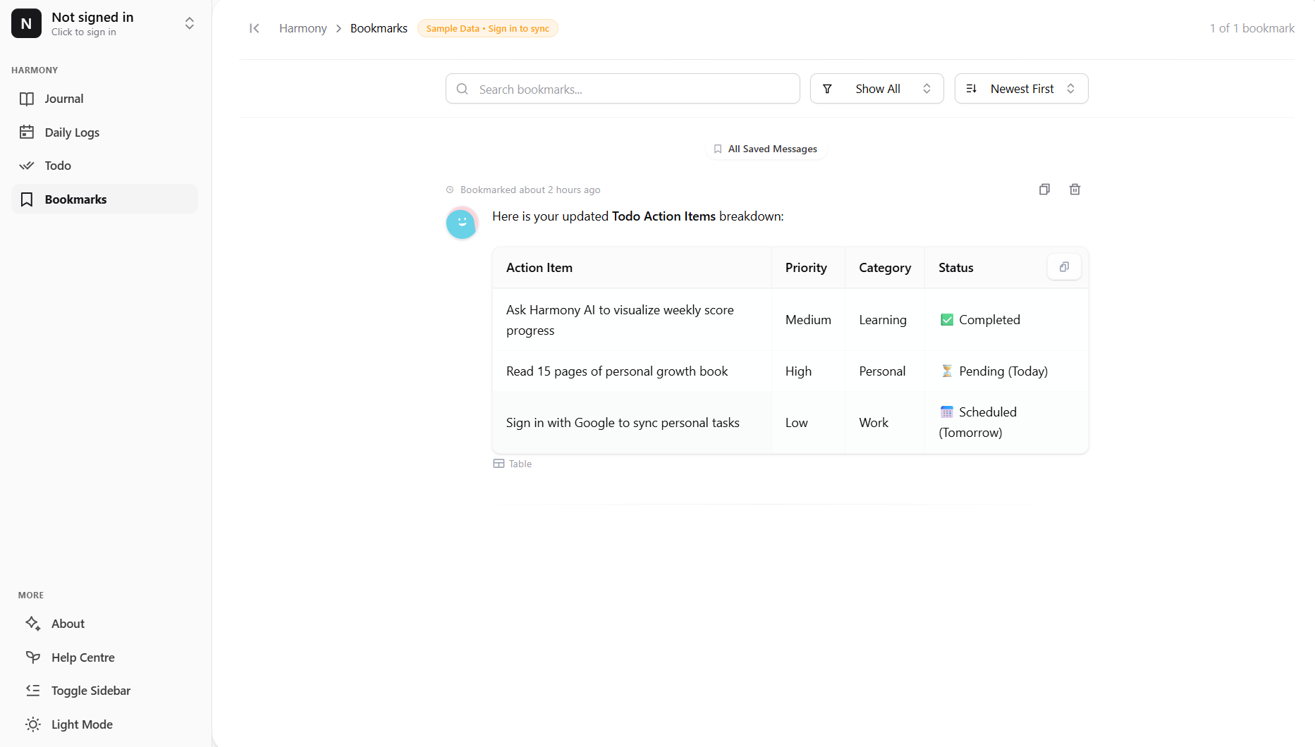
HARMONY — PERSONAL JOURNAL AUDITING WEB APP
Automated Action Items & Unified To-Do Sync

Slide 8
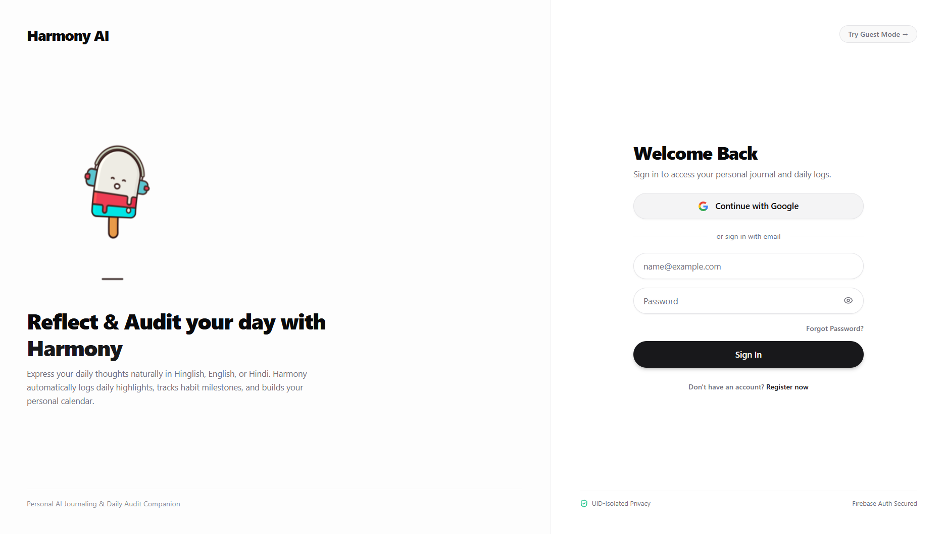
HARMONY — PERSONAL JOURNAL AUDITING WEB APP
Daily Reflection Logs & Interactive Signup Pages

