Slide 1
ARINC-717 Telemetry & Audio
over QUIC with DTN
Concept of Operations — High-Level Team Brief
180
7
~80%
Telemetry Signals
Architectural Layers
BW Reduction in Cruise
Classification: Internal Technical Brief | v2.0

Slide 2
What Are We Solving?
✈ Aircraft generate massive data
📡 Links break. Data must not.
180 telemetry signals + cockpit audio — all needing to reach the ground station reliably, even over intermittent satellite links.
Satellite connectivity drops during manoeuvres, weather, and handoffs. Traditional TCP stalls and loses frames. We need something smarter.
⚡ Bandwidth is scarce & expensive
🔒 Every byte must be authenticated
Transmitting everything, always, wastes cost. We need intelligent buffering — send only when it matters, burst when it's critical.
In aviation, tampered telemetry is catastrophic. Every packet must carry cryptographic proof of origin and integrity before any station trusts it.
GOAL: Build a simulation that proves ARINC-717 + compressed audio can be reliably, securely transported over QUIC with intelligent store-and-forward — and measure every byte.

Slide 3
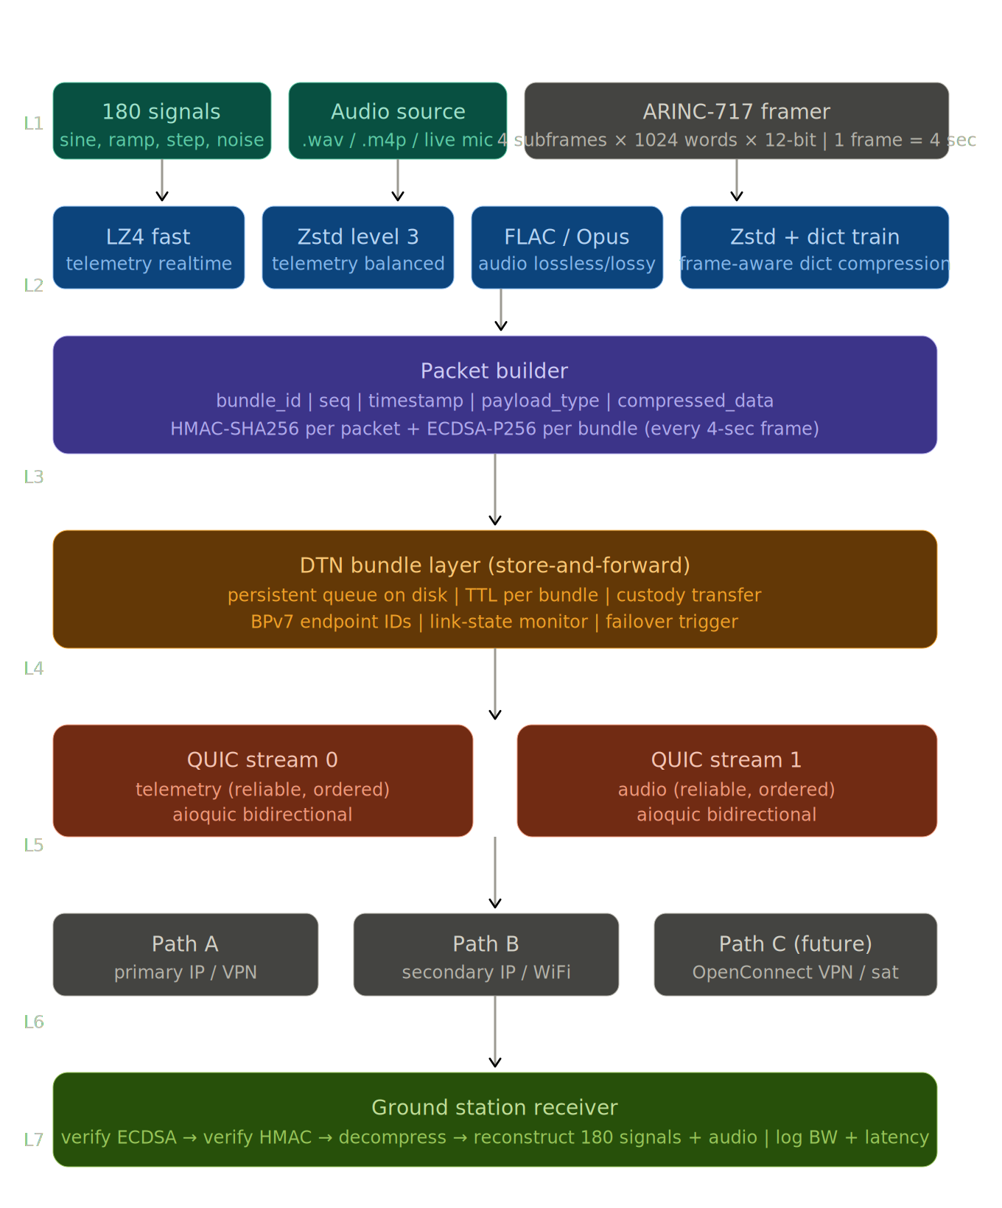
7-Layer System Architecture
End-to-end flow from signal generation to verified ground reconstruction

Slide 4
Layer 1 & 2 — Data Generation & Framing
TELEMETRY — 180 Signals
AUDIO — CVR Simulation
Signal types
Sine, ramp, step, noise, sawtooth
Source
Pre-recorded WAV/M4A or live mic
Quantisation
12-bit per sample (4096 levels)
Chunk size
40ms per QUIC send (codec alignment)
Word rate
1024 words/sec (configurable: 64–1024)
Raw rate
~32 KB/s (16kHz 16-bit mono)
Frame structure
4 subframes × 1 second each
FLAC (lossless)
~16 KB/s — exact reconstruction
Raw data rate
~1.5 KB/s before compression
Opus (lossy)
~2 KB/s — speech-transparent CVR
Identity method
Position in frame = parameter ID
Zstd+PCM
~14 KB/s — lossless middle ground
Ts table
Fast (Ts=1) to slow (Ts=8) per signal class
BW insight
Audio is 10× telemetry — the real cost
💡 Key insight: After compression, telemetry is ~0.3–0.6 KB/s. Audio at 16kbps (Opus) is ~2 KB/s. Total link budget for a full 3-hour flight is dominated by audio — telemetry is nearly free.

Slide 5
Layer 3 — Compression & Cryptographic Security
Compression Algorithms
LZ4
Zstd L3
Zstd + Dict
Speed: ~1 GB/s
Speed: ~400 MB/s
Speed: Best ratio
Ratio: Moderate
Ratio: Good
Ratio: Excellent
Best for: Real-time telemetry
Best for: Balanced frames
Best for: Repetitive patterns
Bundle Packet Structure
4B
4B
4B
8B
1B
1B
4B
N
32B
64B
Magic Header
Bundle ID
Seq Number
Timestamp (µs)
Payload Type
Compression Algo
Payload Length
Compressed Payload
HMAC-SHA256
ECDSA-P256 Sig
🔐 HMAC-SHA256 (per packet)
🔐 ECDSA-P256 (per bundle)
Microseconds per packet. Symmetric key check — receiver immediately rejects forged or corrupted packets before processing. First line of defence.
Asymmetric signature over entire bundle. Proves origin — only the aircraft's private key can sign. Ground station verifies with public key. Non-repudiable.

Slide 6
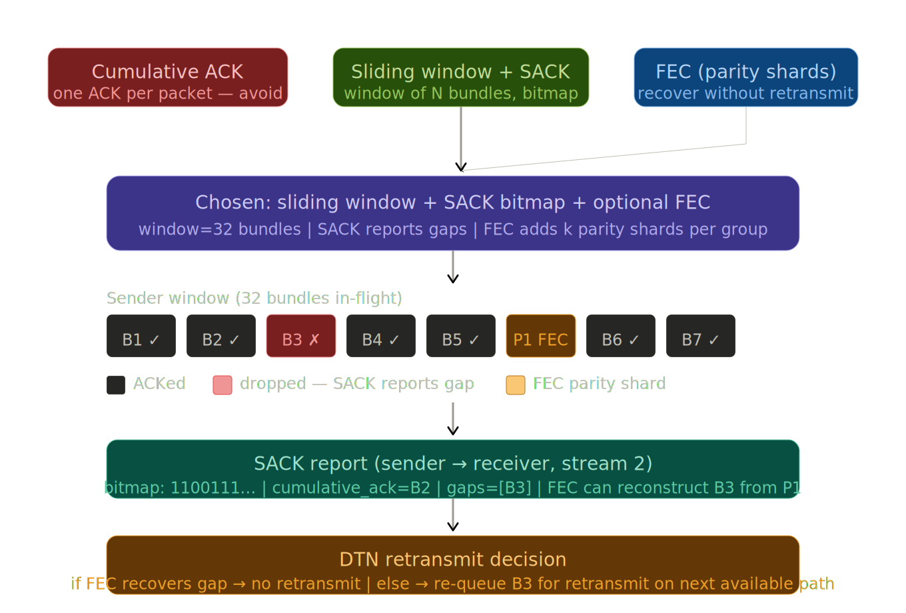
ACK Strategy — Design Decision
How the aircraft knows the ground station received each bundle — and what to do when it doesn't
Selected approach: QUIC Stream 2 ACK — lightweight receiver stats echoed back every bundle. Enables per-stream BW/latency accounting without DTN overhead.

Slide 7
Layer 4 & 5 — DTN Store-and-Forward + QUIC Transport
DTN — Delay/Disruption Tolerant Networking
QUIC — Stream Assignment
① Bundle written to SQLite queue with TTL
Stream 0
② Delivery attempted over QUIC Path A
Telemetry bundles
(reliable, ordered — priority lane)
③ On failure → retry Path B automatically
Stream 1
④ On path recovery → queued bundles drain
Audio chunks
(reliable, ordered — 40ms chunks)
⑤ If all paths down → bundles persist on disk
⑥ Cap: 1000 bundles max, TTL discard warns operator
Stream 2
Server→Client ACKs
(BW stats + latency echo)
Failover: PING every 500ms. 3 consecutive fails → auto-switch to standby path. Live on dashboard.
💡 QUIC multiplexing means audio backlog NEVER blocks telemetry — impossible in TCP. Critical for real-time safety data.

Slide 8
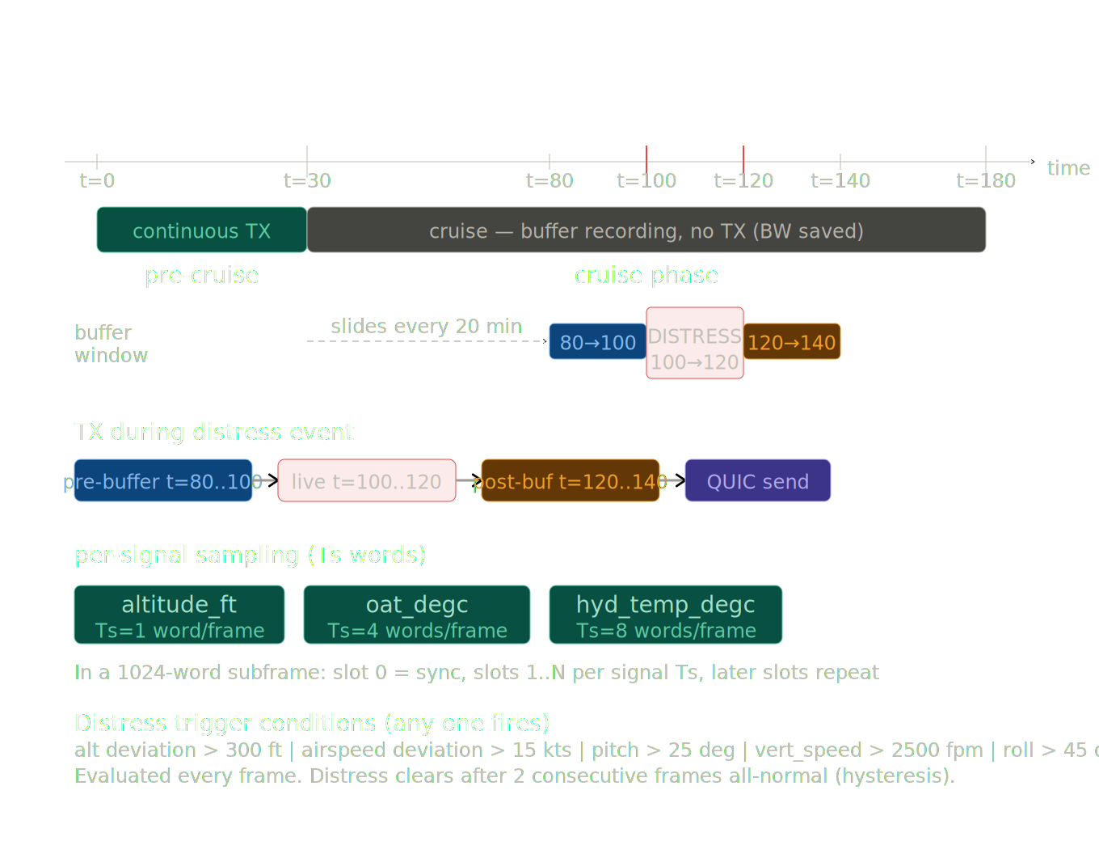
Transmission State Machine — Flight Phase Logic
Intelligent bandwidth control: only transmit what matters, when it matters
RESULT: For a 3-hour flight with one distress event, ~80% BW reduction vs always-on. Pre-event buffer (last 20 min) automatically burst-sent on distress detection.

Slide 9
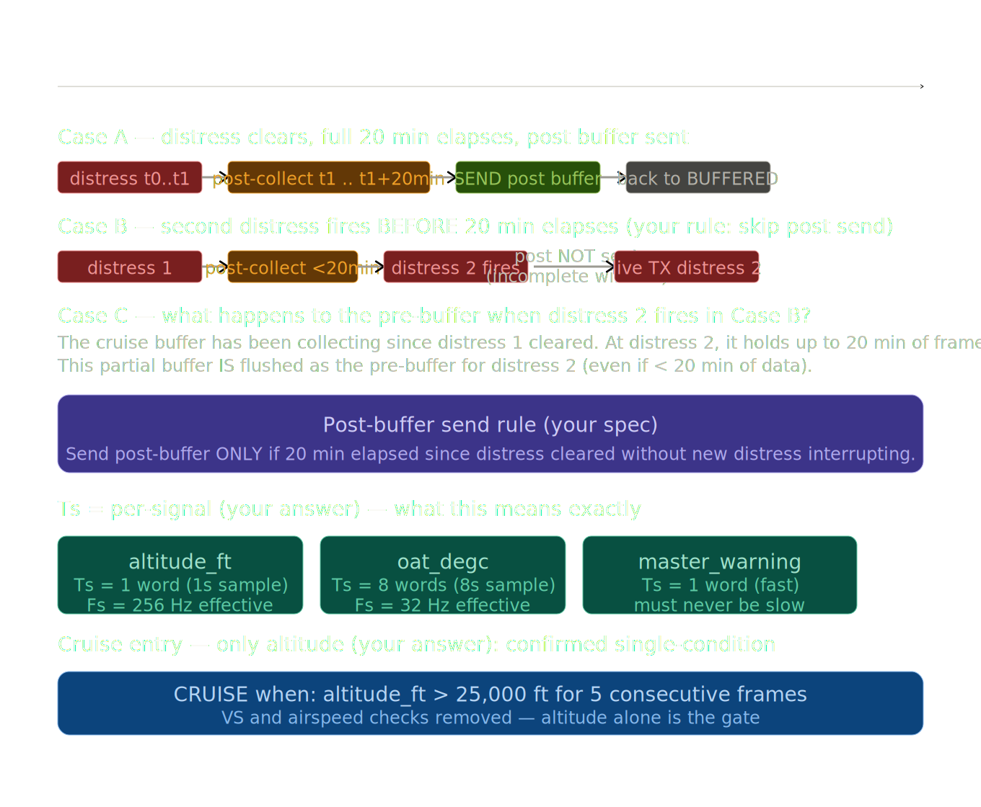
Post-Event Buffer Rules & Signal Timing (Ts)
Three cases for distress clearing + how signal sampling intervals (Ts) are assigned
Cruise entry gate: altitude_ft > 25,000 ft for 5 consecutive 4-second frames (20 seconds confirmation).

Slide 10
Layer 7 — Ground Station Receiver & Verification
1
Receive QUIC streams
2
ECDSA Verification
3
HMAC Per-Packet
Split raw bytes into bundles by magic header (0xA717A717). Parallel stream buffers for telemetry vs audio.
Reject entire bundle if signature invalid. Only aircraft private key can produce valid signature — tamper proof.
Reject any packet with bad HMAC. Fast microsecond check. Corrupted packets never enter the pipeline.
4
Decompress
5
Unpack ARINC-717 Frame
6
Reconstruct & Verify
Use compression_algo field to select correct algorithm. No ambiguity — the header tells the receiver exactly how to unpack.
Extract 180 signals from their fixed word-slot positions. Position IS the identity — no lookup table needed.
Apply inverse 12-bit quantisation using [min, max] range. Compare RMS vs generated signal. Error ≤ quantisation noise floor.

Slide 11
Expected Performance Numbers — Demo Dashboard Preview
Channel
Raw Rate
After Compression
HMAC+ECDSA
QUIC Headers
Telemetry (1024 w/s)
~1.5 KB/s
~0.3–0.6 KB/s
+0.4 KB/s
+0.1 KB/s
Audio — FLAC (lossless)
~32 KB/s
~12–16 KB/s
+0.1 KB/s
+0.1 KB/s
Audio — Opus (16kbps)
~32 KB/s
~2 KB/s
+0.1 KB/s
+0.1 KB/s
~0.5 KB/s
~2 KB/s
<5 ms
~1 ms
Telemetry after Zstd+Dict
Audio after Opus 16kbps
HMAC per packet overhead
ECDSA per bundle signing
Latency Measurement Method
◆ Each packet carries a microsecond send timestamp embedded in the header.
◆ Receiver echoes timestamp back on Stream 2 (ACK channel).
◆ Sender computes RTT = receive_time − send_time, and one-way = RTT/2.
◆ Separate per-stream latency tracked: telemetry vs audio independently.

Slide 12
Module Architecture — Clean Separation of Concerns
Foundation
Layer 1
Layer 1
Intelligence
config.py
signal_generator.py
arinc717_ts.py
flight_phase.py
All tunable parameters. No magic numbers in code. Switch word rate, codec, paths — zero other changes.
180 signals → numpy arrays. Configurable types: sine, ramp, step, noise, sawtooth.
ARINC-717 framer with Ts-aware word slot assignment. 521/1024 words used. Compatible with base spec.
State machine: ENGINE_OFF→TAXI→TAKEOFF→CLIMB→CRUISE→DESCENT→LANDING. CruiseBuffer (20-min rolling). Distress detection on 15 signals.
Intelligence
Layer 3
Layer 3
Layer 3
tx_manager.py
compressor.py
packet_builder.py
bundle_signer.py
Wires phase→TX policy. BUFFERED in cruise. DISTRESS fires burst. POST_EVENT collects 20 min then bursts. Returns to BUFFERED.
Unified interface: LZ4, Zstd, Zstd+Dict, FLAC, Opus. One compress(data, algo) call. Ground station mirrors exactly.
Binary pack: header + payload + HMAC-SHA256. Fixed byte layout. Ground station mirrors exactly.
ECDSA-P256 sign/verify per bundle. Private key stays on aircraft node. Public key distributed to ground stations.
Layer 4
Layer 5
Layer 5
Observability
dtn_queue.py
quic_client.py
quic_server.py
metrics.py + dashboard.py
SQLite persistent queue. TTL management. Dual-path failover. link_monitor pings every 500ms.
aioquic aircraft sender. Three streams. RTT measurement. Per-stream BW tracker.
aioquic ground station. Receives, verifies, decompresses, reconstructs. Mirrors client stats.
Rolling 1-second BW window. Per-stream latency. Live terminal UI via rich. Shows every byte breakdown.

Slide 13
Anticipated Questions & Design Decisions
Q: Why QUIC over TCP?
Q: Why both HMAC and ECDSA?
A: TCP head-of-line blocking stalls telemetry when audio bursts. QUIC streams are independent — telemetry always gets through.
A: HMAC = fast per-packet integrity check (microseconds). ECDSA = non-repudiable origin proof (proves aircraft signed it). Neither alone is sufficient.
Q: Why is the 20-min buffer circular, not flushed?
Q: What if both paths are down simultaneously?
A: We always want the LAST 20 minutes up to the distress moment. A flush-every-20-min model would lose the minutes just before the event.
A: Bundles queue to SQLite (disk) with TTL. When any path recovers, queue drains automatically. Dashboard shows queue depth live.
Q: Is 12-bit quantisation a problem for accuracy?
Q: Can we add more signals beyond 180?
A: It's spec-compliant. Error = range/4096. We document the exact error bound and prove it's within spec at ground station via RMS comparison.
A: Yes. config.py sets the count. The framer will allocate word slots automatically. 1024 words/subframe gives room for 503 additional slots.

Slide 14
What We Are Building — And Why It Matters
A technically rigorous, fully measurable simulation that proves aviation telemetry
and cockpit audio can be transported reliably, securely, and intelligently over modern internet protocols.
Phase 1
Phase 2
Phase 3
Local demo — two QUIC servers on localhost. Kill Path A mid-demo to trigger visible failover. Dashboard live.
VirtualBox — two VMs with OpenConnect VPN as satellite link. Disconnect VPN mid-demo for real network failover.
Client demo — live dashboard showing per-channel BW, latency, compression ratio, ECDSA verification speed.
The simulation is the proof. Every number on the dashboard is real, measured, and defensible to a technical client.

