Slide 1

COSMOPOLITAN UNIVERSITY ABUJA
OFFICIAL SYSTEMS OPERATIONAL MANUAL
SYSTEM MANUAL • VERSION 2.0
MEMOTRACKER SYSTEM
PRESENTATION MANUAL
A step-by-step visual presentation guide for memo creation, multi-tier budget requisitions, executive approval routing, and audit tracking.

Slide 2
COSMOPOLITAN UNIVERSITY ABUJA
SYSTEM OVERVIEW & WORKFLOW
OVERVIEW
1. Institutional Workflow Lifecycle
The CUA MemoTracker System automates formal internal communications, institutional approvals, and multi-tier budget requisitions.
1
2
3
4
Compose Memo
Attach Requisition
Route for Approval
Executive Action
If requesting funds, author enables 3-tier budget breakdown (Category → Group → Sub-Item).
Author locks document and dispatches it into sequential review for HODs, Deans, and Finance.
Reviewing officers endorse, request amendments, or approve. Audit history records every step.
Author enters memo title, routing recipients (To, CC, BCC), rich body text, and attachments.

Slide 3
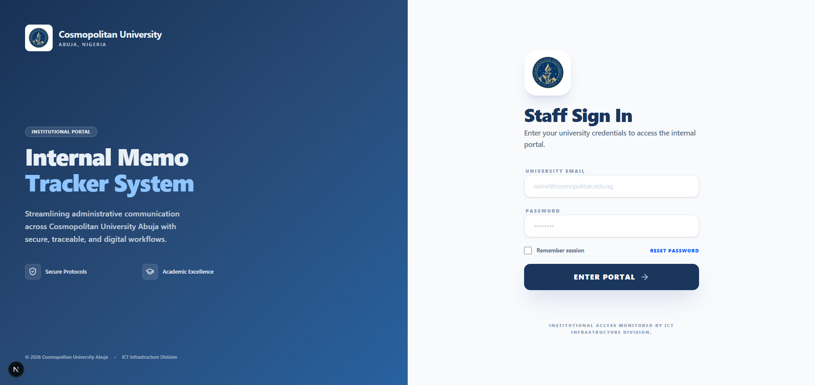
COSMOPOLITAN UNIVERSITY ABUJA
STEP 1: PLATFORM ACCESS & LOGIN
STEP 1 OF 12
1
Authentication & Role Access
1. Access Credentials
Enter your official University staff email address and security password on the login portal.
2. Role Authorization
Permissions (HOD, Dean, Director of Finance, Vice-Chancellor) are automatically assigned based on your account.
PRO TIP / OPERATIONAL NOTE
Always ensure you log out when using shared workstations to preserve privacy.

Slide 4
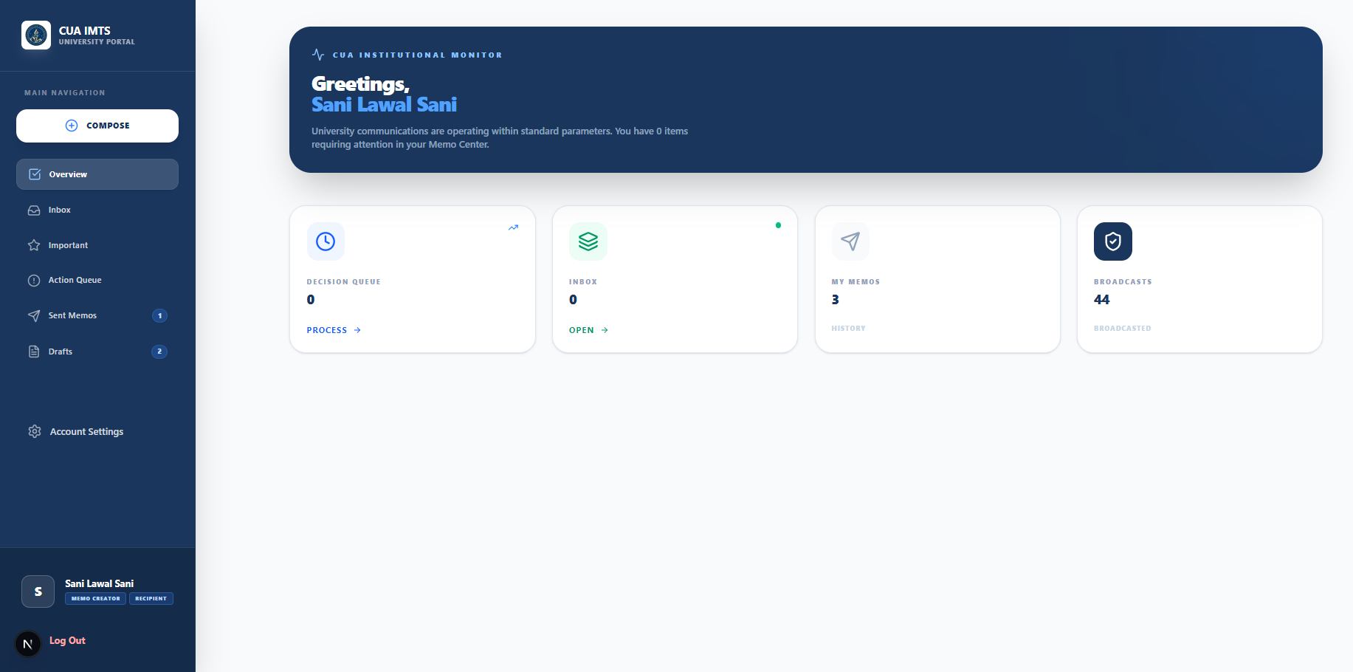
COSMOPOLITAN UNIVERSITY ABUJA
STEP 2: DASHBOARD NAVIGATION
STEP 2 OF 12
2
Workspace Folders & Navigation
1. Action Needed / Inbox
Displays incoming memos routed to your desk for review, endorsement, or approval.
2. Role Authorization
Contains memos initiated by you that are active in recipient approval pipelines.
3. Drafts Folder
Stores unsubmitted memos saved for future editing before routing.
PRO TIP / OPERATIONAL NOTE
Click the badge numbers next to Inbox to see urgent items requiring your review.

Slide 5
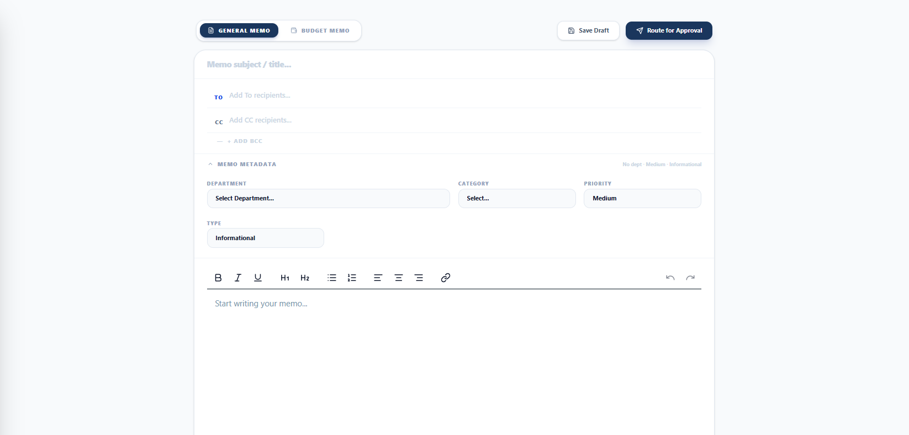
COSMOPOLITAN UNIVERSITY ABUJA
STEP 3: INITIATING A NEW MEMO
STEP 3 OF 12
3
Subject Title & Department Selection
1. + New Memo Button
Click the "+ New Memo" button on the sidebar to launch the compose editor.
2. Subject Title
Type a clear, uppercase subject line (e.g. REQUISITION FOR LAB EQUIPMENT).
3. Department & Category
Select your originating department and academic/administrative category.
PRO TIP / OPERATIONAL NOTE
Subject titles should be concise and clearly define the memo purpose for reviewing officers.

Slide 6
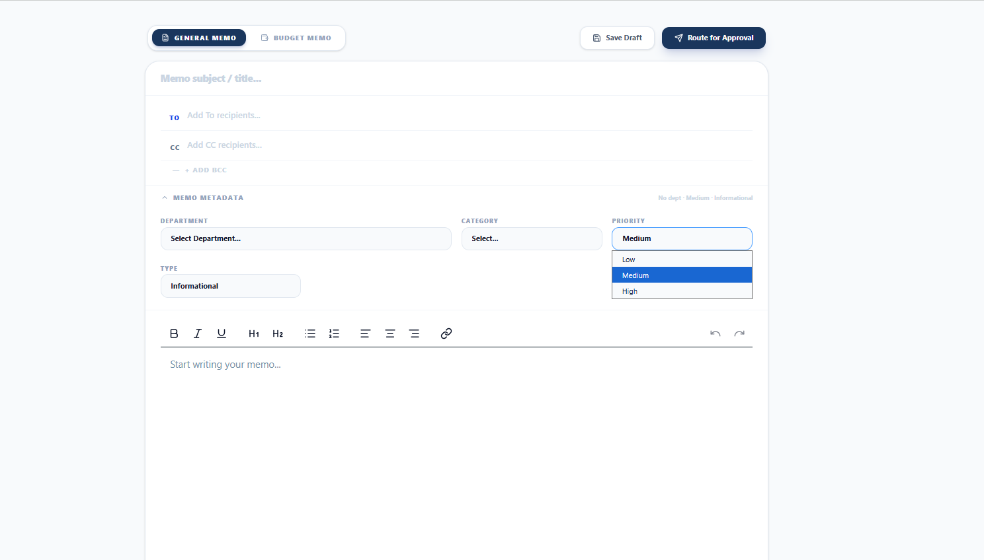
COSMOPOLITAN UNIVERSITY ABUJA
STEP 4: PRIORITY & EXPIRY DATES
STEP 4 OF 12
4
Setting Urgency & Expiration Flags
1. Priority Levels
Select priority level (Low, Medium, High, Urgent) to signal turnaround urgency.
2. Optional Expiry Date
Set an explicit expiry date for time-sensitive requests requiring fast action.
PRO TIP / OPERATIONAL NOTE
High and Urgent memos display bright priority badges on reviewer dashboards.

Slide 7
COSMOPOLITAN UNIVERSITY ABUJA
STEP 5: RECIPIENT ROUTING SETUP
STEP 5 OF 12
5
Configuring Approval Officers (To, CC, BCC)
1. TO (Primary Approvers)
Select officers responsible for reviewing, endorsing, or approving the memo.
2. CC (Informational Copies)
Add officers who must remain informed without requiring direct approval.
3. BCC (Confidential Copy)
Add confidential oversight officers when necessary.
PRO TIP / OPERATIONAL NOTE
Ensure primary approving officers (HOD/Dean) are selected under TO in correct order.

Slide 8
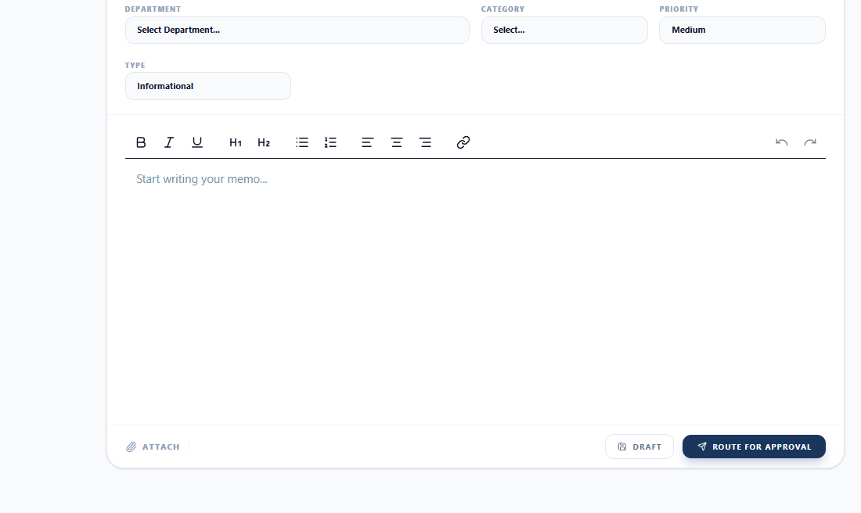
COSMOPOLITAN UNIVERSITY ABUJA
STEP 6: RICH TEXT & ATTACHMENTS
STEP 6 OF 12
6
Formatting Body Text & Supporting Docs
1. Rich Text Formatting
Use bolding, bullet points, numbered lists, and headers to structure text.
2. Supporting Attachments
Click "Attach" on the bottom toolbar to upload proforma invoices or PDF documents.
PRO TIP / OPERATIONAL NOTE
Attach all external vendor quotes or proposals as supporting PDF files.

Slide 9
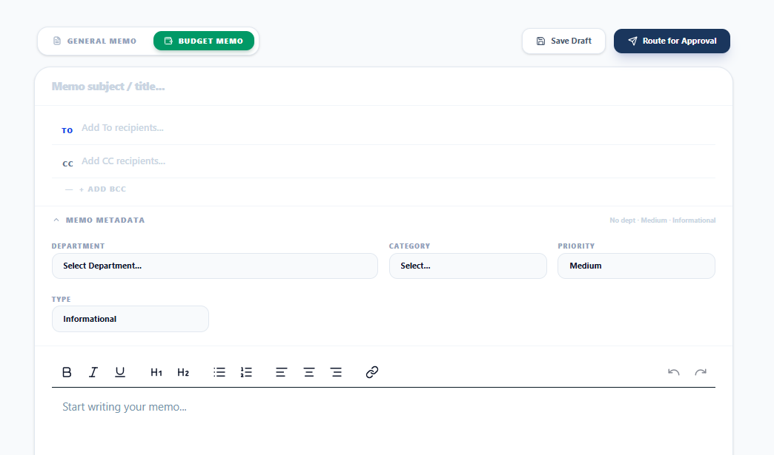
COSMOPOLITAN UNIVERSITY ABUJA
STEP 7: FINANCIAL REQUISITION SETUP
STEP 7 OF 12
7
Activating the Budget Requisition Toggle
1. Financial Memo Toggle
Swith to "Budget Memo" if your memo requests University funds.
2. Requisition Details Card
Appears instantly, summarizing expense items and total calculated budget.
PRO TIP / OPERATIONAL NOTE
Only activate budget requisitions for memos that involve institutional expenses.

Slide 10
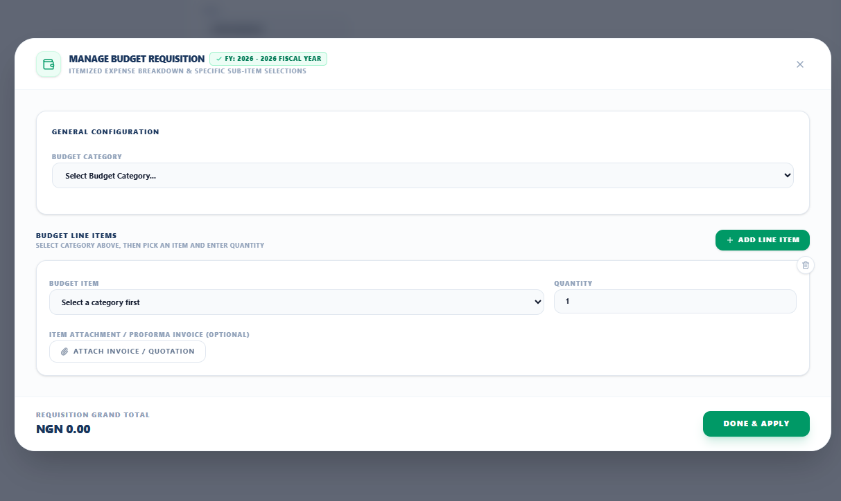
COSMOPOLITAN UNIVERSITY ABUJA
STEP 8: 3-TIER BUDGET SELECTION
STEP 8 OF 12
8
Category → Item Class → Sub-Item Selection
1. Tier 1: Category
Select main expenditure class (e.g. Advertising, Office Supplies, IT).
2. Tier 2: Item Group
Select specific group class (e.g. Equipment Purchase, Computer Hardware).
3. Tier 3: Specific Sub-Item
Choose precise sub-item (e.g. Laptop, DSLR Camera, Sound System).
PRO TIP / OPERATIONAL NOTE
Specific sub-items guarantee accurate accounting rather than general estimations.

Slide 11
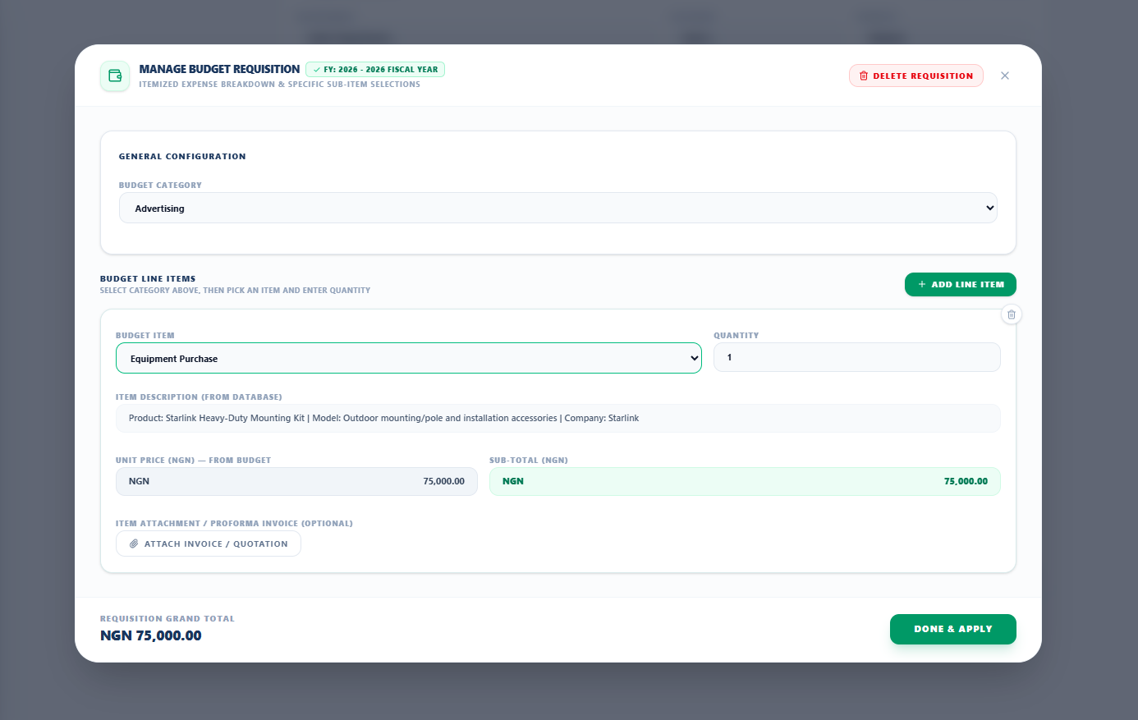
COSMOPOLITAN UNIVERSITY ABUJA
STEP 9: DATABASE AUTO-POPULATION
STEP 9 OF 12
9
Auto-Retrieval of Description & Pricing
1. Pre-Stored Description
Selecting an item automatically fetches its detailed specification from the database.
2. Quantity & Unit Price
System populates standard unit price and calculates line-item subtotal instantly.
PRO TIP / OPERATIONAL NOTE
You can adjust quantities or unit prices if special proforma quotes apply.

Slide 12
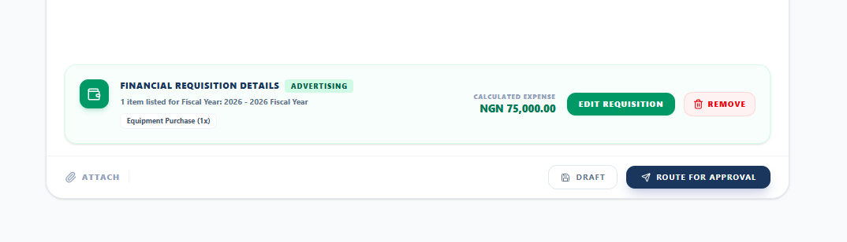
COSMOPOLITAN UNIVERSITY ABUJA
STEP 10: REQUISITION REMOVAL RULES
STEP 10 OF 12
10
Dynamic Remove & Delete Buttons
1. Clean UX on New Memos
When starting a fresh memo, removal buttons stay hidden for clarity.
2. Detaching Added Requisitions
Once items exist, clicking "Remove" detaches the requisition without page refresh.
PRO TIP / OPERATIONAL NOTE
Detaching a requisition resets budget fields cleanly back to default.

Slide 13
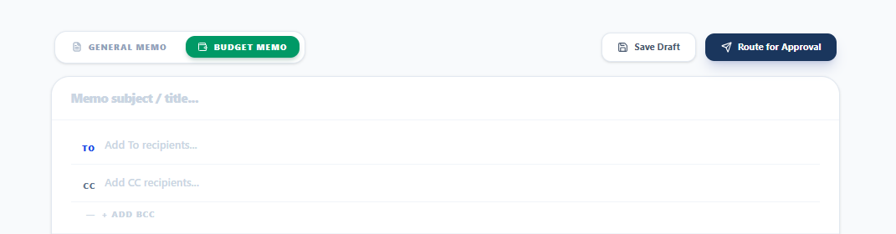
COSMOPOLITAN UNIVERSITY ABUJA
STEP 11: ROUTING FOR APPROVAL
STEP 11 OF 12
11
Submitting Memos into Approval Pipeline
1. Save Draft
Saves your work privately. No recipient notifications are sent out.
2. Route for Approval
Locks document and dispatches it directly to recipient review queues.
PRO TIP / OPERATIONAL NOTE
Both top and bottom submit buttons are explicitly labeled "Route for Approval".
Cosmopolitan University Abuja • Official Systems Operational Guide

Slide 14
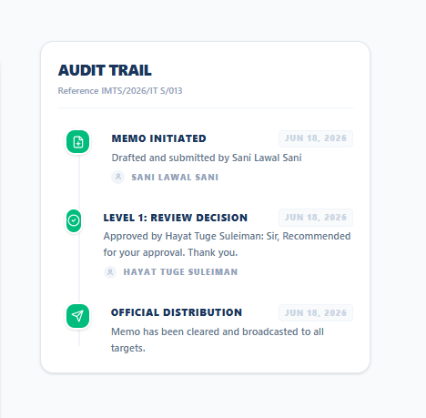
COSMOPOLITAN UNIVERSITY ABUJA
STEP 12: TRACKING AUDIT HISTORY
STEP 12 OF 12
12
Live Progress Tracking & Timeline
1. Sent Memos Status
Check live status (Pending Review, Endorsed, Approved, Rejected) in Sent folder.
2. Complete Audit Trail
Records timestamped officer comments, signatures, and approval actions.
PRO TIP / OPERATIONAL NOTE
Fully approved memos are archived automatically and available for Bursary disbursement.

Slide 15
THANK YOU
CUA MEMOTRACKER SYSTEM OPERATIONAL GUIDE
NEED TECHNICAL OR ADMINISTRATIVE ASSISTANCE?
Contact system administrators
IT SERVICE DEPARTMENT:
Email: hayat.suleiman@cosmopolitan.edu.ng
Cosmopolitan University Abuja • "To The Summit"

