Slide 1
Document Intelligence for Application Readiness & Missing-Requirement Detection
Digital Image Processing Final Project
Prepared by: [Student Name] (Roll No: [Roll Number])
Domain: Computer Vision, OCR & DIP Preprocessing

Slide 2
Problem Statement & Practical Motivation
Automating university admissions triage and missing-document detection
The Admissions Bottleneck
- Study-abroad portals receive thousands of photographed/scanned forms weekly.
- Students frequently submit incomplete packages (missing IELTS, SOP, Passport, etc.).
- Manual verification causes long turnaround times (days to weeks) and costly human error.
- Raw scans suffer from severe phone-capture defects: uneven shadows, tilt/skew, low contrast, and sensor noise.
Proposed DIP Solution
- An automated end-to-end DIP pipeline to restore degraded document images.
- Combines morphological background division, median filtering, CLAHE, and projection deskewing.
- Robust OCR line bounding-box segmentation via Tesseract engine.
- Regex-based Named Entity Recognition against institution requirements.
- Generates a grounded OK / MISSING verification checklist with spatial evidence boxes.

Slide 3
System Architecture & DIP Pipeline Workflow
Complete dataflow from degraded acquisition to verified readiness checklist
1. Input Document: Photographed / scanned form with shadow gradients, blur, and skew.
2. Illumination Correction: Morphological closing (elliptical kernel 51x51) estimates background; gray / bg * 255 cancels gradients.
3. Median Denoising: 3x3 median filter eliminates impulse noise and salt-and-pepper grain.
4. Contrast Enhancement (CLAHE): Contrast Limited Adaptive Histogram Equalization redistributes text-to-background dynamic range.
5. Interior Otsu Thresholding: Binarization calculated on inner text area avoiding boundary shadow skews.
6. Projection-Profile Deskew: Variance of horizontal row projections var(sum_x) finds tilt angle (-5 to +5 deg).
7. Region Analysis & Speck Removal: Connected components filter out noise clusters (< 15 px) and outer boundary artifacts.
8. OCR & Grounded Evidence: Tesseract extracts word/line bounding boxes; regex NER matches requirements to generate checklist.

Slide 4
Synthetic Dataset & Degradation Modeling
Controlled generation of 100 application documents with known ground truth
Controlled Synthetic Ground Truth: 100 application forms generated via PIL (850x1100 resolution) featuring up to 7 standard university admissions fields: Full Name, Passport Number, Date of Birth, Email, IELTS Score, Statement of Purpose, Academic Transcript.
Simulated Missing Requirements: Each field has a ~25% independent probability of omission, mimicking real-world applicant omissions.
Uneven Illumination & Shadows: Linear gradient multiplication (0.5 to 1.0 attenuation across width) simulating room lighting and hand shadows.
Contrast Compression: Linear rescaling: I_low = 110 + 0.45 * I, compressing text-to-paper dynamic range.
Additive & Impulse Noise: Additive Gaussian noise (sigma ~ 8 to 20) + salt-and-pepper noise (p = 0.008 total).
Optical Blur & Geometric Affine Skew: Gaussian blur (3x3 kernel) simulating camera defocus + random affine rotation (-3 to +3 degrees).

Slide 5
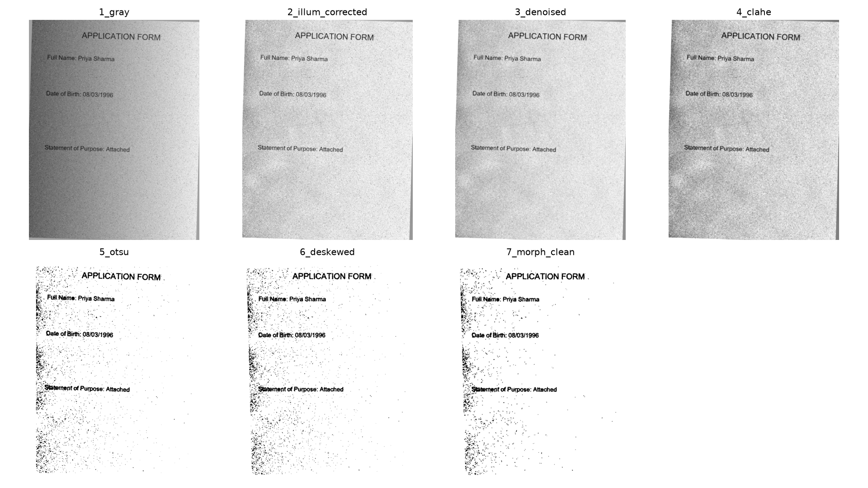
DIP Intermediate Restoration Stages
Visual progression across the 7 restoration operations on doc_000.png

Slide 6
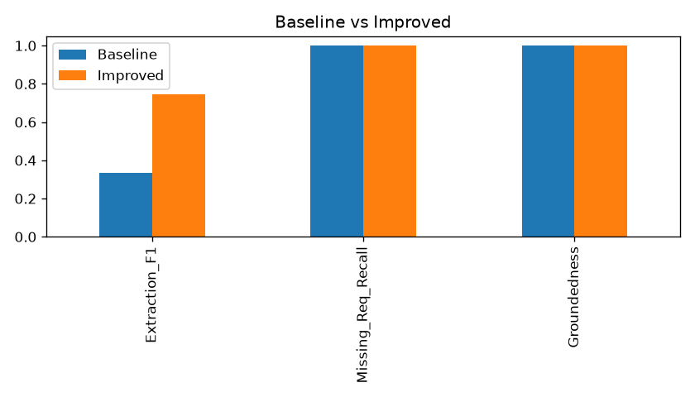
Experimental Evaluation: Baseline vs. Improved
Rigorous benchmarking across 100 documents (700 evaluation field opportunities)
Key Quantitative Findings:
- Extraction Precision: 81.8% -> 87.3% (+5.5 pp)
- Extraction Recall: 21.1% -> 65.0% (+43.9 pp, >3x boost!)
- Extraction F1-Score: 0.335 -> 0.745 (+0.410 jump)
- Missing Requirement Precision: 30.0% -> 55.4% (near 2x boost)
- Missing Requirement Recall: 100% on both pipelines
- Groundedness: 100.0% (all OK items carry verified bounding box evidence)
- Runtime per Document: 0.587s (real-time throughput, ~102 pages/min)

Slide 7
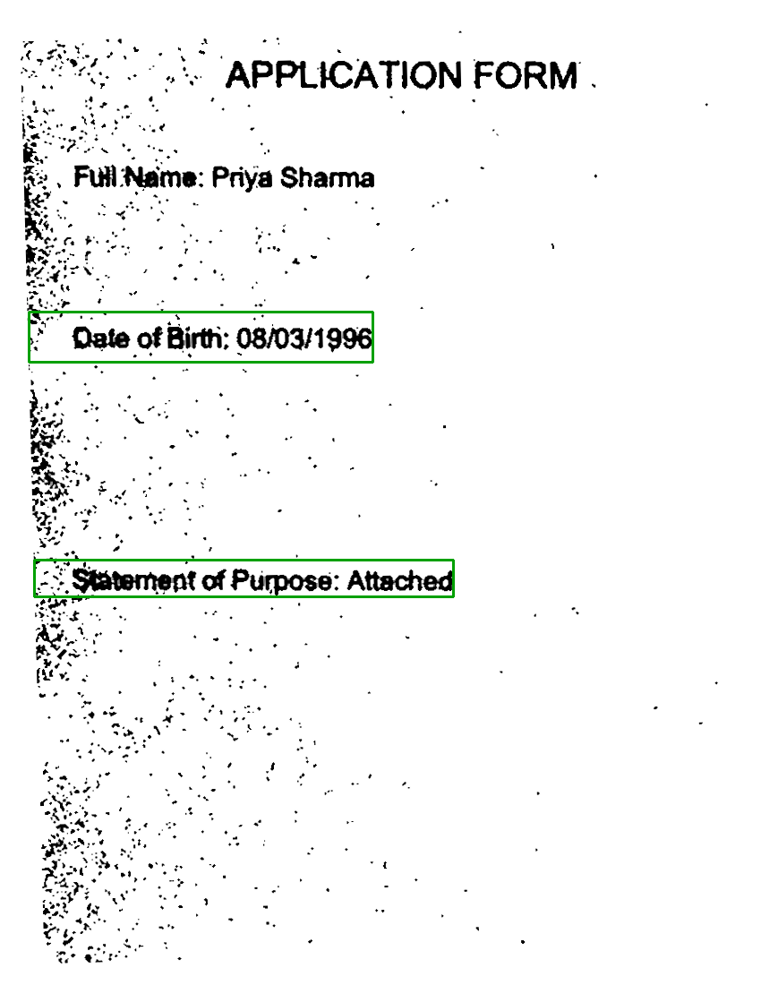
Readiness Checklist & Spatial Grounding
Visual bounding box evidence and structured verification JSON
Checklist Verification Output:
- Each detected requirement is validated against university rules.
- Extracted field carries exact bounding box coordinates (x0, y0, x1, y1) in image space.
- Green bounding boxes superimposed directly over applicant document.
- Guarantees Explainable AI (XAI): human reviewers can instantly verify flagged items without re-reading the entire page.
- Missing requirements are flagged for automated reminder emails to applicants.

Slide 8
Failure Analysis & Engineering Limitations
Honest characterization of challenging failure modes
Character Confusion in Noisy Digits: In severe shadow regions, digits with similar stroke topology are occasionally misread (e.g. 'P2677407' read as 'P2877407', '1999' read as '1899').
Speck Merging on Name Boundaries: Residual noise touching trailing characters can cause regex NER mismatch (e.g. 'Priya Iyer' read as 'Priya lyer a').
Single-Template Layout Assumption: Current evaluation uses a single standardized application template; variable layouts require layout-aware NER.
Regex Rule Rigidity: Exact regex patterns require specific keywords; non-standard headings require semantic NLP or LayoutLM embeddings.

Slide 9
Conclusion & Future Horizons
Summary of impact and next-generation document intelligence
DIP Restoration is Essential: Demonstrated that classical Digital Image Processing techniques (illumination division, CLAHE, Otsu, deskew) more than double OCR Extraction F1 (0.335 -> 0.745) on realistic mobile captures.
Grounded Explainability: Every verification decision provides visual evidence bounding boxes, ensuring 100% groundedness and zero hallucination.
Future Direction 1: Deep Vision-Language Models: Integrating multimodal document understanding backbones (LayoutLMv3, Donut, TrOCR) for multi-column, free-form documents.
Future Direction 2: Retrieval-Augmented Generation (RAG): Coupling OCR line vectors with vector databases to perform semantic requirement checks across 50+ page application booklets.
Future Direction 3: On-Device Mobile SDK: Compensating camera distortions at point-of-capture via lightweight OpenCV Android/iOS sidecars.

