Slide 1

Modelling and Control of an Unbalanced Disk
Group 17

Slide 2



Content:
System dynamics modelling using ANN and GP
Policy learning for swing-up control
Extension to reference tracking

Slide 3
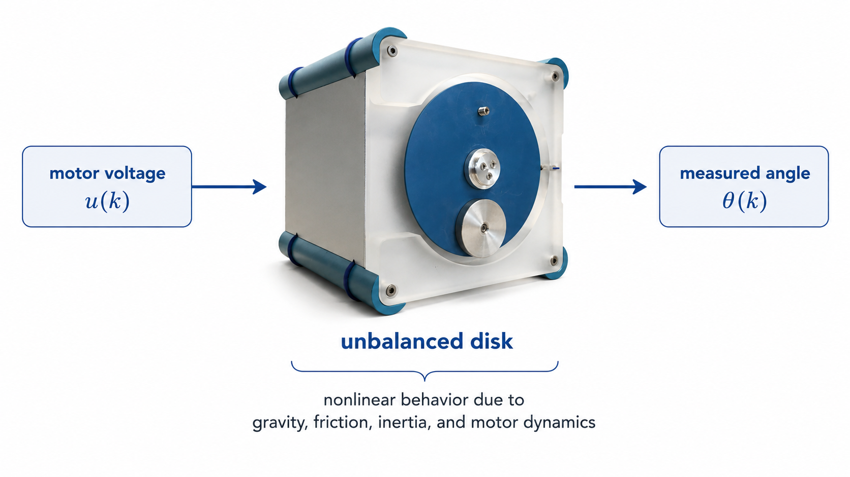
Problem Setup

Slide 4
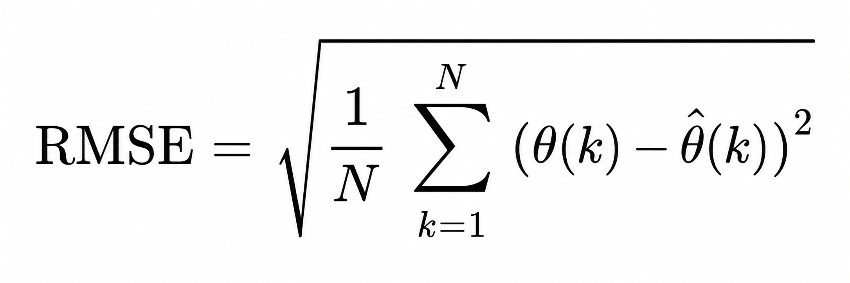
Prediction vs Simulation
Prediction:
one-step-ahead angle prediction
uses measured past angles
Simulation:
full trajectory prediction
feeds back the model's own previous outputs
harder because errors can accumulate

Slide 5

System dynamics modelling using ANN and GP

Slide 6
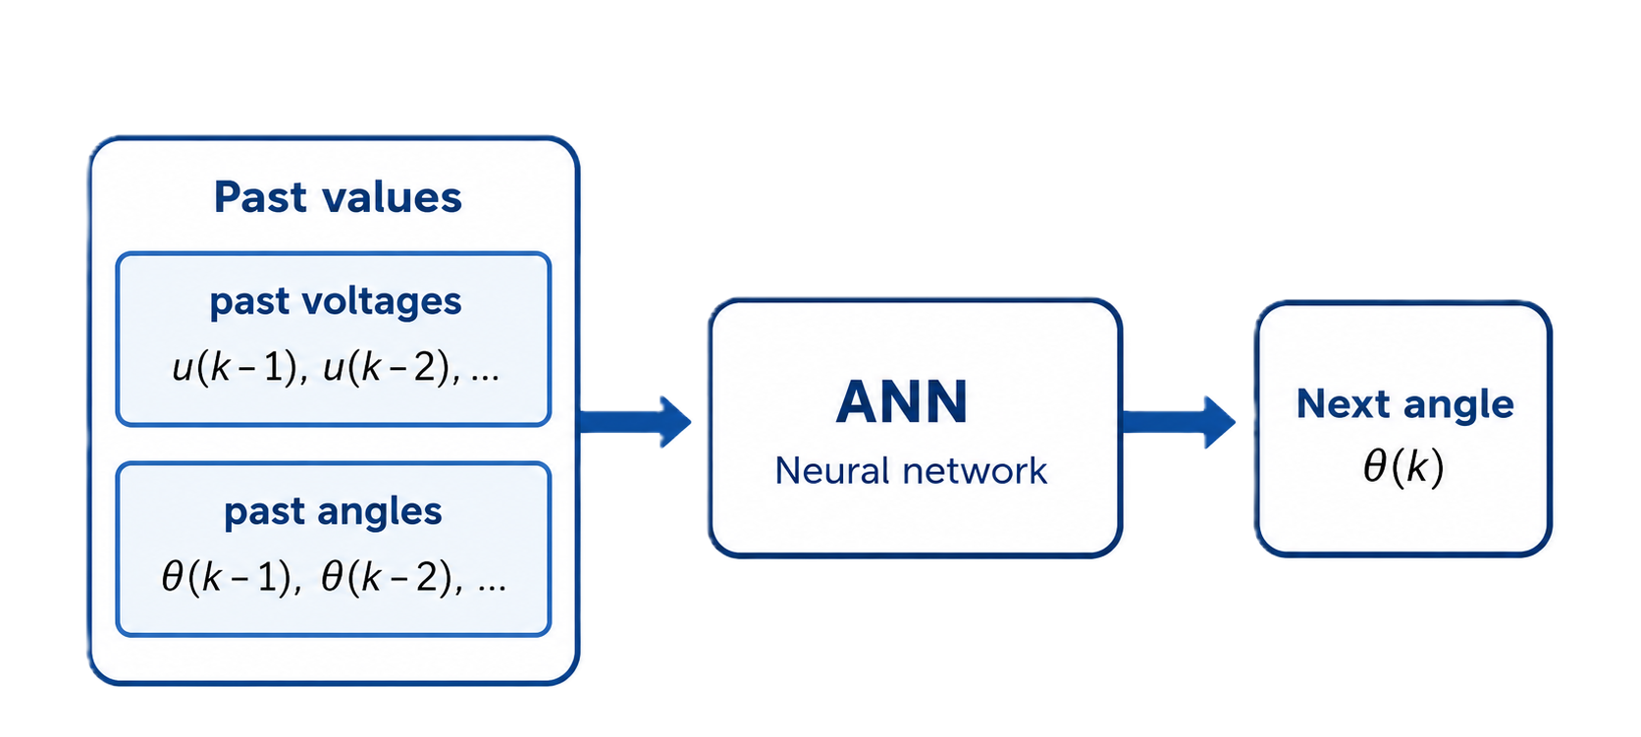
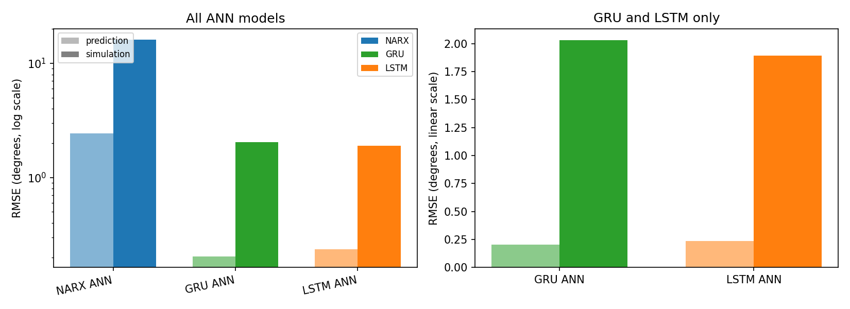




ANN
Prediction and Simulation Results
Models Tested
Simple model:
NARX feedforward ANN
uses past voltages and angles
old $u$ values + old $θ$ values -> next $θ$
Advanced models:
GRU recurrent ANN
LSTM recurrent ANN
use ordered sequences of voltage and angle
Why GRU and LSTM?
Both RNNs:
- they process time sequences
- useful because disk motion depends on previous angles and voltages
GRU:
- simpler recurrent model
- fewer gates
- easier/faster to train
LSTM:
- more detailed memory mechanism
- can keep information over longer sequences
- may be more stable in simulation

Slide 7
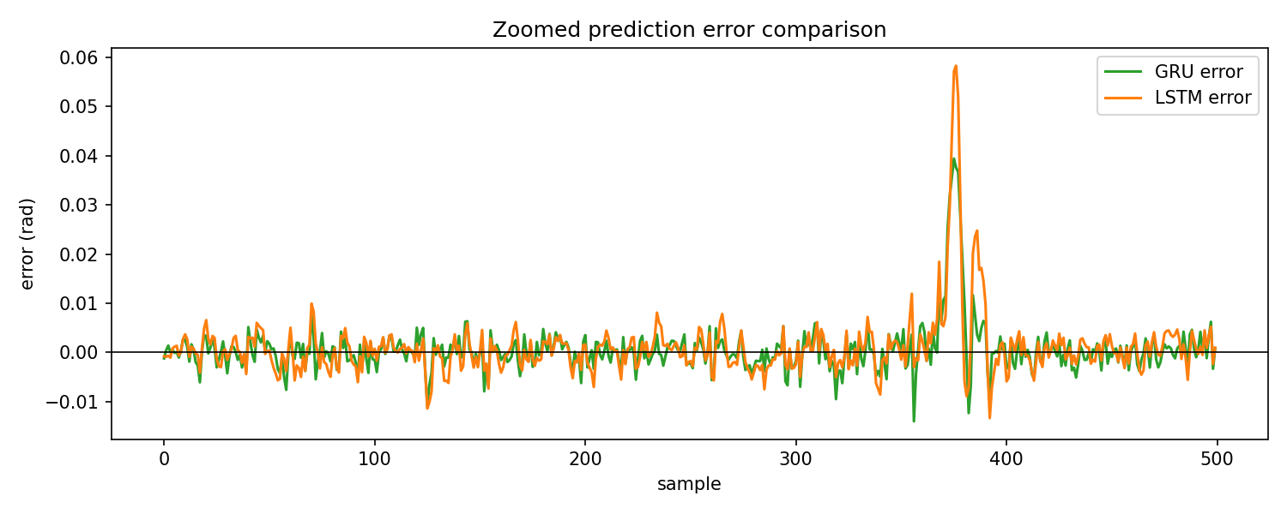
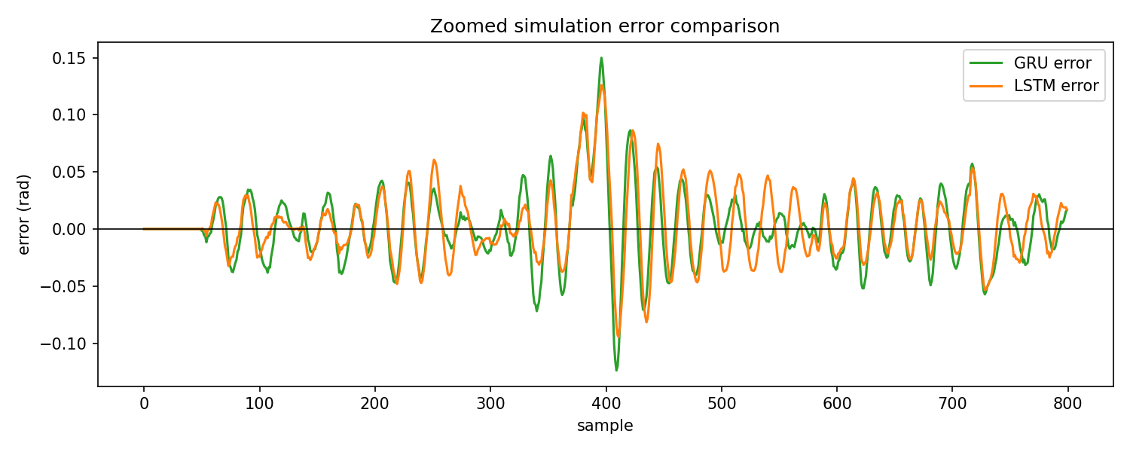

ANN
Prediction and Simulation Results
Models Tested
Simple model:
NARX feedforward ANN
uses past voltages and angles
old $u$ values + old $θ$ values -> next $θ$
Advanced models:
GRU recurrent ANN
LSTM recurrent ANN
use ordered sequences of voltage and angle
Why GRU and LSTM?
Both RNNs:
- they process time sequences
- useful because disk motion depends on previous angles and voltages
GRU:
- simpler recurrent model
- fewer gates
- easier/faster to train
LSTM:
- more detailed memory mechanism
- can keep information over longer sequences
- may be more stable in simulation

Slide 8
ANN
Prediction and Simulation Results

Slide 9
GP

Slide 10
KPIs driving success
Growth rate
Profit margins
We’ve achieved a 22.9% revenue increase over the past fiscal year, exceeding projections. This growth has exceeded our projections and is a testament to our effective strategies and operational efficiency.
As a result of our sustained operational efficiency, we have sustained a 20% profitability rate. By focusing on profit margins, we have been able to remain profitable while also driving growth.

Slide 11
projected revenue growth in the next 12 months
25%

Slide 12
Forecasting for the future →

Slide 13

Financial growth & objectives
Short-term goals
Our immediate focus is on cost control and operational efficiency to maximize cash flow. Long-term growth
For our long-term growth, we are committed to expanding into new markets while maintaining financial stability. Risk mitigation
To safeguard our business against potential risks, we will develop strategies to hedge against economic downturns and market volatility.

Slide 14


Budget allocation
By focusing our financial resources on high-impact areas like technology and talent acquisition, we aim to drive innovation and enhance our competitive edge.

Slide 15
Quote
Smart financial decisions today drive lasting success for the future.

Slide 16
Budget allocation & growth forecast
Category | Budget allocation | Projected growth | ROI expectation
R&D investment | $75M | +20% annually | High
Marketing | $50M | +15% annually | Moderate
Operations | $40M | +5% annually | Stable
Tech upgrades | $30M | +25% annually | High
Market expansion | $80M | +30% annually | High
Cash reserves | $25M | N/A | Essential

Slide 17
Andrew Carnegie
“The first one gets the oyster, the second gets the shell.”

Slide 18
Strategies for sustainable growth
High-return opportunities
Targeted investments support long-term expansion. By focusing on high-return opportunities, we can maximize our growth potential and achieve sustainable success. Technology integration
Leveraging AI and automation to drive financial efficiency. By integrating advanced technologies into our operations, we can streamline processes, reduce costs, and enhance productivity.
Market expansion
Entering new territories to maximize profitability. Expanding into new markets allows us to diversify our revenue streams and reduce our reliance on existing markets. Risk management
We implement strategies to hedge against financial uncertainties. By proactively managing risks, we can safeguard our business against potential threats and ensure long-term stability.

Slide 19
Moving forward with confidence
Financial stability
We remain committed to strong financial management.
Strategic investments
Our next steps focus on long-term value creation.
Sustained growth
We’re positioned for scalable expansion in the coming years.

Slide 20

Thank you

