Slide 1
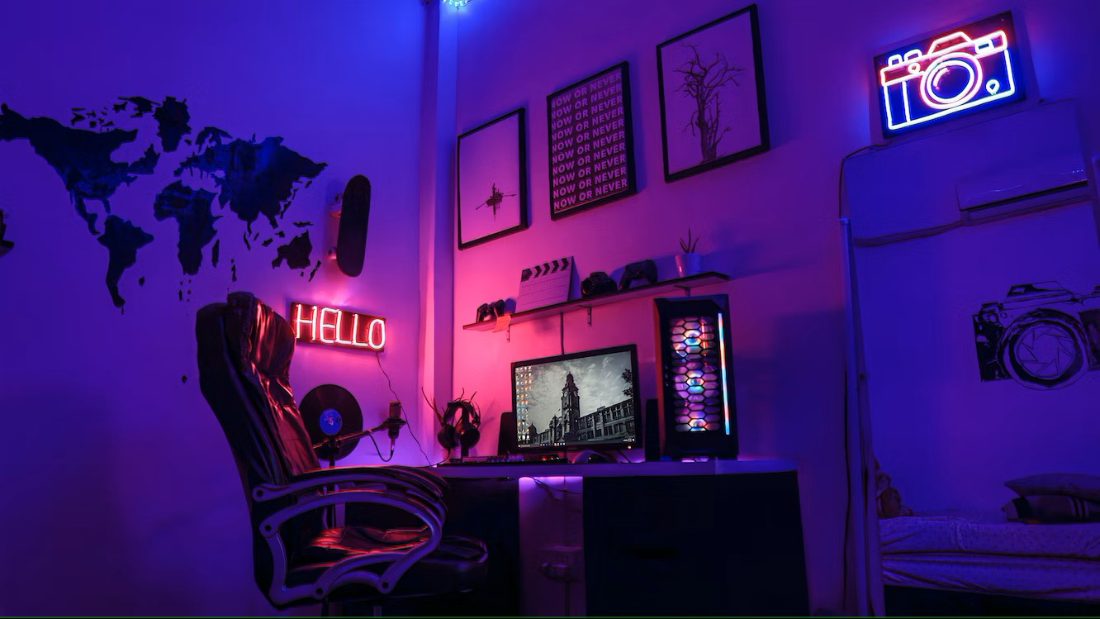
Gamerlytics
A project by nOObs
Huntley Bodden – Github manager and API calls
Nicoleta Cosereanu – Data analytics and researcher
Yi Lu – Statistics and research
Devin Sherwood – Hypothesis testing
Notes:
Nico

Slide 2

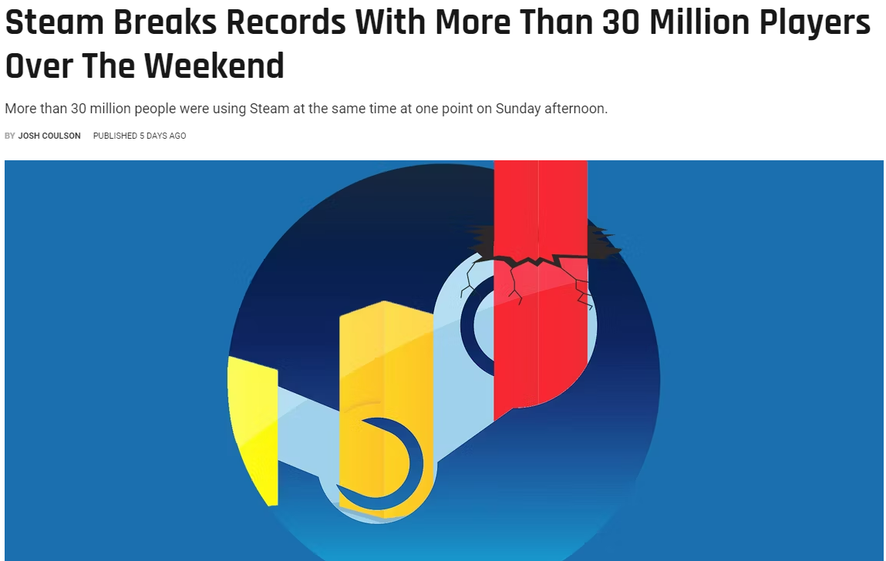
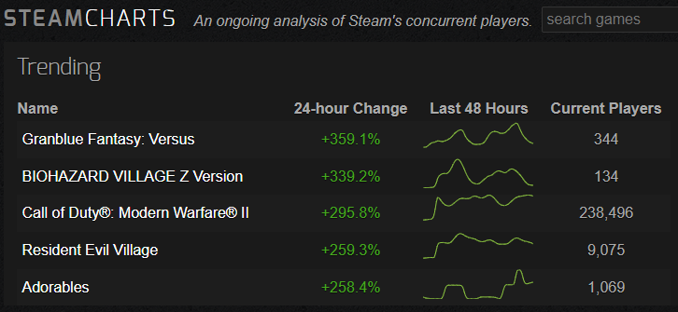
Project Outline
Analyze data from the popular gaming platform, Steam, to understand how key influencers such as price, ratings and playtime are driving both gamer behavior and game popularity.
Notes:
Nico

Slide 3



Data collection, investigation and cleansing
Data was retrieved via API calls from various Steam sources and combined
Steamspy.com/api was used to retrieve game info: ID, game name, developer, publisher, positive & negative ratings, owners, price info, concurrent users and game time averages [returned 24,735 records]
Api.steampowerd.com was used to retrieve current player count by game id [returned 21,119 records]
After analyzing the retrieved data, we identified the key influencers we wanted to analyze in our project, such as price, players, concurrent players, average game time and ratings
We assigned data types and created a csv file for our analysis
Notes:
Huntley

Slide 4
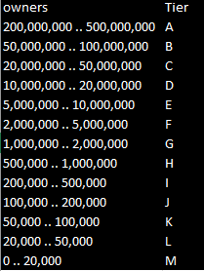
Definitions and context
Owner Tiers: A(most) to M(least)
Rating: Calculated using positive and negative ratings as follows:
If positive ratings are higher than negative, % positive of total shown as positive value
If negative ratings are higher than positive, % negative of total shown as negative value
Players: number of current registered users for each game
Concurrent users: number of people playing a game at the same time
Notes:
Nico

Slide 5

Research topics summary
Hypothesis Question
Correlations and trends:
Price and number of players
Ratings and price
Players and average game time
Players and positive rating
Publisher comparisons
Identify top game publishers with most potential growth in the short-run
Notes:
Devin

Slide 6
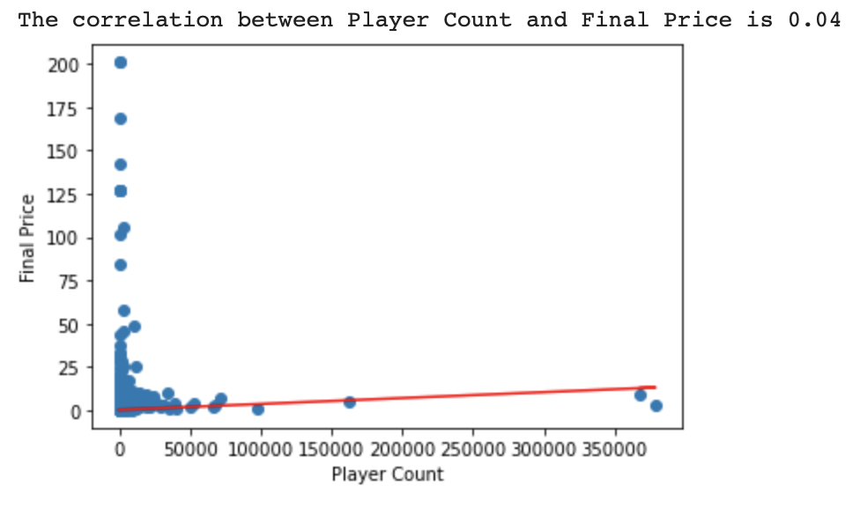
Hypothesis Is price a factor in game popularity?
HA: [Price] is NOT a factor in [game popularity] R$-pc=0
H0 : Price is a factor R$-pc != 0
Null Hypothesis: Our Null Hypothesis suggests the price of the game is a factor in game popularity
Alternative Hypothesis: Our Alternative Hypothesis suggests price of a game is NOT a factor in game popularity
Notes:
Devin

Slide 7
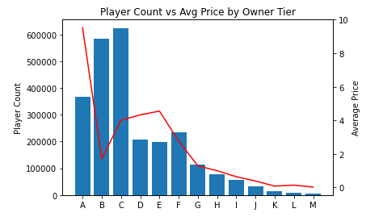
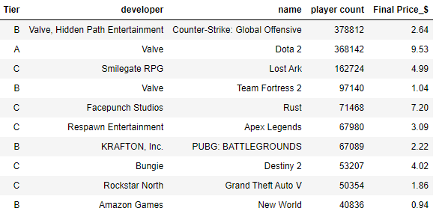
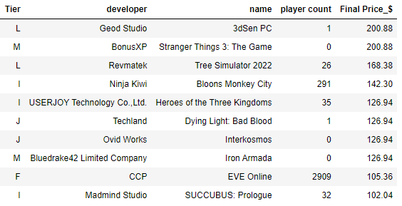
Price How expensive are the top 10 games?
With a correlation factor of 0.04, it is not surprising that the most expensive games (Owner Tier A) have more players than free games.
Top 10 games by player count
Top 10 games by price
Notes:
Nico

Slide 8
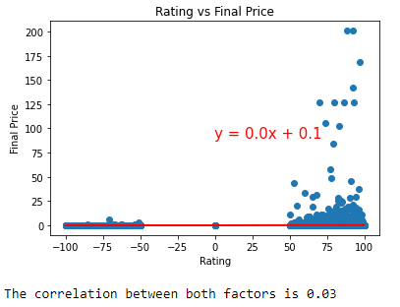
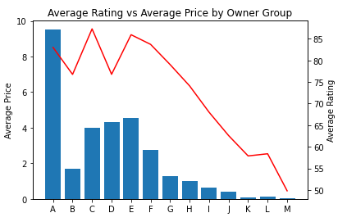
Ratings Are gamers more inclined to rate a game higher if they pay more for it?
By analyzing the rating and price we concluded that price is not an important factor in a game’s rating. The correlation factor between price and rating is 0.03
Owner Tier A has the highest price, yet not the highest rating
Notes:
Nico

Slide 9
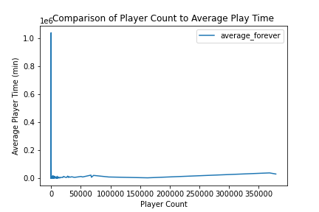
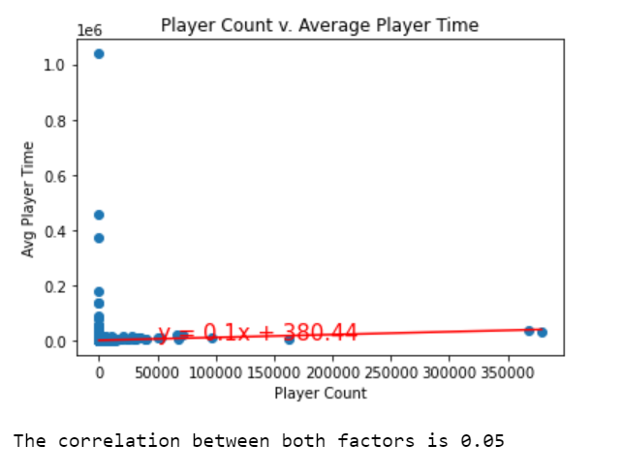
Comparison of Player Count to Avg Player Time Do games with most players have the most play time?
By analyzing player count and average player time we found that having the most registered players does not result in having the highest player time. The correlation factor between player count and average player time is .05

Slide 10
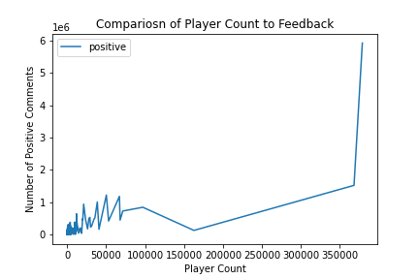
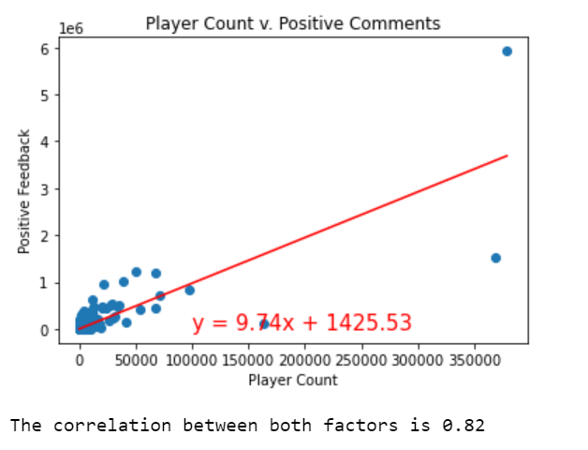
Comparison of Player Count to Player Feed Back Do positive comments attract more players?
There is a positive correlation between player count and player feedback

Slide 11
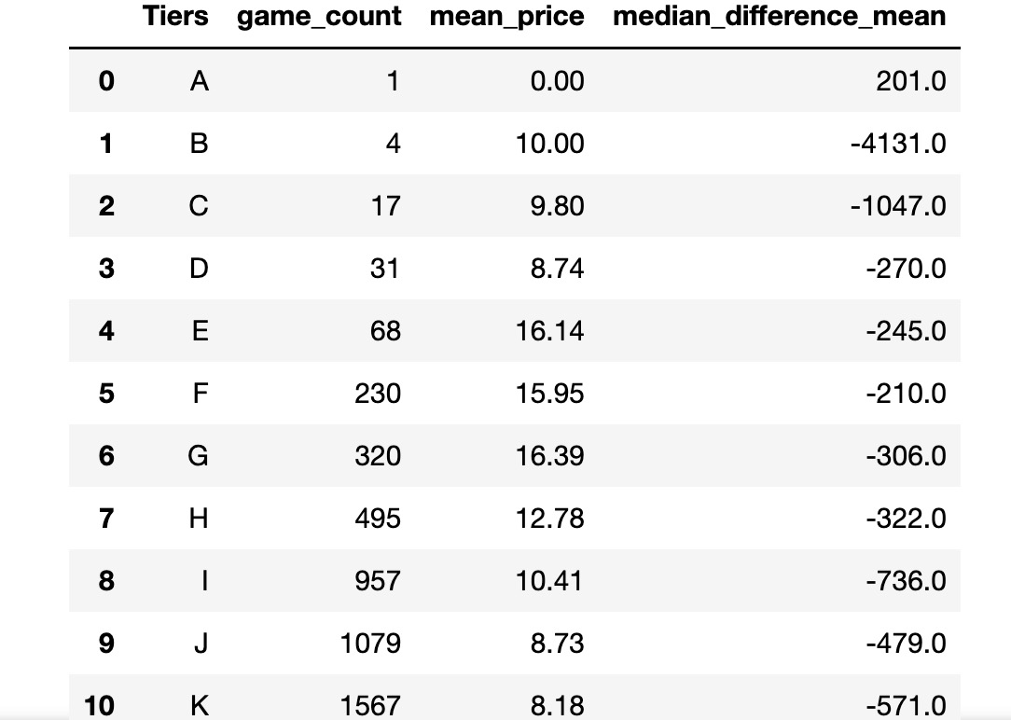
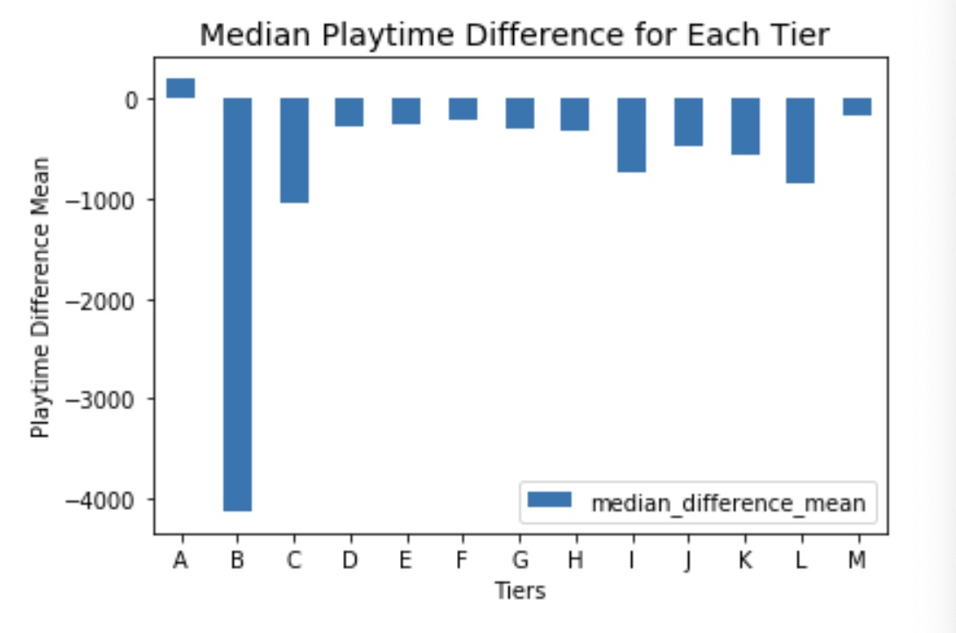
Gamer Engagement Analysis How engaged are players in the past 2 weeks?
There is no strong relationship between player count and median playtime difference
There are 1% of the gamers increased median playtime in past two weeks
Notes:
Yi

Slide 12

Conclusion and recap
Gamers do not choose a game based on price
Gamers do not equate the quality of a game with the price they pay for it
A game with many users is not always the most played game
Positive comments for a game attract players
99% of the gamers are losing interest over time
Notes:
Nico

