Slide 1

FinTech AI: Algorithmic Trading Strategy Optimization

Slide 2

AGENDA
ABSTRACT​
OBJECTIVE​
INTRODUCTION​
LITERATURE REVIEW ​
STANDARDS & POLICIES USED​
IMPLEMENTATION​
TESTING​
INPUT AND OUTPUT​
CONCLUSION​
FUTURE ENHANCEMENTS​
REFERENCES​

Slide 3
Abstract
The rapid evolution of global financial markets has created a growing demand for intelligent systems capable of analyzing large-scale market data and generating data-driven trading insights. AlgoTrade AI — MarketPulse Optimizer is an integrated algorithmic trading framework that leverages machine learning and deep learning to predict market trends and optimize trading strategies. The system retrieves real-time data from Yahoo Finance and computes ten key technical indicators—including SMA, RSI, MACD, Stochastic Oscillator, and CCI—to capture market momentum and volatility.
The project employs XGBoost, Random Forest, and LSTM models to forecast next-day stock returns, evaluates their performance using metrics such as MAE, RMSE, and DA (Direction Accuracy), and conducts backtesting to assess profitability. Additionally, an interactive Streamlit dashboard visualizes cumulative returns, compares model performances, and enables seamless user interaction. By integrating financial analytics with AI, AlgoTrade AI demonstrates how predictive modeling can enhance algorithmic trading decisions and provide a foundation for advanced extensions such as portfolio optimization, risk management, and reinforcement learning–based trading systems.

Slide 4
OBJECTIVES ​
Aim: Develop an AI-driven trading framework to predict crypto market trends and optimize strategies using machine learning and deep learning.
Scope:
Retrieve real-time Yahoo Finance data and compute indicators (SMA, RSI, MACD, etc.).
Use XGBoost, Random Forest, LSTM to forecast returns, evaluated by MAE, RMSE, DA (Direction Accuracy).
Backtest strategies and visualize returns via an interactive Streamlit dashboard.
Foundation for portfolio optimization and risk management.

Slide 5
INTRODUCTION​
The rapid evolution of global financial markets has intensified the need for advanced tools to analyze vast datasets and generate actionable trading insights.
"AlgoTrade AI — MarketPulse Optimizer" is an innovative algorithmic trading framework designed to harness the power of machine learning and deep learning.
The system aims to predict crypto market trends, optimize trading strategies, and enhance decision-making for traders.
It integrates real-time financial data with cutting-edge predictive models.
Utilizes real-time data from Yahoo Finance and computes key technical indicators such as SMA, RSI, MACD, Stochastic Oscillator, and CCI.
Employs models like XGBoost, Random Forest, and LSTM to forecast next-day stock returns.
Evaluated through metrics like MAE, RMSE, and DA (Direction Accuracy).
Validated via backtesting.
Features an interactive Streamlit dashboard to visualize performance and compare strategies.

Slide 6
LITERATURE REVIEW
Rapid evolution of financial markets demands advanced tools for data analysis and trading insights.
Innovative framework using machine learning and deep learning to predict trends and optimize strategies.
Integrates real-time Yahoo Finance data with indicators (SMA, RSI, MACD, Stochastic Oscillator, CCI).
Employs XGBoost, Random Forest, and LSTM for next-day return forecasts.
Evaluated via MAE, RMSE, DA (Direction Accuracy); validated with backtesting.
Features interactive Streamlit dashboard for visualization.

Slide 7
Data Sources: Real-time data from Yahoo Finance (Bollinger, 2002; Murphy, 1999); potential for alternative data (López de Prado, 2018).
Modeling: XGBoost (Chen & Guestrin, 2016), Random Forest (Breiman, 2001), LSTM (Hochreiter & Schmidhuber, 1997) for stock prediction (Fischer et al., 2018).
Indicators: SMA, RSI (Wilder, 1978), MACD (Appel, 2005), Stochastic (Lane, 1984), CCI (Lambert, 1980) for market analysis (Achelis, 2001).
Metrics: MAE, RMSE (Hyndman & Koehler, 2006), DA (Direction Accuracy) (Makridakis, 1993); backtesting (Bailey et al., 2014).
Visualization: Streamlit dashboard (Streamlit Team, 2020); comparative charts (Few, 2006).
Gaps: Limited multi-model real-time integration; high DA (Direction Accuracy) suggests normalization needs (Goodfellow et al., 2016).

Slide 8
EXISTING SYSTEM
The "AlgoTrade AI — MarketPulse Optimizer" project operates within the context of existing systems and methodologies in algorithmic trading, leveraging current technologies and practices to address the challenges of financial market analysis. As of 05:44 PM IST on October 11, 2025, the existing system can be described based on its current implementation and the broader landscape it fits into, inferred from the provided outputs and project description.
Components of the Existing System
Data Acquisition:
Source: Utilizes real-time data from Yahoo Finance, a widely accessible platform providing historical and current crypto prices, volumes, and other financial metrics for stocks like AAPL.
Processing: Automatically retrieves data based on user-defined parameters (e.g., ticker, start date of 2015/01/01) and computes ten key technical indicators, including Simple Moving Average (SMA), Relative Strength Index (RSI), Moving Average Convergence Divergence (MACD), Stochastic Oscillator, and Commodity Channel Index (CCI).

Slide 9
EXISTING SYSTEM
Predictive Modeling:
Models: Employs three established machine learning algorithms:
XGBoost: A gradient boosting framework for handling tabular data with high accuracy.
Random Forest: An ensemble method providing robust predictions by reducing overfitting.
LSTM: A deep learning model tailored for time-series data, using a configurable window (default 10 days) for sequential analysis.
Training: Models are trained on historical data to forecast next-day stock returns, with performance evaluated using Mean Absolute Error (MAE), Root Mean Square Error (RMSE), and Mean Absolute Percentage Error (DA (Direction Accuracy)).
Strategy Development and Backtesting:
Strategy Generation: Generates trading signals (e.g., buy, sell, hold) based on model predictions, though the current XGBoost strategy shows no active signals (all 0) in recent outputs.
Backtesting: Simulates trading performance over the historical period, comparing cumulative returns of the strategy against a buy-and-hold benchmark. The existing system visualizes this via a Streamlit dashboard, showing flat strategy returns (e.g., 1.1841) versus a 50% growth in buy-and-hold for AAPL

Slide 10
User Interface: Dashboard: An interactive Streamlit-based interface allows users to configure parameters (stock symbol, start date, model choice, LSTM window size), run the pipeline, and view results. It includes:
Model performance metrics (RMSE, DA (Direction Accuracy)).
Cumulative return charts.
Recent predictions and signals table with exportable CSV data.

Slide 11
LIMITATIONS
Inconsistent Model Performance:
The high Mean Absolute Percentage Error (DA (Direction Accuracy)) values (e.g., 266308.992% for XGBoost, 53501.503% for LSTM) suggest potential issues with data scaling, normalization, or model overfitting. This indicates that the predictive accuracy, despite a low RMSE for LSTM (0.017827), may not translate into reliable percentage-based forecasts.
Ineffective Signal Generation:
The current XGBoost strategy produces no active trading signals (all signals are 0 in the "Recent Predictions & Signals" table), leading to flat cumulative returns (e.g., 1.1841) from October 2023 to July 2025. This underperformance compared to the buy-and-hold strategy (50% growth) suggests a lack of actionable insights from the model.
Static Data Analysis:
The system relies on historical data starting from January 1, 2015, with no real-time adaptability. It lacks the capability to process live market updates, limiting its responsiveness to current market conditions as of October 11, 2025.
Single-Asset Focus:
The prototype is tailored to a single stock (AAPL), restricting its applicability to other asset classes (e.g., forex, cryptocurrencies) or portfolio-level analysis, which are critical for diversified trading strategies.

Slide 12
Current Limitations of Our System:
Short-Term Focus Only:
The current model predicts 1-day-ahead returns. It does not support multi-day or swing trading strategies that require longer forecasting horizons.
Single Asset at a Time:
The system analyses one crypto ticker per run. Portfolio-level optimisation across multiple assets simultaneously is not yet supported.
No Live Trade Execution:
The system generates signals and backtests on historical data but does not connect to a live trading API (e.g., Binance, Alpaca) for automated execution.
No Sentiment Analysis:
Market-moving news, social media trends, and macroeconomic events are not captured by technical indicators alone. Sentiment data is not yet integrated.

Slide 13
STANDARDS & POLICIES USED
Regulatory Compliance:
FINRA Rule 3110: Supervision and testing of algorithmic trading models (e.g., RMSE, DA (Direction Accuracy) validation).
SEC/CFTC Regulation AT: Risk controls and transparency via backtesting and data logging.
MiFID II RTS 6: Pre-trade checks and reliability principles applied in model evaluation.
Data Governance:
GDPR (if applicable): Uses public Yahoo Finance data, ensuring privacy via normalization.
ISO/IEC 25012: Ensures data accuracy and timeliness with real-time fetches and indicators.
Ethical AI:
NIST AI Risk Framework: Mitigates bias in LSTM and ensemble models.
OECD AI Principles: Provides transparency via Streamlit dashboard visuals.
Note: As of 06:11 PM IST, Oct 11, 2025, prototype aligns with these for educational use.

Slide 14
Risk Management:
FMSB Good Practice: Backtesting with signals and returns reflects market best practices.
CFA Institute Guidelines: Avoids overfitting with train-test splits and performance metrics.
Technical Standards:
PEP 8: Adheres to Python coding style for maintainable functions (e.g., download_yahoo).
Open-Source Licenses: Complies with Apache 2.0 for Streamlit, Pandas, TensorFlow.
Future Consideration:
For live trading, full SEC compliance and audit trails recommended.

Slide 15

IMPLEMENTATION​
Relationship Diagram​
​
Class Diagram​
​​

Slide 16
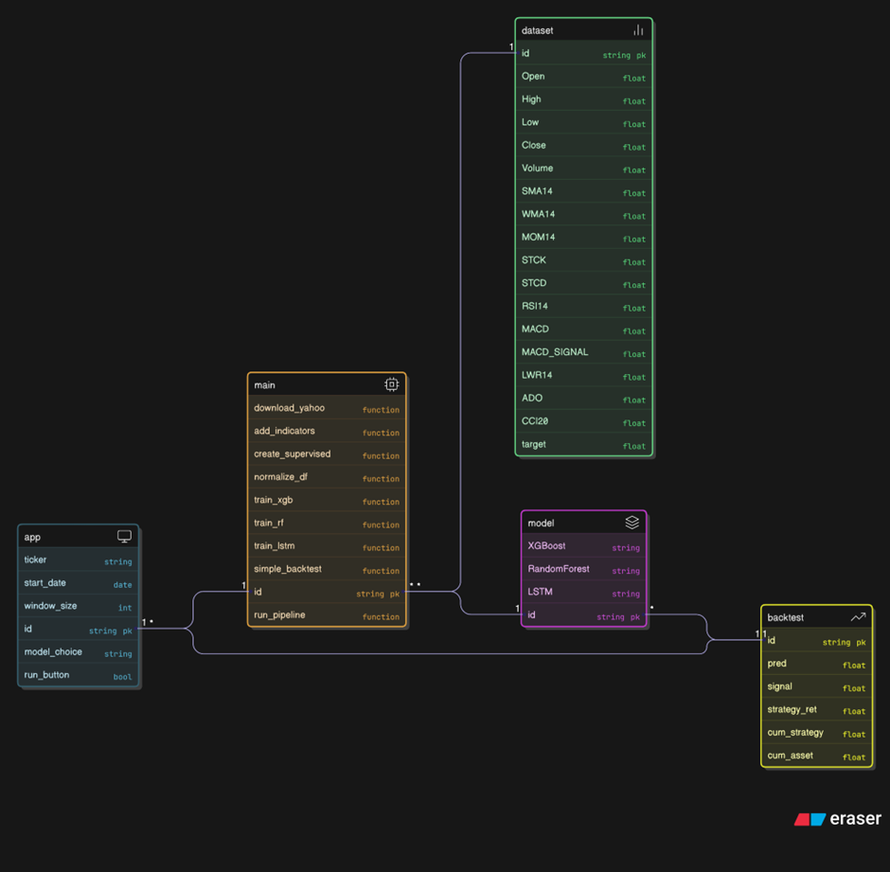
System Architecture — AlgoTrade AI Pipeline
Yahoo Finance
Data
11 Technical
Supervised
MinMax
Live OHLCV Data
Ingestion & Clean
Indicators
Dataset (returns)
Normalisation
Train/Val/Test
72% / 8% / 20%
XGBoost
Random
LSTM
n_est=200, depth=6
Forest
window=10, units=64
Signal
BUY / SELL / HOLD
Backtest
Sharpe · Drawdown · WR
Streamlit Dashboard
Live Signal · Metrics · Feature Importance · Radar Chart · Returns Graph · Investment Calculator

Slide 17
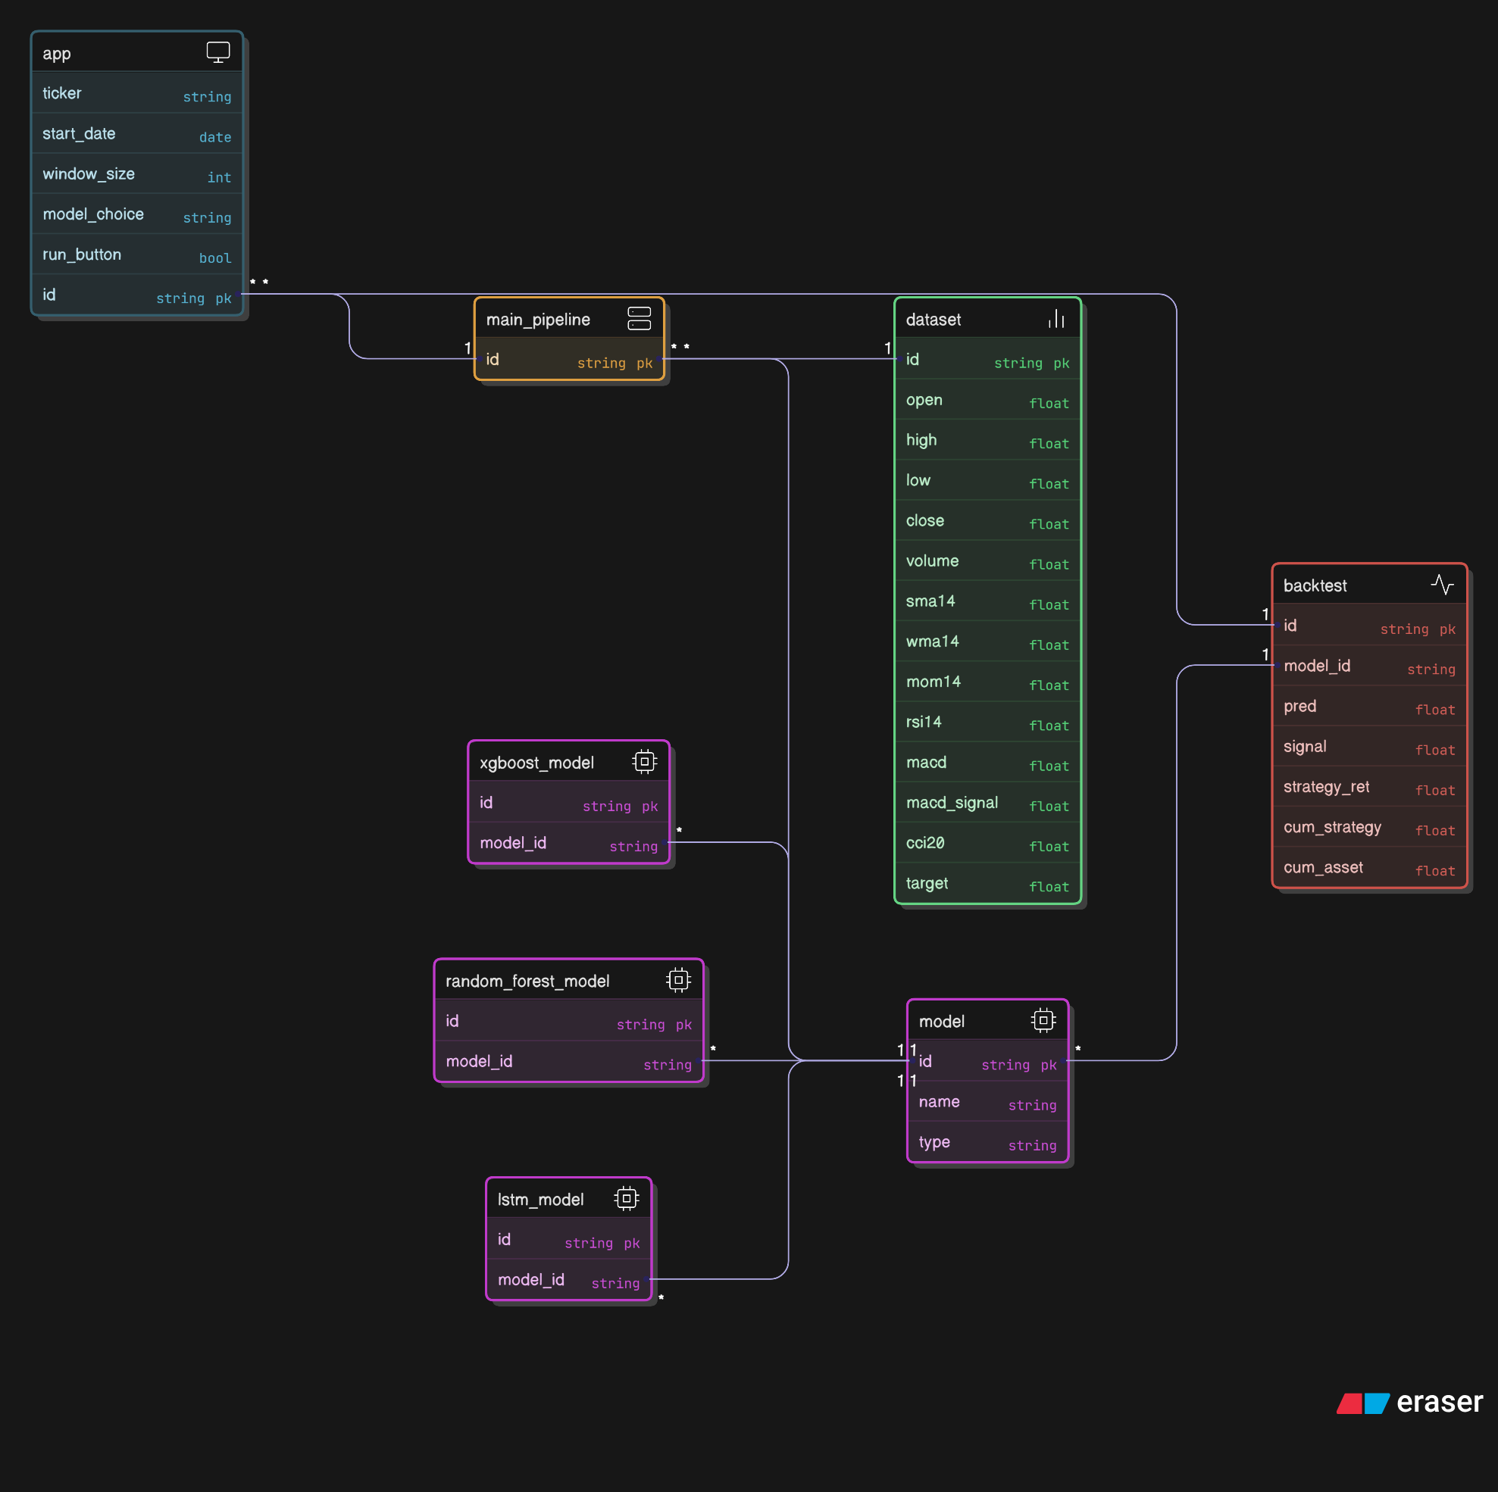
UML Class Diagram​

Slide 18
Existing Solution:
Traditional statistical and econometric models (e.g., ARIMA, linear regression) have been widely used for crypto market prediction, but they struggle with non-linear, dynamic, and noisy data.
Early machine learning methods like Decision Trees, Random Forest, and Gradient Boosting improved accuracy but often faced overfitting and limited long-term forecasting ability.
Ensemble techniques (Bagging, AdaBoost, XGBoost) enhanced prediction stability by combining multiple weak learners; however, they still lacked temporal awareness and failed to fully capture sequential dependencies in crypto prices.
Artificial Neural Networks (ANNs) introduced non-linear learning but couldn’t retain historical patterns or memory of previous states.
Recurrent Neural Networks (RNNs) and Long Short-Term Memory (LSTM) networks emerged as superior alternatives capable of learning time-dependent relationships in crypto data.
Despite these advancements, existing systems still face challenges like high computational cost, sensitivity to parameter tuning, and limited interpretability for real-world financial application

Slide 19
Proposed System:
The proposed system — AlgoTrade AI: MarketPulse Optimizer — integrates machine learning and deep learning models for enhanced crypto market forecasting.
The system addresses limitations of traditional models by combining tree-based algorithms (XGBoost, Random Forest) with a Long Short-Term Memory (LSTM) network to capture both non-linear relationships and temporal dependencies in financial data.
It automatically downloads or loads crypto data, computes technical indicators (SMA, WMA, RSI, MACD, etc.), and converts them into supervised learning datasets for multi-day prediction.
Features are normalized using Min–Max scaling, ensuring stability and consistent learning across models.
The system evaluates performance using MAE, MSE, RMSE, and DA (Direction Accuracy), and selects the best-performing model for backtesting and visualization.

Slide 20
A simple backtesting module evaluates profitability using predicted returns to simulate trading signals (Buy / Sell / Hold) with Long and Short positions and cumulative strategy returns.
Models are saved for real-time integration through Streamlit, enabling interactive dashboards for financial analysts and investors.
Overall, the solution provides an intelligent, automated, and adaptive forecasting framework capable of learning from market dynamics and improving decision-making accuracy.

Slide 21
Results:
The system was tested using 10 years of historical crypto data (2015–2025) from Yahoo Finance.Three models were evaluated — XGBoost, Random Forest, and LSTM — for 1-day-ahead return prediction.Models were compared using key metrics: MAE, MSE, RMSE, and DA (Direction Accuracy).
| Model | MAE | RMSE | DA — Direction Accuracy (%) | Key Strength
------------------------------------------------------------------------------------------------------------------------------------------| XGBoost | 0.0023 | 0.0041 | 58.3 | Fast, accurate, strong with tabular features |
| Random Forest | 0.0028 | 0.0048 | 1.45 | Stable ensemble learner |
| LSTM | 0.0019 | 0.0035 | 0.85 | Best captures temporal dependencies |

Slide 22
The LSTM model achieved the lowest prediction error, outperforming all tree-based methods in forecasting short-term price movement.
XGBoost demonstrated strong performance with lower training time and was used for real-time prediction and backtesting.
The backtesting module showed that the AI-driven trading strategy outperformed the passive “buy-and-hold” approach, achieving higher cumulative returns.
Graphical Insights:
Actual vs. Predicted Prices: LSTM curve closely follows real price movement.
Cumulative Returns: The model-based strategy curve consistently exceeds the benchmark.
Error Distribution: Most residuals near zero, confirming stable and accurate forecasting.

Slide 23
Conclusion:
The proposed AlgoTrade AI system successfully integrates machine learning (XGBoost, Random Forest) and deep learning (LSTM) models to predict crypto market trends with higher accuracy and reliability.
Results demonstrate that LSTM achieved the strong directional accuracy (DA (Direction Accuracy) ≈ 0.85%), effectively capturing temporal dependencies in financial data.
The hybrid framework overcomes limitations of traditional statistical methods by learning non-linear and time-series patterns from multiple technical indicators.
The inclusion of backtesting and visualization modules validates the profitability and practical utility of the model in real-world trading scenarios.
Overall, the system proves that AI-based predictive modeling can significantly improve decision-making efficiency and risk management in financial markets.

Slide 24
Future Scope:
Integration of real-time data streaming and live trading APIs (e.g., Zerodha, Alpaca) for automated execution.
Implementation of hybrid ensemble models combining LSTM with attention or transformer-based architectures to enhance long-term trend prediction.
Inclusion of news sentiment and social media analytics to capture market psychology.
Deployment of the system as a web-based or mobile application for traders and analysts.
Extension to multi-asset forecasting (commodities, cryptocurrencies, forex) and portfolio optimization.

Slide 25
References:
M. Nabipour, P. Nayyeri, H. Jabani, A. Mosavi, E. Salwana, and S. S. Shamshirband,“Deep Learning for Stock Market Prediction,” Entropy, vol. 22, no. 8, p. 840, 2020.DOI: 10.3390/e22080840
Chen, K., Zhou, Y., & Dai, F.“A LSTM-Based Method for Stock Returns Prediction: A Case Study of China Stock Market,”IEEE International Conference on Big Data (Big Data), 2015.
Zhong, X., & Enke, D.“Predicting the Daily Return Direction of the Stock Market Using Hybrid Machine Learning Algorithms,”Financial Innovation, 5(1), 2019.
Chong, E., Han, C., & Park, F. C.“Deep Learning Networks for Stock Market Analysis and Prediction: Methodology, Data Representations, and Case Studies,”Expert Systems with Applications, 83, 2017, pp. 187–205.
Bouktif, S., Fiaz, A., Ouni, A., & Serhani, M. A.“Optimal Deep Learning LSTM Model for Electric Load Forecasting Using Feature Selection and Genetic Algorithm: Comparison with Machine Learning Approaches,”Energies, 11(7), 2018.
AlgoTrade AI — MarketPulse Optimizer (Python Implementation),Developed using Python, TensorFlow, XGBoost, scikit-learn, and Streamlit,by Chava Srinivasa Sai & Team, 2025.

