Slide 1

Vinland Farms A one stop web application for all your farming needs.

Slide 2
Problem Statement
Design a user-friendly and efficient web application that provides a platform for dealers and farmers
Provide a platform for farmers to list all their crops
This application allowing dealers to make a good choice when it comes to spending hard-earned money
This application will help establish a bond between dealers and farmers alike

Slide 3
Mircroservices involved w
FarmerService -> 5001
DealerService -> 5002
AdminService -> 5003
EmailService -> 5004
TransactionService ->5005
SecurityService ->5006
PaymentSercive -> 5007
FarmLand Registry ->8761
API gateWay ->4865

Slide 4
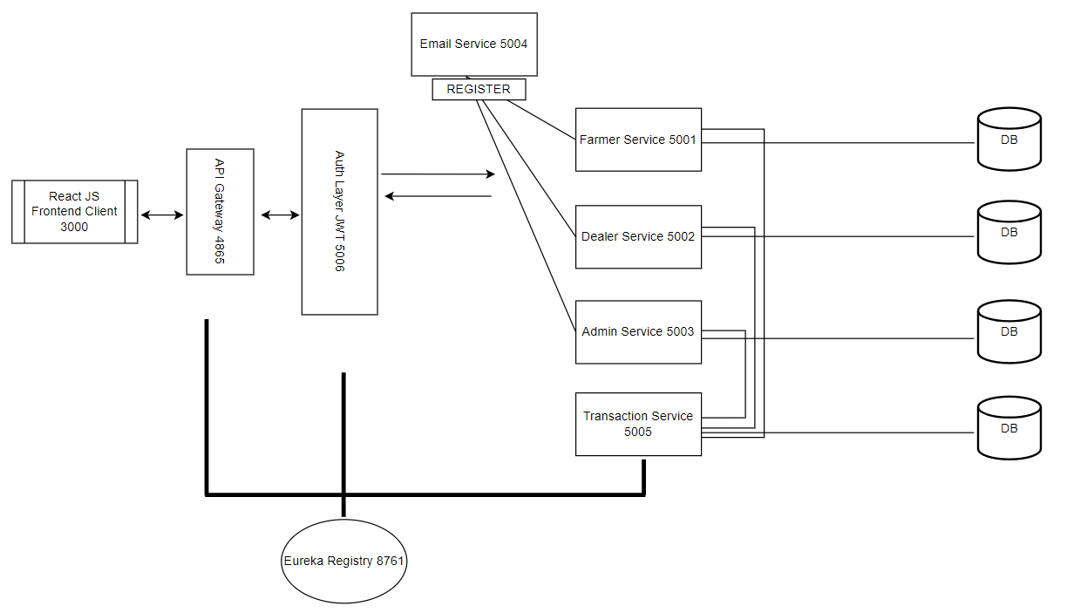
Microservice Architecture

Slide 5









Technologies used
And Many More…

Slide 6
Features
Robust Security Implementation using JWT, encoded credentials and secured payments using razor pay
Highly interactable ease to use UI with responsiveness
Email Alerts for all notifications
Secure way to change password using OTP facilities
Many more features like popup notifications , Wishlist , receipt generation etc

Slide 7
Conclusion
There is a web application for providing a platform for farmers and dealers alike to trade
Transparent trade with multiple features for all roles
With its user-friendly interface and efficient data gathering capabilities, this web application provides a valuable tool for the user.

Slide 8
Thank You

