Slide 1
Cython
Notes:
[toc]
level = 1
title = Cython
# end config

Slide 2
Cython by example
PYTHON
C / C++
def fib(n):
a,b = 1,1
for i in range(n):
a, b = a+b, a
return a
int fib(int n)
{
int tmp, i, a, b;
a = b = 1;
for(i=0; i<n; i++) {
tmp = a; a += b; b = tmp;
}
return a;
}

Slide 3
Cython by example
PYTHON
C / C++
def fib(n):
a,b = 1,1
for i in range(n):
a, b = a+b, a
return a
int fib(int n)
{
int tmp, i, a, b;
a = b = 1;
for(i=0; i<n; i++) {
tmp = a; a += b; b = tmp;
}
return a;
}
CYTHON
def fib(int n):
cdef int i, a, b
a,b = 1,1
for i in range(n):
a, b = a+b, a
return a

Slide 4
Cython by example
PYTHON 1x
C / C++ 70x faster
def fib(n):
a,b = 1,1
for i in range(n):
a, b = a+b, a
return a
int fib(int n)
{
int tmp, i, a, b;
a = b = 1;
for(i=0; i<n; i++) {
tmp = a; a += b; b = tmp;
}
return a;
}
CYTHON 70x faster
def fib(int n):
cdef int i, a, b
a,b = 1,1
for i in range(n):
a, b = a+b, a
return a

Slide 5
For the record...
HAND-WRITTEN EXTENSION MODULE
#include "Python.h"
static PyObject* fib(PyObject *self, PyObject *args)
{
int n, a, b, i, tmp;
if (!PyArg_ParseTuple(args, "i", &n))
return NULL;
a = b = 1;
for (i=0; i<n; i++) {
tmp=a; a+=b; b=tmp;
}
return Py_BuildValue("i", a);
}
static PyMethodDef ExampleMethods[] = {
{"fib", fib, METH_VARARGS, ""},
{NULL, NULL, 0, NULL} /* Sentinel */
};
PyMODINIT_FUNC
initfib(void)
{
(void) Py_InitModule(“fib", ExampleMethods);
}

Slide 6
For the record...
HAND-WRITTEN EXTENSION MODULE 40x faster
#include "Python.h"
static PyObject* fib(PyObject *self, PyObject *args)
{
int n, a, b, i, tmp;
if (!PyArg_ParseTuple(args, "i", &n))
return NULL;
a = b = 1;
for (i=0; i<n; i++) {
tmp=a; a+=b; b=tmp;
}
return Py_BuildValue("i", a);
}
static PyMethodDef ExampleMethods[] = {
{"fib", fib, METH_VARARGS, ""},
{NULL, NULL, 0, NULL} /* Sentinel */
};
PyMODINIT_FUNC
initfib(void)
{
(void) Py_InitModule(“fib", ExampleMethods);
}

Slide 7
What is Cython?
Cython is a Python-like language that:
Improves Python’s performance – 1000x speedups not uncommon
wraps external code: C, C++, Fortran, others...
The cython command:
generates an optimized C or C++ source file from a Cython source file,
the C/C++ source is then compiled into a Python extension module.
Other features:
built-in support for NumPy,
integrates with IPython,
Combine C’s performance with Python’s ease of use.
http://www.cython.org/

Slide 8
Cython in the wild
Project | Cython files | KLOC
numpy | 7 | 5
scipy | 17 | 18
pandas | 14 | 22
sympy | 12 | 12 (cythonized python)
scikits-learn | 28 | 9
scikits-image | 38 | 10
sage | 354 | 387
mpi4py | 41 | 10

Slide 9
Speed up Python
GENERATED C
PYTHON
static PyObject *__pyx_pf_5cyfib_cyfib(PyObject *__pyx_self, int __pyx_v_n) {
int __pyx_v_a; int __pyx_v_b;
PyObject *__pyx_r = NULL; PyObject *__pyx_t_5 = NULL;
const char *__pyx_filename = NULL;
...
for (__pyx_t_1=0; __pyx_t_1<__pyx_t_2; __pyx_t_1+=1) {
__pyx_v_i = __pyx_t_1;
__pyx_t_3 = (__pyx_v_a + __pyx_v_b);
__pyx_t_4 = __pyx_v_a;
__pyx_v_a = __pyx_t_3;
__pyx_v_b = __pyx_t_4;
}
...
}
def fib(n):
a,b = 1,1
for i in range(n):
a, b = a+b, a
return a
CYTHON
def fib(int n):
cdef int i, a, b
a,b = 1,1
for i in range(n):
a, b = a+b, a
return a

Slide 10
Wrap C / C++
C / C++
GENERATED WRAPPER
int fact(int n)
{
if (n <= 1)
return 1;
return n * fact(n-1);
}
static PyObject *__pyx_pf_5cyfib_cyfib(PyObject *__pyx_self, int __pyx_v_n) {
int __pyx_v_a; int __pyx_v_b;
PyObject *__pyx_r = NULL; PyObject *__pyx_t_5 = NULL;
const char *__pyx_filename = NULL;
...
for (__pyx_t_1=0; __pyx_t_1<__pyx_t_2; __pyx_t_1+=1) {
__pyx_v_i = __pyx_t_1;
__pyx_t_3 = (__pyx_v_a + __pyx_v_b);
__pyx_t_4 = __pyx_v_a;
__pyx_v_a = __pyx_t_3;
__pyx_v_b = __pyx_t_4;
}
...
}
CYTHON
cdef extern from “fact.h”:
int _fact “fact”(int)
def fact(int n):
return _fact(n)

Slide 11
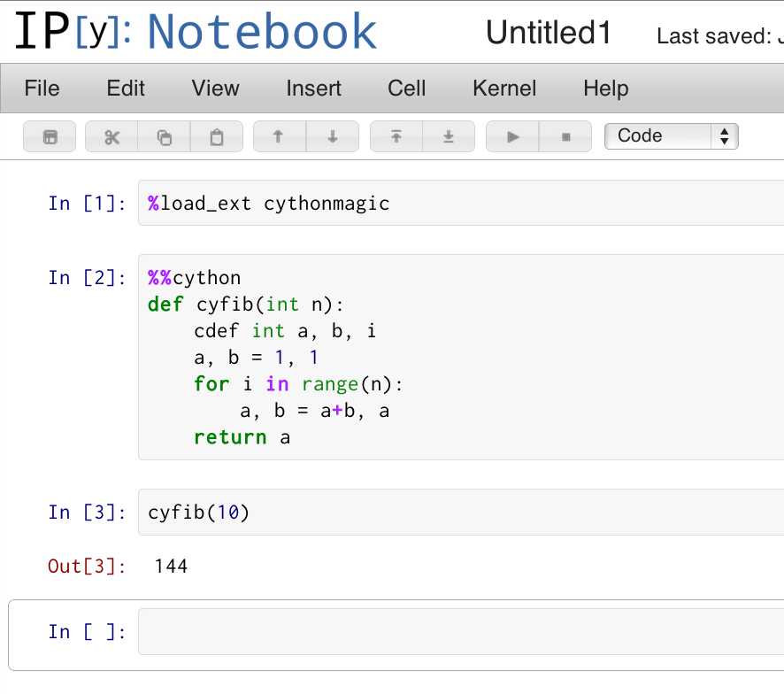
Cython + IPython
IPython provides cython magic commands, the most useful of which is %%cython.
IPYTHON / IPYTHON NOTEBOOK: CYFIB.IPY / CYFIB.IPYNB
In [10]: %load_ext cythonmagic
In [11]: %%cython
....: def cyfib(int n):
....: cdef int a, b, i
....: a, b = 1, 1
....: for i in range(n):
....: a, b = a+b, a
....: return a
....:
In [12]: cyfib(10)
Out[12]: 144

Slide 12
Cython pyx files
cython generates this.
Cython source file
fib.pyx
C Extension File
fib.c
cython
You write this.
compile
Library Files (if wrapping)
Python Extension Module
fib.so
*.h files
*.c files
compile

Slide 13
Compiling with distutils
FIB.PYX
# Define a function. Include type information for the argument.
def fib(int n):
...
SETUP_FIB.PY
# Cython has its own "extension builder" module that knows how
# to build cython files into python modules.
from distutils.core import setup
from distutils.extension import Extension
from Cython.Distutils import build_ext
ext = Extension(”fib", sources=[”fib.pyx"])
setup(ext_modules=[ext],
cmdclass={'build_ext': build_ext})

Slide 14
Compiling an extension module
CALLING FIB FROM PYTHON
# Mac / Linux
$ python setup_fib.py build_ext –-inplace
# Windows
$ python setup_fib.py build_ext –-inplace –c mingw32
$ python
>>> import fib
>>> fib.fib()
Traceback (most recent call last):
File "<stdin>", line 1, in ?
TypeError: function takes exactly 1 argument (0 given)
>>> fib.fib("dsa")
Traceback (most recent call last):
File "<stdin>", line 1, in ?
TypeError: an integer is required
>>> fib.fib(3)
5

Slide 15
pyximport
pyximport: import a Cython source file as if it is a pure Python module.
Detects changes in Cython file, recompiles if necessary, loads cached module if not.
Great for simple cases.
RUN_FIB.PY
import pyximport
pyximport.install() # hooks into Python’s import mechanism.
from fib import fib # finds pi.pyx, automatically compiles.
print fib(10)

Slide 16
Hello World Exercise
Notes:
[toc]
level = 2
title = Def vs. CDef
# end config

Slide 17
cdef: declare C-level object
LOCAL VARIABLES
C FUNCTIONS
def fib(int n):
cdef int a, b, i
...
cdef float distance(float *x, float *y, int n):
cdef:
int i
float d = 0.0
for i in range(n):
d += (x[i] – y[i])**2
return d
EXTENSION TYPES
cdef class Particle(object):
cdef float psn[3], vel[3]
cdef int id
Typed function arguments are declared without cdef.

Slide 18
def, cdef, cpdef
DEF FUNCTIONS: AVAILABLE TO PYTHON + CYTHON
def distance(x, y):
return np.sum((x-y)**2)
CDEF FUNCTIONS: FAST, LOCAL TO CURRENT FILE
cdef float distance(float *x, float *y, int n):
cdef:
int i
float d = 0.0
for i in range(n):
d += (x[i] – y[i])**2
return d
CPDEF FUNCTIONS: LOCALLY C, EXTERNALLY PYTHON
cpdef float distance(float[:] x, float[:] y):
cdef int i
cdef int n = x.shape[0]
cdef float d = 0.0
for i in range(n):
d += (x[i] – y[i])**2
return d

Slide 19
def, cdef examples
DEF — PYTHON FUNCTIONS
CDEF — C FUNCTIONS
# Python callable function.
def inc(int num, int offset):
return num + offset
# Call inc for values in sequence.
def inc_seq(seq, offset):
result = []
for val in seq:
res = inc(val, offset)
result.append(res)
return result
# cdef becomes a C function call.
cdef int fast_inc(int num,
int offset):
return num + offset
# fast_inc for a sequence
def fast_inc_seq(seq, offset):
result = []
for val in seq:
res = fast_inc(val, offset)
result.append(res)
return result
INC FROM PYTHON
FAST_INC FROM PYTHON
# inc is callable from Python.
>>> inc.inc(1,3)
4
>>> a = range(4)
>>> inc.inc_seq(a, 3)
[3,4,5,6]
# fast_inc not callable in Python
>>> inc.fast_inc(1,3)
Traceback: ... no 'fast_inc'
# But fast_inc_seq is 2x faster
# for large arrays.
>>> inc.fast_inc_seq(a, 3)
[3,4,5,6]
Notes:
[toc]
level = 2
title = Def vs. CDef
# end config

Slide 20
CPdef: combines def + cdef
CPDEF — C AND PYTHON FUNCTIONS
# cdef becomes a C function call.
cpdef fast_inc(int num, int offset):
return num + offset
# Calls compiled version inside Cython file
def inc_seq(seq, offset):
result = []
for val in seq:
res = fast_inc(val, offset)
result.append(res)
return result
FAST_INC FROM PYTHON
# fast_inc is now callable in Python via Python wrapper
>>> inc.fast_inc(1,3)
4
# No speed degradation here
>>> inc.inc_seq(a, 3)
[3,4,5,6]
Notes:
[toc]
level = 2
title = Def vs. CDef
# end config

Slide 21
cimport: access C stdlib functions
# uses Python’s sin implementation
# Incurs Python overhead when calling
from math import sin as pysin
# NumPy’s sin ufunc: fast for arrays, slower for scalars
from numpy import sin as npsin
# uses C stdlib’s sin from math.h: no Python overhead
from libc.math cimport sin
# other headers are supported
from libc.stdlib cimport malloc, free
# ... more on cimport later ...
Notes:
[toc]
level = 2
title = Def vs. CDef
# end config

Slide 22
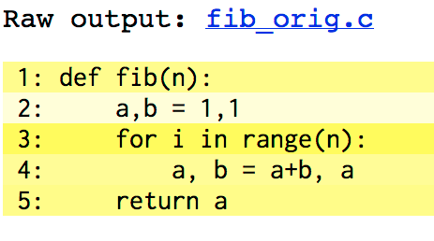
Profiling with annotations
FIB_ORIG.PYX: NO CDEFS
FIB_ORIG.HTML
def fib(n):
a,b = 1,1
for i in range(n):
a, b = a+b, a
return a
$ cython –a fib_orig.pyx
$ open fib_orig.html
CREATE ANNOTATED SOURCE
The darker the highlighting, the more lines of C code are required for the given line of Cython code.
Notes:
[toc]
level = 2
title = Def vs. CDef
# end config

Slide 23
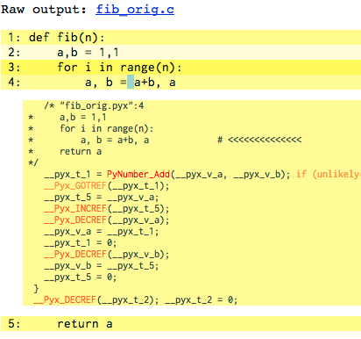
Profiling with annotations
Notes:
[toc]
level = 2
title = Def vs. CDef
# end config

Slide 24
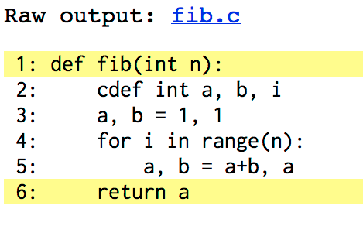
Profiling with annotations
FIB.PYX: WITH CDEFS
FIB.HTML
def fib(int n):
cdef int i, a, b
a,b = 1,1
for i in range(n):
a, b = a+b, a
return a
$ cython –a fib.pyx
$ open fib.html
CREATE ANNOTATED SOURCE
Notes:
[toc]
level = 2
title = Def vs. CDef
# end config

Slide 25
Sinc Exercise
Notes:
[toc]
level = 2
title = Def vs. CDef
# end config

Slide 26
Pure Python mode
FIB.PYX
FIB.PY
def fib(int n):
cdef int i, a, b
a,b = 1,1
for i in range(n):
a, b = a+b, a
return a
import cython
# Can put all type dels here
@cython.locals(n=cython.int)
def fib(n):
cython.declare(a=cython.int,
b=cython.int,
i=cython.int)
a,b = 1,1
for i in range(n):
a, b = a+b,
return a
cython.address(x), cython.sizeof(x) &x, sizeof(x)
stct = cython.struct(x=cython.int,
y=cython.float)
a = cython.declare(stct)
T = cython.typedef(cython.p_int)

Slide 27
Cython directives
# cdef becomes a C function call.
cpdef fast_inc(int num, int offset):
return num + offset
# Calls compiled version inside Cython file
def inc_seq(seq, offset):
result = []
for val in seq:
res = fast_inc(val, offset)
result.append(res)
return result

Slide 28
Wrapping external C functions
EXTERNAL C FUNCTIONS
# len_extern.pyx
# First, "include" the header file you need.
cdef extern from "string.h":
# Describe the interface for the functions used.
int strlen(char *c)
def get_len(char *message):
# strlen can now be used from Cython code (but not Python)…
return strlen(message)
CALL FROM PYTHON
>>> import len_extern
>>> len_extern.strlen
Traceback (most recent call last):
AttributeError: 'module' object has no attribute 'strlen'
>>> len_extern.get_len("woohoo!")
7
Notes:
[toc]
level = 2
title = Functions from C Libraries
# end config

Slide 29
Wrapping external C structures
TIME_EXTERN.PYX
cdef extern from "time.h":
# Declare only what is used from `tm` structure.
struct tm:
int tm_mday # Day of the month: 1-31
int tm_mon # Months *since* january: 0-11
int tm_year # Years since 1900
ctypedef long time_t
tm* localtime(time_t *timer)
time_t time(time_t *tloc)
def get_date():
""" Return a tuple with the current day, month, and year."""
cdef time_t t
cdef tm* ts
t = time(NULL)
ts = localtime(&t)
return ts.tm_mday, ts.tm_mon + 1, ts.tm_year
CALLING FROM PYTHON
>>> extern_time.get_date()
(8, 4, 2011)
Notes:
[toc]
level = 2
title = Structures from C Libraries
# end config

Slide 30
Python classes, extension types
PYTHON CLASS
class Particle(object): # Inherits from object; can use multiple inh.
def __init__(self, m, p, v): # attributes stored in instance __dict__
self.m = float(m) # creating / updating attribute allowed anywhere.
self.vel = np.asarray(v) # All attributes are Python objects.
self.pos = np.asarray(p)
def apply_impulse(self, f, t): # can be defined in or out of class.
newv = self.vel + t / self.m * f
self.pos = (newv + self.vel) * t / 2.
self.vel = newv
def speed(self):
...
Notes:
[toc]
level = 2
title = Classes
# end config

Slide 31
Python classes, extension types
EXTENSION TYPE
cdef class Particle: # Creates a new type, like list, int, dict
cdef float *vel, *pos # attributes stored in instance’s struct
cdef public m # expose variable to Python.
def __cinit__(self, float m, p, v): # allocate C-level data,
self.m = m # called before __init__()
self.vel = malloc(3*sizeof(float))
self.pos = malloc(3*sizeof(float))
# check if vel or pos are NULL...
for i in range(3):
self.vel[i] = v[i]; self.pos[i] = p[i]
cpdef apply_impulse(self, f, t): # methods can be def, cdef, or cpdef.
...
def __dealloc__(self): # deallocate C arrays, called when gc’d.
if self.vel: free(self.vel)
if self.pos: free(self.pos)
Notes:
[toc]
level = 2
title = Classes
# end config

Slide 32
Python classes, extension types
PYTHON CLASS
>>> vec = arange(3.)
>>> p = Particle(1.0, vec, vec)
>>> print p.vel # can access attributes (and modify them)
array([0., 1., 2.]
>>> p.apply_impulse(vec, 1.0)
>>> p.vel
array([0., 2., 4.])
>>> p.charge = 4.0 # set new attribute outside of class.
EXTENSION TYPE
>>> vec = arange(3.)
>>> p = Particle(1.0, vec, vec)
>>> print p.vel # attributes are private by default
AttributeError: ...
>>> print p.m # ...but can access readonly and public attributes.
1.0
>>> p.apply_impulse(vec, 1.0) # can call def or cpdef methods.
>>> p.charge = 4.0 # AttributeError: attributes fixed at compile time.
Notes:
[toc]
level = 2
title = Classes
# end config

Slide 33
Wrap C++ class
RECTANGLE_EXTERN.H
class Particle {
public:
float mass, charge;
float vel[3], pos[3];
Particle(float m, float c, float *p, float *v);
~Particle();
float getMass();
void setMass(float m);
float getCharge();
const float *getVel();
const float *getPos();
void applyImpulse(float *f, float t);
};

Slide 34
Wrap C++ class
PARTICLE.PYX
cdef extern from ”particle_extern.h":
cppclass _Particle “Particle”:
float mass, charge, vel[3], pos[3]
Particle(float m, float c, float *p, float *v)
float getMass()
void setMass()
float getCharge()
const float *getVel()
const float *getPos()
void applyImpulse(float *f, float t)
# continued on next slide...
Notes:
[toc]
level = 2
title = Classes
# end config

Slide 35
Wrap C++ class
PARTICLE.PYX
cdef class Particle:
cdef _Particle *thisptr # ptr to C++ instance
def __cinit__(self, m, c, float[::1] p, float[::1] v):
if p.shape[0] != 3 or v.shape[0] != 3:
raise ValueError(“...”)
self.thisptr = new Particle(m, c, &p[0], &v[0])
def __dealloc__(self):
del self.thisptr
def applyImpulse(self, float[::1] v, float t):
self.thisptr.applyImpulse(&v[0], t)
Notes:
[toc]
level = 2
title = Classes
# end config

Slide 36
Wrap C++ class
PARTICLE.PYX
# ...continued
property mass: # Cython-style properties.
def __get__(self):
return self.thisptr.getMass()
def __set__(self, m):
self.thisptr.setMass(m)
Notes:
[toc]
level = 2
title = Classes
# end config

Slide 37
Classes from C++ libraries
SETUP.PY
from distutils.core import setup
from Cython.Distutils import build_ext
from distutils.extension import Extension
sources = [‘particle.pyx’, particle_extern.cpp’]
setup(
ext_modules=[Extension(”particle",
sources=sources, language="c++")],
cmdclass = {'build_ext': build_ext}
)

Slide 38
Classes from C++ libraries
CALLING FROM PYTHON
>>> p = Particle(1.0, 2.0, arange(3.), arange(1., 4.))
>>> print p.mass # can access a __get__-able property.
1.0
>>> p.mass = 5.0 # can assign to a __set__-able property.
>>> p.apply_impulse(arange(3.), 1.0)
>>> del p # calls __dealloc__(), which calls C++ delete.

Slide 39
Templated classes
PARTICLE_TMPL.H
template<class T> class Particle {
public:
Particle(T m, T c, T *pos, T *vel);
~Particle();
T getMass(); void setMass(T m);
};
PARTICLE_TMPL.PYX
cdef extern from “particle_tmpl.h”:
cppclass _Particle “Particle”[T]:
_Particle(T m, T c, T *pos, T *vel)
T getMass()
void setMass(T m)
cdef class Particle:
cdef _Particle[float] *thisptr
def __cinit__(self, ...):
...

Slide 40
cimport and pyd files
To use Cython code in multiple files, create a pyd file of declarations for a corresponding pyx file and cimport it elsewhere.
PARTICLE.PYD
COLLISIONS.PYX
cdef extern from “particle.h”:
cppclass _Particle “Particle”:
...
cdef class Particle:
cdef _Particle *thisptr
from particle cimport Particle
def detect_collision(Particle p0,
Particle p1):
...
PYD FILES PROVIDED WITH CYTHON
from libc.stdlib cimport malloc, free # C std library
cimport numpy as cnp # numpy C-API
from libcpp.vector cimport vector # C++ std::vector
Notes:
[toc]
level = 2
title = Using NumPy with Cython
[exercise]
title = cython
# end config

Slide 41
Cython, NumPy, memoryviews
Typed memoryviews allow efficient access to memory buffers (such as NumPy arrays) without any Python overhead.
TYPED MEMORYVIEWS
def sum(double[::1] a): # a: contiguous 1D buffer of doubles.
cdef double s = 0.0
cdef int i, n = a.shape[0]
for i in range(n):
s += a[i]
return s
USE JUST LIKE NUMPY ARRAYS
In[1]: from mysum import sum
In[2]: a = arange(1e6)
In[3]: %timeit sum(a)
1000 loops, best of 3: 998 us per loop
In[4]: %timeit a.sum()
1000 loops, best of 3: 991 us per loop
Notes:
[toc]
level = 2
title = Using NumPy with Cython
[exercise]
title = cython
# end config

Slide 42
Cython, NumPy, memoryviews
ACQUIRING BUFFERS
cdef int[:, :, :] mv # a 3D typed memoryview, can be assigned to...
# 1: a C-array:
cdef int a[3][3][3]
# 2: a NumPy-array:
a = np.zeros((10,20,30), dtype=np.int32)
# 3: another memoryview
cdef int[:, :, :] a = b
USING MEMORYVIEWS
# indexing like NumPy, but faster, at C-level.
mv[1,2,0] # → integer
# Slicing like NumPy, but faster.
mv[10] == mv[10, :, :] == mv[10,...] # → a new memoryview.
Notes:
[toc]
level = 2
title = Using NumPy with Cython
[exercise]
title = cython
# end config

Slide 43
Cython, NumPy, memoryviews
STRIDED AND CONTIGUOUS MEMORYVIEWS
# uses strided lookup when indexing
cdef int[:, :, :] strided_mv
# can acquire buffer from a non-contiguous np array.
strided_mv = arr[::2, 5:, ::-1]
# faster than strided, but only works with C-contiguous buffers.
cdef int[:, :, ::1] c_contig
c_contig = np.zeros((10, 20, 30), dtype=np.int)
c_contig = arr[:, :, :5] # non-contiguous, so ValueError at runtime.
# faster than strided, only works with Fortran-contiguous.
cdef int[::1, :, :] f_contig
f_contig = np.asfortranarray(arr)
Notes:
[toc]
level = 2
title = Using NumPy with Cython
[exercise]
title = cython
# end config

Slide 44
Parallelization using OpenMP
Cython supports native parallelism. To use this kind of parallelism, the Global Interpreter Lock (GIL) must be released. It currently supports OpenMP (more backends might be supported in the future).
1) Release the GIL before a block of code:
with nogil:
# This block of code is executed after releasing the GIL
2) Declare that a cdef function can be called safely without the GIL:
cdef int mandelbrot_escape(double x, double y, int n) nogil:
…
3) Parallelize for-loops with prange:
from cython.parallel import prange
...
for j in prange(M):
for i in prange(N):
d[j,i] = mandelbrot_escape(xs[i], ys[j], n)
Notes:
44

Slide 45
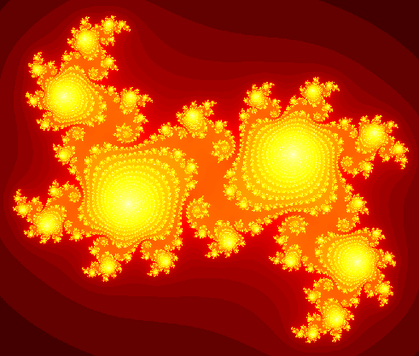
Capstone exercise: compute Julia set
PURE-PYTHON VERSION
# julia_pure_python.py
def kernel(z, c, lim):
count = 0
while abs(z) < lim:
z = z * z + c
count += 1
return count
def compute_julia(cr, ci, N, bound, lim):
julia = np.empty((N, N), dtype=np.uint32)
grid_x = np.linspace(-bound, bound, N)
grid_y = grid_x * 1j
c = cr + 1j * ci
for i, x in enumerate(grid_x):
for j, y in enumerate(grid_y):
julia[i,j] = kernel(x+y, c, lim)
return julia
Notes:
45

Slide 46
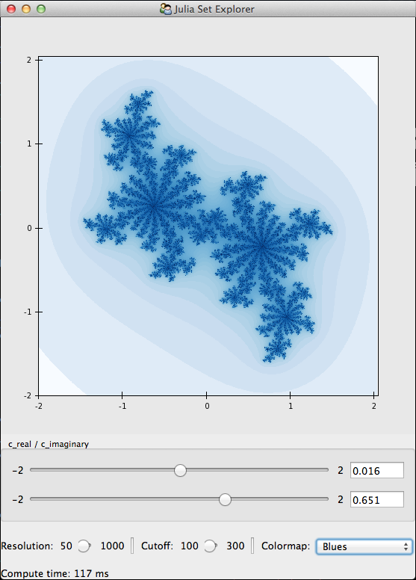
Capstone exercise: compute Julia set
# To run and visualize the python version:
$ python julia_ui.py julia_pure_python.py
# If using Anaconda:
$ python.app julia_ui.py julia_pure_python.py
# To run the cython version
$ python julia_ui.py julia_cython.pyx
# Anaconda
$ python.app julia_ui.py julia_cython.pyx
# To get an annotated file:
$ cython –a julia_cython.pyx
Notes:
46

Slide 47
Add Type Information
def abs_sq(float zr, float zi):
...
def kernel(float zr, float zi,
float cr, float ci,
float lim, int cutoff):
cdef int count
...
def compute_julia(float cr, float ci, int N,
float bound, float lim, int cutoff):
...
Notes:
47

Slide 48
Use Cython C Functions
cdef float abs_sq(...):
...
cdef int kernel(...):
...
Notes:
48

Slide 49
Use typed memoryviews
def compute_julia(...):
cdef int[:,::1] julia # 2D, C-contiguous.
cdef float[::1] grid # 1D, C-contiguous.
...
julia = empty((N,N), dtype=int32)
grid = array(linspace(...), dtype=float32)
# all array accesses and assignments faster.
Notes:
49

Slide 50
Add Cython directives
cimport cython
...
# don’t check for out-of-bounds indexing.
@cython.boundscheck(False)
# assume no negative indexing.
@cython.wraparound(False)
def compute_julia(...):
...
Notes:
50

Slide 51
Parallelization using OpenMP
from cython.parallel cimport prange
cdef float abs_sq(...) nogil:
...
cdef int kernel(...) nogil:
...
def compute_julia_parallel(...):
...
# release the GIL and run in parallel.
for i in prange(N, nogil=True):
...
Notes:
51

Slide 52
Parallelization using OpenMP
Extension("julia_cython", ["julia_cython.pyx"],
extra_compile_args=[“-fopenmp”],
extra_link_args=[“-fopenmp”])
Notes:
52

Slide 53
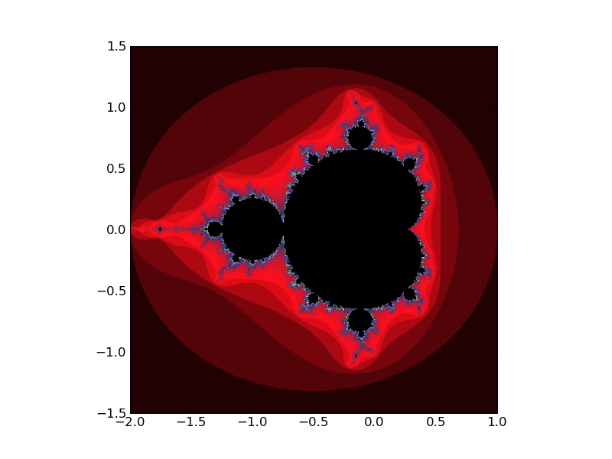
Conclusion
Solution | Time | Speed-up
Pure Python | 630.72 s | x 1
Cython (Step 1) | 2.7776 s | x 227
Cython (Step 2) | 1.9608 s | x 322
Cython+Numpy (Step 3) | 0.4012 s | x 1572
Cython+Numpy+prange (Step 4) | 0.2449 s | x 2575
Timing performed on a 2.3 GHz Intel Core i7 MacBook Pro with 8GB RAM using a 2000x2000 array and an escape time of n=100. [July 20, 2012]
Notes:
[exercise]
title = cython_rankdata
# end config
53

Slide 54
Cython in the age of Python JITs
PyPy (for general Python code) and Numba (for numerical programming) are emerging ways to improve Python’s performance. These just-in-time compilers dynamically infer the types of python variables and generate fast code on the fly. For loop-heavy numerical programming, Numba is able to generate code as fast as Cython.
Cython’s merits:
Generates standalone C extension module – others do not need to have Cython installed.
Has mature wrapping and diagnosis capabilities (cython –a) that JITters lack.
Greater control over generated code.
Can speed up both general Python and numerical code.
Parallelization support.
Notes:
[exercise]
title = cython_rankdata
# end config
54

