Slide 1


Group No.:
WFS_209
UCCC & SPBCBA & SDHGCBCA
& IT COLLEGE
Group Members:
Devendra Sonawane 2548008 [4752]
Shivam Das 2548032 [4330]
Dipika Yadav 2548005 [4215]
Project Guided :
Prof. Nisarg Naik

Slide 2

Café Management System
The Problem | Our Solution | Key Features
Manual order taking leads to errors and delays. | A centralized Cafe Management System named "The Code Cafe". | Role-Based Access: Separate interfaces for Admin, Chef, and Cashier.
Inefficient billing and payment processing. | A digital platform to streamline all cafe operations. | Order Management: Intuitive system for placing, tracking, and completing orders.
Difficulty in tracking daily sales and performance. | Improves speed, accuracy, and communication. | Sales Analytics: Real-time dashboard and sales history for performance tracking.
Poor communication between front-of-house and kitchen staff. |  | Real-time Notifications: Instant alerts for new orders to keep staff synchronized.

Slide 3
Development Team
Devendra Prabhakar Sonawane | Shivam DharmendraBhai Das | Dipika Mahendra Prasad Yadav
Roll No: 2548008 | Roll No: 2548032 | Roll No: 2548005
Contribution: Project Lead, Backend Development (PHP, CodeIgniter), Database Management. | Contribution: Frontend Development (HTML, CSS, Bootstrap), UI/UX Design, JavaScript. | Contribution: System Analysis, Testing, Documentation, and Presentation.

Slide 4







Technologies Used
PHP: The core server-side scripting language used for all backend logic, from handling user requests to processing data.
CodeIngniter: The powerful PHP framework that provided the Model-View-Controller (MVC) architecture, routing, and security for our application.
HTML5: The standard markup language used to create the structure and content of all web pages in the application.
CSS3: Used for custom styling to enhance the visual design, creating a unique and branded look for our "Code Cafe" theme.
JS: Implemented for client-side interactivity, such as dynamically updating the order cart, handling real-time notifications, and form validation.
MySQL: The core server-side scripting language used for all backend logic, from handling user requests to processing data.
Bootstrap5: A front-end framework used to design a responsive, mobile-first, and aesthetically pleasing user interface for all pages.

Slide 5
System Requirements
Web Server:
Apache or Nginx with ‘mod_rewrite’ enabled
Web Browser:
Google Chrome, Mozilla Firefox, Microsoft Edge, or Safari (any modern, up-to-date browser).
PHP:
Version 8.1 or higher
Required extension: intl, mbstring, mysqlnd.
Operating System:
Windows, macOS, or Linux
Database:
MySQL, or MariaDB.
Hardware:
A standard computer or mobile device with an active internet connection.
Dependency Manager:
Composer 2

Slide 6
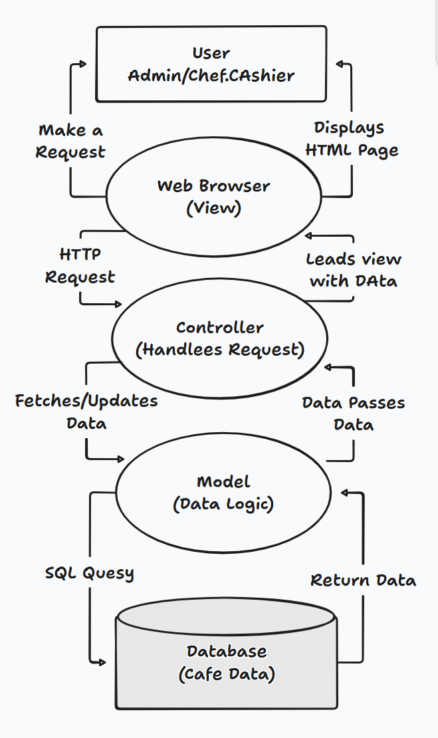
System Architecture (MVC)
Admin
Full Control: Manages Menu, Categories, Staff, and Tables.
Business Oversight: Views a comprehensive dashboard with sales analytics and order history.
System Settings: Configures cafe details like name, address, and GST number.
Chef
Kitchen Command: Views a dedicated dashboard for Pending and In Making orders.
Status Updates: Updates order status to keep the entire system synchronized.
Order History: Can review a history of all Completed orders.
Cashier
Point of Sale: Creates new Dine-In or Take Away orders for customers.
Transaction Management: Finalizes orders and processes payments.
Performance Tracking: Views a personal dashboard summarizing their total orders and sales for the day.

Slide 7
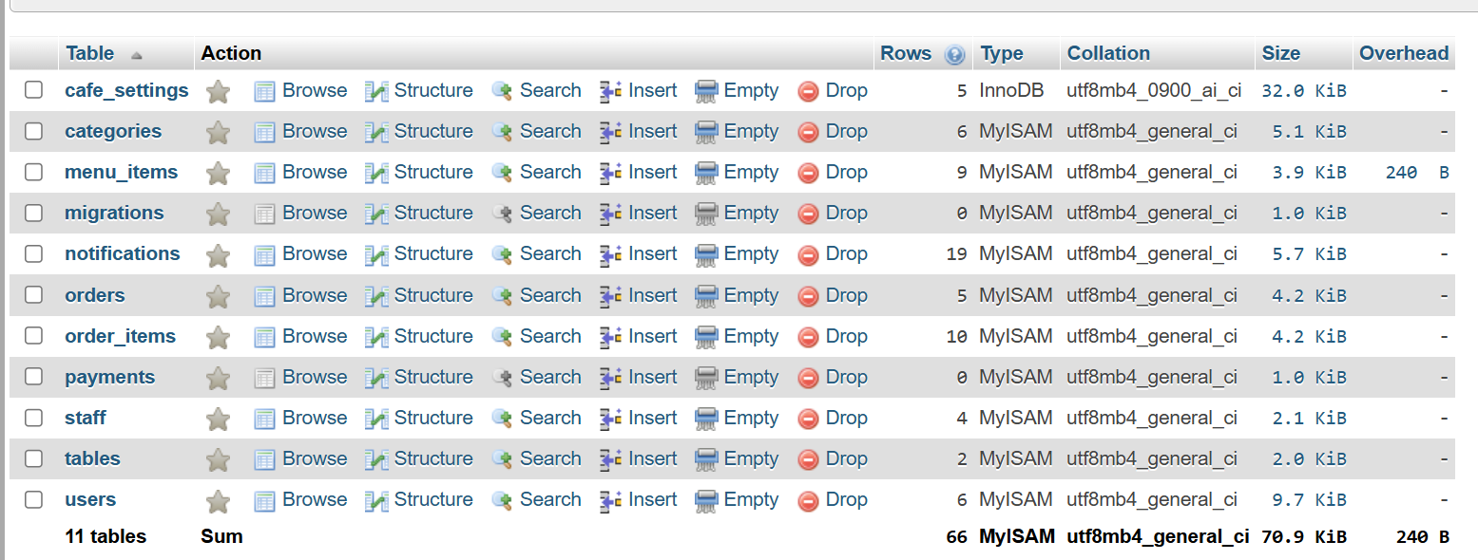
Database Design

Slide 8
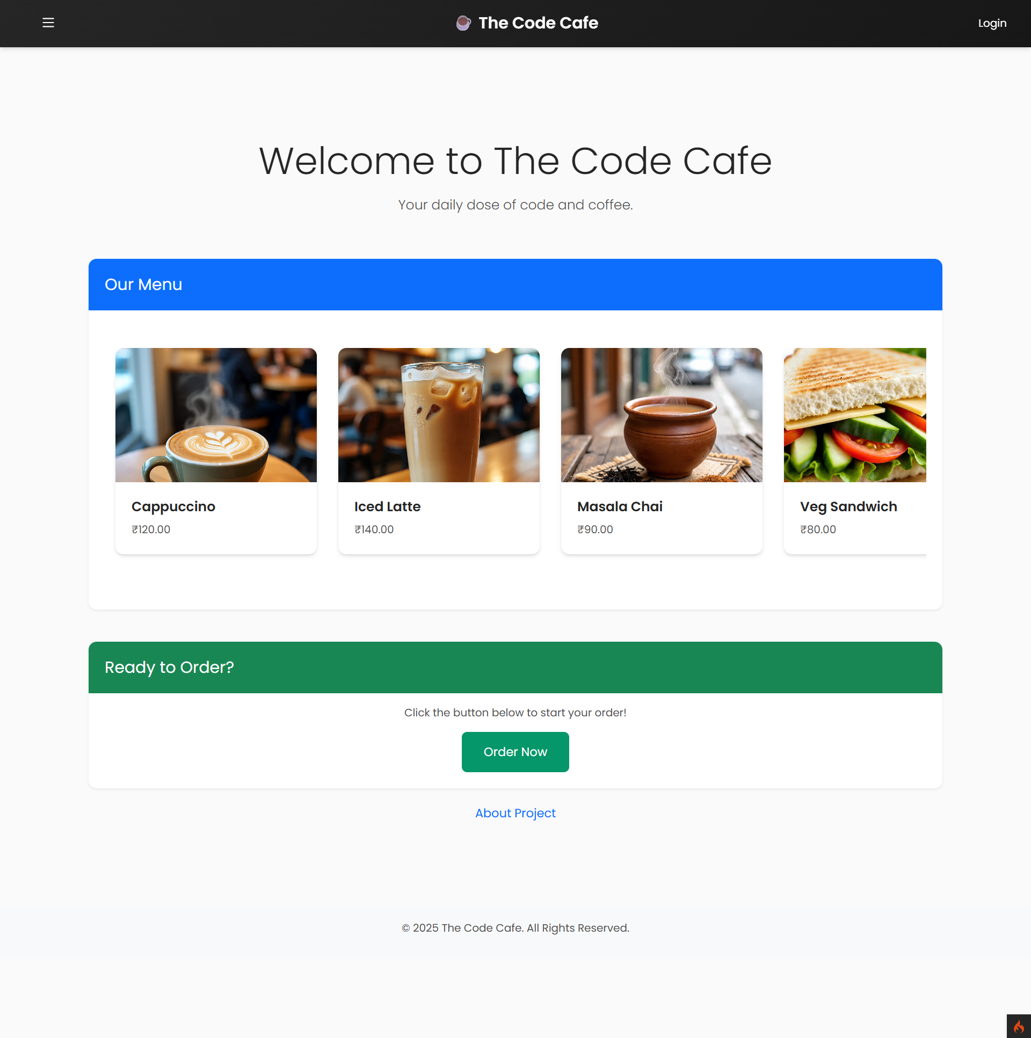
Landing Page
Visually Appealing Menu: A dynamic menu carousel showcases popular items with high-quality images and prices. Menu data is fetched directly from the database, so it's always up-to-date.
Clear Call-to-Action: A prominent "Order Now" button guides the user directly to the ordering process.
Guest & Staff Separation: This page is designed for customers (guests). Staff can access their login portal via the "Login" link in the header.
Fully Responsive: The layout is designed with Bootstrap to be accessible and user-friendly on any device, from desktops to mobile phones.

Slide 9
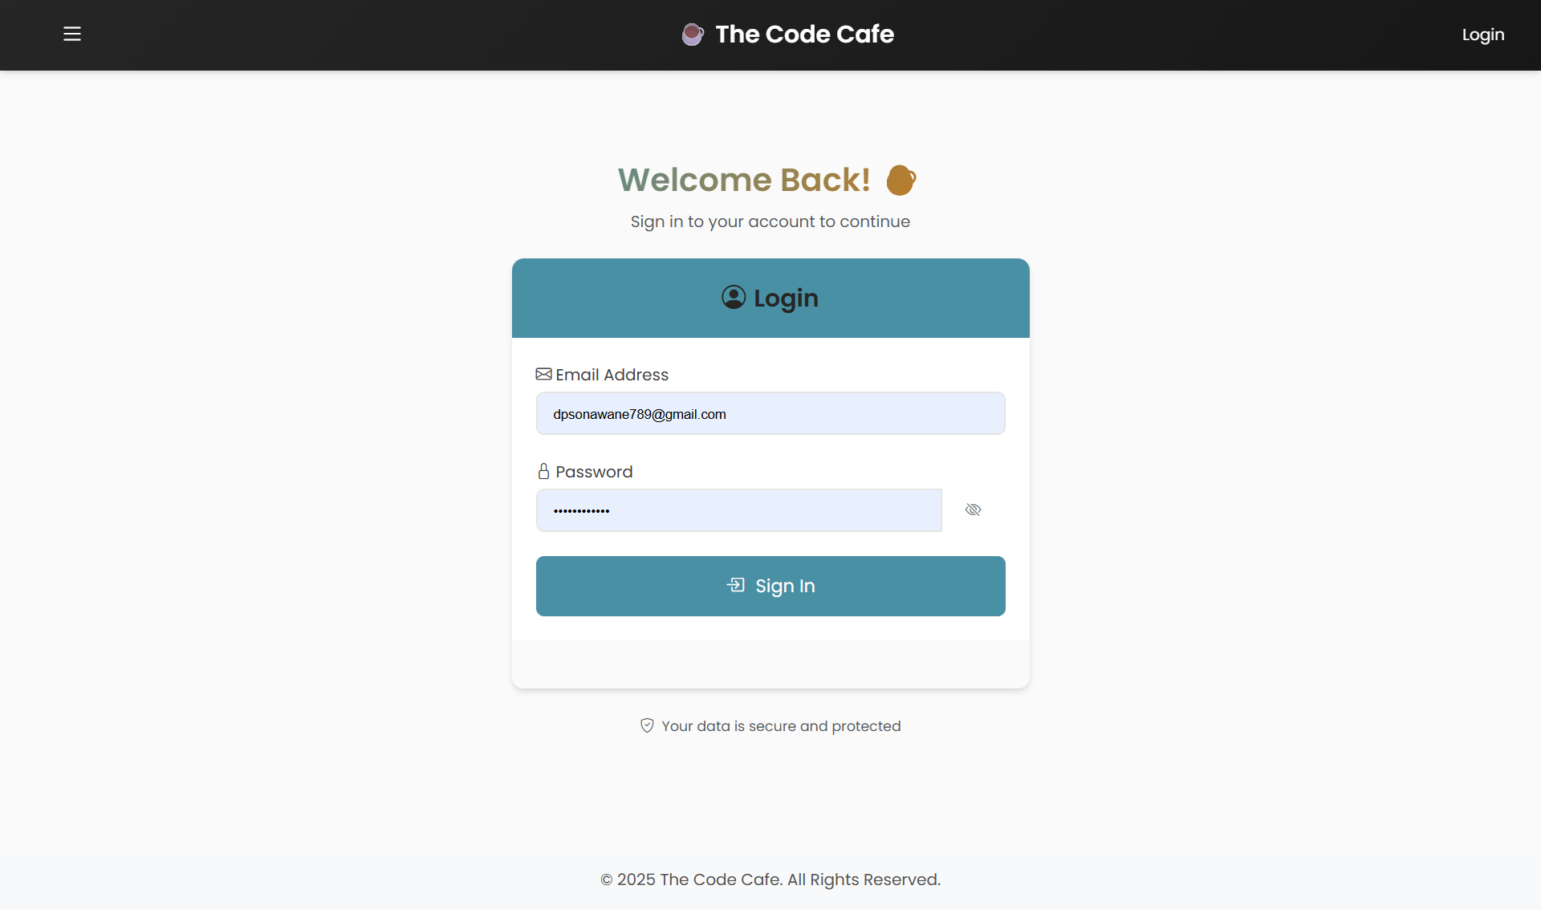
Login Page
Single, Secure Entry Point: One login page for all staff roles (Admin, Chef, Cashier).
Credential Verification: The system validates the user's email and password against the database. Passwords are securely hashed using PHP's password_hash() function.
Role-Based Redirection: - After successful login, the system identifies the user's role. It automatically redirects them to their specific dashboard (e.g., /admin/dashboard, /chef/dashboard).

Slide 10
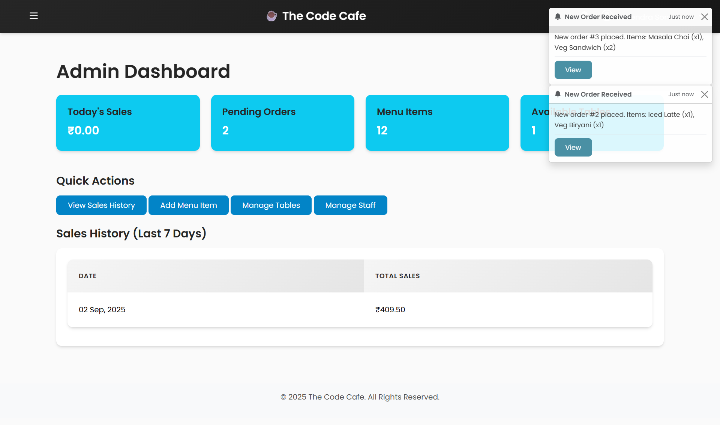
Admin Dashboard
At-a-Glance Overview: Real-time stats on Today's Sales, Pending Orders, total Menu Items, and Available Tables.
Quick Actions: Direct links to manage core modules like Sales History, Menu, Tables, and Staff.
Sales Trend: A summary table of Sales History for the Last 7 Days to quickly gauge performance.
Live Order Notifications: Instant toast notifications appear for new orders, keeping the admin constantly updated.

Slide 11
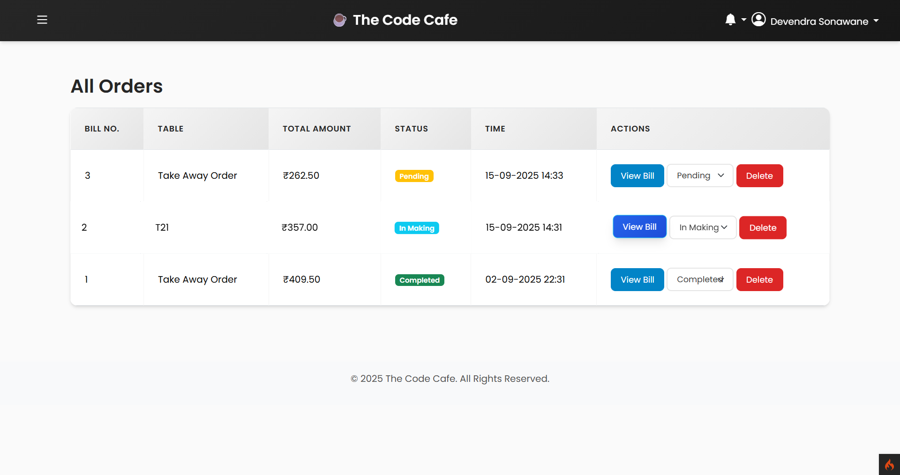
Admin Side Order Management
comprehensive View: Displays a complete list of all orders in the system, regardless of their status (Pending, In Making, Completed).
At-a-Glance Status: Color-coded status badges provide a quick visual summary of the current state of every order.
Live Status Control: Admins can directly override or update any order's status using the dropdown menu.
Full Order Management: Admins have the ability to View any bill and Delete incorrect or canceled orders from the system.

Slide 12
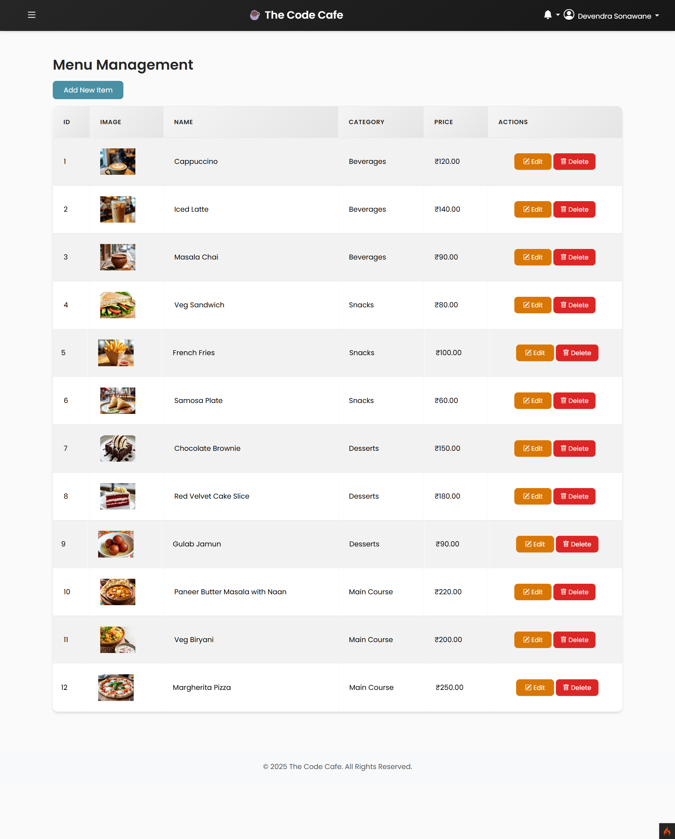
Menu Management
Centralized Menu Overview: A clean, tabular view of all menu items with their image, name, category, and price.
Easy Item Creation: The "Add New Item" button opens a simple form for adding new products to the menu, including image uploads.
Full CRUD Operations: Admins have completed Create, Read, Update, and Delete capabilities for all menu items.
Image & Category Management: - Allows for easy updates to an item's image, price, and category, ensuring the customer-facing menu is always accurate.

Slide 13
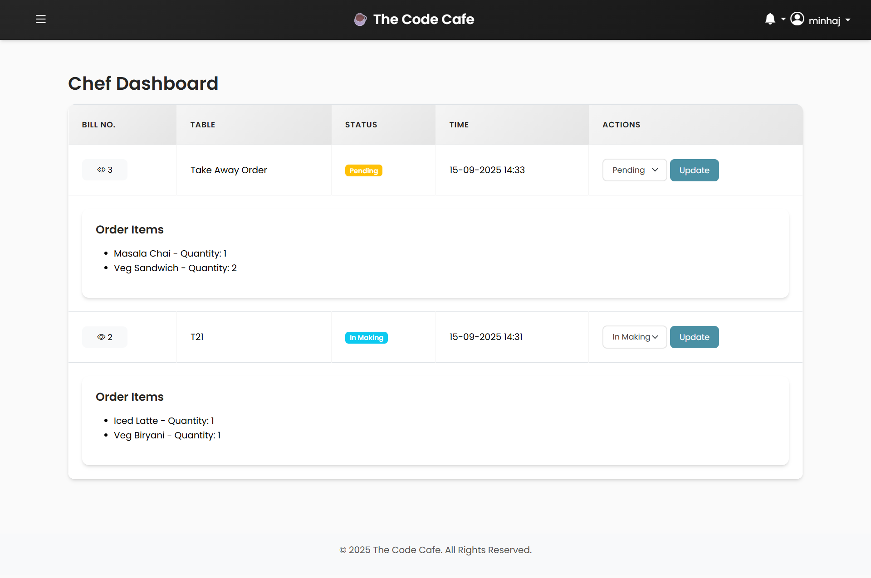
Chef Dashboard
Focused Order Queue: Displays only Pending and In Making orders, providing a clear and actionable to-do list.
Detailed Order View: Chefs can expand each order to see a detailed list of items and their quantities.
Real-Time Status Updates: The chef can change an order's status from Pending to In Making or Completed.
Task Completion: Marking an order as Completed removes it from the queue and can free up the table for new customers.

Slide 14
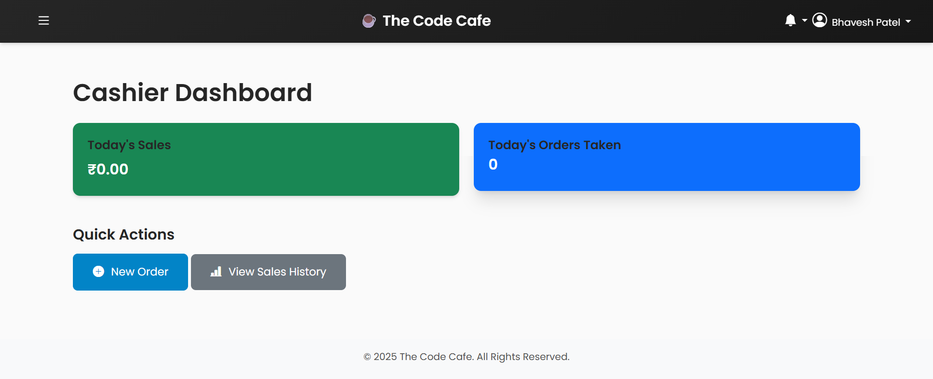
Cashier Dashboard
Personalized & Simple: A minimal interface showing only the cashier's own sales and orders for the day.
New Order Creation: The primary action is the 'New Order' button, which takes them directly to the point-of-sale interface.
Quick Access to Sales: A link to 'View Sales History' allows them to review past transactions and reports relevant to their role.
Focused Workflow: No access to sensitive admin functions, ensuring a secure and focused workflow for front-of-house staff.

Slide 15
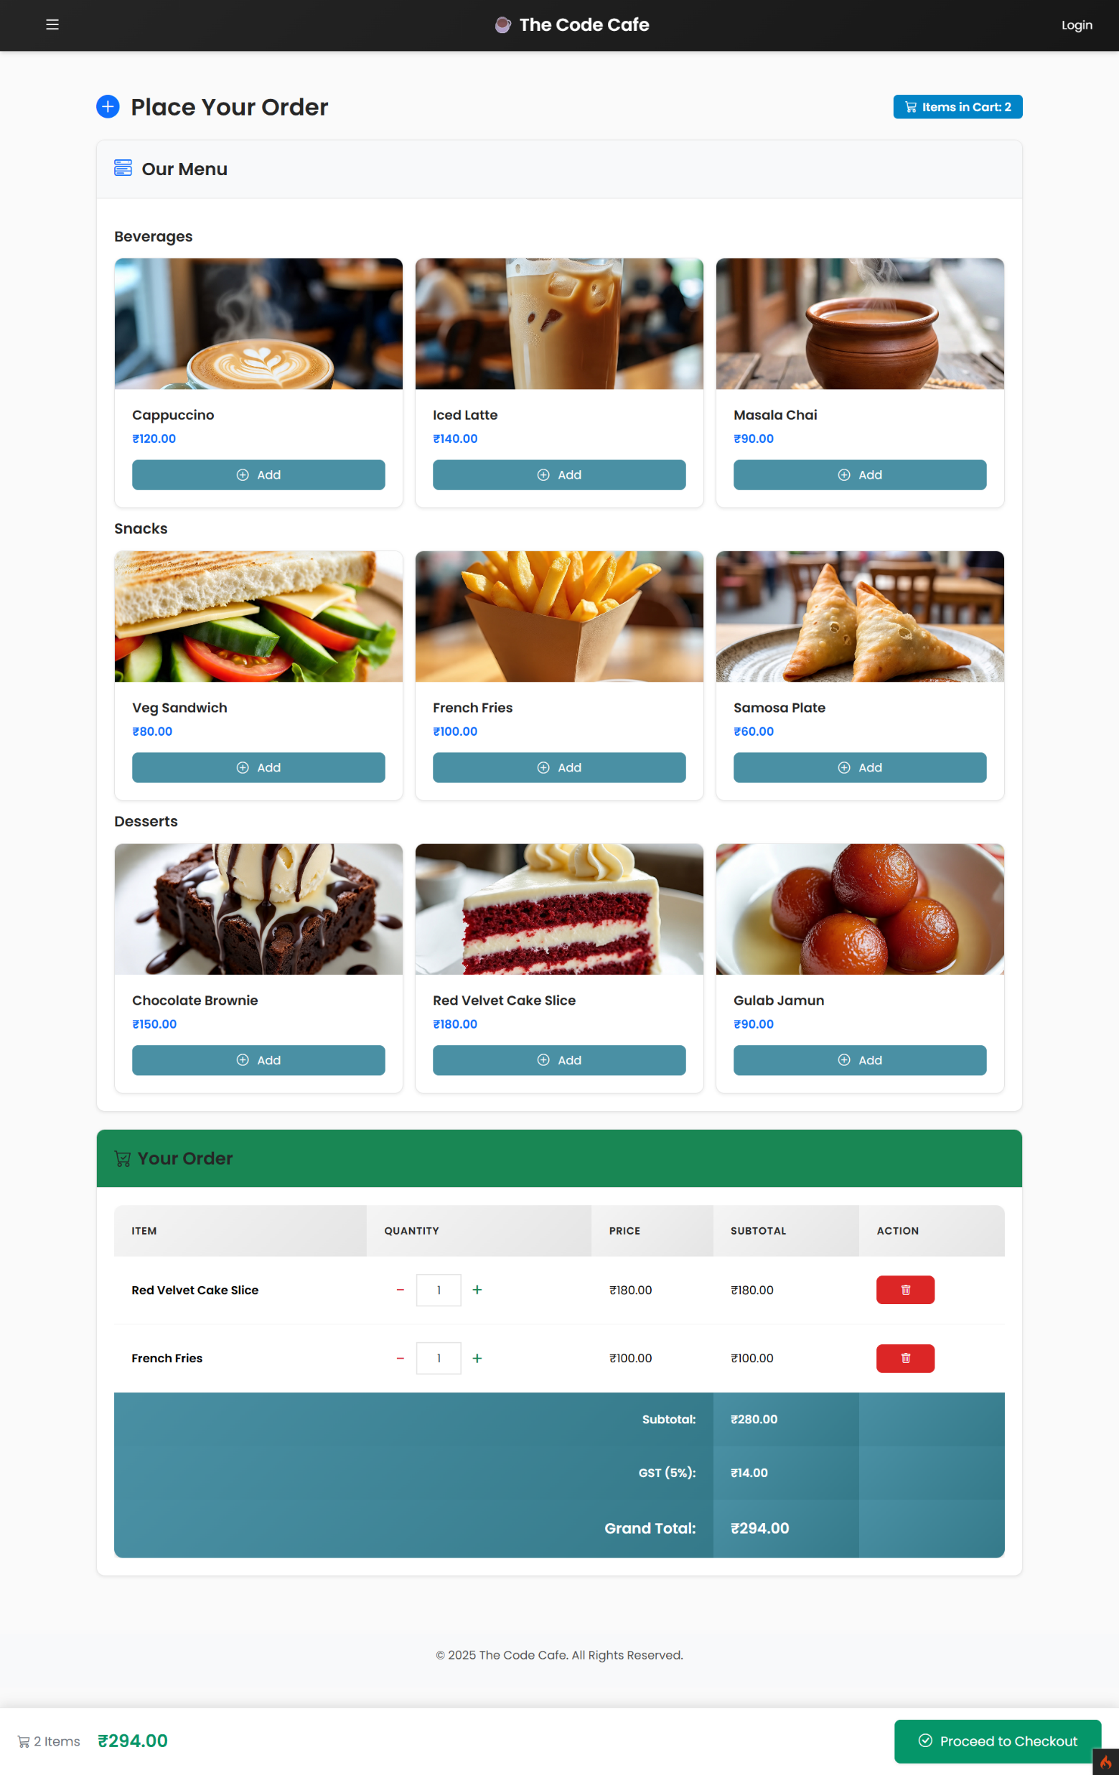
User side Order Page
(Without Login)
Categorized Menu Display: The menu is neatly organized by categories like "Beverages," "Snacks," and "Desserts". Each item is shown with a clear image, name, and price.
Interactive Live Cart: Clicking "Add" instantly moves an item to the "Your Order" section without a page reload. Users can easily adjust quantities or remove items directly in the cart.
Real-Time Calculation: The subtotal, GST (set at 5%), and grand total are automatically recalculated with every change.
Sticky Checkout Bar: A persistent bar at the bottom of the screen always shows the total items and amount, with a clear "Proceed to Checkout" button for a seamless user journey.

Slide 16
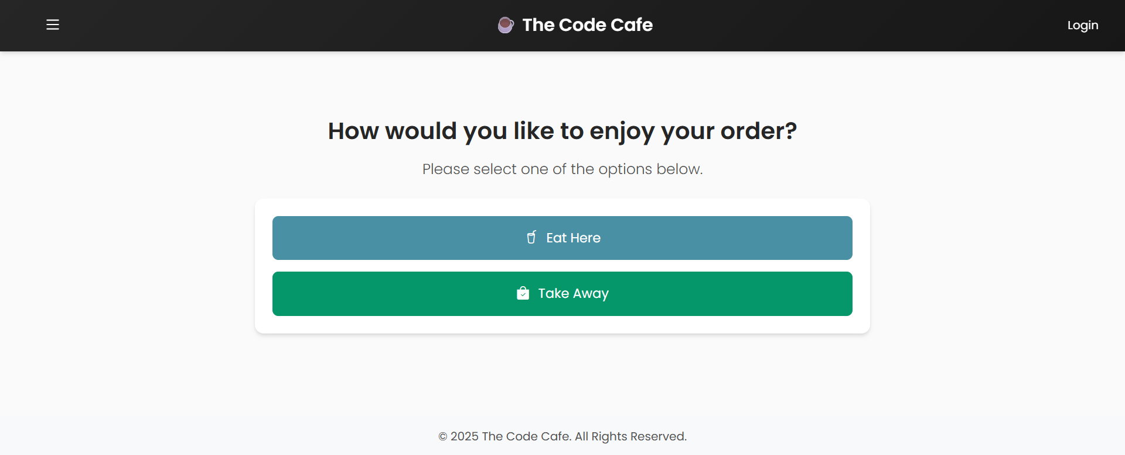
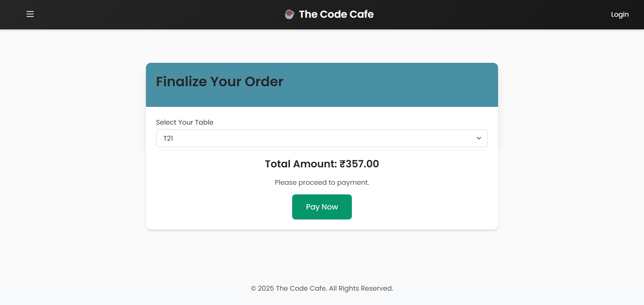
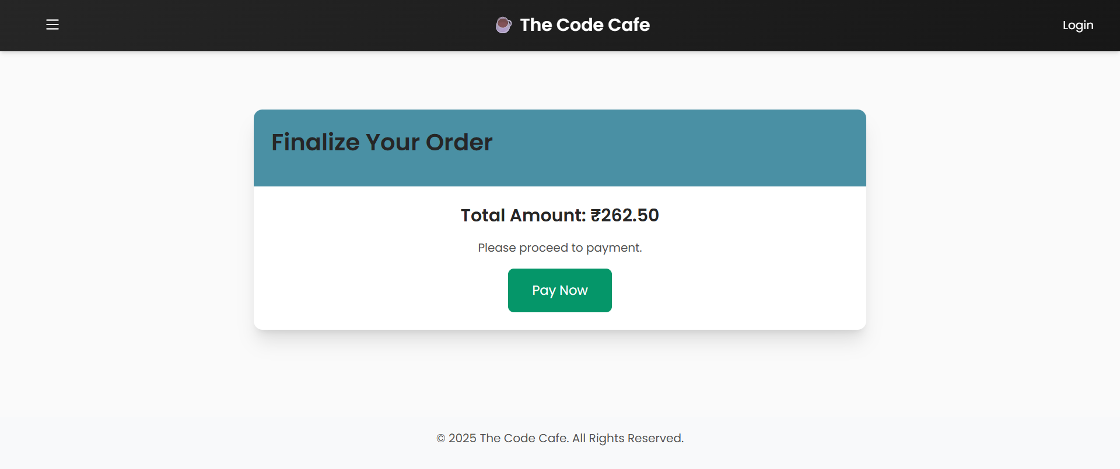
Order Type Selection
If ‘Eat Here’ is Choose by Customer
If ‘Take Away’ is Choose by Customer

Slide 17
Defining Our Boundaries:
Project Scope
In Scope (What Our Project Delivers) | Out of Scope (For Future Development)
✅ Main Order Management: Full functionality for creating, viewing, and managing orders for guests and staff. | ❌ Inventory Management: The system does not track stock levels of ingredients or supplies.
✅ Role-Based Staff System: Secure login and distinct dashboards for Admin, Chef, and Cashier roles. | ❌ Online Payment Gateway Integration: The "Pay Now" button simulates a transaction; a real payment gateway (like Stripe or Razorpay) is not integrated.
✅ Menu and Table Administration: Full CRUD (Create, Read, Update, Delete) functionality for menu items, categories, and tables. | ❌ Advanced Customer Features: Does not include a customer loyalty program, user accounts for customers, or saving order history for guests.
✅ Sales Reporting: Admins can view and filter sales history to track performance over time. | ❌ Employee Payroll & HR: While staff can be managed, the system does not handle payroll, attendance, or other HR functions.

Slide 18
Project Summary and Achievements
Core Message: We successfully developed a robust, scalable, and user-friendly Cafe Management System that streamlines operations and provides valuable business insights.
Achieved Efficiency: Our system reduces manual errors and improves communication between staff, leading to faster service and a better customer experience.
Delivered Core Functionality: We implemented all essential features for a modern cafe, including dynamic menu control, multi-role access, and real-time order tracking.
Built a Scalable Foundation: By using the CodeIgniter 4 framework and a well-designed MVC architecture, we've created a solid foundation that can be easily expanded with new features in the future.

Slide 19


