Slide 1
Automated News Production
JOUR479V/779V – Computational Journalism
University of Maryland, College Park
Nick Diakopoulos, Ph.D.

Slide 2

https://automatedinsights.com/

Slide 3
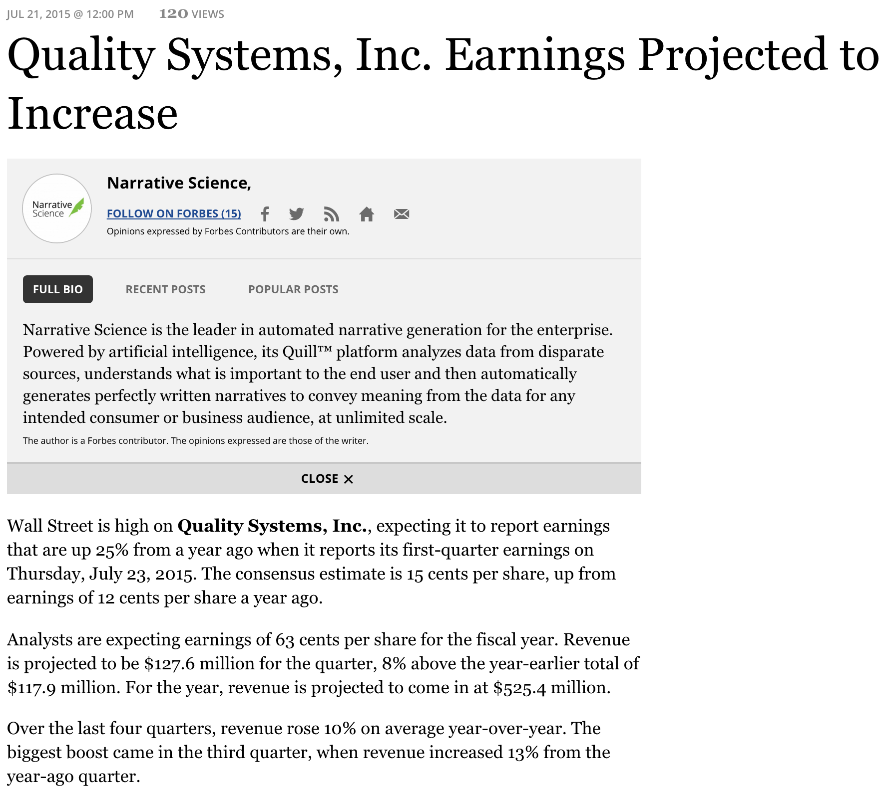

Slide 4



Automated Writing Software
Notes:
Another area where algorithms are beginning to influence us in the media is that they can automatically produce stories directly from structured data.
Automated Insights recently announced that it is producing and publishing 3,000 earnings report articles per quarter for the Associated Press, all automatically generated from data
Other companies like Narrative science do this for sports data, or in other business oriented scenarios.

Slide 5
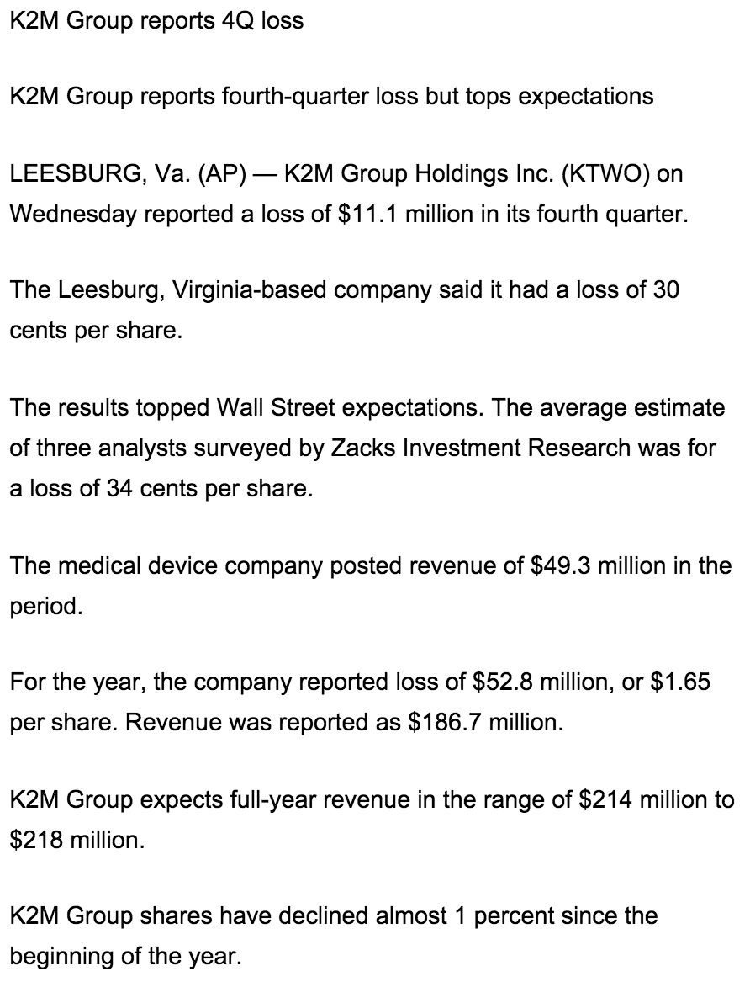
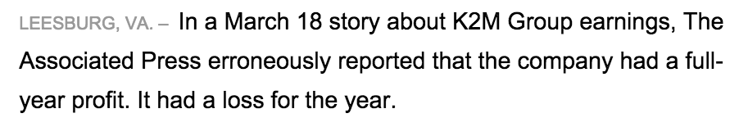
Notes:
This is an example of AI output. It’s straightforward and readable without being flowery. But in fact this was the 2nd go at it. The first time, the output had an error in it.
Initial research has shown that often people can’t even tell the difference b/t the human and machine generated text.

Slide 6
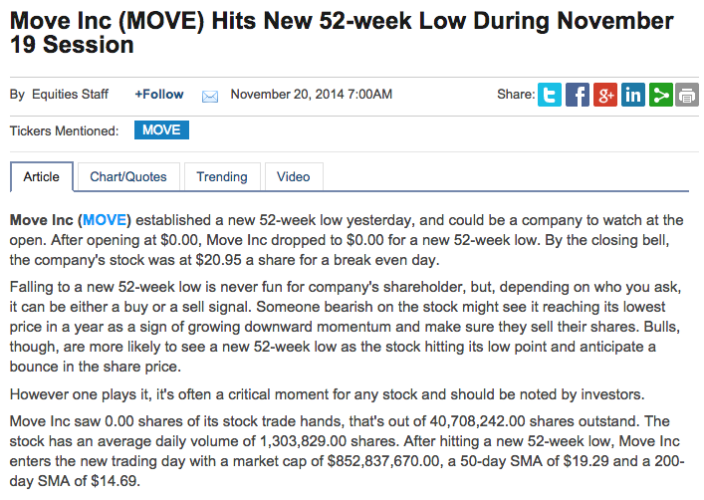
Notes:
Robot writers can make incorrect decisions at any of these stages leading to errors or inaccuracies. One of the biggest challenges for these technologies is to have CLEAN input data, as that minimizes the potential for downstream error. In this example we see the implications of an algorithmic writer not understanding CONTEXT: that a company was bought and that it was delisted, leading to a share price of 0.
http://jimromenesko.com/2014/11/20/someone-didnt-get-the-memo-about-move/
Can also raise the concern of data accuracy here. What if a data stream were to be hacked and polluted (a so called “pollution attack”) … this could have implications particularly in e.g. this domain of finance.

Slide 7
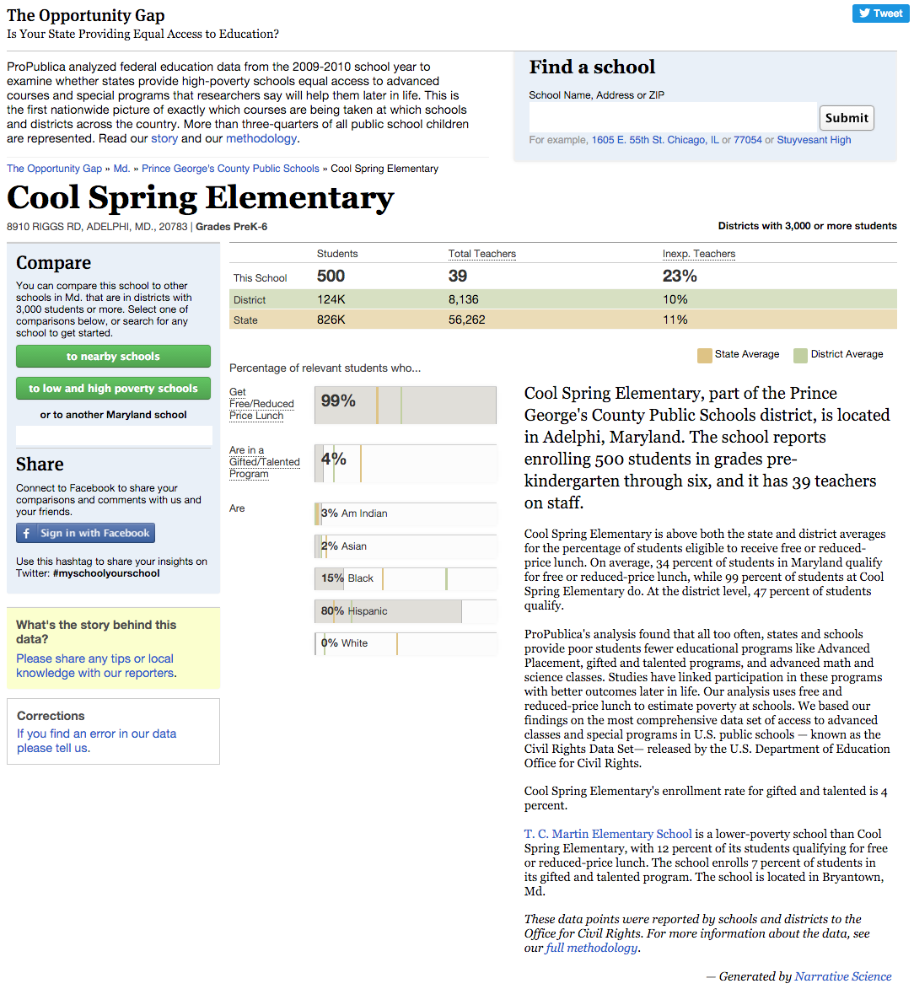
Notes:
Automatically generated text isn’t just used in financial reporting. Here’s an example of its use in a news app produced by Propublica called the opportunity gap. http://projects.propublica.org/schools/schools/240051000510
More context on the project: https://www.propublica.org/nerds/item/how-to-edit-52000-stories-at-once
“Also launching with this new release are short narrative descriptions of almost all of the more than 52,000 schools in our database, generated algorithmically by Narrative Science”
“Unlike a normal editing process, we weren't just working with a single story but tens of thousands of them. It isn’t practical to read 52,000 narratives. Also, Narrative Science’s systems are more complex than simple boilerplate with interpolated variables. Editing one narrative does not mean you’ve edited them all. In addition to recasting whole paragraphs, their systems generate a variety of sentences to express the same kind of data, so that reading the narratives for several schools would seem more natural and not automated. So edits that made sense in one case ended up not working in other cases, and sentences that seemed correct given one set of circumstances seemed wrong in others – often subtly.”

Slide 8
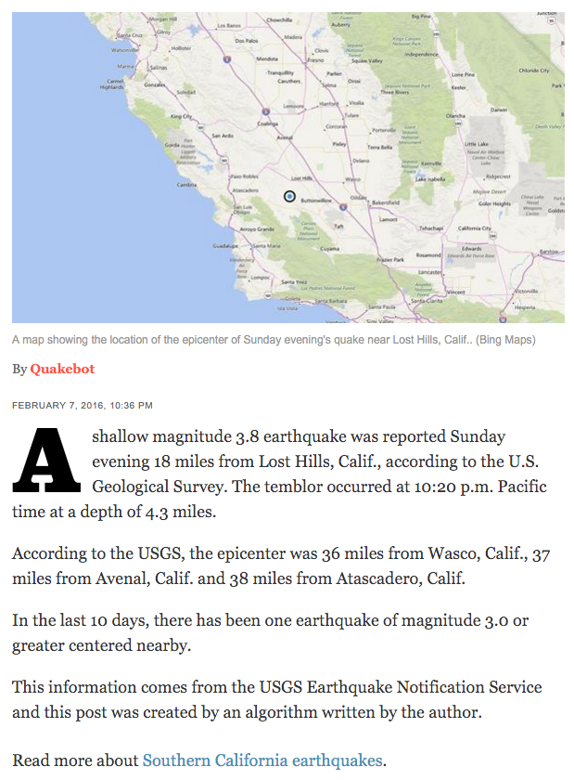
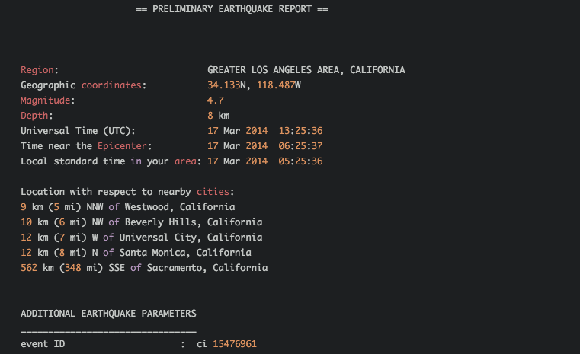
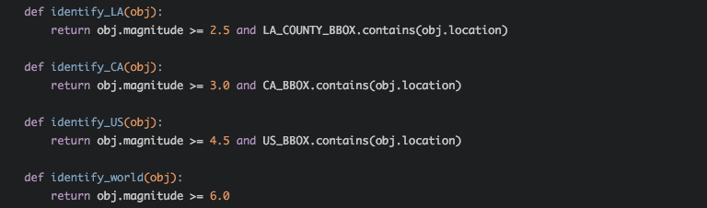
http://www.latimes.com/local/earthquakes/
Notes:
The LA Times quakes page are written by their QuakeBot: http://www.latimes.com/local/earthquakes/, often with additional reporting layered in. More info here: https://source.opennews.org/en-US/articles/how-break-news-while-you-sleep/
The way this works is that USGS has an earthquake notification service, and the author of the quakebot set it up to send him an email whenver there was a quake > 2.5 magnitude. Then he would parse that email into its constituent elements and generate the text of the report. Since USGS will send out further updates they need to track that and update their own DB or editors.
The other interesting human element here are the thresholds used to define newsworthiness. The magnitude of the earthquake needs to be larger depending on whether it’s local, regional, national, or international news.

Slide 9
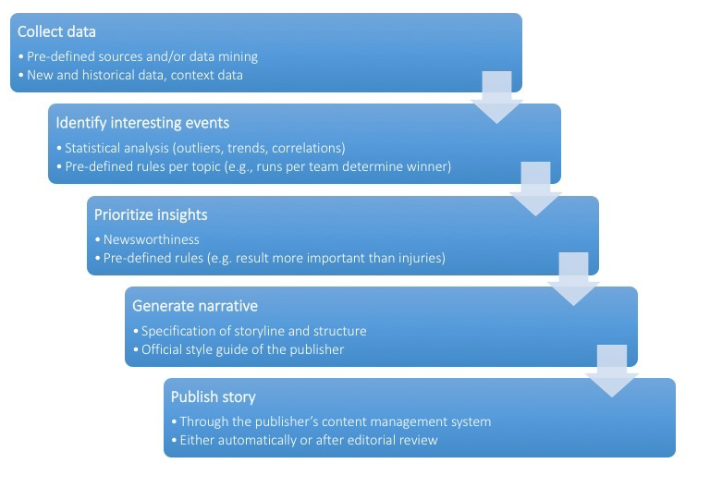
Automated Writing Pipeline
Notes:
This is the general flow of how a writing bot works. It’s similar to how a human journalists might assess data and think about writing a story, and as such there are many EDITORIAL DECISIONS that get made in that process.
The point though is that errors might get introduced at any stage. What if the data input is noisy? What if there are thresholds that need to be tuned?
Clearly there are many editorial decisions being made by these systems, from the data used (or not used) as input, how that data is used for augmentation or personalization, the definitions and operationalizations of the features or angles computed, and the criteria used to prioritize those features. Add to this questions of errors and mistakes, data quality, and the identity of the algorithms that produced the text and there are many ethical considerations to be aware of

Slide 10
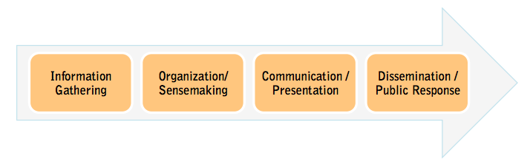
Editorial Support Algorithms
gathering,
curating,
vetting
data mining
story finding
storytelling
writing
visualization
content
optimization
Notes:
Algorithms are increasingly used throughout the newsroom to accomplish various tasks. Some of these we might personify as “bots” and others we may just consider as computationally enhanced tools.
Editorial support tools are about enhancing the role of journalists by using computing to speed up or augment their work.
This includes tasks across the news production pipeline from information gathering, to story production, and dissemination. The driving factor here is about SCALE and ability to create or cope with more information faster or with fewer people.

Slide 11
Bot Ethics
How accurate is the data? Do you have the rights?
Is the automation repetitive? Does it match your style?
Will you disclose that it’s even automatically produced?
“The computer did it” isn’t much of an explanation
How to communicate accuracy or bias of bot?
What should journo-bots be allowed to do? Do we need bot editors?
Tom Kent. https://medium.com/@tjrkent/an-ethical-checklist-for-robot-journalism-1f41dcbd7be2
Notes:
There are efforts underway to consider how to responsibly use algorithms. This is still underway…

Slide 12
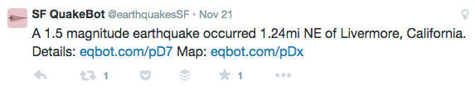
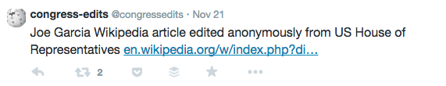
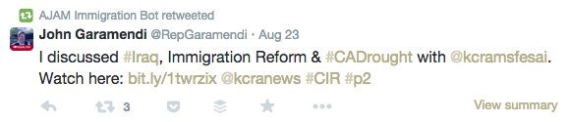
News Bot Examples
Notes:
Bots are also beginning to manifest more and more on social media, which is a hugely important area for content dissemination now. Some are produced by news organizations, as well as civic hackers, and also critics who are using the medium make statements and share opinions.
Lots of quake bots out there
Also some interest civic ones dealing with edits on wikipedia (use this to talk about open source of these things and ability to spread)
Bots that re-share information on certain topics or monitor individuals in power
More info on census americans bot: http://fivethirtyeight.com/datalab/introducing-censusamericans-a-twitter-bot-for-america/ (it tweets short biographies of Americans based on data they provided to the U.S. Census Bureau between 2009 and 2013)

Slide 13
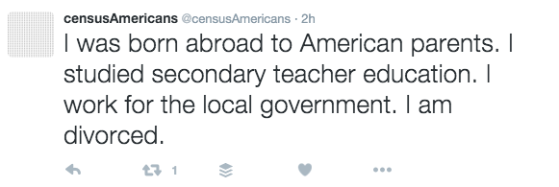
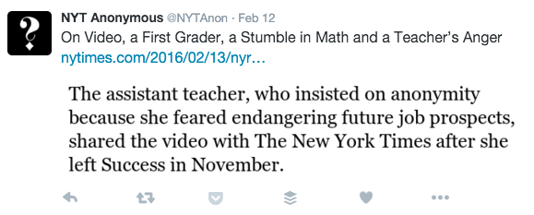
More Bots
Notes:
NYTAnon highlights usage of anonymous sources in NYT. Basically it searches articles via the article search api for key phrases.

Slide 14
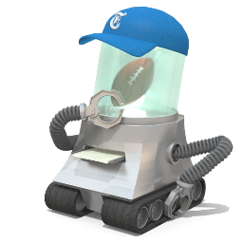
New York Times 4th Down Bot
Notes:
Let’s consider one particular bot put out by the New York Times. There are also some interesting questions and challenges when we put algorithms smack in the center of the newsroom.
Idea of 4th down bot and what it predicts: For every fourth down in a game, it uses that model to decide whether the coach should ideally “go for it,” “punt,” or “go for a field goal.”

Slide 15
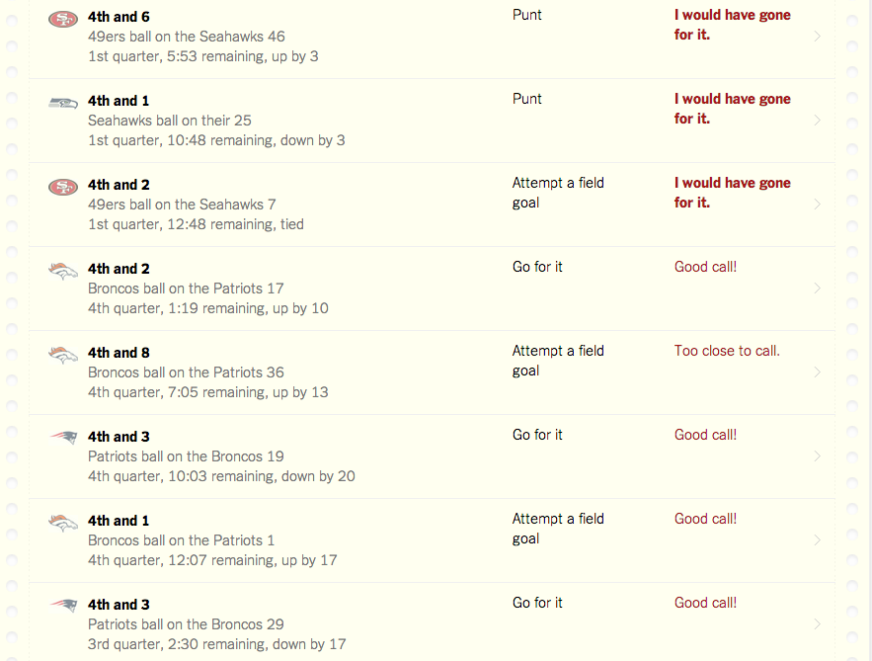
Notes:
http://nyt4thdownbot.com/
This is an example of the output, it also tweets about these things. So it is doing data mining / prediction, and also generating outputs

Slide 16
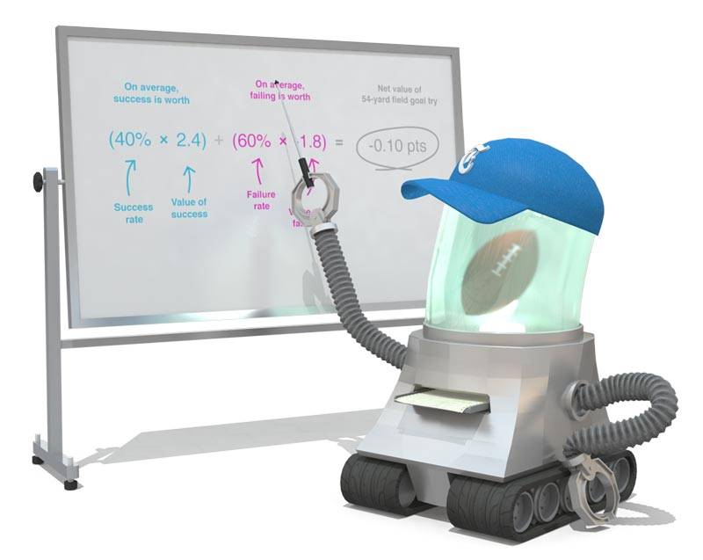
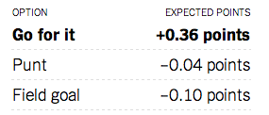
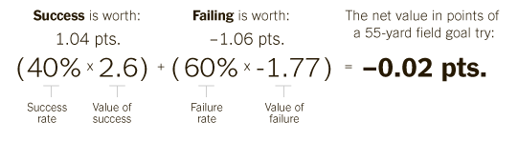
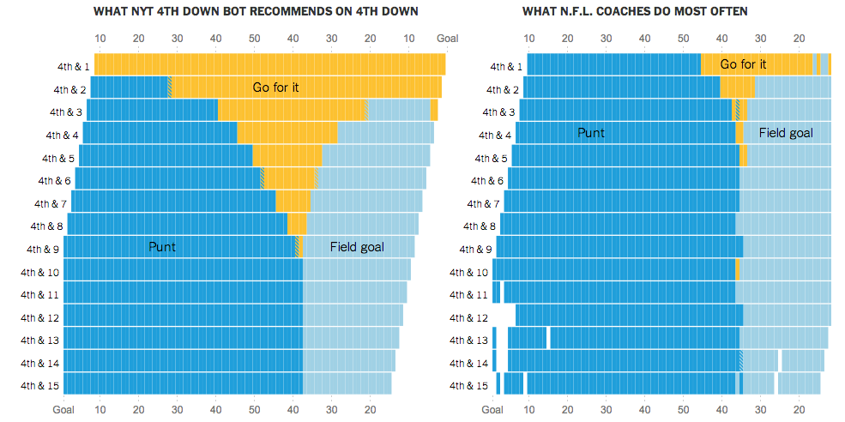
Notes:
So there’s a model, with data and a simple calculation algorithms for the decision / prediction that the bot makes.
Burke and Quealy do a deft job of explaining how the bot defines its world. It pays attention to the yard line on the fourth down as well as how many minutes are left in the game. Those are the inputs to the algorithm. It also defines two criteria that inform its predictions: expected points and win percentage. The model’s limitations are clearly delineated—it can’t do overtime properly for instance. And Burke and Quealy explain the bias of the bot, too: With its data-driven bravado, it’s less conservative than the average NFL coach.
There are all kinds of questions that having these bots around raise: how should journalists be transparent about the bots they use? Source code transparency? What’s the right way to visualize the model to communicate that? How to represent accuracy? How to explain bias of bot?

Slide 17
Readings
Guide to Automated Journalism
What types of news writing do you think are more likely to be automated? Beyond sports and finance, what will come next?
What are advantages and limitations of automated journalism?
Why might automated news be perceived as more credible but less readable than human-written news?
Notes:
Likely uses: Routine coverage, areas where high quality data is availabl
Advantages: large scale, personalization, quicker, cheaper, fewer errors
Limitations: data availability & quality, insight “outside the box”, writing quality (humor, sarcasm, metaphor)

Slide 18
Readings
The Robotic Reporter
To what extent do you think automation will replace humans in journalism? Will jobs be lost?
Should we but more authority / trust in automated journalists?
Notes:
other roles are created for journalists in automated systtems: automation editor at AP, data collection, “meta-writer” to work on encoding narrative frames
Trust: mitigated human bias? Numbers more trustworthy?

Slide 19
Readings
Automation in the Newsroom
What role do humans still play in automated writing algorithms?
How should newsrooms handle errors in automation?
News York Times Slack Bot
What are the pros / cons to interacting with a bot via chat?
Notes:
Humans: style, wording, specify important metrics, editorial thresholds of “small” or “large”, deciding what constitutes a fair comparison based on data context, editing / checking to see if data was used appropriately and is high quality, doing additional reporting and adding context
Errors: benchmarking, testing, posting corrections
Cons: discoverability (what can it do?); command syntax (is it flexible enough?).
Pros: fits with exisitng practices

Slide 20
Readings
News Bots: Automating news and information dissemination on Twitter
What are the dangers of deploying public interest news bots on proprietary / private platforms like Twitter?
Do you think news bots have the capacity to hold institutions accountable?
Notes:
Dangers: platform can censor you, block you just because it doesn’t “get it”; you have to be careful to play by the rules of the platform e.g. rate limits; some people might report you (e.g flag as “offensive” or “spam” just because they don’t like the content of what you’re sharing

Slide 21
Break

Slide 22
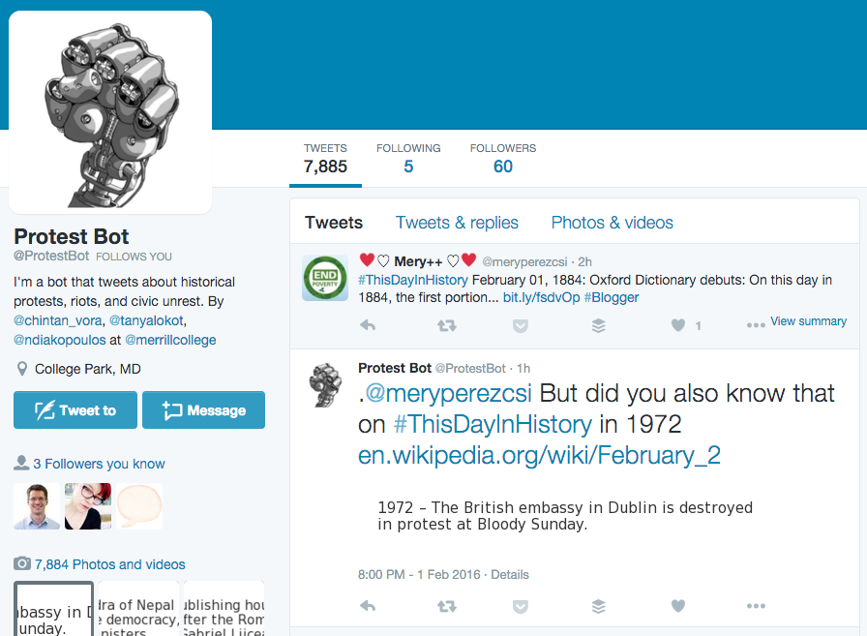
Protest Bot
https://twitter.com/protestbot
Notes:
Protest bot listens to people using the hashtag “#ThisDayInHistory” and then it responds to those people with a new event that also happened on this day. The events that it responds with come from Wikipedia and have been filtered to only include those that relate to protests, riots, and civic unrest. It responds with an image of the event description as well as a link to the Wikipedia page.
It’s amazing that people really follow and respond to the bot, often thanking it for information.

Slide 23
Bots Brainstorming
Let’s get in groups of 3
(15 mins)
Each group come up with at least 5 ideas for bots with some news goal
What inputs should it have?
What are outputs? Will it interact?
What should it DO? (and why?)

Slide 24
Bots Brainstorm - Dimensions
Inputs | Outputs | Algorithms | Intent / Function
Database / Archive | Commentary | Analyzing | Accountability
Other Websites | Geo-specific | Augmenting | Breaking News
RSS feeds | Niche | Curating / Aggregating | Critique / Opinion
Other Tweets | Topical | Generating | Discovery / Investigation
Tweet Replies |  | Reacting / Responding | Entertainment
Other Twitter Accounts |  | Rebroadcasting | Informing
Hashtags |  |  | Service

Slide 25
Bots Design
(15 mins)
Pick one bot and write out detailed steps that bot needs to take (don’t worry about code).
Are the inputs available to make it work?
Is it feasible?
What’s the algorithm?

Slide 26
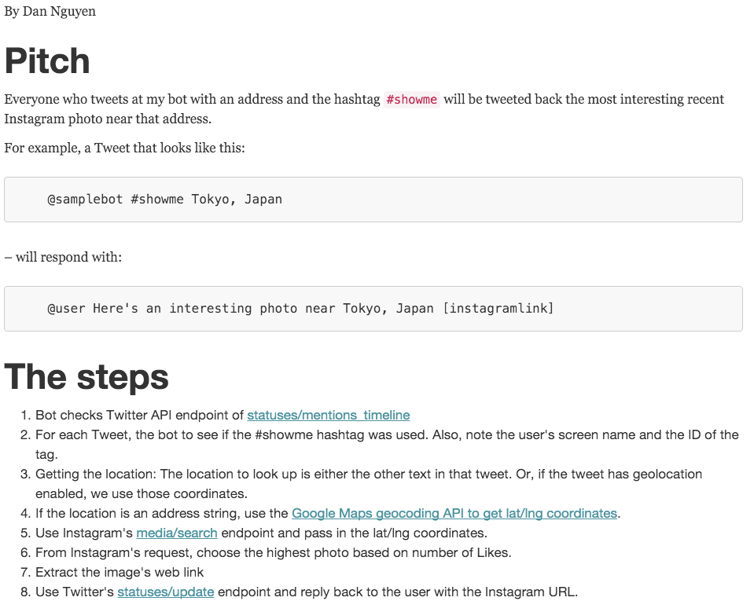
Notes:
http://www.compjour.org/files/code/bots/sample-memo/

Slide 27
Bots Redux
(15 mins)
Any volunteers to explain your detailed bot idea back to class?
Feedback from class:
Will it work?
Will is have journalistic value?

Slide 28
Bot Implementation
Let’s jump over to Jupyter to look at how to use the Twitter API

Slide 29
Questions?

