Slide 1






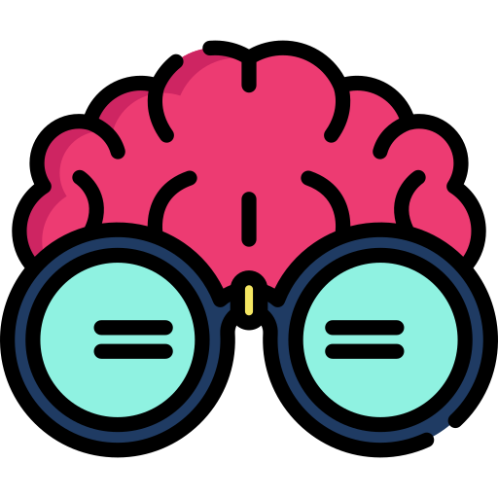
Getting Started: Installing Python and PsychoPy
Start
Do you have python installed on your laptop??
Do you have Windows or Mac?
Are you expert in Python?
(Do you know what a python environment is? Do you know how to create one with specific python version??)
Uninstall python
We recommend installing Python following our guidelines. This ensures compatibility with our tutorials and helps us provide better support. Multiple Python versions can cause conflicts.
Did you install python using miniconda??
As you are already an expert, we will leave it to you to install the required packages.
What we suggest you to have for the following the tutorials on the website is 2 environments:
Should have at least pandas, numpy, matplotlib, seaborn, and I2MC installed
Should have PsychoPy installed (you can also install PsychoPy as standalone software)
Install python and libraries
Our favourite way to install python is by using miniconda.
Click here for instructions
You will require some libraires to process the data
Click here for instructions
You will need an IDE, we recommend Spyder
Click here for instructions
You will need Psychopy to create a small study
Click here for instructions
Psychopy standalone
Sometimes it may be complex to install PsychoPy as a library. In case you encounter any error, you can install PsychoPy as a standalone software.
Final checks
To double check you Psychopy installation we will ask you to test it by running a small script
Had problems installing Pyschopy?
Click here for instructions
Run the check
That's unfortunate!
Please let us know what issues you're experiencing - we're happy to help troubleshoot.
Also, the PsychoPy forum is an excellent resource with many experts
Did everything go well?
(did you see the message that you are ready for the workshop?)
Send us an email
Check the
Psychopy forum
Well done!!!
You are officially one of us nerds now!!!!

