Slide 1
PaleDJ
By Jason Eichman

Slide 2
Intro
Design a custom music player for that friend who is always DJ’ing the parties. For example: A tablet plugged into the audio system playing music as the “Remote Controlled Media Player” and a cellphone as the DJ’s remote controller. Allowing the DJ to play music from anywhere.
Requirements:
Remotely control the music player with another device.
Transfer music files between devices. (ftp, wifi direct, cloud drive)
Handle song requests.. Via Google Cloud Messaging
There will be more as time goes on.

Slide 3
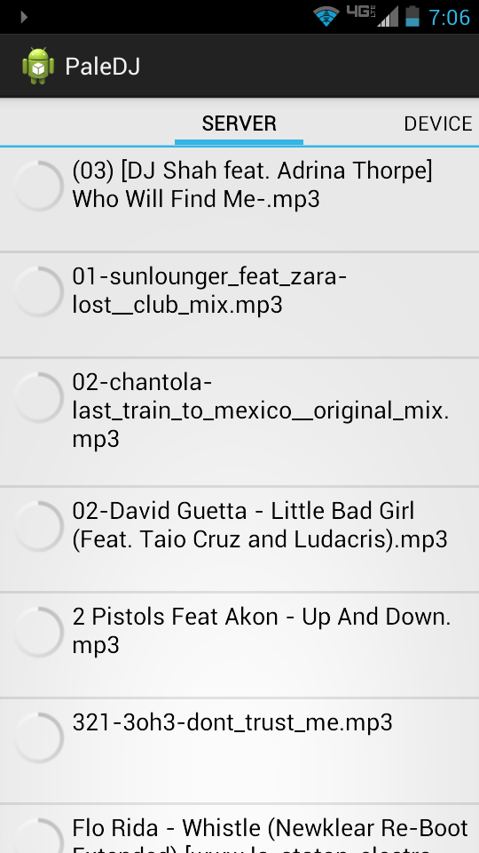
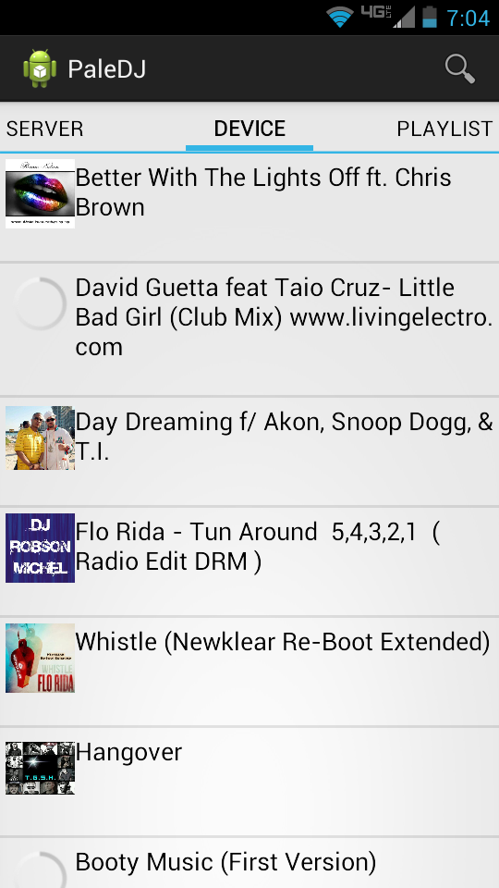
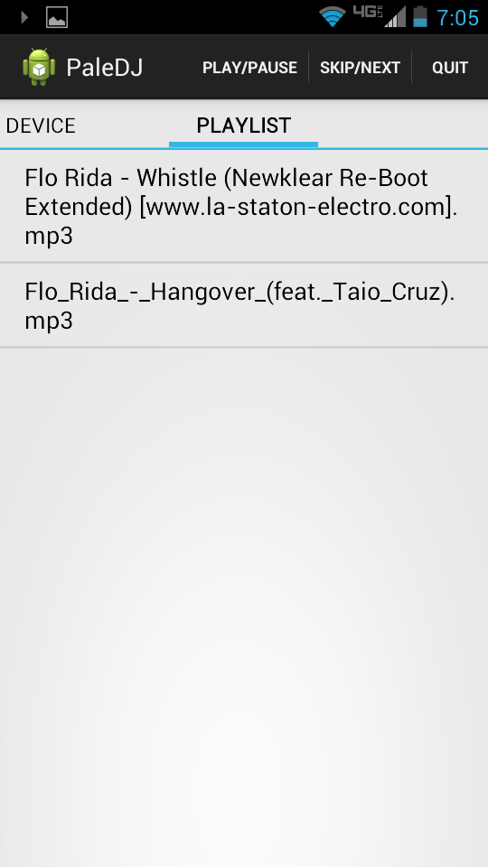
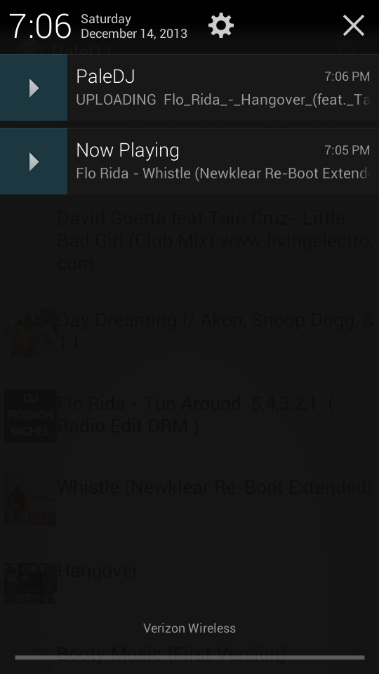
Demo
Server: all the music files on my FTP server
Device: all the music files on the device
Playlist: Music to be played
The media player and file transfer operations are fire and forget.
All progress updates are sent to the notification bar.
Using AsyncTask for quik operations such as deleting files on the server and retrieving the file list from the server
MediaPlayer is handled in a Service and updates are reported to the Notification Bar
Uploading and Downloading files is handled in an intent service and updates are reported in the Notifications Bar
Multiple third party libraries : Otto Event Bus, View Page Indicator, GCM, ABS, Sliding Menu

Slide 4
Retro:
The Good:
Learn how and when to use AsyncTask, Service, Intent Service.
Third party libraries can be huge time savers.
IdeaJ and Android Studio’s dependency management is much easier to use.
The Bad:
Eclipse and learning to identify if Eclipse needs to be restarted or if it’s a bug in the code. Many hours have been wasted when all I needed was a restart.
Outro
UI design and experience is a big next step.
Tie the MediaPlayer that is running, to a view in the the Main Activity when the app is being used.
Replace the FTP with Google Cloud Drive.
Add P2P file Sharing through Wifi Direct
Add Remote MediaPlayer Control through GCM.
Add song requests from other app users at the same gathering.
File Sharing is a sketchy business. Unikely it will be for sale.

