Slide 1
Session 11
Chapter 6 – The Database Language SQL
Simple Queries in SQL
Database Systems

Slide 2
Objectives
1
Understand how to write simple queries
2
Understand about NULL values
3
Understand about the string data type, date-time data type
4
Know how to order the output

Slide 3
Contents
1
SQL Overview
2
Projection in SQL
3
Selection in SQL
4
Comparison of Strings and Pattern matching in SQL
5
Date time data type
6
NULL values
7
Ordering the output

Slide 4
SQL Overview
The most commonly used relational DBMS’s query and modify the database through a language called SQL.
SQL (stands for Structured Query Language) is the set of statements with which all programs and users access data in an database.
The language, Structured English Query Language ("SEQUEL") was developed by IBM Corporation. SEQUEL later became SQL (still pronounced "sequel").
Today, SQL is accepted as the standard RDBMS language.

Slide 5
SQL Revisions
Year | Name | Alias | Comments
1986 | SQL-86 | SQL-87 | First published by ANSI. Ratified by ISO in 1987.
1989 | SQL-89 | FIPS 127-1 | Minor revision, adopted as FIPS 127-1.
1992 | SQL-92 | SQL2, FIPS 127-2 | Major revision (ISO 9075), Entry Level SQL-92 adopted as FIPS 127-2.
1999 | SQL:1999 | SQL3 | Added regular expression matching, recursive queries, triggers, support for procedural and control-of-flow statements, non-scalar types, and some object-oriented features.
2003 | SQL:2003 |  | Introduced XML-related features, window functions, standardized sequences, and columns with auto-generated values (including identity-columns).
2006 | SQL:2006 |  | ISO/IEC 9075-14:2006 defines ways in which SQL can be used in conjunction with XML. It defines ways of importing and storing XML data in an SQL database, manipulating it within the database and publishing both XML and conventional SQL-data in XML form. In addition, it provides facilities that permit applications to integrate into their SQL code the use of XQuery, the XML Query Language published by the World Wide Web Consortium (W3C), to concurrently access ordinary SQL-data and XML documents.
2008 | SQL:2008 |  | Defines more flexible windowing functions, clarifies SQL 2003 items that were still unclear ^{[1]}

Slide 6
Transact SQL (T-SQL)
Transact-SQL (T-SQL) is Microsoft's and Sybase's proprietary extension to SQL
T-SQL
SQL

Slide 7
Sub-languages of T-SQL
T - SQL
DDL
(Data Definition Language)
DML
(Data Manipulation Language)
DCL
(Data Control Language)

Slide 8
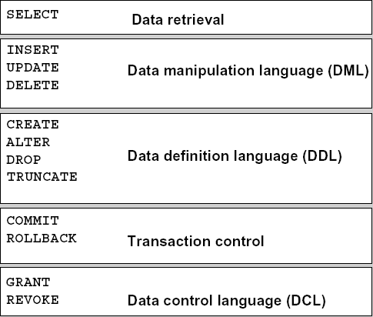
Sub-languages of T-SQL

Slide 9
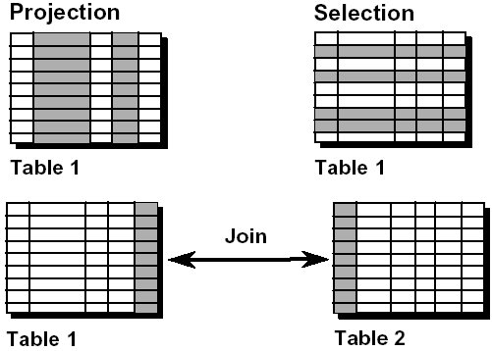
SELECT commands
A SELECT statement retrieves information from the database. Using a SELECT statement, you can do the following:
Projection: You can use the projection capability in SQL to choose the columns in a table that you want returned by your query.
Selection: You can use the selection capability in SQL to choose the rows in a table that you want returned by a query (with WHERE clause)
Joining: You can use the join capability in SQL to bring together data that is stored in different tables by creating a link between them.

Slide 10
Notes
A keyword refers to an individual SQL element.
For example, SELECT and FROM are keywords.
A clause is a part of a SQL statement.
For example, SELECT employee_id, last_name, ... is a clause.
A statement is a combination of two or more clauses.
For example, SELECT * FROM employees is a SQL statement.

Slide 11
Basic Syntax for a simple SELECT queries
SELECT [ ALL | DISTINCT ]
[ TOP n [ PERCENT ] ]
* | {column_name | expression [alias],…}
FROM tableName
[WHERE conditional expressions]
SELECT identifies which attributes are produced as part of the answer
  ALL: Specifies that duplicate rows can appear in the result set. ALL is the default
  DISTINCT: Specifies that only unique rows can appear in the result set. Null values are considered equal for the purposes of the DISTINCT keyword
  TOP n [ PERCENT ]:Specifies that only the first n rows are to be output from the query result set. n is an integer between 0 and 4294967295. If PERCENT is also specified, only the first n percent of the rows are output from the result set. When specified with PERCENT, n must be an integer between 0 and 100
FROM identifies which table
WHERE identifies the conditions for filtering the results, like selection-condition in relational algebra

Slide 12
A trick for reading & writing queries
It’s generally easiest to examine a SELECT-FROM-WHERE query by:
  First looking at the FROM clause to learn which relations are involved in the query
  Then, move to the WHERE clause to learn what it is about tuples that is important to the query
  Finally, look at the SELECT clause to see what the output format is
The same order: FROM, then WHERE, then SELECT is often useful when writing queries of your own as well

Slide 13
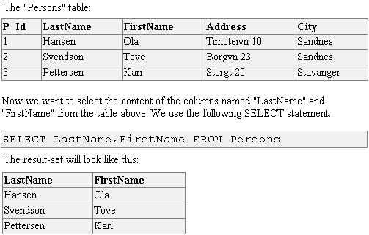
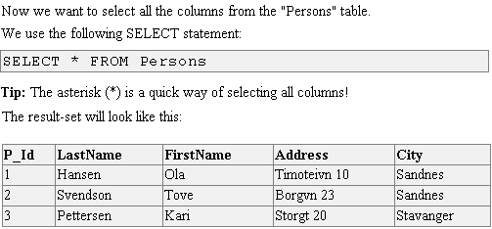
Example: SELECT all columns

Slide 14
Projection in SQL
We can, if we wish, eliminate some of the components of the chosen tuples; that is, we can project the relation produced by a SQL query onto some of its attributes
In place of the * of the SELECT clause, we may list some of the attributes of the relation mentioned in the FROM clause. The result will be projected onto the attributes listed
SELECT ColumnName1, ColumnName2, …
FROM tableName

Slide 15
Example: Projection in SQL

Slide 16
Projection in SQL: Renaming Column headers
We could rename a column header in the result by using column alias
Follow the name of attribute by the keyword as and an alias.
SELECT ColumnName1 as Alias1, ColumnName2 as Alias 2, …
FROM tableName

Slide 17

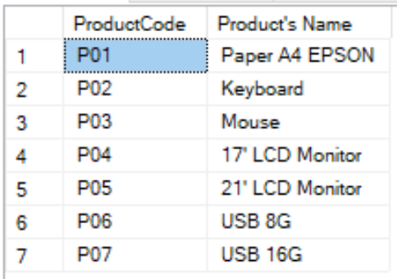
Example: Renaming column headers
The example displays the “Name” as “Product’s Name”
Because “Product’s Name” contain a space, it has been enclosed in double quotation marks.

Slide 18
Projection in SQL: extended projection
In the SELECT cause, we could create new attribute by using an expression
We should give an alias for the column corresponding to the expression
SELECT ColumnName1, …, expression1 as alias1,…
FROM tableName

Slide 19

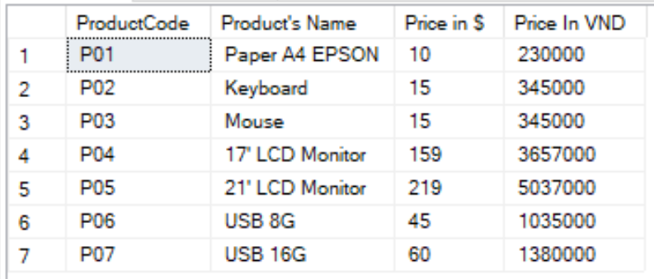
Example: Extended projection
Note that the resultant calculated column “Price In VND” is not a new column in the “Products” table; it is for display only.

Slide 20
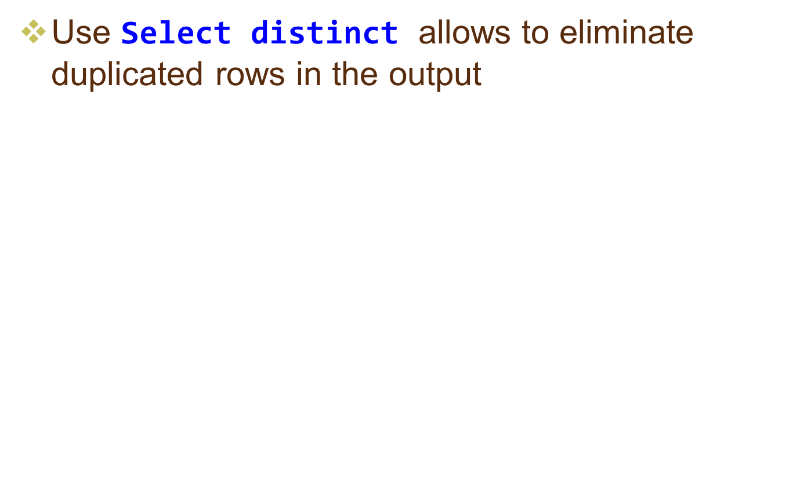
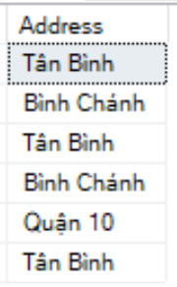

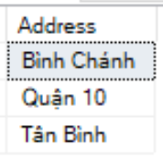

Duplication Eliminating with
SELECT distinct

Slide 21
Selection in SQL (Restricting data)
While retrieving data from the database, you may need to restrict the rows of data that are displayed
In that case, the solution is to use the WHERE clause
The WHERE clause is equal to the selection operator of relational algebra
The expression that may follow WHERE include conditional expressions like those found in C or Java

Slide 22
Selection in SQL (or Restricting data)
SELECT [ ALL | DISTINCT ]
[ TOP n [ PERCENT ] ]
* | {column_name | expression [alias],…}
[FROM tableName]
[WHERE conditional expressions]
WHERE: restricts the query to rows that meet conditions expressed by conditional expressions
Conditional expression: is composed of column names, expressions, constants, and a comparison operator

Slide 23




Example: Restricting data

Slide 24


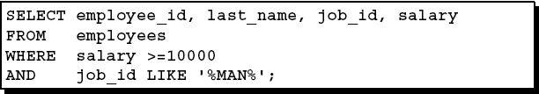

Example: Restricting data

Slide 25

Comparison of Strings
Two strings are equal if they are the same sequence of characters.
When comparing strings with different declarations, only the actual strings are compared (SQL ignores any “pad” characters that must be presenet in the database in order to give a string its required length)
We can use “<“, “>”, “=“, “<=”, “>=” and “<>” operators to compare two strings

Slide 26
Pattern matching in SQL
An alternative form of comparison expression is:
s LIKE p
where:
  S: is a string
  P: is a pattern (with the optional use of some special characters: “%”, “_” ..)
    % corresponds to a sequence of characters
    _ corresponds to any character
Similarly, “s NOT LIKE p” is true if and only if string s does not match pattern p

Slide 27


Example: Pattern matching in SQL
List title of the movies having title being with ‘Star’ and a blank.
List title of the movies having title with 5 characters long
Sequence of five ‘_’ characters

Slide 28

Example: Pattern matching in SQL
List title of the movies begin with a S or a G.

Slide 29
Dates and Times
SQL generally support dates and times as special data types. These values are often representable in a variety of formats such as:
  Date: ‘05/14/1948’, ’14 May 1948’, ‘1948-05-14’
  Time: ’15:00:02’, ’16:10:25.5’
  DateTime: ‘1948-05-14 12:00:02’
We can compare dates or times using the same comparison operators we use for numbers or strings (<, >, <=, >=, =, <>)

Slide 30


NULL values
Null is a special marker used in Structured Query Language (SQL) to indicate that a data value does not exist in the database.
Since Null is not a member of any data domain, it is not considered a "value", but rather a marker (or placeholder) indicating the absence of value.
  When we operate on a NULL and any value, using an arithmetic operator like *, +, -, …, the result is NULL.
  When we compare a NULL value and any value, using a comparison operator like = or >, the result is UNKNOWN
We could use expression “x is NULL” to ask if x has the value NULL

Slide 31
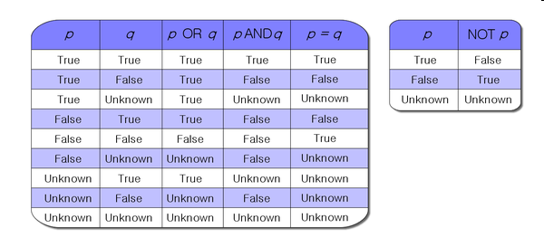
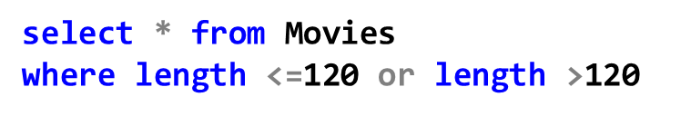
The Truth-value ‘Unknown’
Truth table for three-value logic
Does this query give all Movies in output?

Slide 32
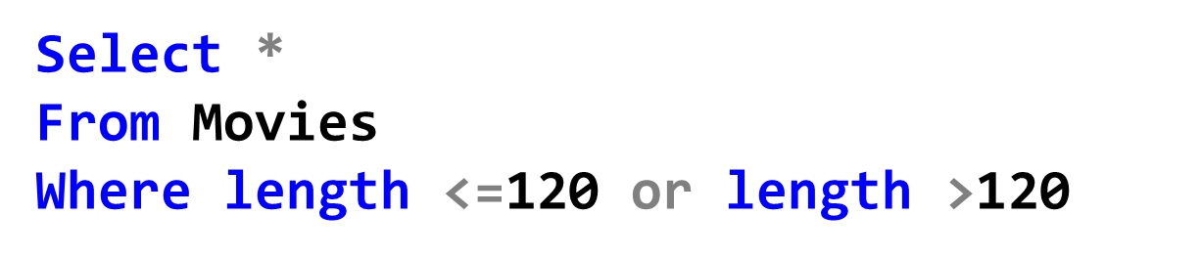
Example: The Truth-value ‘Unknown’
What are the results of the following query?
=> Movies tuples with non-NULL lengths

Slide 33
Ordering the Output
While retrieving data from the database, you may need to specify the order in which the rows are displayed.
In that case, the solution is to use the ORDER BY clause

Slide 34
Ordering the Output
SELECT [ ALL | DISTINCT ]
[ TOP n [ PERCENT ] ]
* | {column_name | expression [alias],…}
FROM table
[WHERE conditional expression]
[ORDER BY {expression1 [ASC | DESC], expression2 [ASC | DESC] …} ]
If you use the ORDER BY clause, it must be the last clause of the SQL statement.
ORDER BY clause: Specifies one or many column on which to sort.
A sort column can be specified as a name or column alias, an expression, or a nonnegative integer representing the position of the name, alias, or expression in select list.
Multiple sort columns can be specified. The sequence of the sort columns in the ORDER BY clause defines the organization of the sorted result set.
  The results are first sorted on the first column; then the tuples having the same value on the first column will be sorted on the second column, and so on.

Slide 35
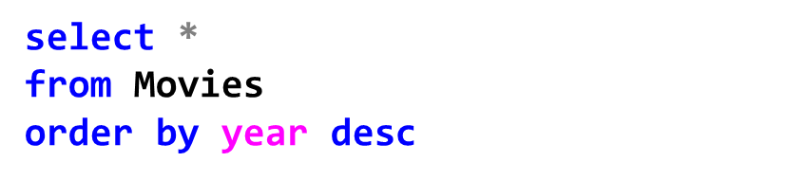
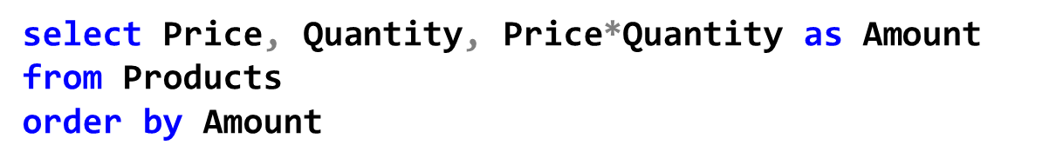
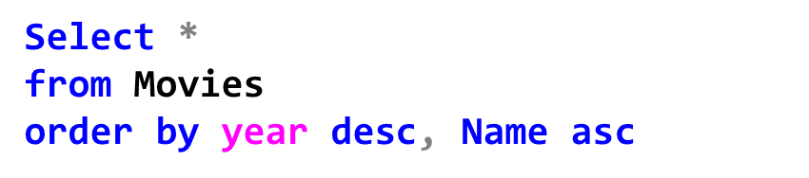
Example: Ordering the output
Sorting by column name
Sorting by column alias
Sorting by Multiple Columns

Slide 36
Thank You !

