Slide 1
Session 12
Chapter 6 – Queries involving more than one relation
Database Systems

Slide 2
Objectives
1
Know how to query data from more than one relation
2
Know how to Dis-ambiguate Attributes
3
Understand the role of column Aliases and table Aliases
4
Know how to use set-operators (union, different, intersect) in SQL

Slide 3
Contents
1
Product and Join in SQL
2
Dis-ambiguating Attributes
3
Tuple Variables
4
Union
5
Intersection
6
Difference

Slide 4
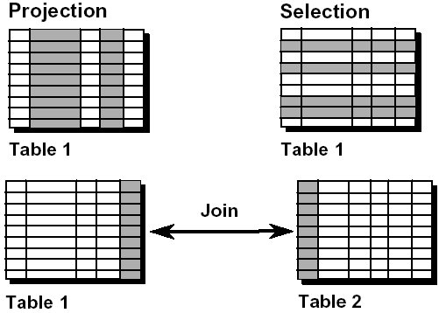
Review: Capabilities of SQL SELECT Statements
Projection: You can use the projection capability in SQL to choose the columns in a table that you want returned by your query.
Selection: You can use the selection capability in SQL to choose the rows in a table that you want returned by a query (with WHERE clause)
Joining: You can use the join capability in SQL to bring together data that is stored in different tables by creating a link between them.

Slide 5
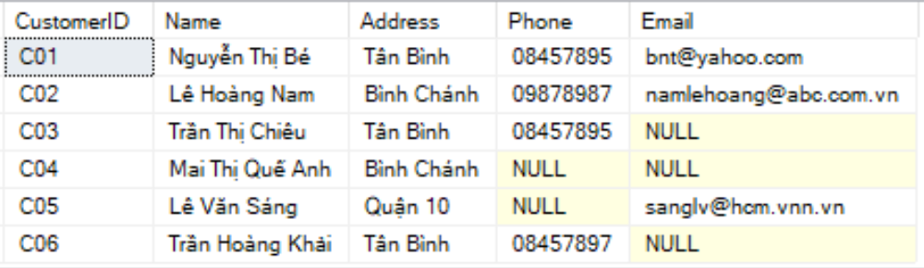
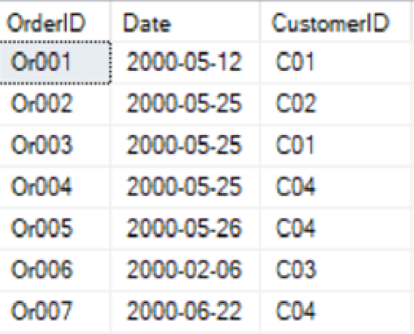
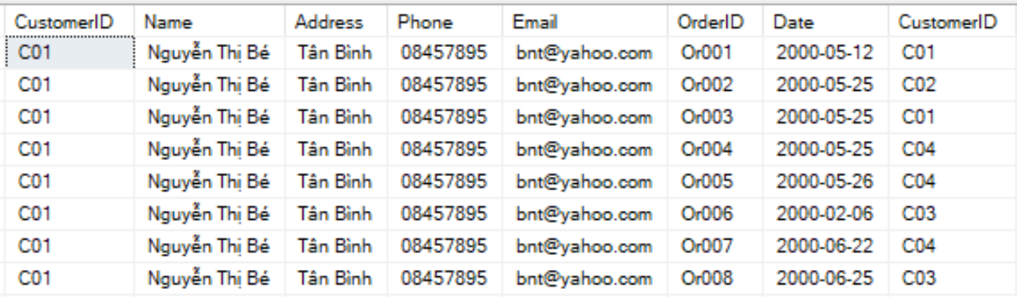
Review: A Cartesian Products example
Customers (6 rows)
Orders (7 rows)
Customer x Orders (6x7 = 42 rows)

Slide 6
1 – Products & Joins in SQL
When data from more than one table in the database is required, a join condition is used. Rows in one table can be joined to rows in another table according to common values existing in corresponding columns, that is, usually primary and foreign key columns.
To display data from two or more related tables:
  List each relation in the FROM clause
  Write a simple join condition in the WHERE clause.
To join n tables together, you need a minimum of n-1 join conditions.

Slide 7
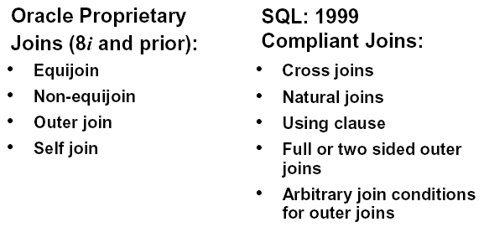
Types of JOINs

Slide 8
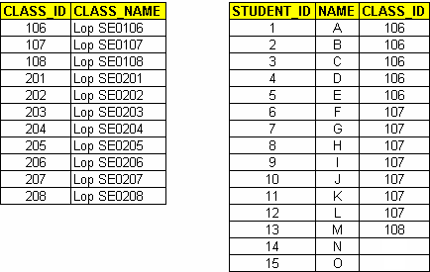
What is an inner join?
To determine a student’s class name, you compare the value in the CLASS_ID column in the CLASS table with the CLASS_ID values in the STUDENT table.
The relationship between the STUDENT and CLASS tables is values in the CLASS_ID column on both tables must be equal.

Slide 9
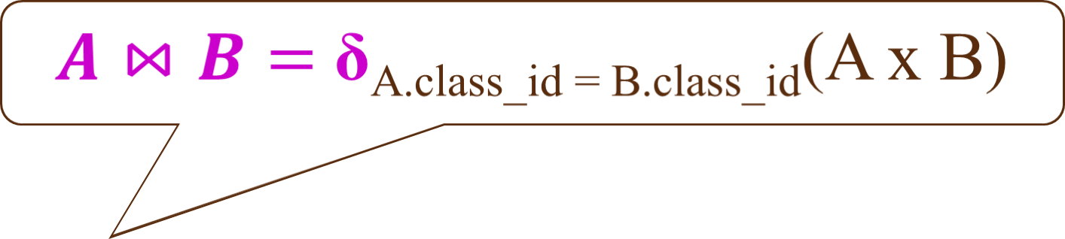
How to express inner Join with Relational Algebra?
SELECT *
FROM Student A, Class B
WHERE A.class_id = B.class_id
SELECT *
FROM Student A INNER JOIN Class B
on A.class_id = B.class_id

Slide 10
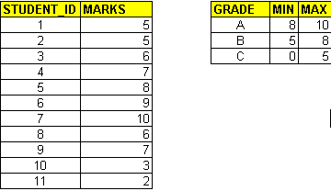
Inner join with non-equal condition
A join condition containing something other than an equality operator = Theta join in RA.
Student
Ranking
δA.mark >= B.min AND A.mark < B.max(AxB)
SELECT A.student_id, B.grade
FROM Student A, Ranking B
WHERE A.marks >= B.MIN
AND A.mark < B.MAX

Slide 11
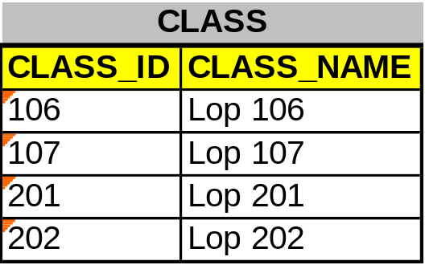
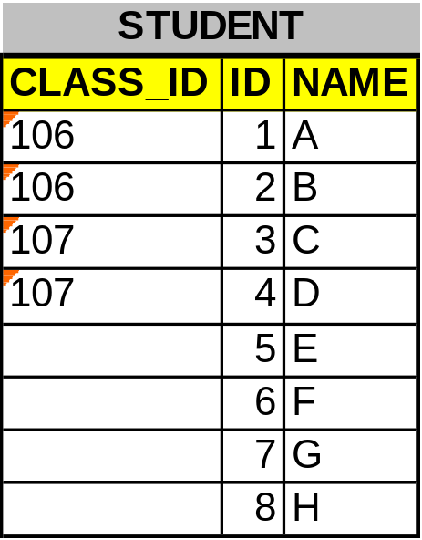
Outer Joins
If a row does not satisfy a join condition, the row will not appear in the query result. These rows are called dangling rows (or dangling tuples).
The missing rows can be returned if an outer join operator is used in the join condition.

Slide 12
Left Outer Join
When using left outer join of CLASS (on the left) and STUDENT (on the right), all the classes will appear regardless of whether or not they have any student
SELECT A.class_name
FROM Class A
LEFT OUTER JOIN Student B
ON A.class_id = B.class_id

Slide 13
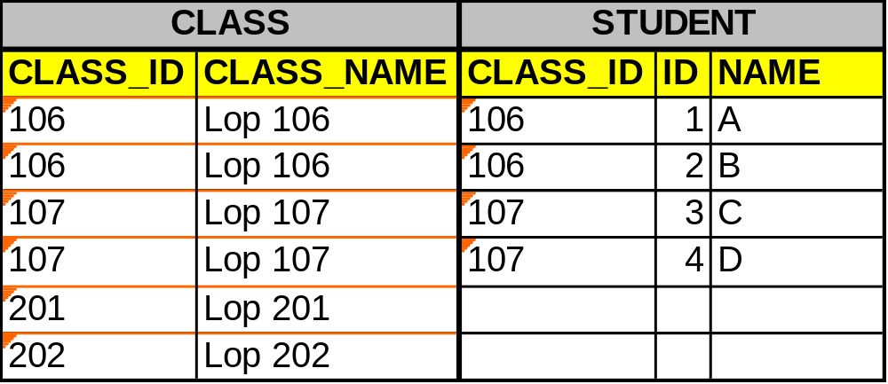
Output of LEFT OUTER JOIN
The red box is on the Left

Slide 14
Right Outer Join
When using right outer join of CLASS (on the left) and STUDENT (on the right), all the students will appear, regardless of whether or not they have any class
SELECT B.name
FROM Class A
RIGHT OUTER JOIN Student B
ON A.class_id = B.class_id

Slide 15
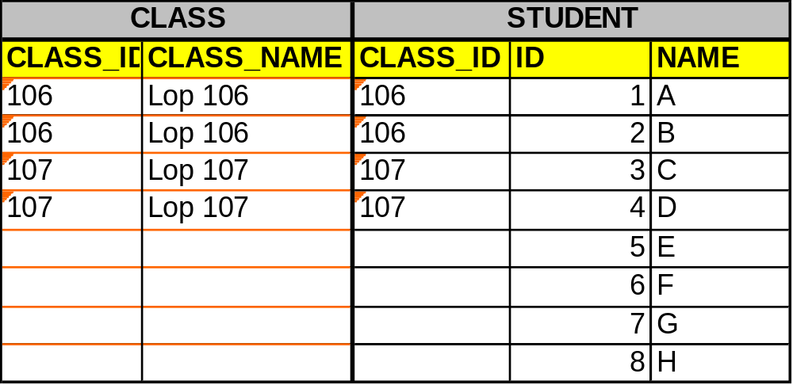
Output of RIGHT OUTER JOIN
The red box is on the Right

Slide 16
Full Outer Join
When using full outer join of CLASS and STUDENT, all students and all classes will appear
SELECT B.name
FROM class A
FULL OUTER JOIN student B
ON A.class_id = B.class_id

Slide 17
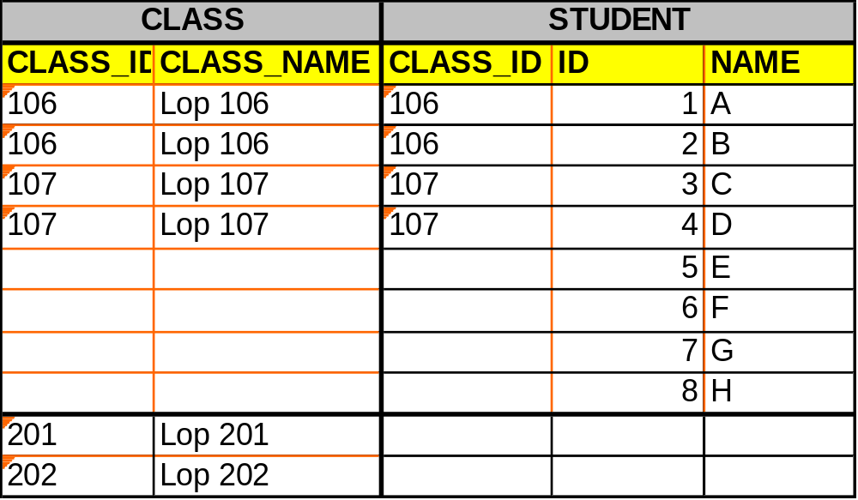
Output of FULL OUTER JOIN
LEFT OUTER JOIN
RIGHT OUTER JOIN

Slide 18
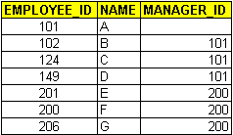
Self Joins
Sometimes you need to join a table to itself.
SELECT A.employee_id + ‘ MANAGED BY ‘ + B.employee_id
FROM employee A, employee B
WHERE A.Manager_id = B.Employee_ID

Slide 19
Cartesian Products
A Cartesian product is formed when:
  A join condition is omitted
  A join condition is invalid
  All rows in the first table are joined to all rows in the second table
To avoid a Cartesian product, always include a valid join condition in a WHERE clause.

Slide 20
2. Disambiguating attributes
Sometimes we ask a query involving several relations, and among these relations are two or more attributes with the same name. If so, we need a way to indicate which of these attributes is meant by a use of their shared name.
SQL solves this problem by allowing us to place a relation name and a dot in front of an attribute, thus R.A refers to the attribute A of relation R

Slide 21
Disambiguating attributes example
Two relations:
  MovieStar (name, address, gender, birthdate)
  MovieExec (name, address, cert#, netWorth)
Both relations have attributes “name” and “address”. Look at the following query to see the way of dis-ambiguating:
SELECT MovieStar.Name, MovieExec.Name
FROM MovieStar, MovieExec
WHERE MovieStar.Address = MovieExec.Address

Slide 22
3. Tuple Variables
Disambiguating attributes by prefixing the relation name works as long as the query involves combining several different relations
However, sometimes we need to ask a query that involves two ore more tuples from the same relation. How to do that?
Solution: we may list a relation R as many times as we need to in the FROM clause but we need a way to refer to each occurrence of R. SQL allows us to define, for each occurrence of R in the FROM clause, an “ALIAS” which we shall refer to as a tuple variables

Slide 23
Tuple variables example
Sometimes you need to join a table to itself.
SELECT A.employee_id + ‘ MANAGED BY ‘ + B.employee_id
FROM employee A, employee B
WHERE A.Manager_id = B.Employee_ID

Slide 24
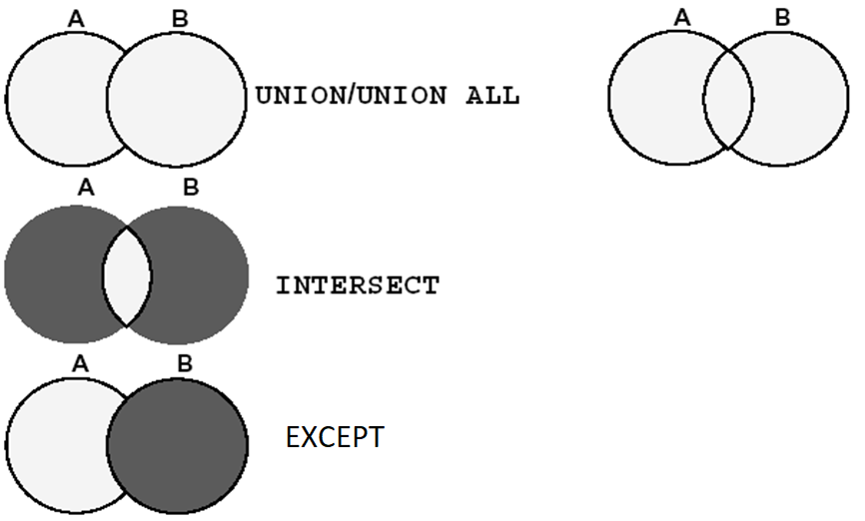
SET operators (Union, Intersection, Difference)

Slide 25
UNION & UNION ALL
The UNION operator eliminates any duplicated rows.
But UNION ALL still returns duplicated rows

Slide 26
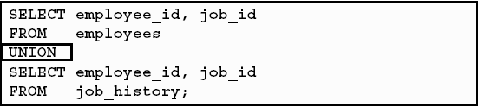
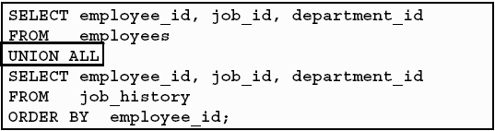
Example: UNION

Slide 27
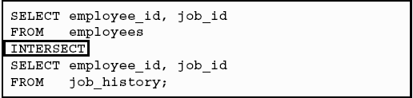
INTERSECT
{A ∩ B} = {a | a is in A and B}

Slide 28
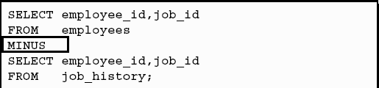
Difference
SELECT employee_id, job_id FROM employees
EXCEPT
SELECT employee_id, job_id FROM job_history
SQL Server
Oracle

Slide 29
Thank You !

