Slide 1
Database System Session 1
Chapter1: The Worlds of Database Systems
Database Systems

Slide 2
1. What is a database?
a database is a collection of information that exists over a long period of time, often many years.
The term database refers to a collection of data that is managed by a DBMS (Database Management System). The DBMS is expected to:
  Allow users to create new databases and specify their schemas (logical structure of the data)
  Give users the ability to query and modify the data
  Support the storage of very large amounts of data — many terabytes or more — over a long period of time
  Enable durability, the recovery of the database
  Control access to data from many users at once

Slide 3
2. Evolution of Database Models
Time | Database model | Examples
1960s – 1980s | File systems | VMS/VSAM
1970s – 1990s | Hierarchical data model | IMS
1970s – 1990s | Network data model | IDS
1980s - present | Relational model | DB2, Oracle, MS, SQL Server, MySQL
1990s - present | Object-oriented data model Object-relational data model | Versant, DB2 UDB, Oracle 12c
1990s - present | Web enabled data model | dbXML, Tamino, MS SQL Server, Oracle 12c

Slide 4
a. File systems
A file database stores information of a table in a single file in which each line contains one record where fields are separated by commas, whitespaces, tabs, … There is no structural relationship among records.
Advantages | Disadvantages
Easy to understand and implement Require less hardware and software skills Best for small database | May contain duplicate data Data manipulation is inefficient (if one record of a file is deleted or updated, all related information has to be deleted or updated manually) Information retrieving is very time consuming in large databases

Slide 5
b. Hierarchical data model
Hierarchical database represents the data in a tree-like structure in which there is a single parent for each record. This model structure allows the one-to-one and a one-to-many relationship.
Universities
Departments
Courses
Students

Slide 6
b. Hierarchical data model
Advantages | Disadvantages
Easy to understand the relationships among different records Pace of accessing the information is speedy due to the predefined paths | Do not allow many-to-many relationships Any change in the relationships may require manual reorganization of the data

Slide 7
c. Network data model
Network database allows multiple parent and child relationships i.e., it maintains many-to-many relationship. Network database is basically a graph structure.
Companies
One-to-many relationship
Many-to-many relationship
Departments
Suppliers
Employees
Projects

Slide 8
c. Network data model
Advantages | Disadvantages
The model is simple and the implementation is effortless Easy access to Data Ability to manage more relationship: one-to-one, one-to-many, many-to-many | System complexity: each and every record has to be maintained with the help of pointers Because of the pointers, insertion, updates and deletion become more complex A change in structure demands a change in the application -> lack of structural independence.

Slide 9
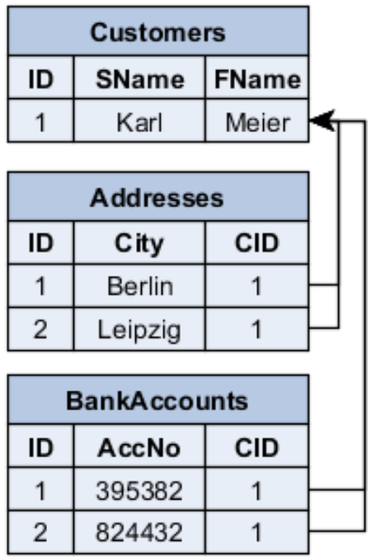
d. Relational data model
Relational data model stores information in tables (entities) and allows the entities to be related through a common attribute.

Slide 10
d. Relational data model
Advantages | Disadvantages
Support operations like union, intersection, difference, Cartesian product, select, project, join and division. Easy access to Data Use a language which is easy and human readable | The response to a query is time-consuming and inefficient if the number of tables between which the relationships are established increases.

Slide 11
3. Outline of Database-System Studies
We divide the study of databases into 2 parts:
  Part I: How to design a database
    Chapter 2: Relational Data Model
    Chapter 3&4: Design database by two different approaches.
  Part II: Manipulation with a database
    Chapter 6: The database language SQL
    Chapter 7: Constraints and Triggers
    Chapter 9: Stored Procedure.

