Slide 1
Chapter 1: Introduction to Statistics
LEARNING OBJECTIVES
1. Big picture of Statistics
2. Data
3. Collecting data
4. Mechanistic and Empirical models

Slide 2
Why is Statistics?
Statistics allows you to understand a subject much more deeply.
Statistics helps us to make discoveries in science, make decisions based on data, and make predictions.
Statisticians and statistical methods are important part of pharmaceutical industry, social scientists, business practice,…

Slide 3
What is Statistics?
Statistics is the science of collecting, organizing, analyzing, and interpreting DATA in order to make decisions
Descriptive Statistics:
(thống kê mô tả)
Involves organizing, summarizing, and displaying (hiển thị) data.
e.g. Tables, charts, averages
Inferential Statistics:
(thống kê suy luận)
Involves using sample data to draw conclusions about a population.

Slide 4
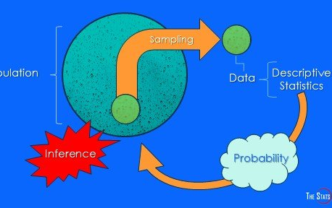
Big picture of Statistics

Slide 5
Statistical concepts
Population: the complete collection of all individuals to be studied.
Sample: Sub-collection of members selected from a population.
Data: consist of information coming from observations, counts, measurements, or responses.
Parameter: a numerical measurement describing some characteristic of a population.
Statistic: a numerical measurement describing some characteristic of a sample.

Slide 6
Type of data
Qualitative data
(dữ liệu định tính)
Quantitative data
(dữ liệu định lượng)
Major
Place of birth
Age
Temperature
Discrete
Continuous

Slide 7
Collecting data
Retrospective study (Nghiên cứu hồi cứu): using historical data.
Observational study (Nghiên cứu quan sát): A researcher observes and measures characteristics of interest of part of a population.
Designed experiment (Thiết kế thử nghiệm): A treatment is applied to part of a population and responses are observed

Slide 8
Statistical model
Mechanistic model (mô hình cơ học): built from our underlying knowledge.
Example: Current = Voltage/Resistance, or I = U / R
(dòng điện=điện áp/điện trở)
Empirical model (mô hình thực nghiệm): uses our engineering and scientific knowledge of the phenomenon (hiện tượng):
Response = deterministic function + random error
Example: I = U / R + ε
Remark: ε is a term added to the model to account for the fact that the observed values of current flow do not perfectly conform to the mechanistic model.

Slide 9
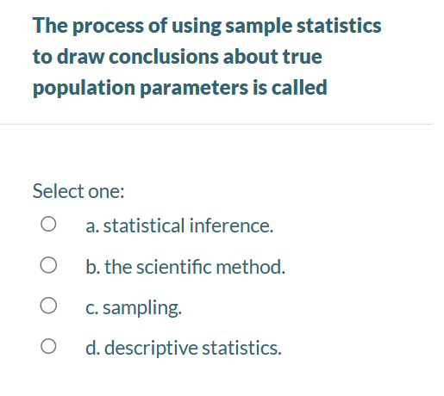

Slide 10
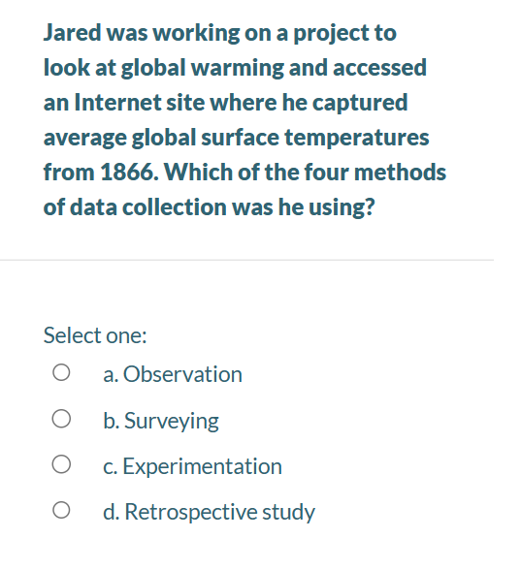

Slide 11
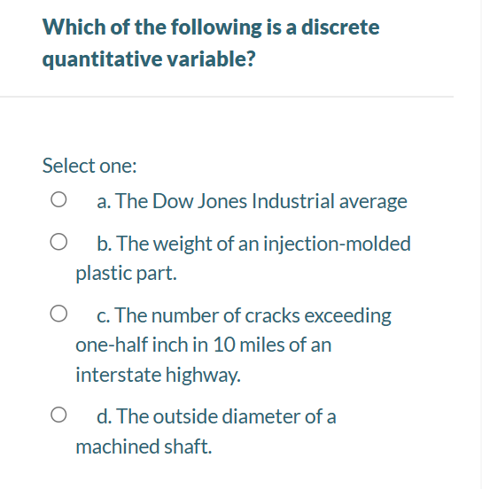

Slide 12
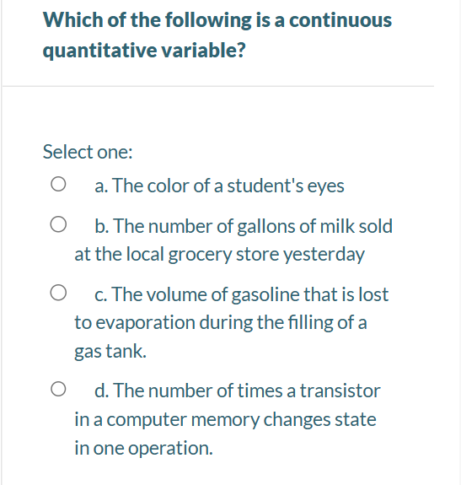

Slide 13
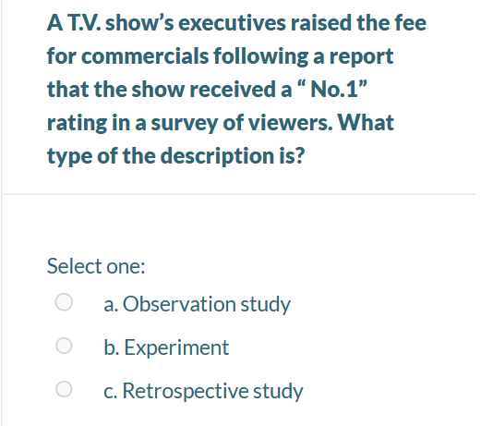

Slide 14
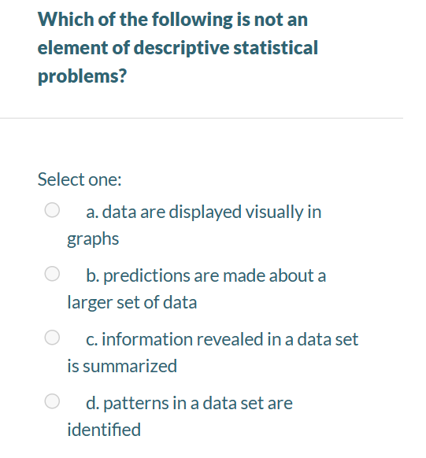

Slide 15
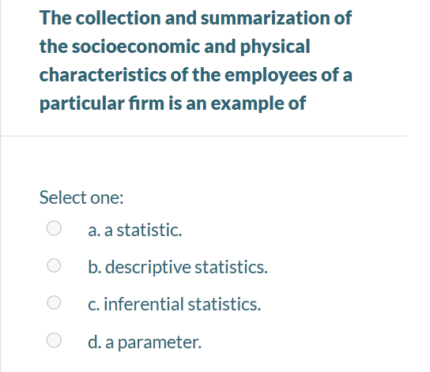

Slide 16
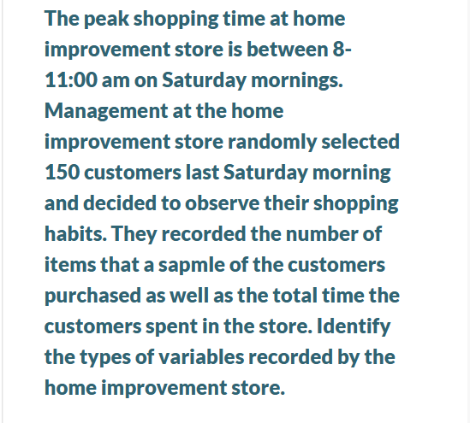
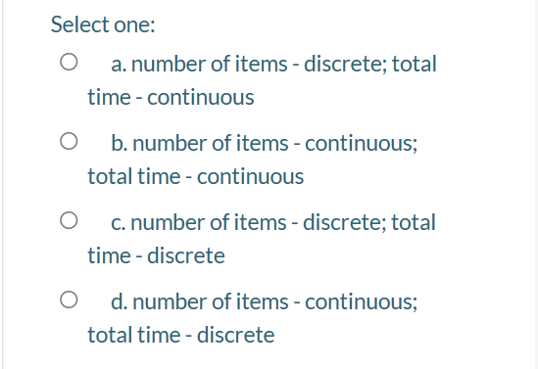

Slide 17
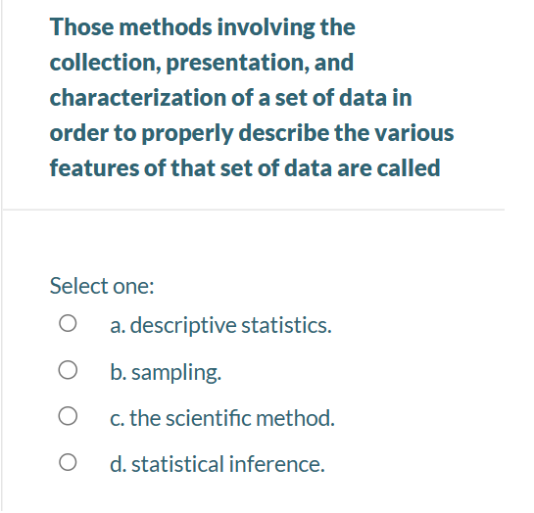

Slide 18

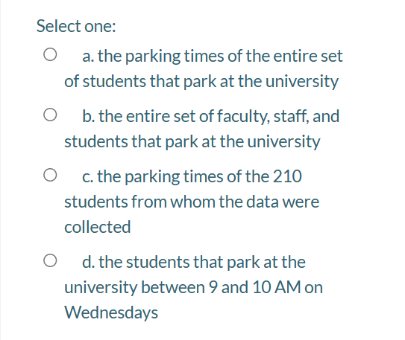

Slide 19
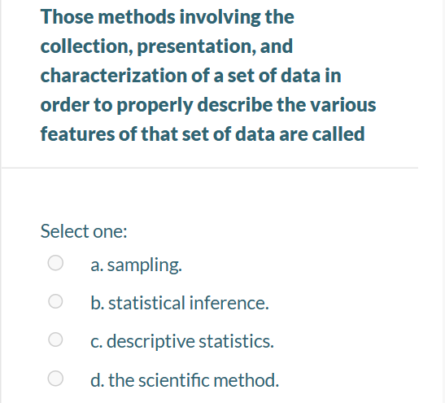

Slide 20
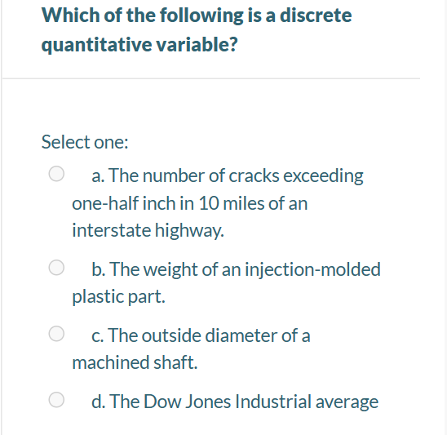

Slide 21
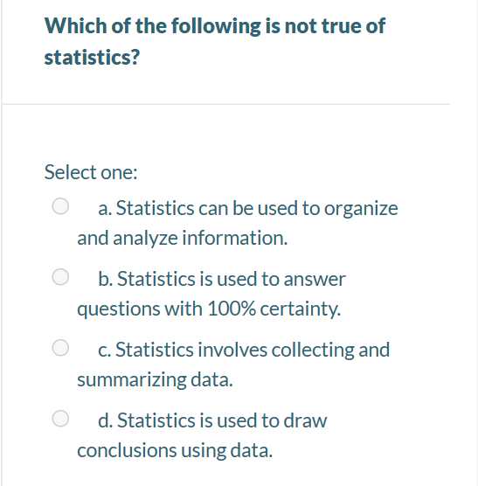

Slide 22
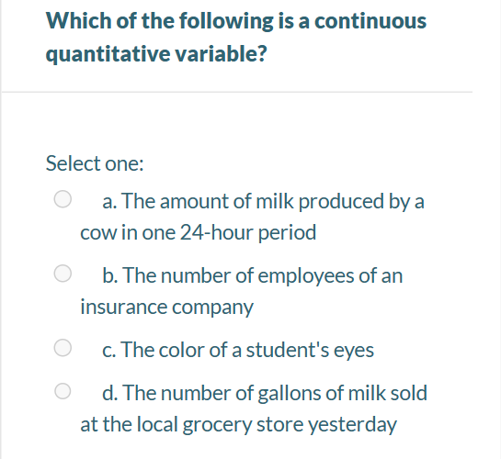

Slide 23
