Slide 1
Chapter 2: PROBABILITY
LEARNING OBJECTIVES
1. Sample spaces and events
2. Interpretations of Probability
3. Addition rules
4. Conditional probability
5. Multiplication and total probability rules
6. Independence
7. Bayes’ theorem
8. Random variables

Slide 2
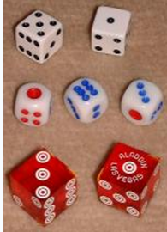
Sample spaces and events
Example
When a six-sided die is rolled,
the sample space :
S = {1, 2, 3, 4, 5, 6}.
The event A that an even number
is obtained = {2, 4, 6}.
The event B that a number
greater than 2 is obtained
= {3, 4, 5, 6}.

Slide 3
Sample spaces and events
Definition
An experiment that can result in different outcomes, even though it is repeated in the same manner everytime, is called a random experiment.
The set of all possible outcomes of a random experiment is called the sample space (denoted as S)
An event is a subset of the sample space of a random experiment.

Slide 4


Sample spaces and events
Example 1: A probability experiment consists of tossing a coin and then rolling a six-sided die. Describe the sample space.
Tree diagram:
H1 H2 H3 H4 H5 H6
T1 T2 T3 T4 T5 T6
The sample space has 12 outcomes:
S = {H1, H2, H3, H4, H5, H6, T1, T2, T3, T4, T5, T6}

Slide 5
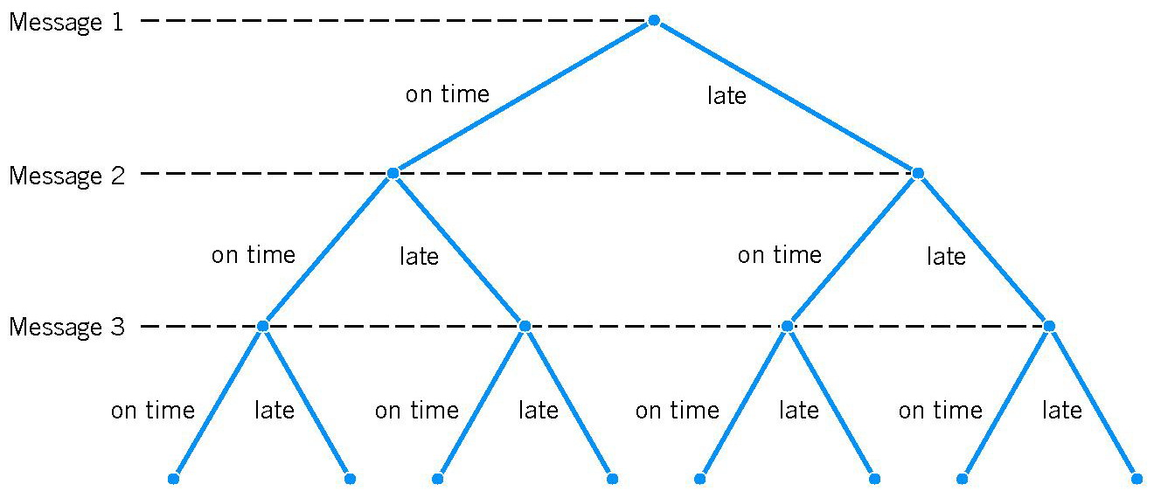
Sample spaces and events
Example 2: Each message in a digital communication system is classified as to whether it is received within the time specified by the system design. If three messages are classified, use a tree diagram to represent the sample space of possible outcomes.

Slide 6
Sample spaces and events
Basic Set Operations
The union of two events is the event that consists of all outcomes that are contained in either of the two events. We denote the union as E₁∪E₂.
The intersection of two events is the event that consists of all outcomes that are contained in both of the two events. We denote the intersection as E₁∩E₂.
The complement of an event in a sample space is the set of outcomes in the sample space that are not in the event. We denote the component of the event E as E’.

Slide 7
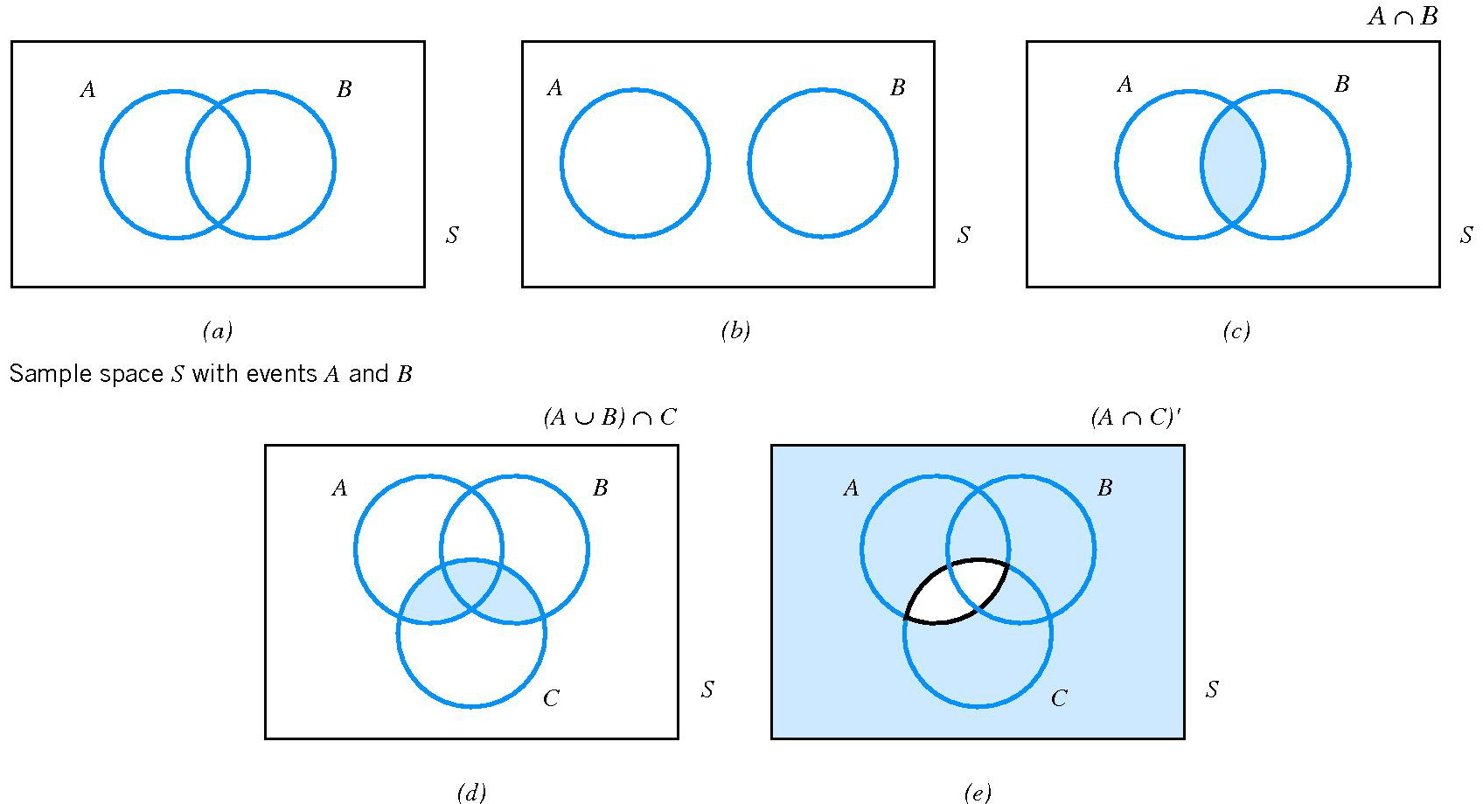
Sample spaces and events
Venn Diagrams
mutually exclusive

Slide 8
Sample spaces and events
Important properties:
A ∪ (B ∪ C) = (A ∪ B) ∪ C
A ∩ (B ∩ C) = (A ∩ B) ∩ C
A ∩ (B ∪ C) = (A ∩ B) ∪ (A ∩ C)
(A ∪ B)’ = A’∩ B’
(A ∩ B)’ = A’∪ B’
A = (A ∩ B) ∪ (A ∩ B’)

Slide 9
Interpretations of Probability
Introduction
There are different approaches to assessing the probability of an uncertain event:
1. a priori classical probability (xs cổ điển tiên nghiệm): the probability of an event is based on prior knowledge of the process involved.
2. empirical classical probability (xs cổ điển thực nghiệm): the probability of an event is based on observed data.

Slide 10
Interpretations of Probability
Equally Likely Outcomes
Whenever a sample space consists of N possible outcomes that are equally likely, the probability of each outcome is 1/N.
1. a priori classical probability
2. empirical classical probability

Slide 11
Interpretations of Probability
Example: Find the probability of selecting a face card (Jack, Queen, or King) from a standard deck of 52 cards.

Slide 12
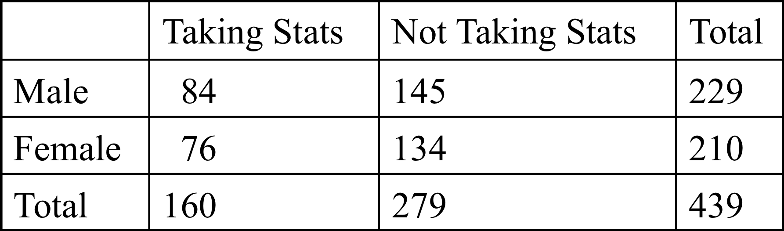
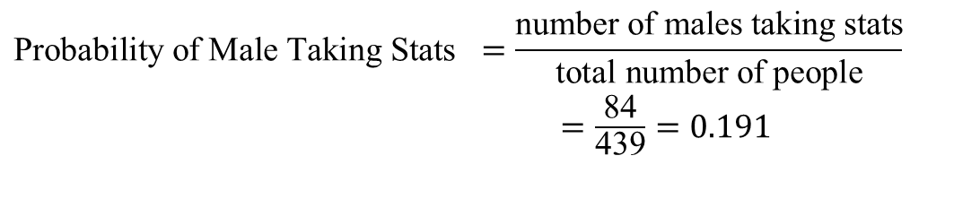
Interpretations of Probability
Example: Find the probability of selecting a male taking statistics from the population described in the following table:
$$\text{Probability} \text{of} \text{Male} \text{Taking} \text{Stats} =\frac{\text{number} \text{of} \text{males} \text{taking} \text{stats}}{\text{total} \text{number} \text{of} \text{people}}$$ $=\frac{\text{84}}{\text{439}}=0.191$

Slide 13
Interpretations of Probability
Axioms of Probability
Probability is a number that is assigned to each member of a collection of events from a random experiment that satisfies the following properties:
(S is the sample space and E is any event)
1. P(S) = 1
2. 0 ≤ P(E) ≤ 1
3. For two events E₁ and E₂ with E₁∩E₂ = Ø
P(E₁ ∪ E₂) = P(E₁) + P(E₂)

Slide 14
Interpretations of Probability
For a discrete sample space, the probability of an event E, denoted as P(E ), equals the sum of the probabilities of the outcomes in E.
Example 1: A random experiment can result in one of the outcomes
S = {a, b, c, d} with probabilities 0.1, 0.3, 0.5, and 0.1, respectively. Let A = {a, b}, B = {b, c, d}, A’= S \ A, B’ = S \ B.
Find P(A); P(B); P(A’); P(B’); P(A∩ B); P(A∪ B).
Example 2: A visual inspection of a location on wafers from a semiconductor manufacturing process resulted in the following table.
What is the probability that a wafer contains three or more particles in the inspected location?
Number of contamination particles | Proportion of wafers
0 | 0.40
1 | 0.15
2 | 0.20
3 | 0.10
4 or more | 0.15

Slide 15



Complement rule
If the complement of A, denoted by $A^{′},$ consists of all the outcomes in which the event A does not occur, then we have:
$$P\left(A\right)+P\left(A^{′}\right)=1$$
Remark: Depending on the problem, it may be easier to find $P\left(A′\right)$ and then use the above equation to find P(A).
Example: A number is chosen at random from a set of whole numbers from 1 to 50. Calculate the probability that the chosen number is not a perfect square.
Notes:
perfect square: Số chính phương

Slide 16
Addition rules
1. If A and B are mutually exclusive events,
P(A ∪ B) = P(A) + P(B)
2. A collection of events, E₁, E₂, …, E_{k} is said to be mutually exclusive if for all pairs,
E_{i} ∩ E_{j} = Ø
For a collection of mutually exclusive events,
$$P\left(E_{1}∪E_{2}∪…∪E_{k}\right)=P\left(E_{1}\right)+P\left(E_{2}\right)+…+P(E_{k})$$
3. General: If A and B are any events,
P(A ∪ B) = P(A) + P(B) – P(A ∩ B)

Slide 17
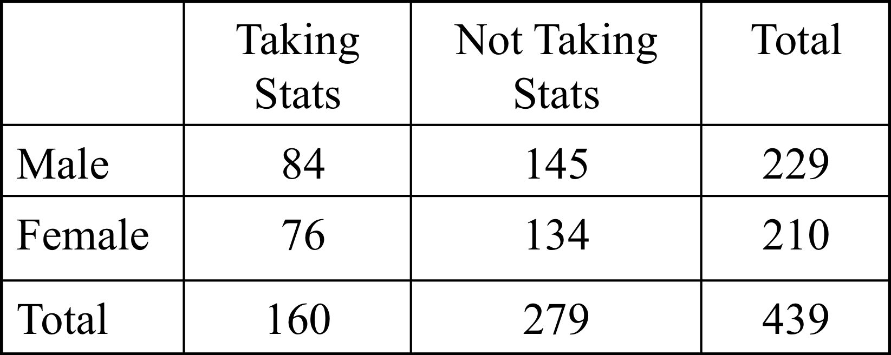
Addition rules
Example: Find the probability of selecting a male or a statistics student from the population described in the following table:
P(Male or Stat) = P(M) + P(S) – P(M or S)
= 229/439 + 160/439 – 84/439 = 305/439

Slide 18
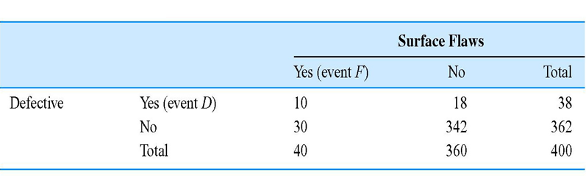


Conditional Probability
The conditional probability of an event B, given that an event A already occurred, is denoted by P(B|A).
Notes:
Surface flaw: lỗ hổng bề mặt; Defective: Lỗi

Slide 19
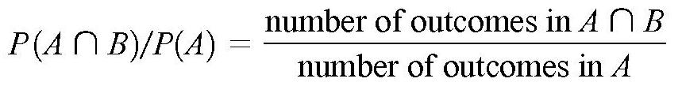
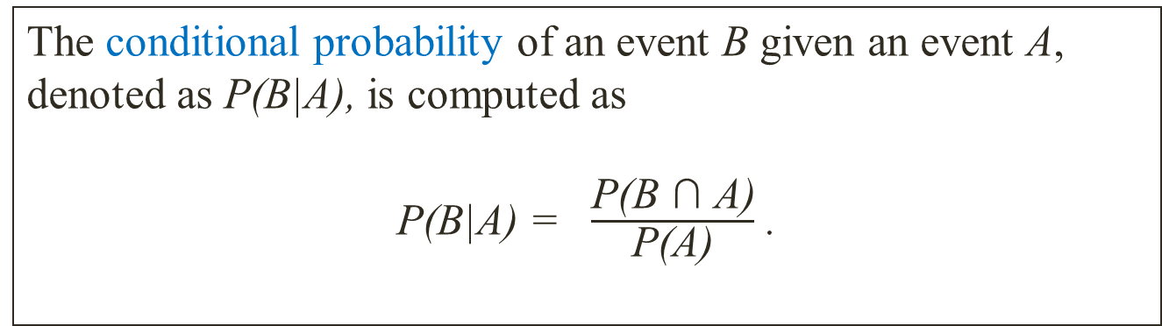
Conditional Probability
Definition
The conditional probability of an event B given an event A,
denoted as P(B|A), is computed as
P(B|A) = $\frac{\text{P}\text{(}\text{B}\text{ ∩ }\text{A}\text{)}}{\text{P}\text{(}\text{A}\text{)}}$ .
Special case: All outcomes are equally likely

Slide 20
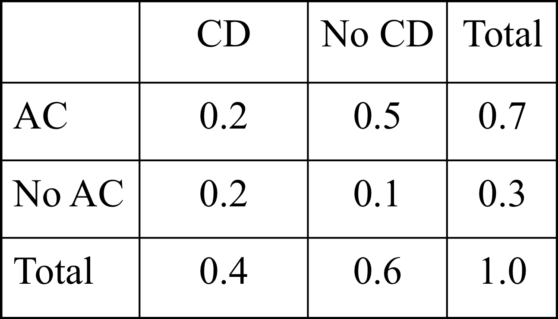
Conditional Probability
Example: Of the cars on a used car lot, 70% have air conditioning (AC) and 40% have a CD player (CD). 20% of the cars have both.
What is the probability that a car has a CD player, given that it has AC ?

Slide 21
Multiplication rule
Multiplication Rule
P(A ∩ B) = P(A|B)P(B) = P(B|A)P(A)
Example: The probability that an automobile battery subject to high engine compartment temperature suffers low charging current is 0.7. The probability that a battery is subject to high engine compartment temperature is 0.05.
The probability that a battery is subject to low charging current and high engine compartment temperature is
C={a battery suffers low charging current}
T ={a battery is subject to high engine compartment temperature}
Notes:
automobile battery : ắc quy ô tô; high engine compartment temperature: Nhiệt độ khoang động cơ cao, low charging current : dòng sạc thấp

Slide 22
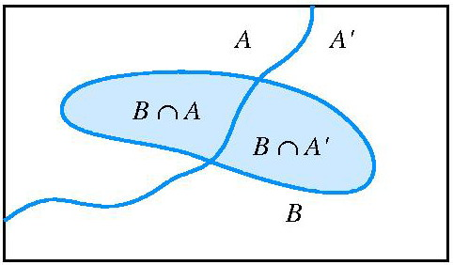
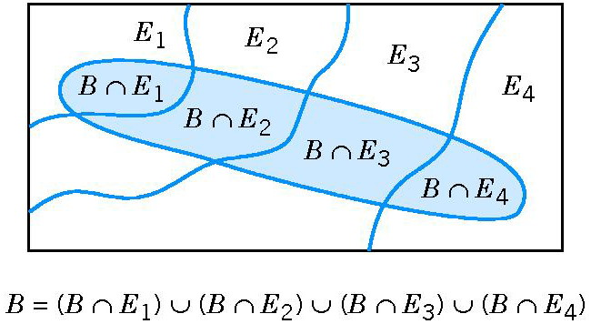
Total Probability Rule
Partitioning an event into two mutually exclusive subsets.
Partitioning an event into several mutually exclusive subsets.

Slide 23
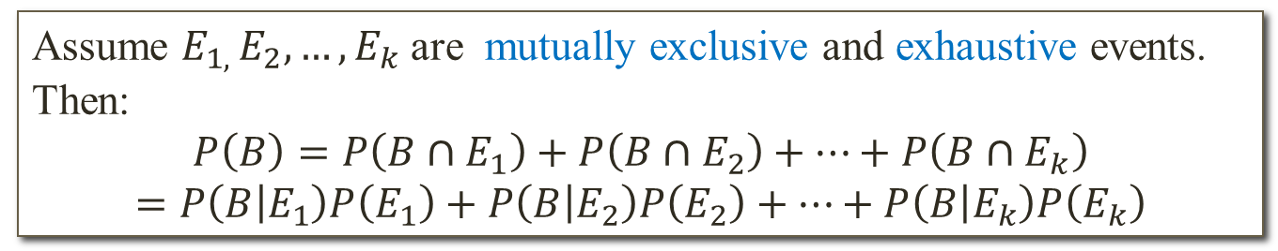
Total Probability Rule
Total Probability Rule: two events
$$P\left(B\right)=P\left(B∩A\right)+P\left(B∩A^{′}\right)=P\left(B | A\right)P\left(A\right)+P\left(B | A^{′}\right)P(A^{′})$$
Total Probability Rule: multiple events
Assume $E_{1, }E_{2},…,E_{k}$ are mutually exclusive and exhaustive events. Then:
$$P\left(B\right)=P\left(B∩E_{1}\right)+P\left(B∩E_{2}\right)+…+P\left(B∩E_{k}\right)$$
$$=P\left(B | E_{1}\right)P\left(E_{1}\right)+P\left(B | E_{2}\right)P\left(E_{2}\right)+…+P\left(B | E_{k}\right)P\left(E_{k}\right)$$

Slide 24
Total Probability Rule
Example: The information of the contamination (ô nhiễm) discussion is summarized in the following table:
Let F denote the event that the product fail. Find P(F).
Probability of Failure | Level of Contamination | Probability of Level
0.100 | High | 0.2
0.005 | No high | 0.8
Hint:
Let H denote the event that the chip is exposed to high level of contamination.
So P(H) = 0.2 and P(H’) = 0.8.
Moreover, P(F|H) = 0.1 and P(F|H’) = 0.005.
Thus, P(F) = 0.1*0.2 + 0.005*0.8 = 0.024.
Notes:
Level of Contamination: Mức độ ô nhiễm

Slide 25
Independence
Definition
Two events are called independent if the occurrence of one event
does not change the probability of the other event. Equivalently,
any one of the following equivalent statements is true:
P(A|B) = P(A)
(2) P(A ∩ B) = P(A)P(B)
(3) P(B|A) = P(B)
Remark: If A and B are independent events, then so are events A and B’, events A’ and B, and events A’ and B’.

Slide 26
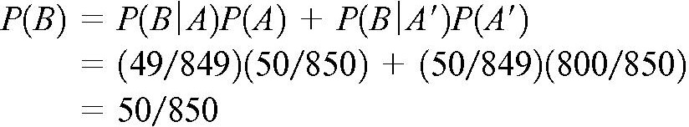
Independence
Example: A day’s production of 850 manufactured parts contains 50 parts that do not meet customer requirements. Two parts are selected at random, without replacement, from the batch.
Let A ={the first part is defective}, and B ={the second part is defective}.
We suspect that these two events are not independent because knowledge that the first part is defective suggests that it is less likely that the second part selected is defective.
Hint:
P(B|A) = 49/849
Conclusion: the two events are not independent, as we suspected.
Notes:
Suspect: nghi ngờ

Slide 27
Independence
Definition
The events E₁, E₂, …, E_{k} are independent if and only if for any subset of these events
$$P\left(E_{1}∩E_{2}∩…∩E_{k}\right)=P\left(E_{1}\right)P\left(E_{2}\right)…P(E_{k})$$
Question: Two coins are tossed.
Let A denote the event “at most one head on the two tosses”
and B denote the event “one head and one tail in both tosses.” Are A and B independent events?

Slide 28
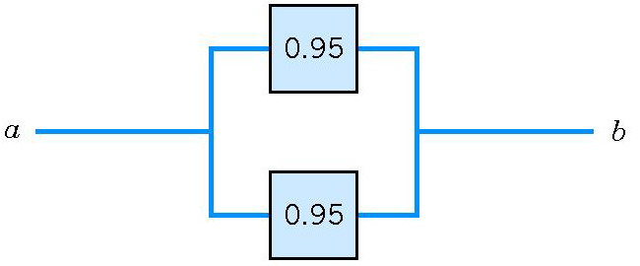
Independence
Example: The following circuit operates only if there is a path of functional devices from left to right. The probability that each device functions is shown on the graph. Assume that devices fail independently. What is the probability that the circuit operates?
P(T ∪B) = 1- P[(T ∪B)’]
= 1- P(T’∩B’)
P(T’∩B’) = P(T’)*P(B’)
= (1 - 0.95)² =0.05²
Let T and B denote the events that the top and bottom devices operate, respectively.
So P(T ∪B) = 1 - 0.05² =0.9975
Notes:
functional devices : thiết bị chức năng

Slide 29
Bayes’ Theorem
If E₁, E₂, …, E_{k} are k mutually exclusive and exhaustive events and B is any event,
A special case:

Slide 30
Bayes’ Theorem
Example 1: In a state where cars have to be tested for the emission of pollutants, 25% of all cars emit excessive amount of pollutants. When tested, 99% of all cars that emit excessive amount of pollutants will fail, but 17% of all cars that do not emit excessive amount of pollutants will also fail. What is the probability that a car that fails the test actually emits excessive amounts of pollutants?
Example 2: Two events A and B are such that P(A∩B) = 0.15, P(A∪B) = 0.65, and P(A|B) = 0.5. Find P(B|A).
Notes:
emits excessive amounts of pollutants: thải quá lượng khí thải

Slide 31
Random variables
Definition
A random variable is a function that assigns a real number to each outcome in the sample space of a random experiment.
Remark:
1. A random variable is denoted by an uppercase letter such as X. After an experiment is conducted, the measured value of the random variable is denoted by a lowercase letter such as x = 70 milli-amperes.
2. A discrete random variable is a random variable with a finite (or countable infinite) range.
3. A continuous random variable is a random variable with an interval of real numbers for its range.

