Slide 1
VayuSetu
Why the air is bad, where it is worst, and who should act — with every number measured.
Build with AI: Code for Communities · Track 02, Clean Air & Climate Resilience
Live: vayusetu-999960875509.asia-south1.run.app

Slide 2
THE PROBLEM
Every AQI app tells you a number and a colour
— 30 million people in Delhi NCR; GRAP decisions are taken on a city average.
— An average hides the locality breathing four times it, and says nothing about why.
— India's response does not usually fail at detection. It fails at closure: the Green Delhi app took 84,765 complaints in 2024, 10,656 went overdue, and one department had 99 of its 183 'resolved' complaints reopened.
— And the instruments themselves are unreliable: in 2025 only 270 of 562 real-time monitors gave stable data.

Slide 3
WHAT VAYUSETU DOES
Six questions after the number
Question | Answered from
What is happening? | 70 CPCB monitors via OpenAQ, hourly
Can that monitor be trusted? | Four integrity checks on every reading
Where is it worst? | Each monitor against the robust median of its neighbours
Why? | NASA FIRMS fires sectored by ERA5 wind, boundary layer height
Who should act? | Gemini, over measured evidence, verified in code
Was it really fixed? | Closure needs a checked photo and the measurements after

Slide 4
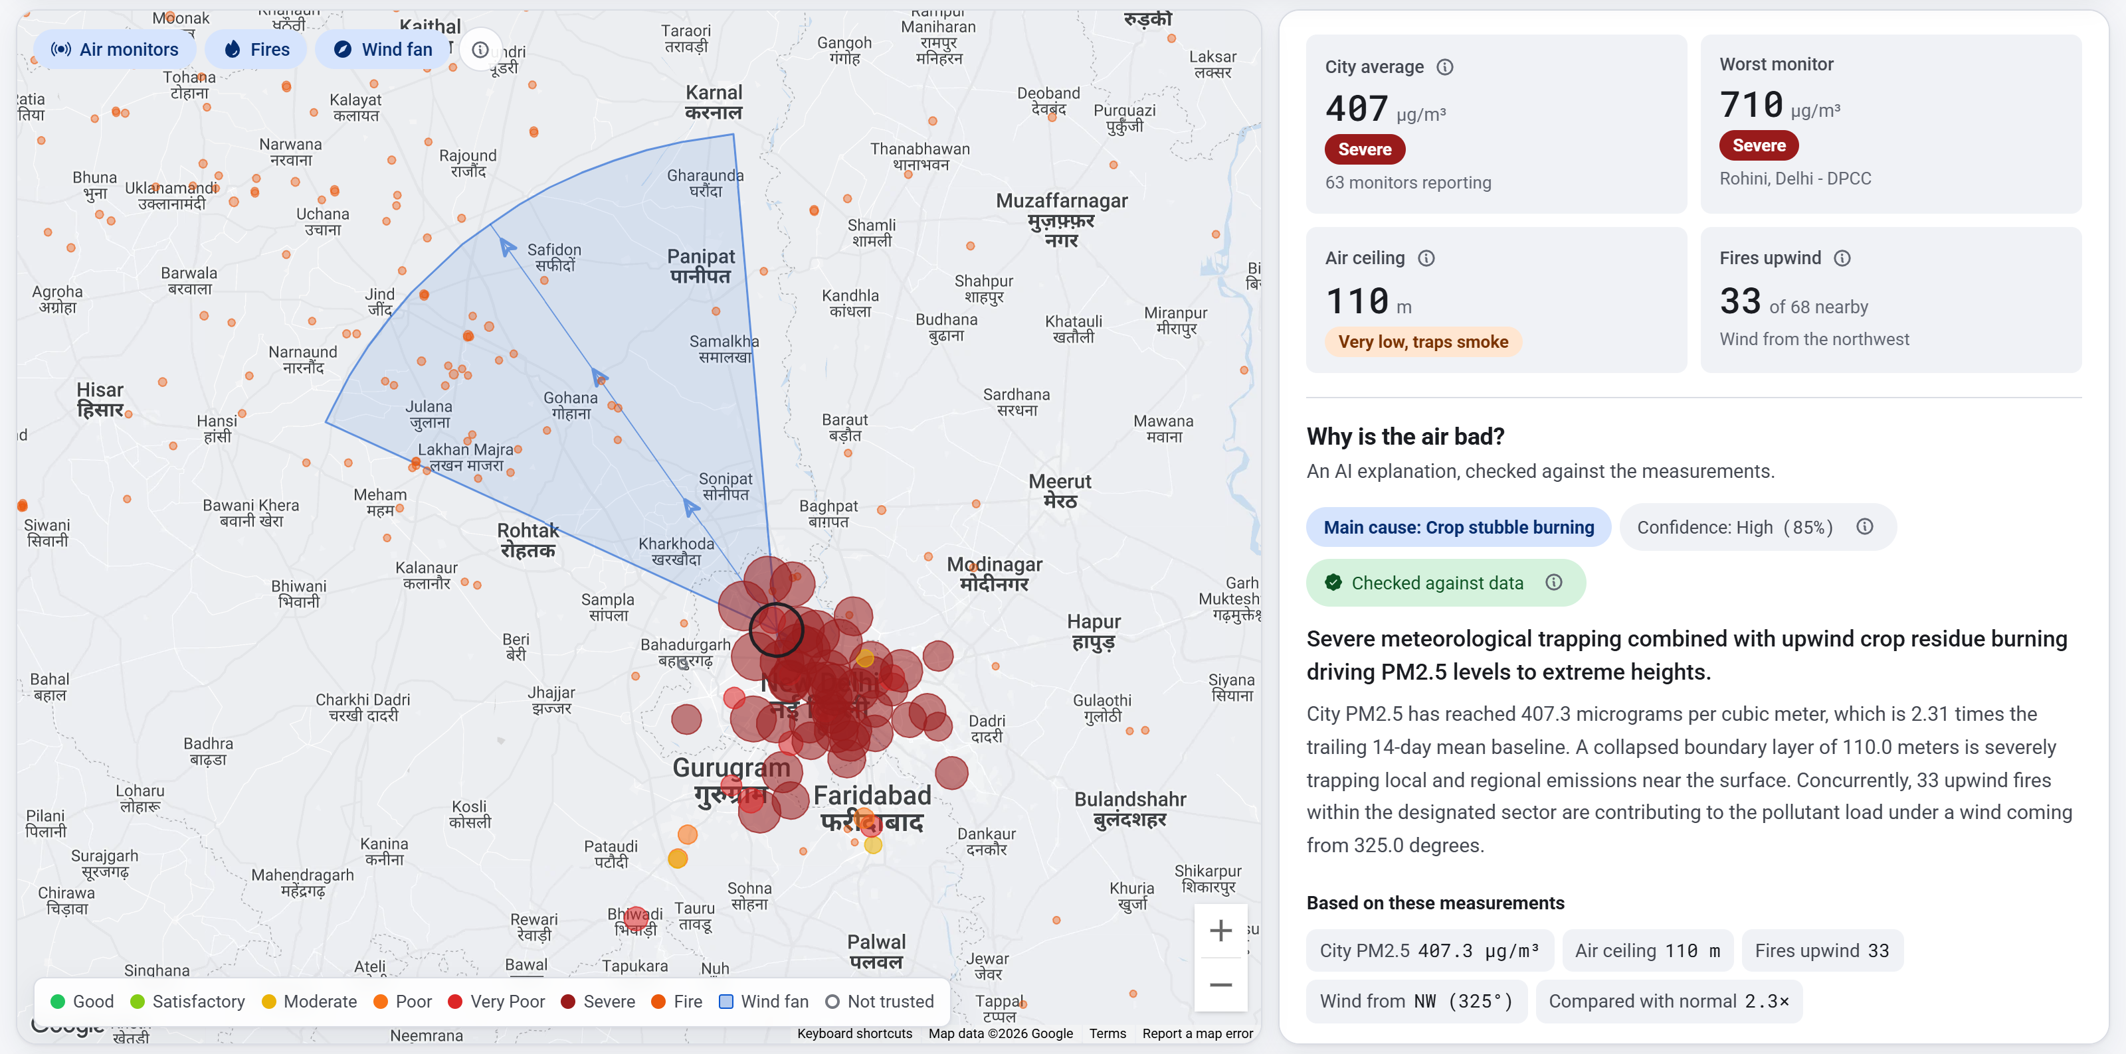
12 NOVEMBER 2025, 01:30 IST
A real episode, explained end to end
407.3
µg/m³ city average — Severe
110 m
air ceiling trapping it
33
fires inside the upwind fan
0.85
Gemini's confidence, cause: crop burning

Slide 5
HYPER-LOCAL DETECTION
The event the city average hid
629 → 507
NSIT Dwarka, 3 hours
123
the region's median that hour
24,500
people in that square kilometre
111
confirmed event-hours, 26 localities
— Measurement, not a model: one monitor against the robust median of the monitors reporting in the same hour, confirmed only when it persists for two hours with distinct values.
— At the peak of the smog episode it reports nothing — the whole region is Severe together. That is the correct answer, and the page says so.

Slide 6
WHY INTEGRITY COMES FIRST
Our own headline was a broken sensor
— The first README led with 'Arya Nagar, 918 µg/m³'. Its readings that morning: 717, 31, 559, 33, 500, 0, 886, 4, 918, 19 — while every monitor within 25 km held near 250.
— 22 of the 40 events we first ranked highest had faults like that nearby.
— Four checks now gate every reading: stuck values, zeros during dirty air, impossible spikes, implausibly low during an episode. Thresholds set from 35,602 real readings.
— 51 outliers refused as sensor faults. The attribution finding survives unchanged: r = +0.57 with upwind fires, −0.48 with the air ceiling.

Slide 7
REACH
The same check, every CPCB monitor in India
62 of 361
monitors not trustworthy (17%)
26
states covered
240
monitors with a faulted hour
985.0
µg/m³ error code in the public feed
— Exactly 985.0 appears on 8 monitors in Karnataka and Tamil Nadu for 345 hours — 214 of them at one monitor in Hassan, while the rest of the state read about 30.
— Each monitor is judged against its own state's median; states too thin for a median are labelled, never reported clean. Every verdict ships with the raw readings behind it.

Slide 8
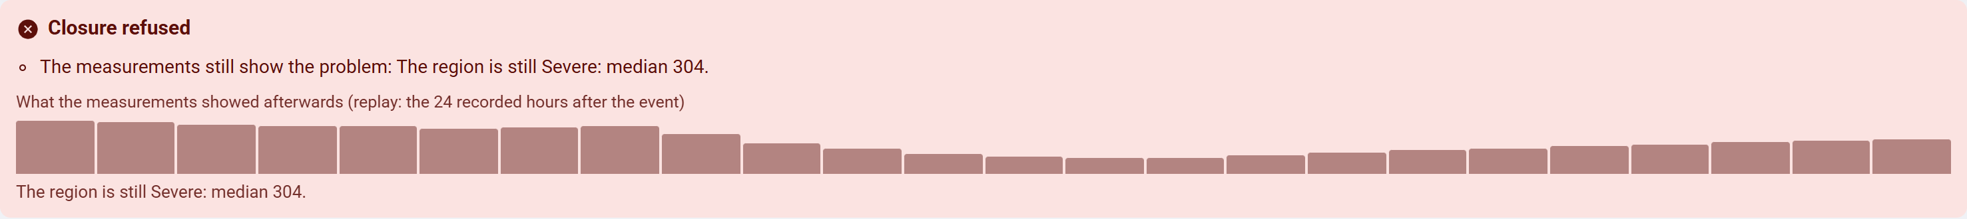
ACCOUNTABILITY
A case closes only when the evidence agrees
— Measurements open a case for the agency named on the monitor itself, with a deadline: 24 h for a local event, 72 h for a broken monitor, 12 h for a regional episode.
— Overdue and CAQM escalation are computed on read, so there is no scheduler to fail quietly.
— To close: a site photo Gemini examines (is it genuine, is a source still visible), taken within 1 km — and the readings afterwards must show the problem gone.
— A region-wide case cannot be closed with a note while the monitors still show Severe a day later. The refusal, and its reason, go in the audit trail.
— Every agency and officer is a demo account: no real contact details exist in this codebase.

Slide 9
CROSS-STATE
The fires the count stopped seeing
Punjab, Oct–Nov | 2020 | 2025
Satellite fire alerts (daytime) | 74,975 | 3,936 (−95%)
Land burned (MODIS burn scars) | 17,565 km² | 8,965 km² (−49%)
Land burned per alert | 0.23 km² | 2.28 km² (10×)
— Amritsar has the most alerts and ranks 10th by land burned; Sangrur ranks 3rd by alerts and 1st by land. An inspection plan built on counts goes to the wrong districts.
— Nine verification notices go to Punjab's and Haryana's boards, copied to CAQM — not blame for a given day: we tested that link and it is r = +0.32 once the season is removed.

Slide 10
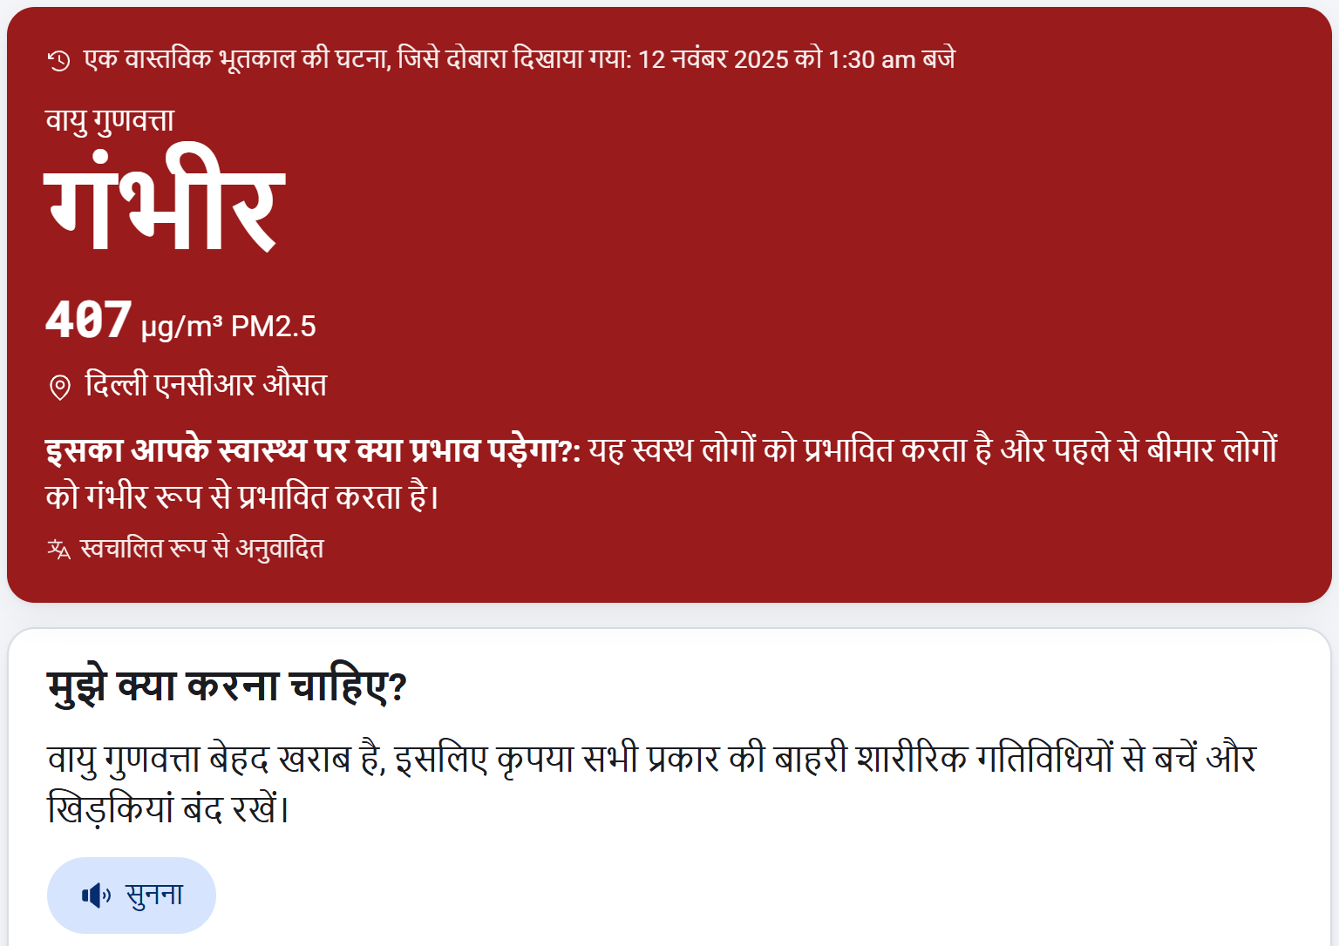
RESIDENTS
The same facts, in the resident's language
— Ten Indian languages, with the advice read aloud.
— Health guidance follows the CPCB band, written for someone who has never seen an AQI map.
— A resident can send a photo of the haze; Gemini triages it, and it can corroborate a reading but can never set a pollution value or trigger a response on its own.
— Installs as an app; the service worker never caches a reading.

Slide 11
RIGOUR
We tested our own ideas, and published what failed
Claim we tested | Result
Gridded ML beats interpolation | No — loses at every network density
Satellite AOD explains the gaps | No — r = +0.04
72-hour forecast beats persistence | No — loses at every horizon
Day-ahead Severe warning beats the calendar | No — +0.61 against the calendar's +0.71
Our top hotspot was real pollution | No — a faulty monitor; 22 of the top 40 were
Burned area explains daily PM2.5 | No — r = −0.66, the smoke hides the scars
Upwind fires + air ceiling explain episodes | Yes — r = +0.55 and −0.42
The model registry refuses a model that loses to its baseline. It refused ours, so none of these is in the product.

Slide 12
DEPLOYABILITY
Built to be run by someone else
— One Cloud Run service in asia-south1 serves the API and the site; `bash infra/deploy.sh` builds, deploys and smoke-tests it.
— BigQuery per tenant: a new city is a bounds entry, a dataset and a backfill — the same path the national run used for 26 states.
— Two open Apache-2.0 schemas so another system can consume an episode without trusting our models, validated against real output in code.
— No API key in the repository or the image: Gemini's lives in Secret Manager, and Google Air Quality authenticates as the runtime service account.

Slide 13
LIMITS, STATED
What it does not do
— No forecast and no predicted hotspot map: both were falsified, so neither is served.
— Hotspots are hidden by the average, not from the network — the detector needs a monitor to be there.
— Attribution is correlational over one season, and counts fire alerts that now undercount burning about tenfold.
— The demo is a replay of a real episode, labelled on screen, because the CPCB live feed is stalled; the Monitors tab shows Google's modelled air beside our latest measurement.
— Every agency is a demo account, and case actions would sit behind identity in production.

