Slide 1
VayuSetu
Why the air is bad, where it is worst, and who should act — with every number measured.
Build with AI: Code for Communities · Track 02, Clean Air & Climate Resilience
Live: vayusetu-999960875509.asia-south1.run.app

Slide 2
RIGOUR
We tested our own ideas, and published what failed
Claim we tested | Result
Gridded ML beats interpolation | No — loses at every network density
Satellite AOD explains the gaps | No — r = +0.04
72-hour forecast beats persistence | No — loses at every horizon
Day-ahead Severe warning beats the calendar | No — +0.61 against the calendar's +0.71
Our top hotspot was real pollution | No — a faulty monitor; 22 of the top 40 were
Burned area explains daily PM2.5 | No — r = −0.66, the smoke hides the scars
Upwind fires + air ceiling explain episodes | Yes — r = +0.55 and −0.42
The model registry refuses a model that loses to its baseline. It refused ours, so none of these is in the product.

Slide 3
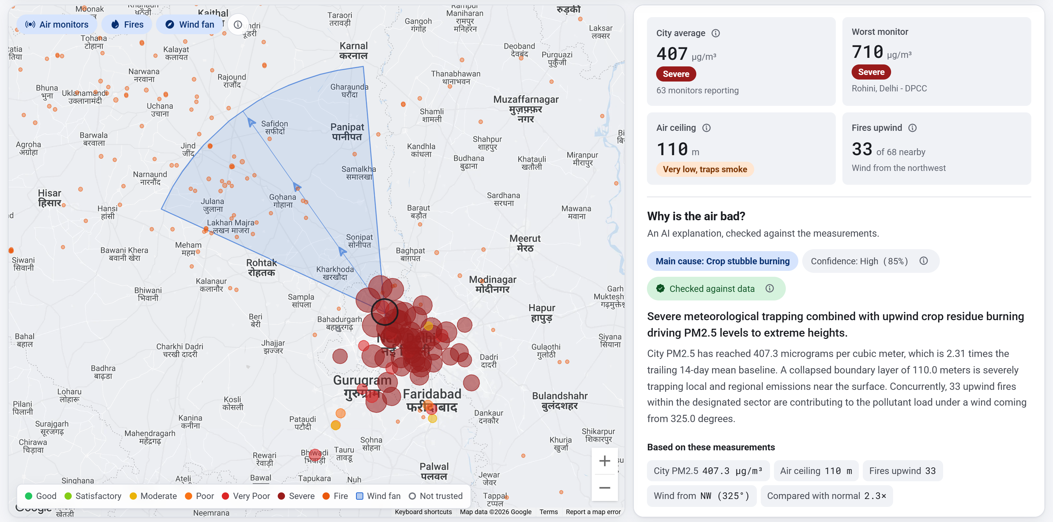
12 NOVEMBER 2025, 01:30 IST
A real episode, explained end to end
407.3
µg/m³ city average — Severe
110 m
air ceiling trapping it
33
fires inside the upwind fan
0.85
Gemini's confidence, cause: crop burning

Slide 4
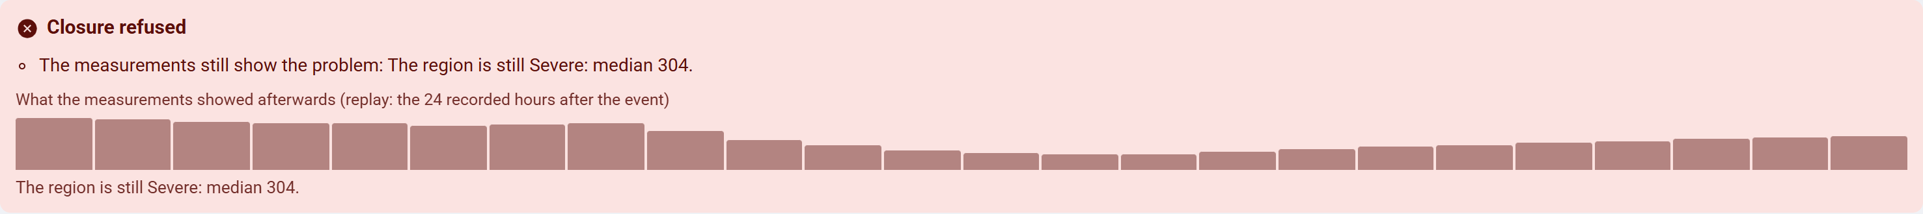
ACCOUNTABILITY
A case closes only when the evidence agrees
— Measurements open a case for the agency named on the monitor itself, with a deadline: 24 h for a local event, 72 h for a broken monitor, 12 h for a regional episode.
— Overdue and CAQM escalation are computed on read, so there is no scheduler to fail quietly.
— To close: a site photo Gemini examines (is it genuine, is a source still visible), taken within 1 km — and the readings afterwards must show the problem gone.
— A region-wide case cannot be closed with a note while the monitors still show Severe a day later. The refusal, and its reason, go in the audit trail.
— Every agency and officer is a demo account: no real contact details exist in this codebase.

Slide 5
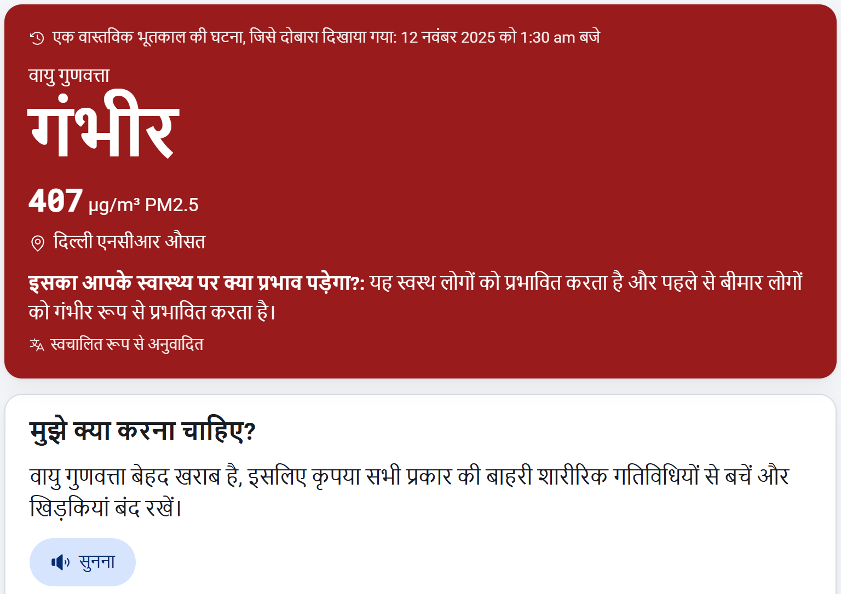
RESIDENTS
The same facts, in the resident's language
— Ten Indian languages, with the advice read aloud.
— Health guidance follows the CPCB band, written for someone who has never seen an AQI map.
— A resident can send a photo of the haze; Gemini triages it, and it can corroborate a reading but can never set a pollution value or trigger a response on its own.
— Installs as an app; the service worker never caches a reading.

