Slide 1
Project Name: SmartMoveTransport
Course: DB2 Module – Course Work
Tech Stack: PHP 7/8, HTML 5, CSS 3, JavaScript, Oracle XE, MongoDB, XAMPP (Windows)
Team : Vinudana Dissanayaka (cohndse261f-001)
Stephani Fernando (cohndse261f-049)

Slide 2
Problem & Objectives
Build a web‑based transport booking system (bus, shuttle, etc.)
Provide real‑time reservation, payment, refund, and analytics
Demonstrate dual‑database integration (relational + document) for a university assignment

Slide 3
High‑Level Architecture
Component | Role
Web Front‑end (HTML/CSS/JS) | UI, forms, maps, alerts
PHP Controllers / Models (/Web/models/*.php) | Business logic, call DB layer
Oracle XE | Core relational data (users, vehicles, trips, bookings, payments, refunds, shifts, maintenance)
MongoDB | Analytic/feedback data (passenger reviews, vehicle docs, travel announcements)
External services (e.g., email, SMS) – optional | Notification & logging

Slide 4
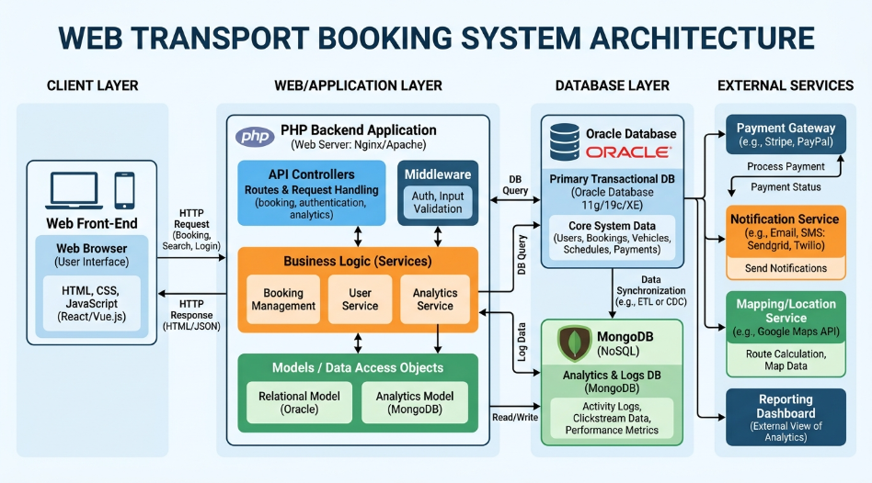

Slide 5
Oracle XE – Core Relational Schema
Table | Primary Key
USERS | USER_ID
VEHICLES | VEHICLE_ID
TRIPS | TRIP_ID
BOOKINGS | BOOKING_ID
PAYMENTS | PAYMENT_ID
REFUNDS | REFUND_ID
SHIFTS | SHIFT_ID
MAINTENANCE | MAINTENANCE_ID
Key PHP‑DB Helpers (see Web/config/db.php):
Database::getOracle() – lazy singleton Oracle connection (oci_connect)
Database::queryOracle($sql, $params) – SELECT helper with column‑alias mapping (e.g., tripid → tripId)
Database::executeOracle($sql, $params) – INSERT/UPDATE/DELETE (auto‑commit)
Stored‑procedure wrappers (callBookTicket, callProcessRefund) that pass input/output parameters via PL/SQL blocks

Slide 6
PHP Model Overview
Model | Primary Responsibilities
User.php | CRUD on USERS, authentication helpers
Vehicle.php | CRUD on VEHICLES, expose document retrieval via MongoService
Booking.php | Wrapper around Oracle booking & refund procedures
News.php | Pulls system announcements (travel_announcements) from MongoDB
MongoService.php | Analytic queries, top‑rated lists, keyword search
Database (db.php) | Low‑level DB abstraction (Oracle + MongoDB)

Slide 7
Slide | Picture | Why it Helps
Architecture | Architecture diagram (above) | Gives a “big picture” view of components and data flow.
DB Design | Oracle ER diagram (above) | Shows relational tables & keys – great for DB module grading.
Analytics | MongoDB collections diagram (above) | Highlights why a document DB was chosen.
Booking Flow | Flowchart of the ticket‑booking sequence (you can sketch or use a simple diagram tool) | Clarifies procedural steps for the audience.
UI Screenshots | Capture a few pages from /Web/index.php (login, trip list, booking confirmation) | Demonstrates the actual UI you built.
Sample Review | Screenshot of a passenger review page (MongoDB output) | Shows analytics in action.
Health Check | Console output or a small table showing Oracle & MongoDB status | Proves robustness.

