Slide 1


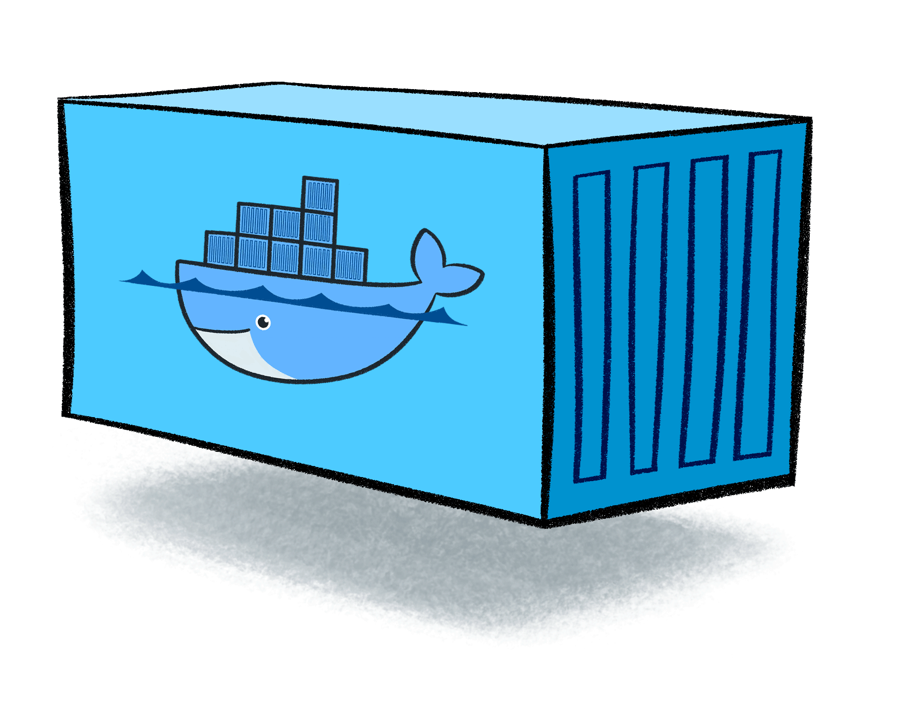

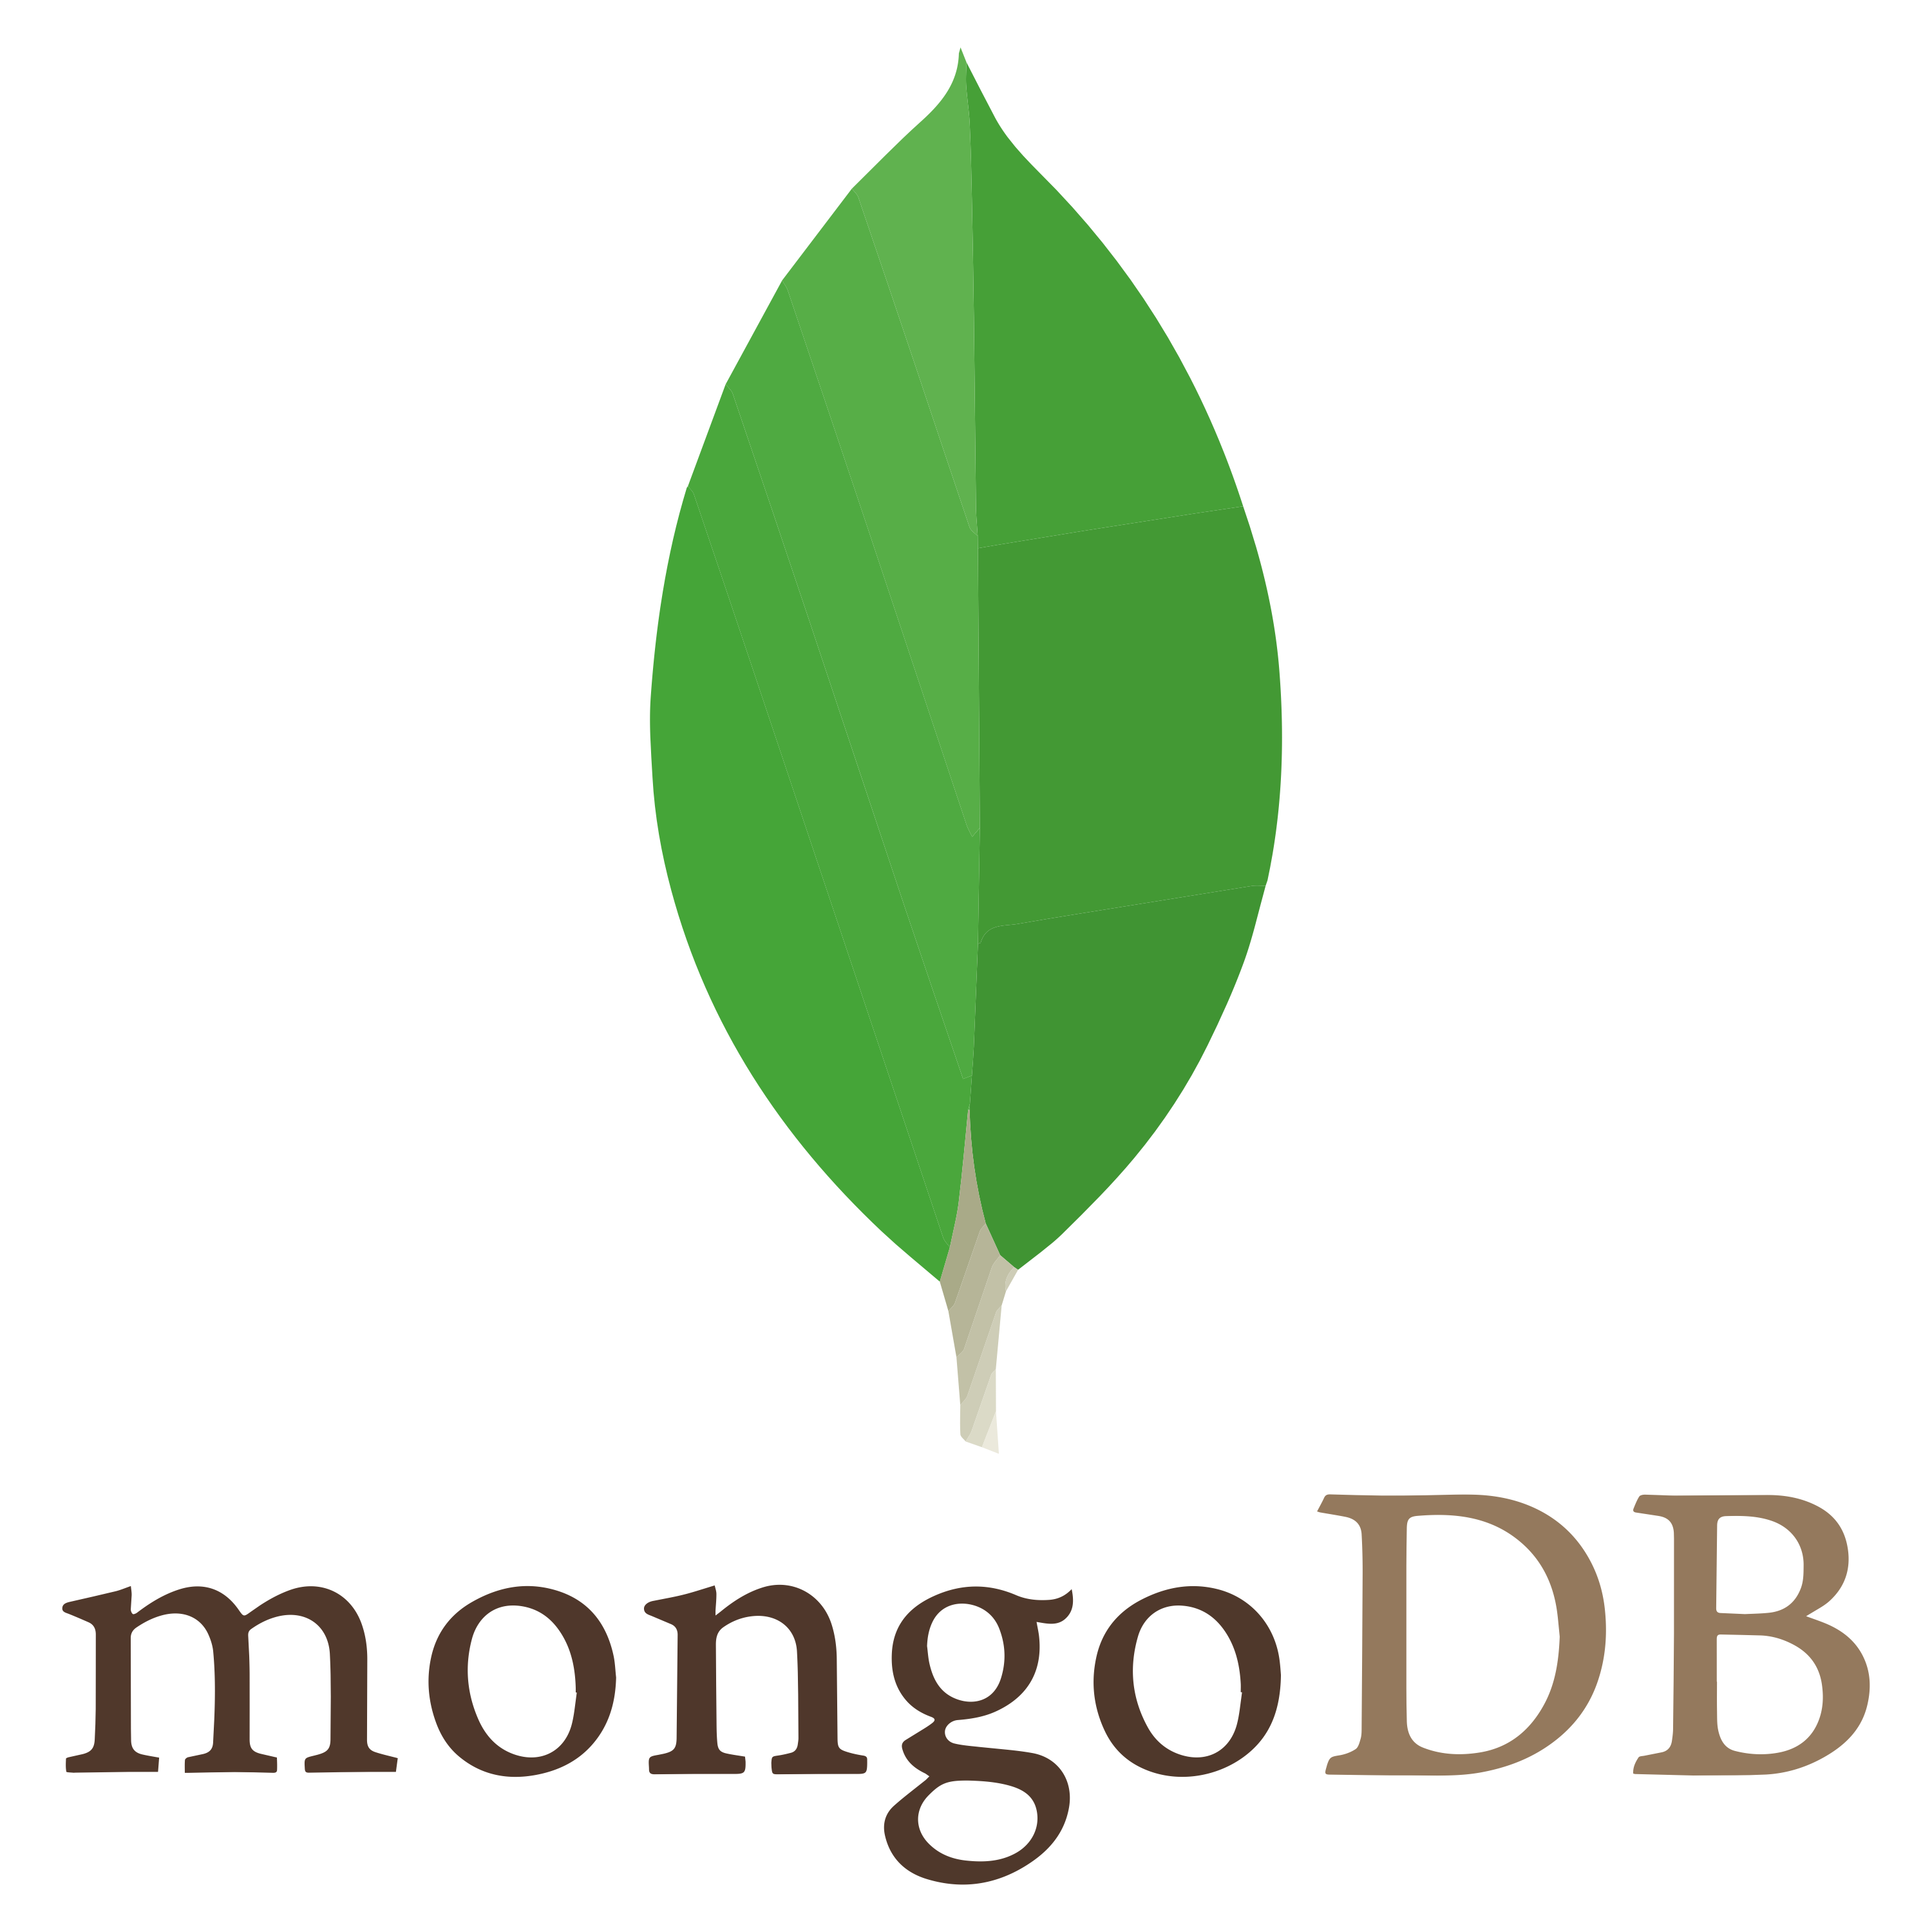

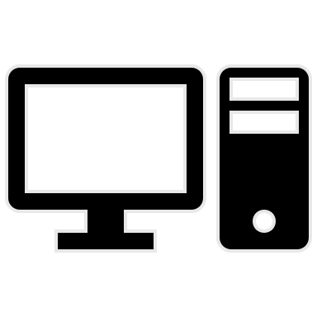
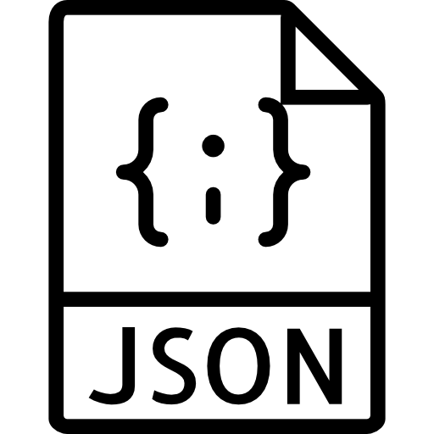

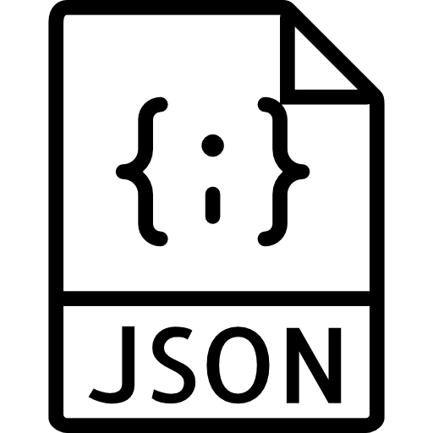
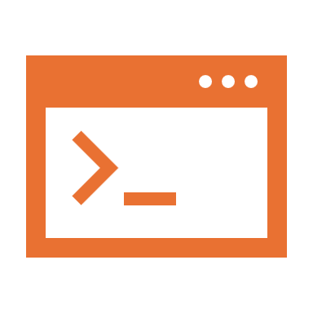

docker-cli commands
docker ps -a
docker images
docker ps
docker search
Docker host
Images
Containers
docker image …
docker container …
Docker Hub
Docker Registry
docker stop
docker pull
docker run
docker rm
docker start
Docker restart
running
exited
8.0.11
docker inspect
docker logs
folder_app
docker inspect
my_app
docker exec -it
docker build
docker run
Dockerfile
running
.dockerignore
1.0.0
Lifecycle
docker rmi
…

Slide 2
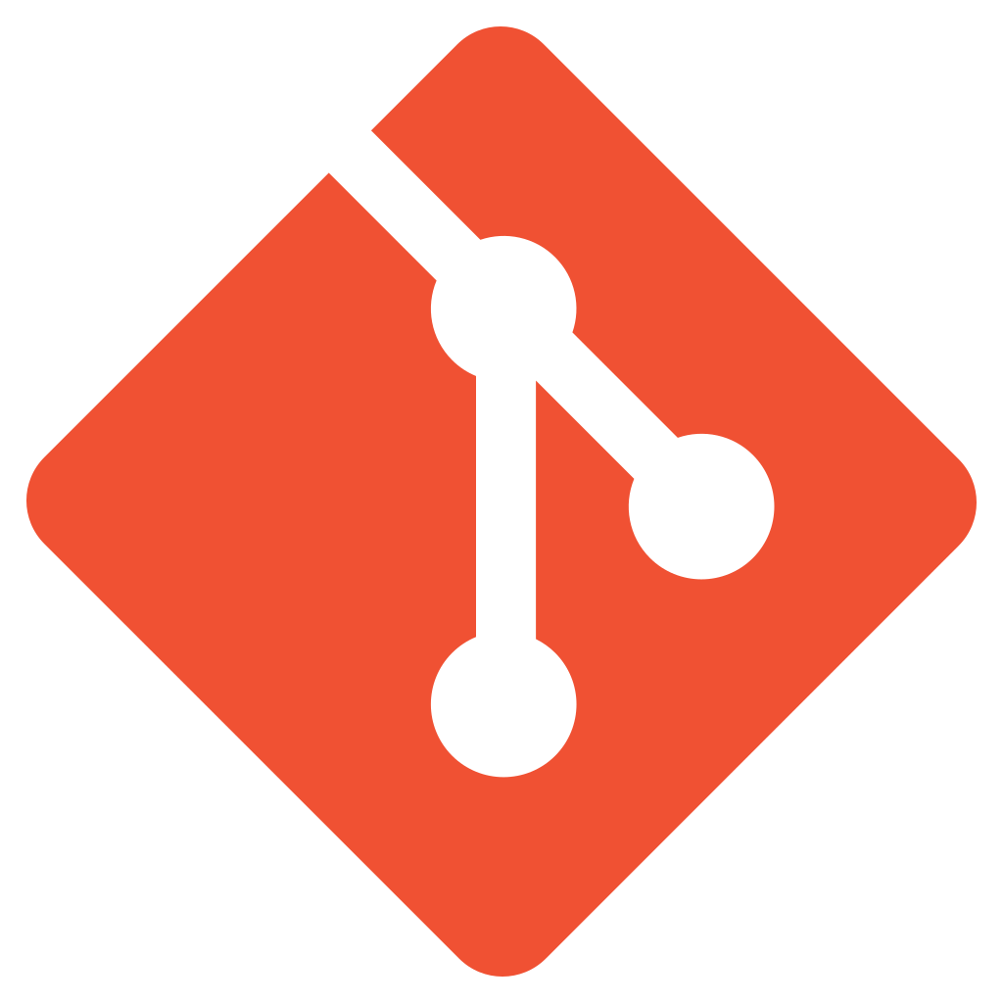
CI
CD
Sources
Repositories
artifacts
my_app
1.1.0
Build
img
Deploy
Test
Deploy
Prod
Test
Envs
Prod

