Slide 1
CS 35L Software Construction Lab Week 8 – Dynamic Linking

Slide 2
Building an executable file
source
code
compiler
object
code
linker
executable
file
Translates programming
language statements into
cpu’s machine-language
instructions
Adjusts any memory
references to fit the
Operating System’s
memory model

Slide 3
Linking libraries
source
code
compiler
object
code
linker
executable
file
object
code
library
A previously compiled
collection of standard
program functions

Slide 4
Static Linking
Carried out only once to produce an executable file
If static libraries are called, the linker will copy all the modules referenced by the program to the executable
Static libraries are typically denoted by the .a file extension

Slide 5
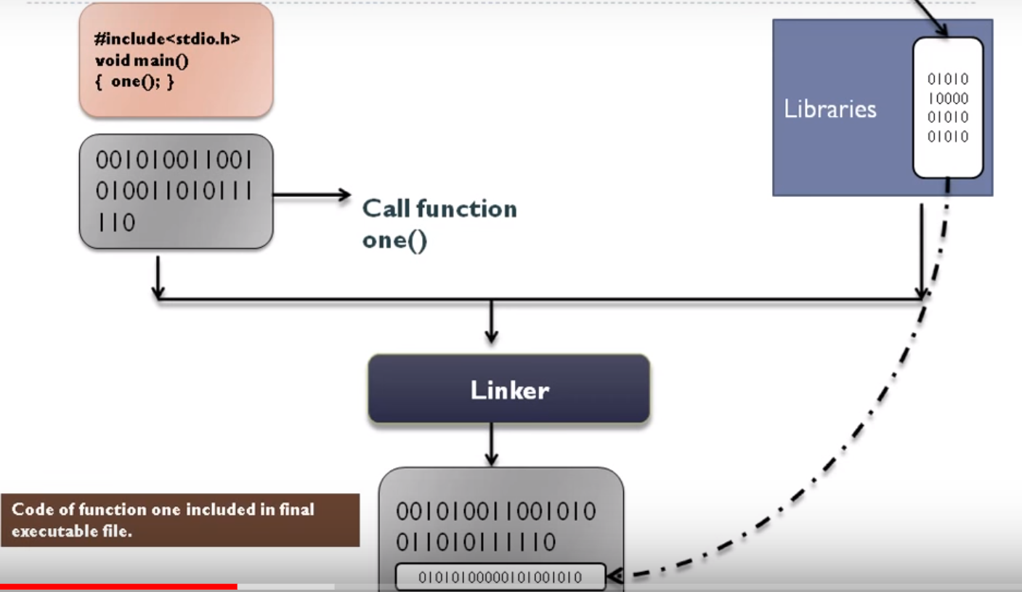

Slide 6
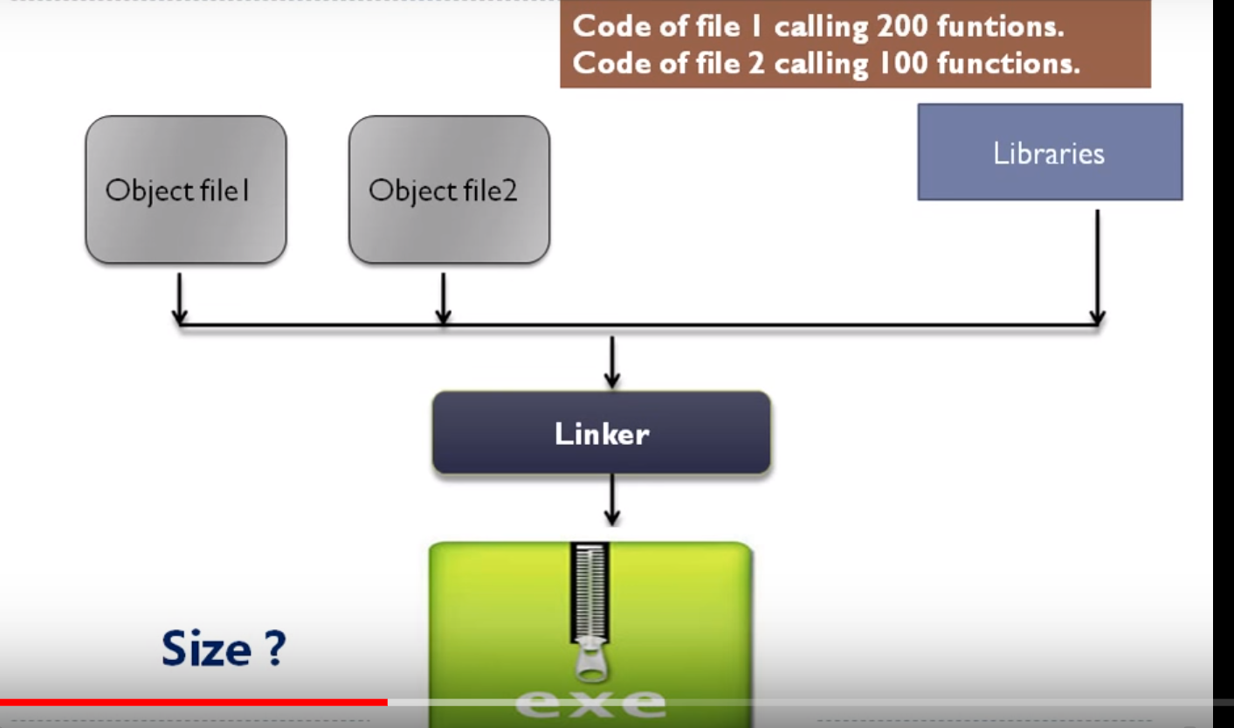

Slide 7
Dynamic Linking
If shared libraries are called:
Only copy a little reference information when the executable file is created
Complete the linking during loading time or running time
Dynamic libraries are typically denoted by the .so file extension
.dll on Windows

Slide 8
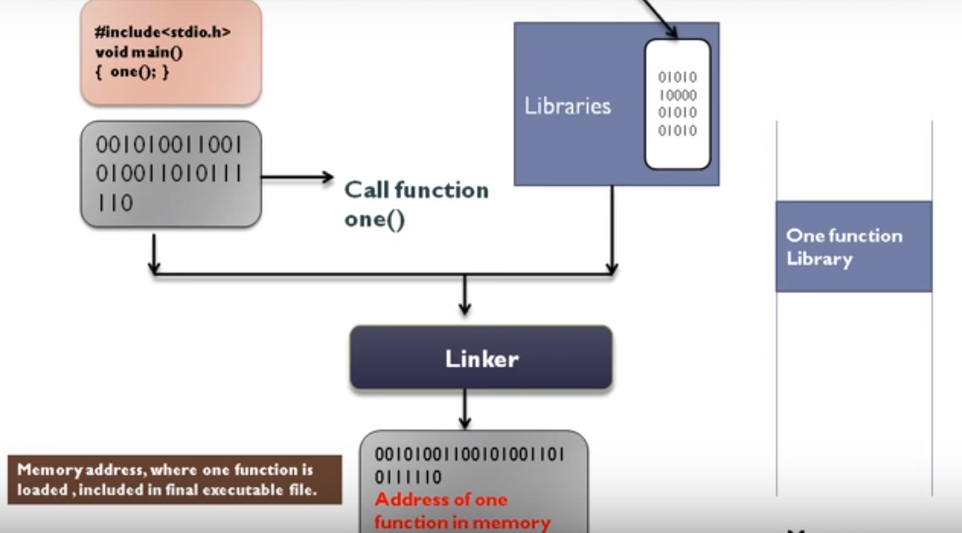
Memory

Slide 9
Smaller is more efficient
object
file
object
file
static linking
function
library
function
library
executable
files
object
file
object
file
dynamic linking
pointer
pointer
shared
function
library

Slide 10
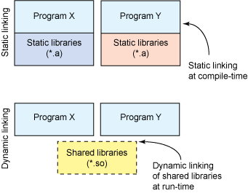

Slide 11
Dynamic linking
Dynamic vs. static linking resulting size $ gcc -static hello.c -o hello-static $ gcc hello.c -o hello-dynamic $ ls -l hello 80 hello.c 13724 hello-dynamic 1688756 hello-static

Slide 12
Advantages of dynamic linking
The executable is typically smaller
When the library is changed, the code that references it does not usually need to be recompiled
The executable accesses the .so at run time; therefore, multiple programs can access the same .so at the same time
Memory footprint amortized across all programs using the same .so

Slide 13
Disadvantages of dynamic linking
Performance hit
Need to load shared objects (at least once)
Need to resolve addresses (once or every time)
Notes:
What if the necessary dynamic library is missing?
What if we have the library, but it is the wrong version?

Slide 14
Linking and Loading
Linker collects procedures and links them together into one executable program
Why isn't everything written as just one big program, saving the necessity of linking?
Efficiency: if just one function is changed in a 100K line program, why recompile the whole program? Just recompile the one function and relink.

Slide 15
Linking and Loading
Dynamic loading refers to mapping (or less often copying) an executable or library into a process's memory after it has started.
Dynamic linking refers to resolving symbols - associating their names with addresses or offsets - after compile time.

Slide 16
Exploring combinations
Dynamic loading, static linking: The executable has an address/offset table generated at compile time, but the actual code/data aren't loaded into memory at process start. The goal is to give the programmer control over memory use while also avoiding the overhead of linking at runtime.
Notes:
Static loading, dynamic linking: The executable contains a reference to the dynamic/shared library, but the symbol table is missing or incomplete. Both loading and linking occur at process start, which is considered "dynamic" for linking but not for loading.

Slide 17
Exploring combinations
Dynamic loading, dynamic linking: Object file is loaded dynamically after program start, and symbols both in the calling program and in the library are resolved based on the process's memory layout at that time.
Static loading, static linking: Everything is resolved at compile time. At process start everything is loaded into memory immediately and no extra resolution (linking) is necessary.

Slide 18
Lab 7
Write and build simple “cos(sqrt(3.0))” program in C
Use ldd to investigate which dynamic libraries your C program loads
Use strace to investigate which system calls your C program makes
Use “ls /usr/bin | awk ‘NR%101==SID%101’” to find ~25 linux commands to use ldd on
Record output for each one in your log and investigate any errors you might see
From all dynamic libraries you find, create a sorted list
Remember to remove the duplicates!

