Slide 1
CS 35L Software Construction Lab Week 8 – Dynamic Linking

Slide 2
Linking and Loading
Dynamic loading refers to mapping (or less often copying) an executable or library into a process's memory after it has started.
Dynamic linking refers to resolving symbols - associating their names with addresses or offsets. It binds the shared libraries dynamically to the running process.

Slide 3
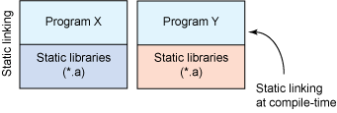
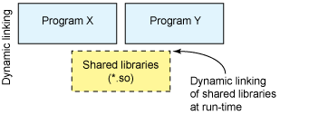
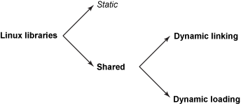
Anatomy of Linux shared libraries
1
2
Libraries - to package similar functionality → modular programming
Linux supports two types
static library
functionality to bind to a program statically at compile-time
dynamic library
functionality to bind to a program dynamically at run-time
dynamic linking - have Linux load the library upon execution
dynamic loading - selectively call functions with the library in a process
http://www.ibm.com/developerworks/library/l-dynamic-libraries/

Slide 4
Dynamic Loading
To let an application load and link libraries itself
application can specify a particular library to load, then
application can call functions within that library
load shared libraries from disk (file) into memory and re-adjust its location done by a library named ld-linux.so.2
Dynamic Loading API
dlopen - makes an object file accessible to a program void *dlopen (const char *file, int mode);
RTLD NOW → relocate now; RTLD LAZY → to relocate when needed; dlsym - gives resolved address to a symbol within this object
void *dlsym(void *restrict handle, const char *restrict name);
dlerror - returns a string error of the last error that occurred
check char *dlerror(); if an error occurs
dlclose - closes an object file

Slide 5
Creating static and shared libs in GCC
mymath.h
mul5.c
add1.c
#define MY_MATH_H
#ifndef MY_MATH_H
void add1(int *i);
void mul5(int *i);
#endif
#include "mymath.h"
void mul5(int *i)
{
*i *= 5;
}
#include "mymath.h"
void add1(int *i)
{
*i += 1;
}
gcc -c mul5.c -o mul5.o
gcc -c add1.c -o add1.o
ar -cvq libmymath.a mul5.o add1.o ----> (static lib)
gcc -shared -fpic -o libmymath.so mul5.o add1.o -----> (shared lib)

Slide 6
Dynamic loading
#include <stdio.h>
#include <dlfcn.h>
int main(int argc, char* argv[]) {
int i = 10;
void (*myfunc)(int *); void *dl_handle;
char *error;
dl_handle = dlopen("libmymath.so", RTLD_LAZY);//RTLD_NOW
if(!dl_handle) {
printf("dlopen() error - %s\n", dlerror()); return 1;
}
//Calling mul5(&i);
myfunc = dlsym(dl_handle, "mul5"); error = dlerror();
if(error != NULL) {
printf("dlsym mul5 error - %s\n", error); return 1;}
myfunc(&i);
//Calling add1(&i);
myfunc = dlsym(dl_handle, "add1"); error = dlerror();
if(error != NULL) {
printf("dlsym add1 error - %s\n", error); return 1;
}
myfunc(&i);
printf("i = %d\n", i);
dlclose(dl_handle);
return 0;
}

Slide 7
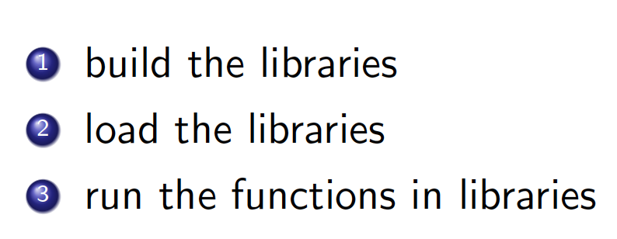
Homework 7
Homework - to split an application into dynamically linked modules
randall.c = randcpuid.c + randlibhw.c + randlibsw.c + randmain.c
1
2
3
4
1

Slide 8
Homework 7
Flags:
gcc -shared -fPIC greeting-fr.c -o greeting-fr.so
gcc -ldl -Wl,-rpath=. greeting-dl.c -o greet-dl
-fPIC to output position independent code
-ldl: is a library designation for the linker (-lmylib would mean links libmylib.so)
-Wl,rpath=dir to set rpath option to be dir to linker (by using -Wl)
-shared to build a shared object
Attribute of functions:
__attribute__ (( constructor )) to run when dlopen() is called
__attribute__ (( destructor )) to run when dlclose() is called
Notes:
ldl: It tells the linker to find and link a file named libdl.so(or sometimes libdl.a). It has the same effect as placing a full path to the library in question in the same position of the command line.

