Slide 1
GOLD TEAM · DATABASE MANAGEMENT
Willson Financial
Database Case Study | Complete Solution
Kobe Alexander
Samuel Dirr
Sebastian Siqueiros
Zachary White
Professor Sue Sampson · Spring 2026

Slide 2





Presentation Agenda
01
04
Group Introduction
Database Build
Meet Gold Team & our roles
CREATE tables, insert records, display data
02
05
Case Study Background
Business Reports
The Willson Financial Case Study
Three queries, results & report summary
03
06
Entity Relationship Diagram
Database App
Finalized ERD | 7 tables, 5 relationships
Tkinter GUI, tech stack & key assumptions

Slide 3

Group Introduction
Samuel Dirr
Kobe Alexander
Database Architect
Data & Population Lead
Finalized ERD, data types & constraints, 3NF compliance
CREATE TABLE scripts, sample data insertion
Sebastian Siqueiros
Zachary White
Reports & Queries Lead
Documentation Lead
Report queries, display scripts & screenshots
Word documents, presentation & project coordination

Slide 4
Case Study Background
Jake and Ned Willson identified an underserved market in their small New Mexico town, only one financial firm existed to serve a growing population of ranchers, farmers, and retirees. Both earned CFA licenses; Ned also holds an MBA. They founded Willson Financial, registered with the SEC, and hired Phoenix Two Star (Office Administrator) and June Santos (Compliance Manager, part-time).
Jake Willson
Co-Founder / CFA
Ned Willson
Co-Founder / CFA, MBA
The Three Business Questions
Phoenix Two Star
1
Office Administrator
How many clients were added each month over the past six months?
June Santos
2
What is the average asset value across all clients?
Compliance Manager (PT)
3
Which clients have more than 10 transactions in a single month?

Slide 5
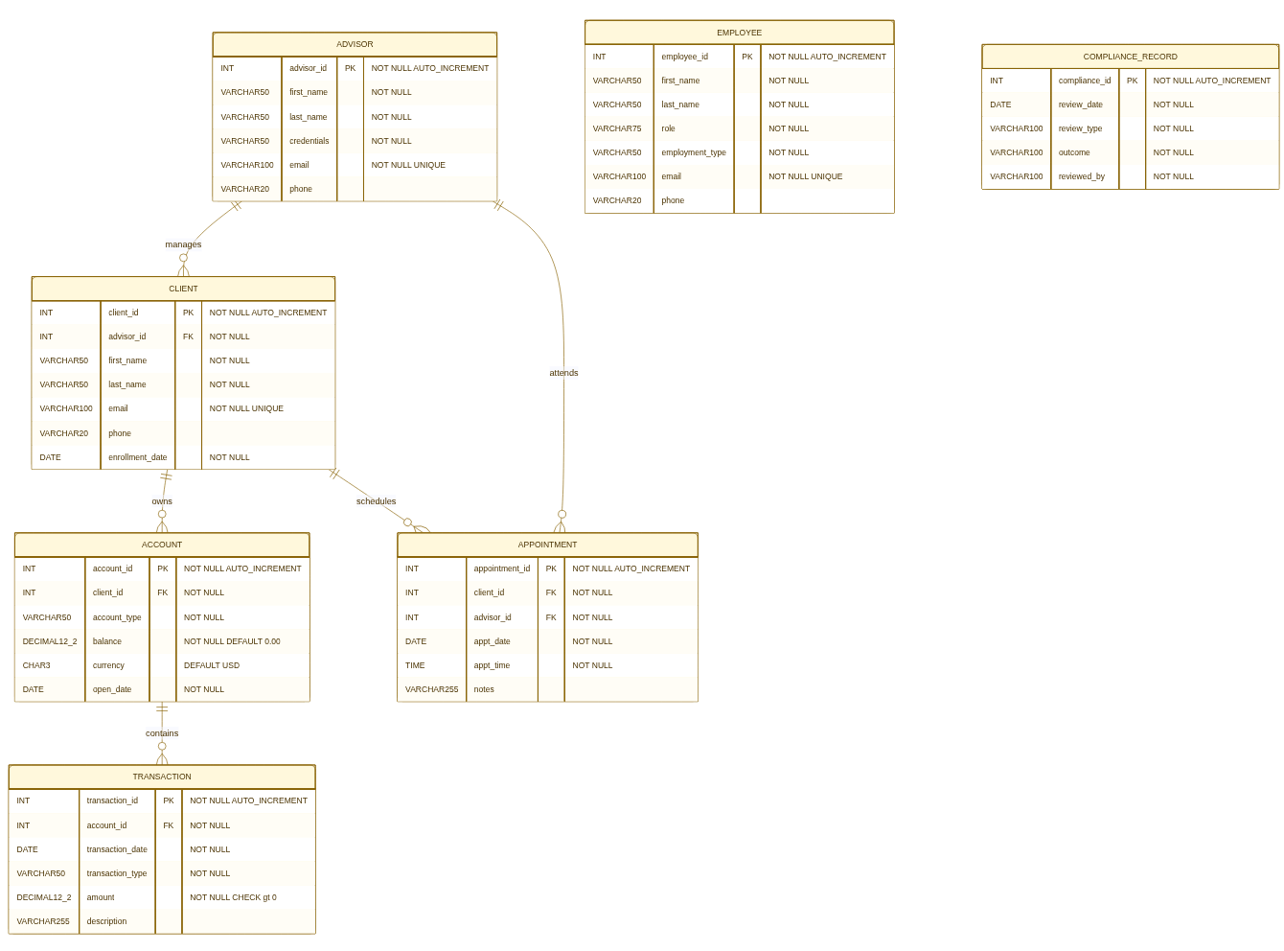
Entity Relationship Diagram
Crow's Foot Notation · 7 Entities · 5 Relationships · All tables in 3NF

Slide 6
Database Design | 7 Tables
EMPLOYEE
TRANSACTION
Jake, Ned, Phoenix, June + staff
Deposits & withdrawals, CHECK > 0
ADVISOR
APPOINTMENT
CFA/MBA credentialed advisors
Client-advisor meeting records
CLIENT
COMPLIANCE_RECORD
NM ranchers, farmers, retirees
SEC review outcomes | June Santos
ACCOUNT
All tables verified in Third Normal Form — no partial or transitive dependencies.
Individual Brokerage, IRA, Retirement

Slide 7
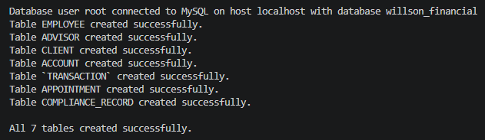
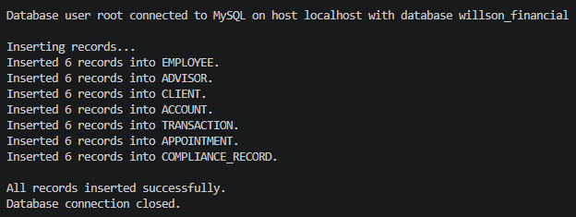
Milestone 2 | Table Creation
Script: create_tables.py
Connects to willson_financial via .env
Creates all 7 tables in dependency order
EMPLOYEE & ADVISOR first (no FK deps)
CLIENT references ADVISOR
Script: insert_records.py — 6 records per table
ACCOUNT references CLIENT
TRANSACTION references ACCOUNT
APPOINTMENT references CLIENT & ADVISOR
COMPLIANCE_RECORD (no dependencies)

Slide 8
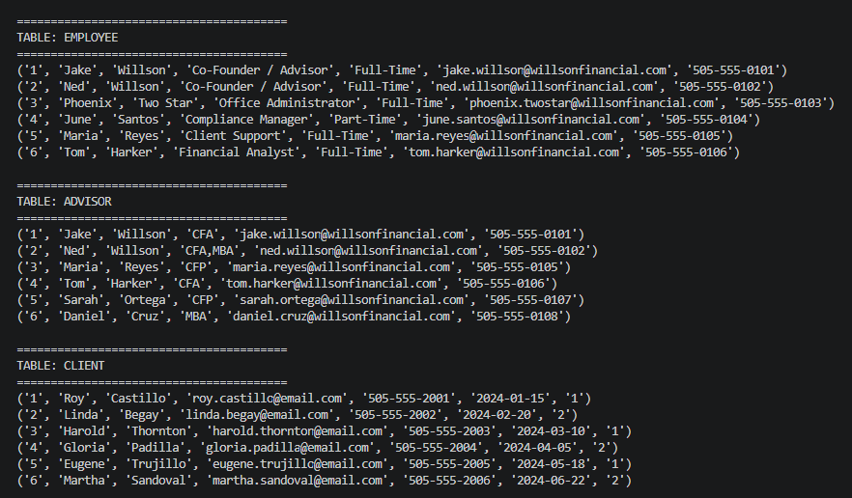
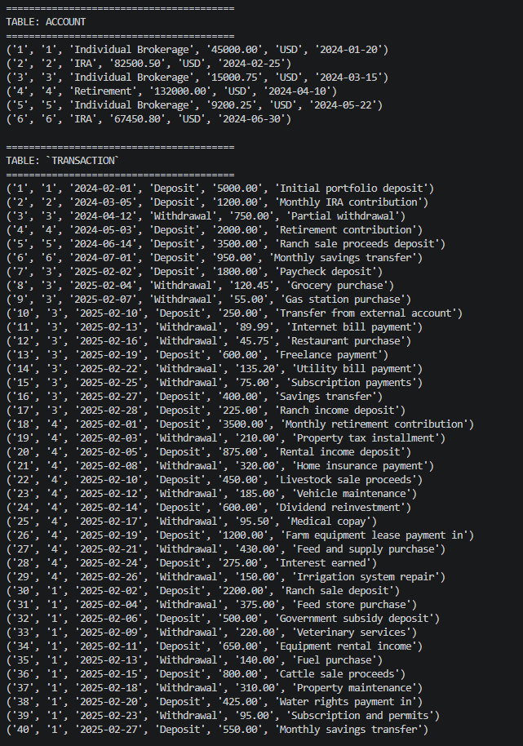
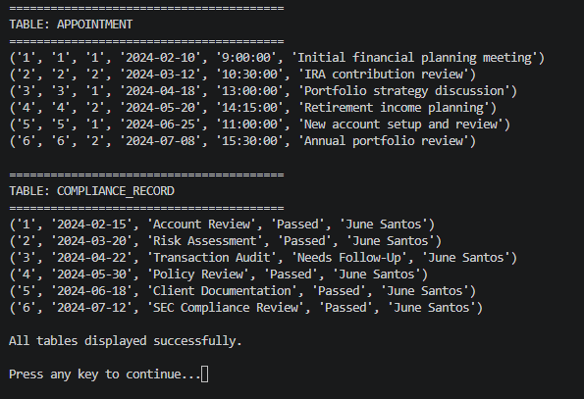
Milestone 2 | Data Display
Script: display_tables.py
Runs SELECT * on all 7 tables and prints every record to the console. Verifies data was inserted correctly and is fully retrievable.

Slide 9
Report 1 | Monthly Client Growth
Business Question:
How many clients have been added for each of the past six months?
SELECT DATE_FORMAT( enrollment_date, '%Y-%m') AS month, COUNT(client_id) AS total_clients FROM CLIENT GROUP BY month ORDER BY month;
Result
Mostly one client per month; January and March each saw two enrollments, totaling 8 clients across Jan–Jun 2024.
Result: 8 clients total — Jan & Mar had 2 each; Feb, Apr, May, Jun had 1 each (Jan–Jun 2024).

Slide 10
Report 2 | Average Client Assets
Business Question:
What is the average amount of assets (in currency) for the entire client list?
Roy Castillo
$45,000.00
Average Balance | All Clients
Brokerage
$58,525.38
Linda Begay
$82,500.50
IRA
Harold Thornton
$15,000.75
Brokerage
USD · Across 6 client accounts
Gloria Padilla
$132,000.00
Retirement
Eugene Trujillo
$9,200.25
Brokerage
Martha Sandoval
$67,450.80
IRA
SELECT ROUND(AVG(balance), 2) AS avg_assets FROM ACCOUNT;

Slide 11
Report 3 | High Transaction Clients
Business Question:
How many clients have more than 10 transactions in a single month?
Gloria Padilla
12 transactions
SELECT c.first_name, c.last_name, DATE_FORMAT(t.transaction_date, '%Y-%m') AS month, COUNT(t.transaction_id) AS transaction_total FROM CLIENT c JOIN ACCOUNT a ON c.client_id=a.client_id JOIN `TRANSACTION` t ON a.account_id=t.account_id GROUP BY c.client_id, month HAVING transaction_total > 10 ORDER BY transaction_total DESC;
Account 4 — Retirement
Feb 2025
Roy Castillo
11 transactions
Account 1 — Individual Brokerage
Feb 2025
Harold Thornton
11 transactions
Account 3 — Individual Brokerage
Feb 2025
Why it matters: These clients may need adjusted billing tiers or a dedicated advisor review.

Slide 12
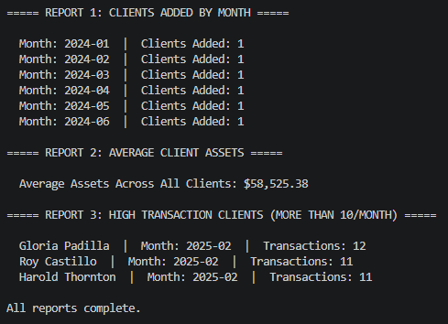
Report Results | Terminal Output
Script: reports.py | All three queries in a single run
Report 1: 8 clients total | Jan & Mar: 2 each | Feb, Apr, May, Jun: 1 each
Report 2: Average assets: $58,525.38
Report 3: 3 clients exceed 10 tx in Feb 2025

Slide 13
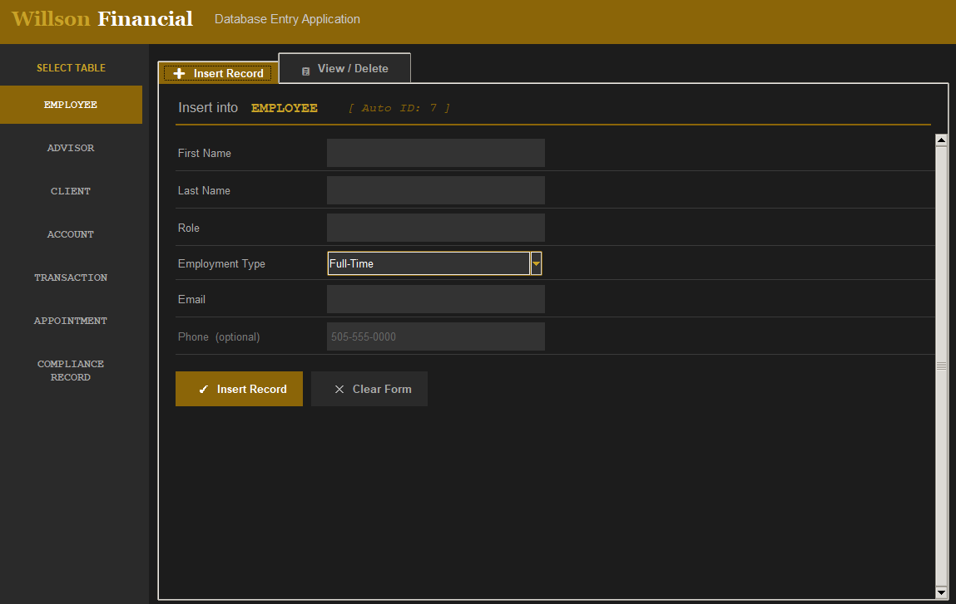
Database Entry Application
Tech Stack
Python Standard Library
tkinter — Core GUI framework, widgets & event bindings
tkinter.ttk — Treeview, Combobox, Scrollbar, Notebook
tkinter.messagebox — Confirmation dialogs & error popups
re — Email & phone input validation
datetime — YYYY-MM-DD and HH:MM:SS validation
os — .env file path resolution
Third-Party Libraries
mysql-connector-python — MySQL connection, query execution, error handling
python-dotenv — Loads DB credentials from .env file
MySQL & Tcl/Tk
MySQL 8.0 — FK constraints, error codes 1062/1451/1452
Tcl/Tk 8.6 — Overrides system dropdown colors on Windows

Slide 14
Report Summary
Key Findings at a Glance
Report 1 — Monthly Client Growth
Willson Financial enrolled clients steadily from January through June 2024, with January and March each seeing two new clients as the firm expanded its reach.
Report 2 — Average Client Assets
The average asset value across all six client accounts is $58,525.38 USD, ranging from $9,200.25 to $132,000.00, reflecting a diverse client base of ranchers, farmers, and retirees.
Report 3 — High Transaction Clients
Three clients exceeded 10 transactions in February 2025 — Gloria Padilla (12), Roy Castillo (11), and Harold Thornton (11) — flagging them for potential billing tier review or dedicated advisor attention.

Slide 15
Key Assumptions
Single Primary Advisor
Compliance Is Manual
Each client has one assigned advisor. Co-advising is out of scope for this pilot.
June Santos enters all compliance records manually. Automated SEC feeds are out of scope.
Asset Values Are Current
USD Only
Balances reflect the most recent known value | not historical time-series data.
All monetary values stored in USD. Multi-currency support not required at this stage.
Enrollment = First Account
6 Pilot Records Per Table
A client's enrollment date equals the date their first account was opened.
Each table has 6 sample records. Clients reflect NM ranchers, farmers, and retirees.

Slide 16
Thank You
Willson Financial | Database Case Study
7
36
3
Tables Built
Total Records
Business Reports
Kobe Alexander
Samuel Dirr
Sebastian Siqueiros
Zachary White
Professor Sue Sampson · Spring 2026

