Slide 1






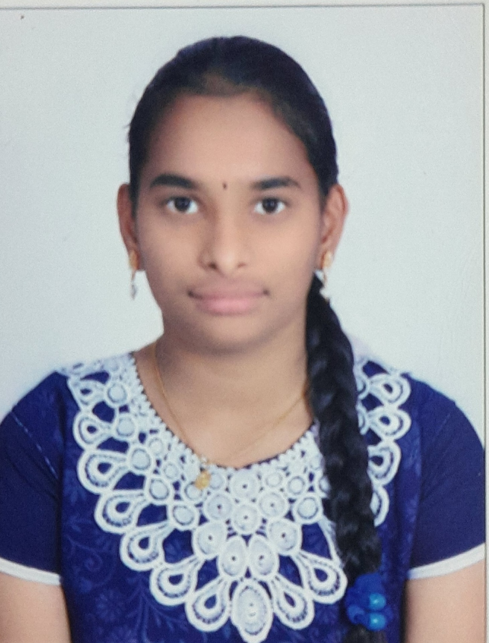
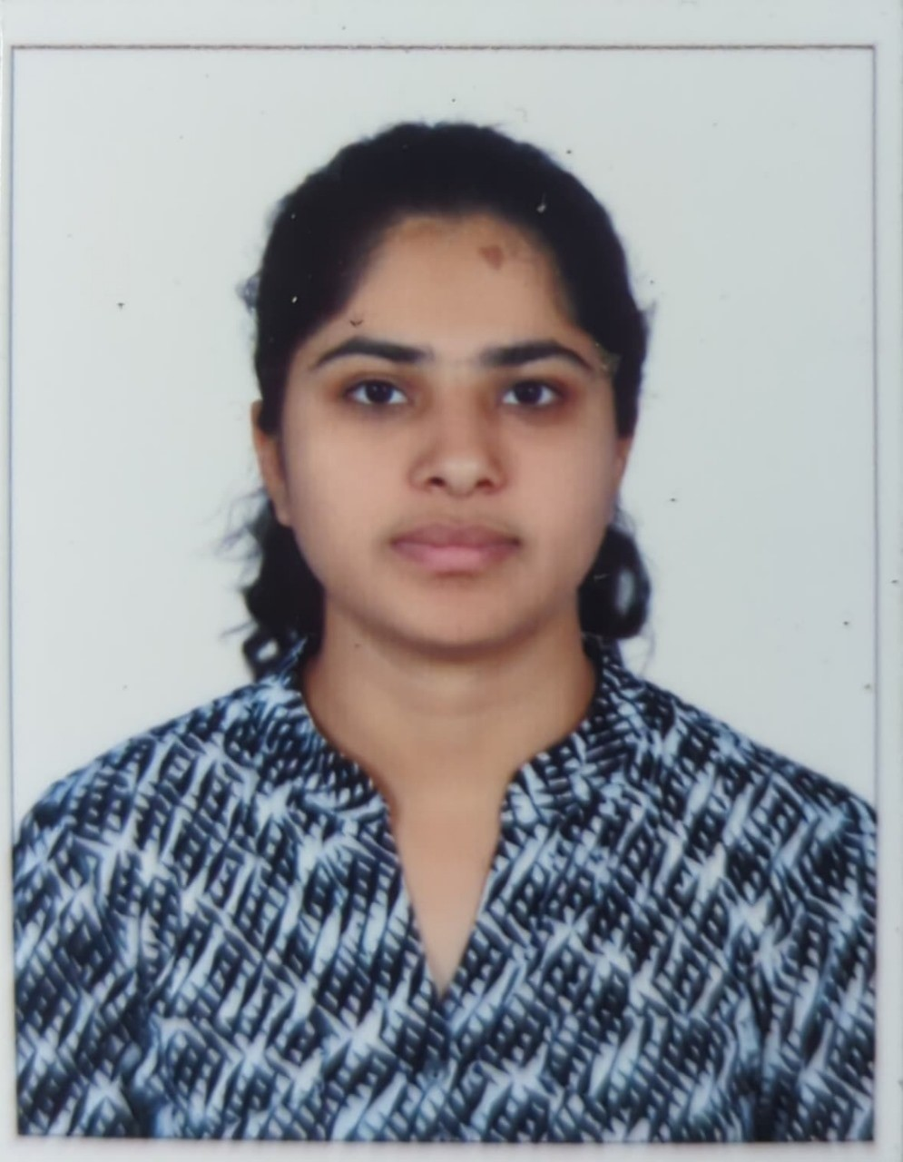
ACE
Engineering College
An AUTONOMOUS Institution
DEPARTMENT OF CSE (ARTIFICIAL INTELLIGENCE & MACHINE LEARNING)
Hearty
To 2020 - 24 Batch Students
SELECTED IN
A.AKSHITHA
20AG1A6605
M.SRI LASYA
20AG1A6637
P.LAKSHMI PRIYA
20AG1A6646
Best wishes from HOD, Faculty, Principal, Management

