Slide 1





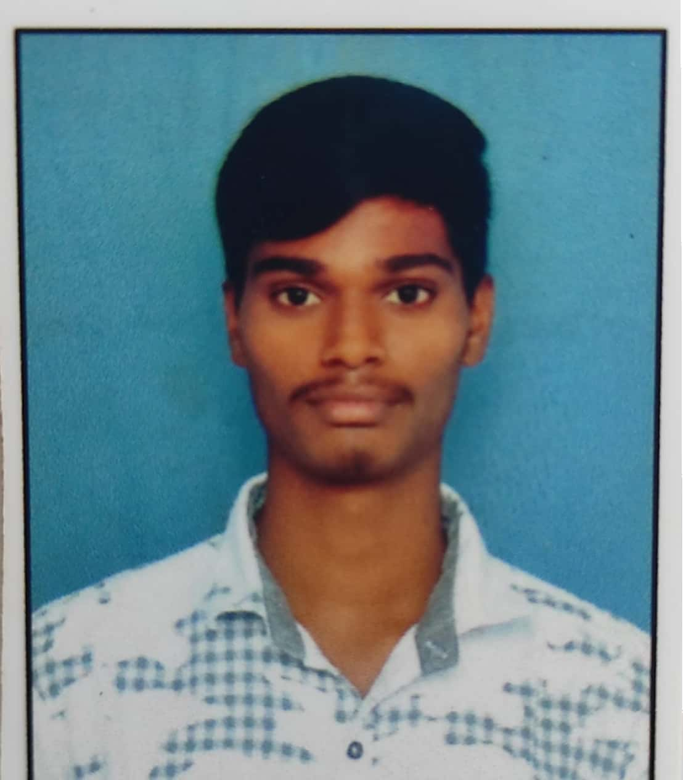
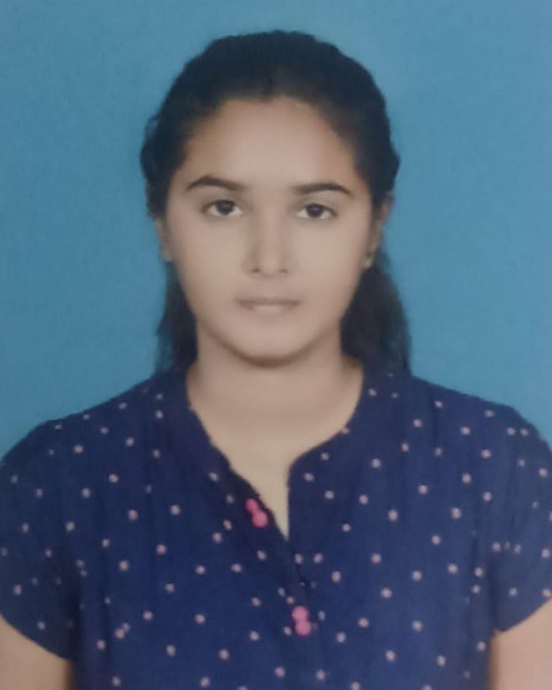
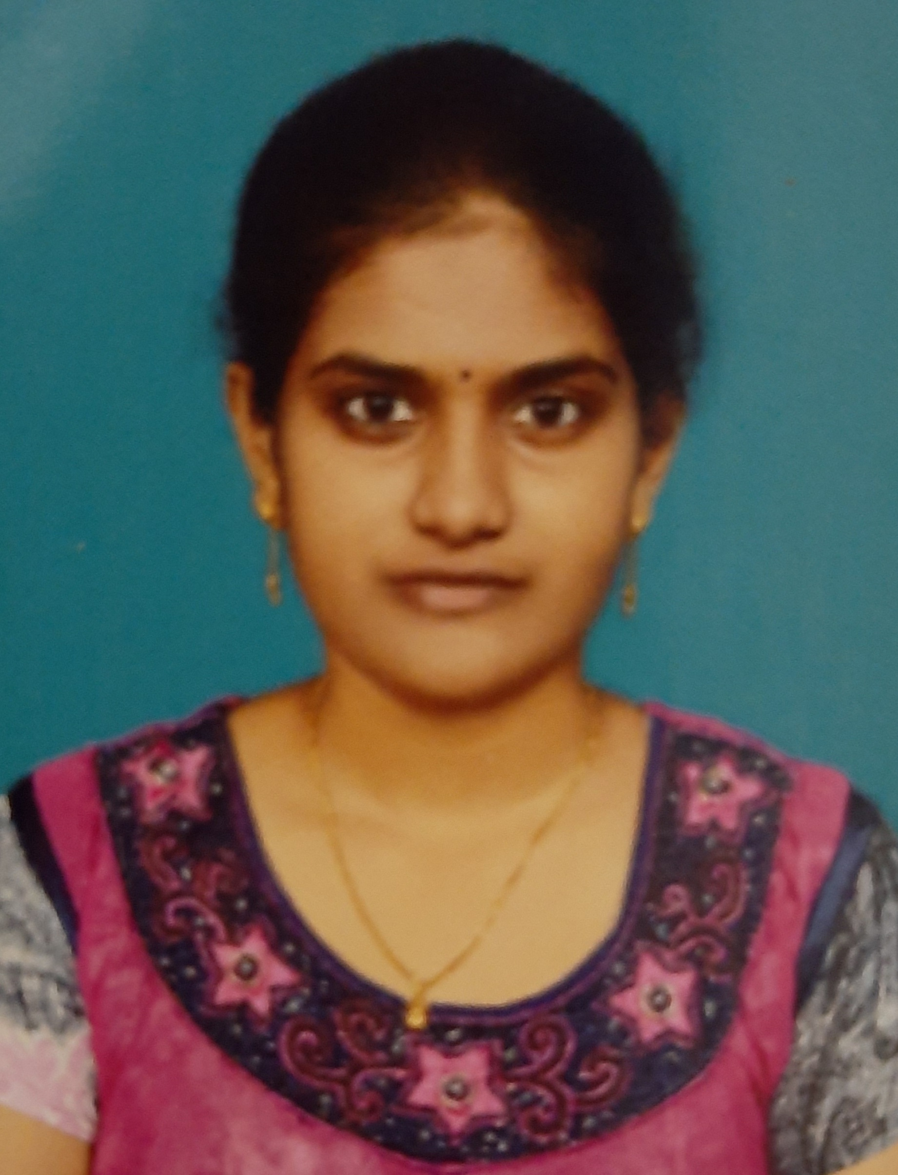
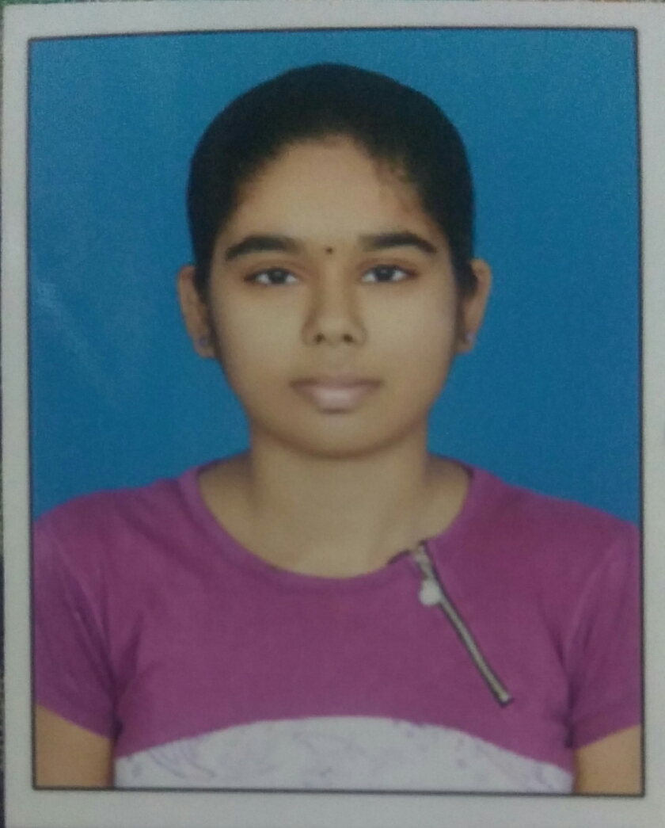
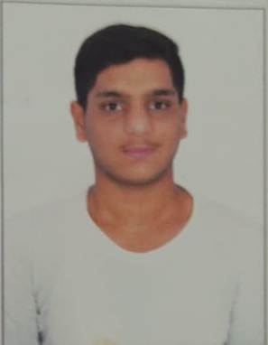
ACE
Engineering College
An AUTONOMOUS Institution
DEPARTMENT OF CSE (ARTIFICIAL INTELLIGENCE & MACHINE LEARNING)
Hearty Congratulations
2020-2024 Batch Students
Selected in
A. ANIL KUMAR
20AG1A6603
B. RASHMITHA
20AG1A6608
K.KEERTHI TEJASVI
20AG1A6631
K. MANEESHA REDDY
20AG1A6633
VINEETH NAGA SAIRAM
20AG1A6659
Best wishes from HOD, Faculty, Principal, Management

