Slide 1




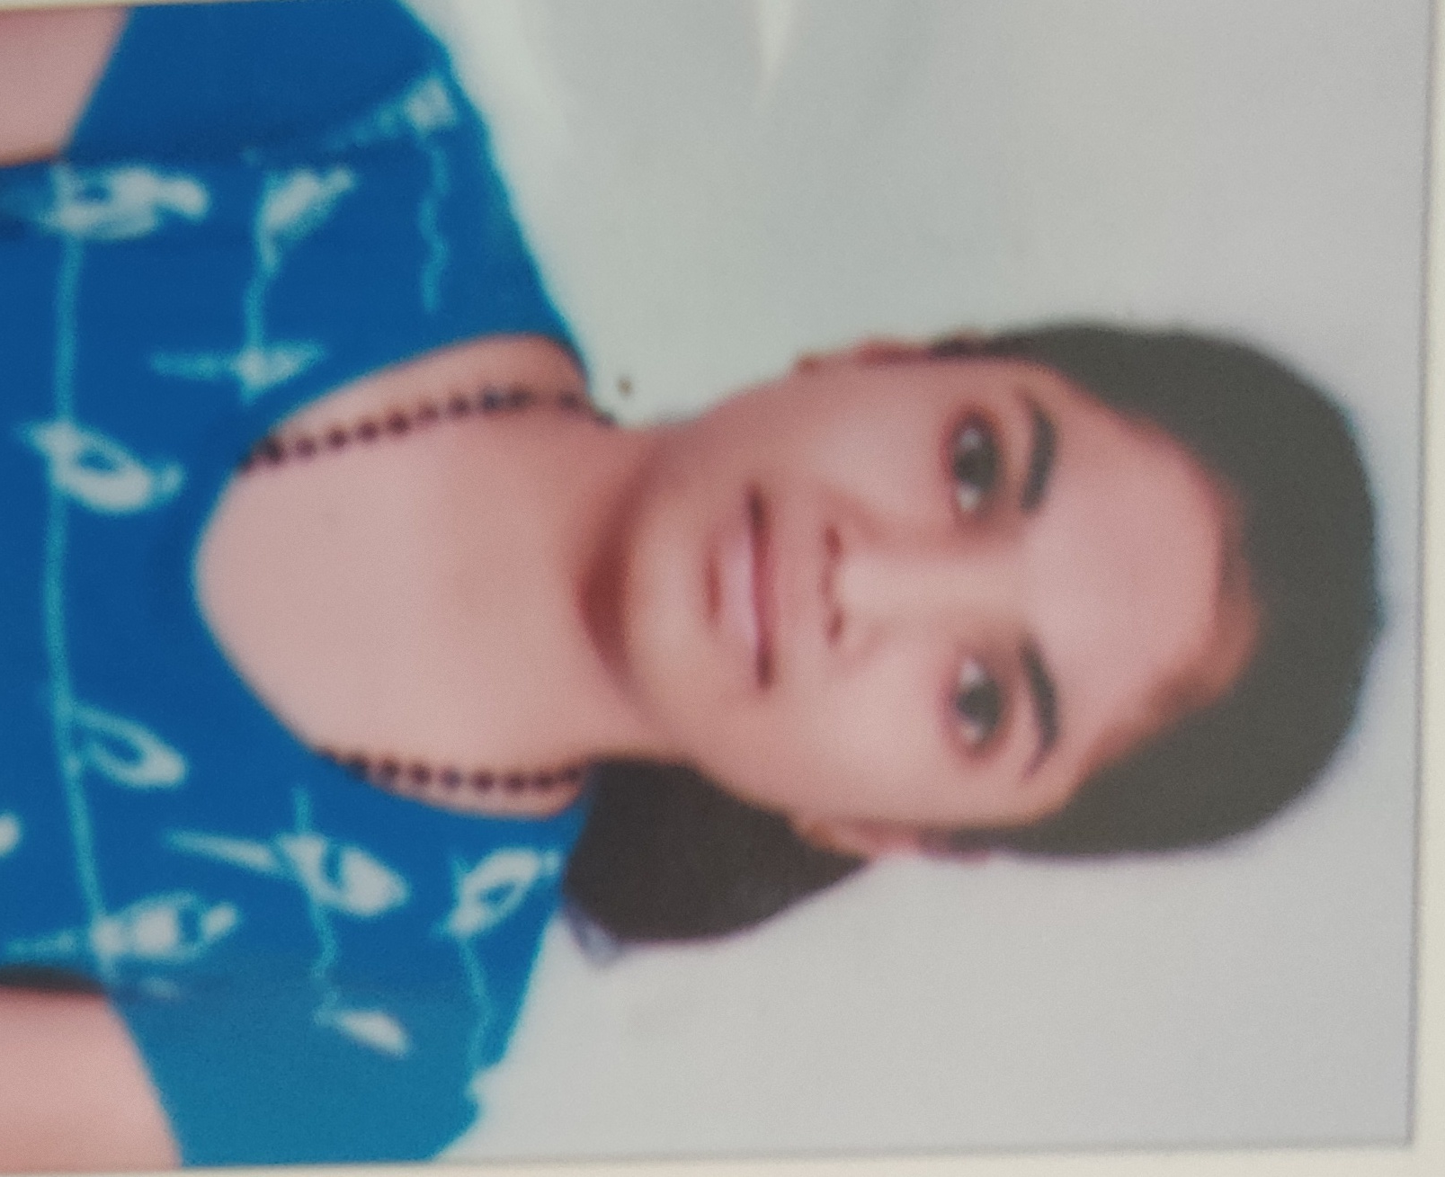
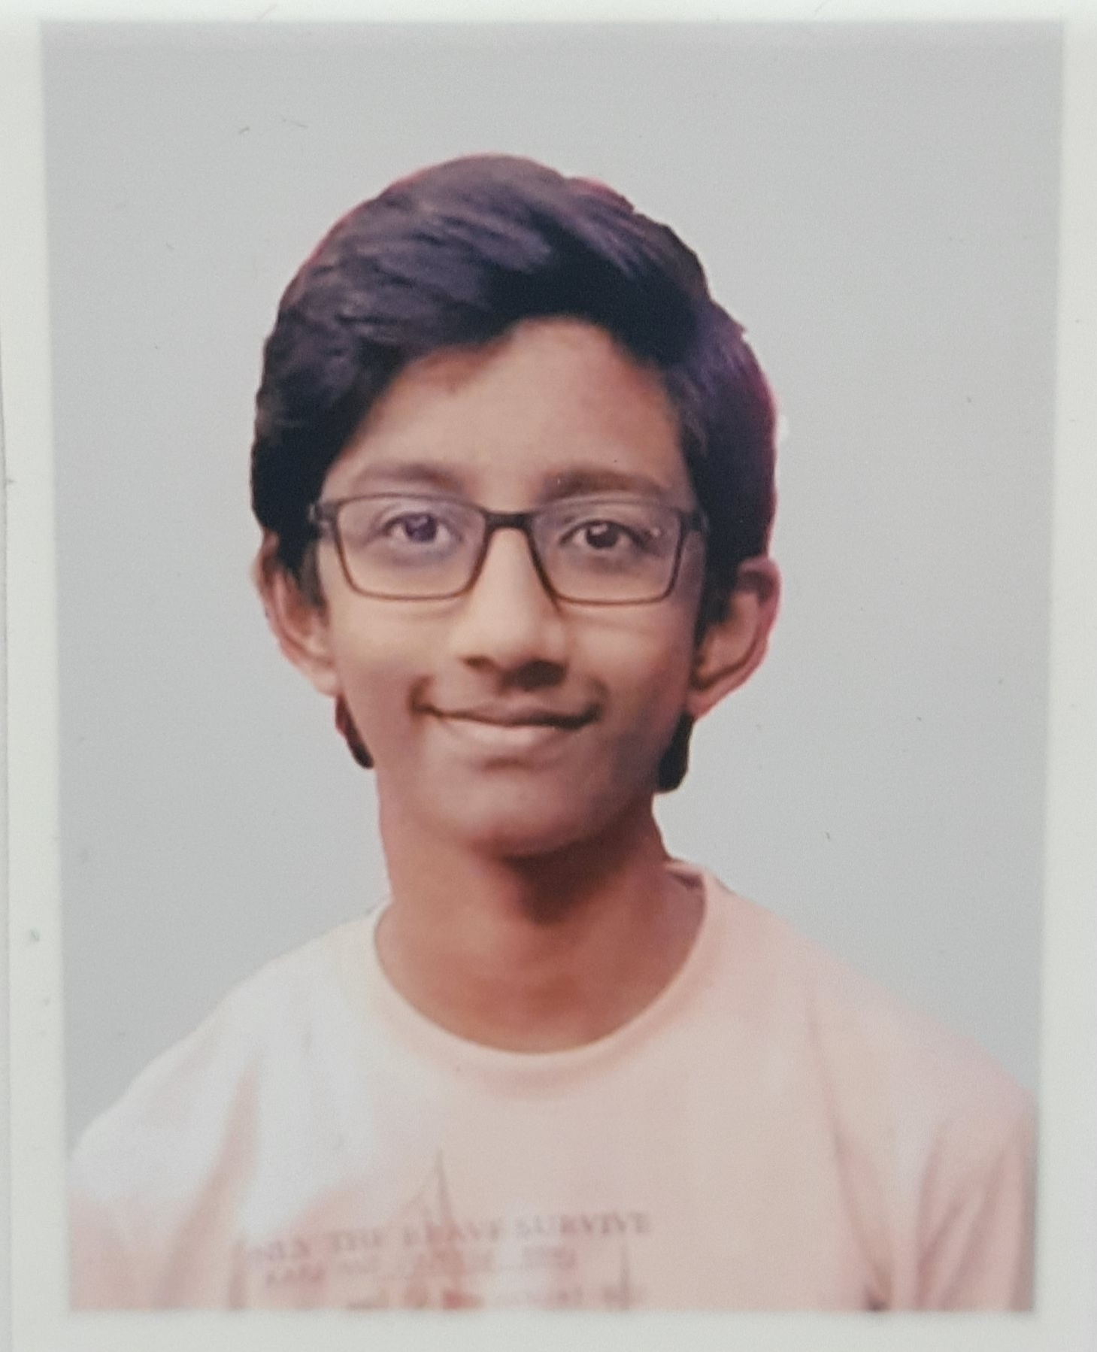
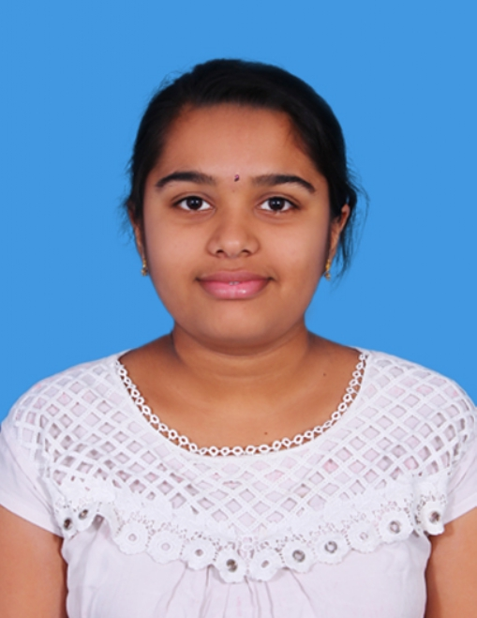
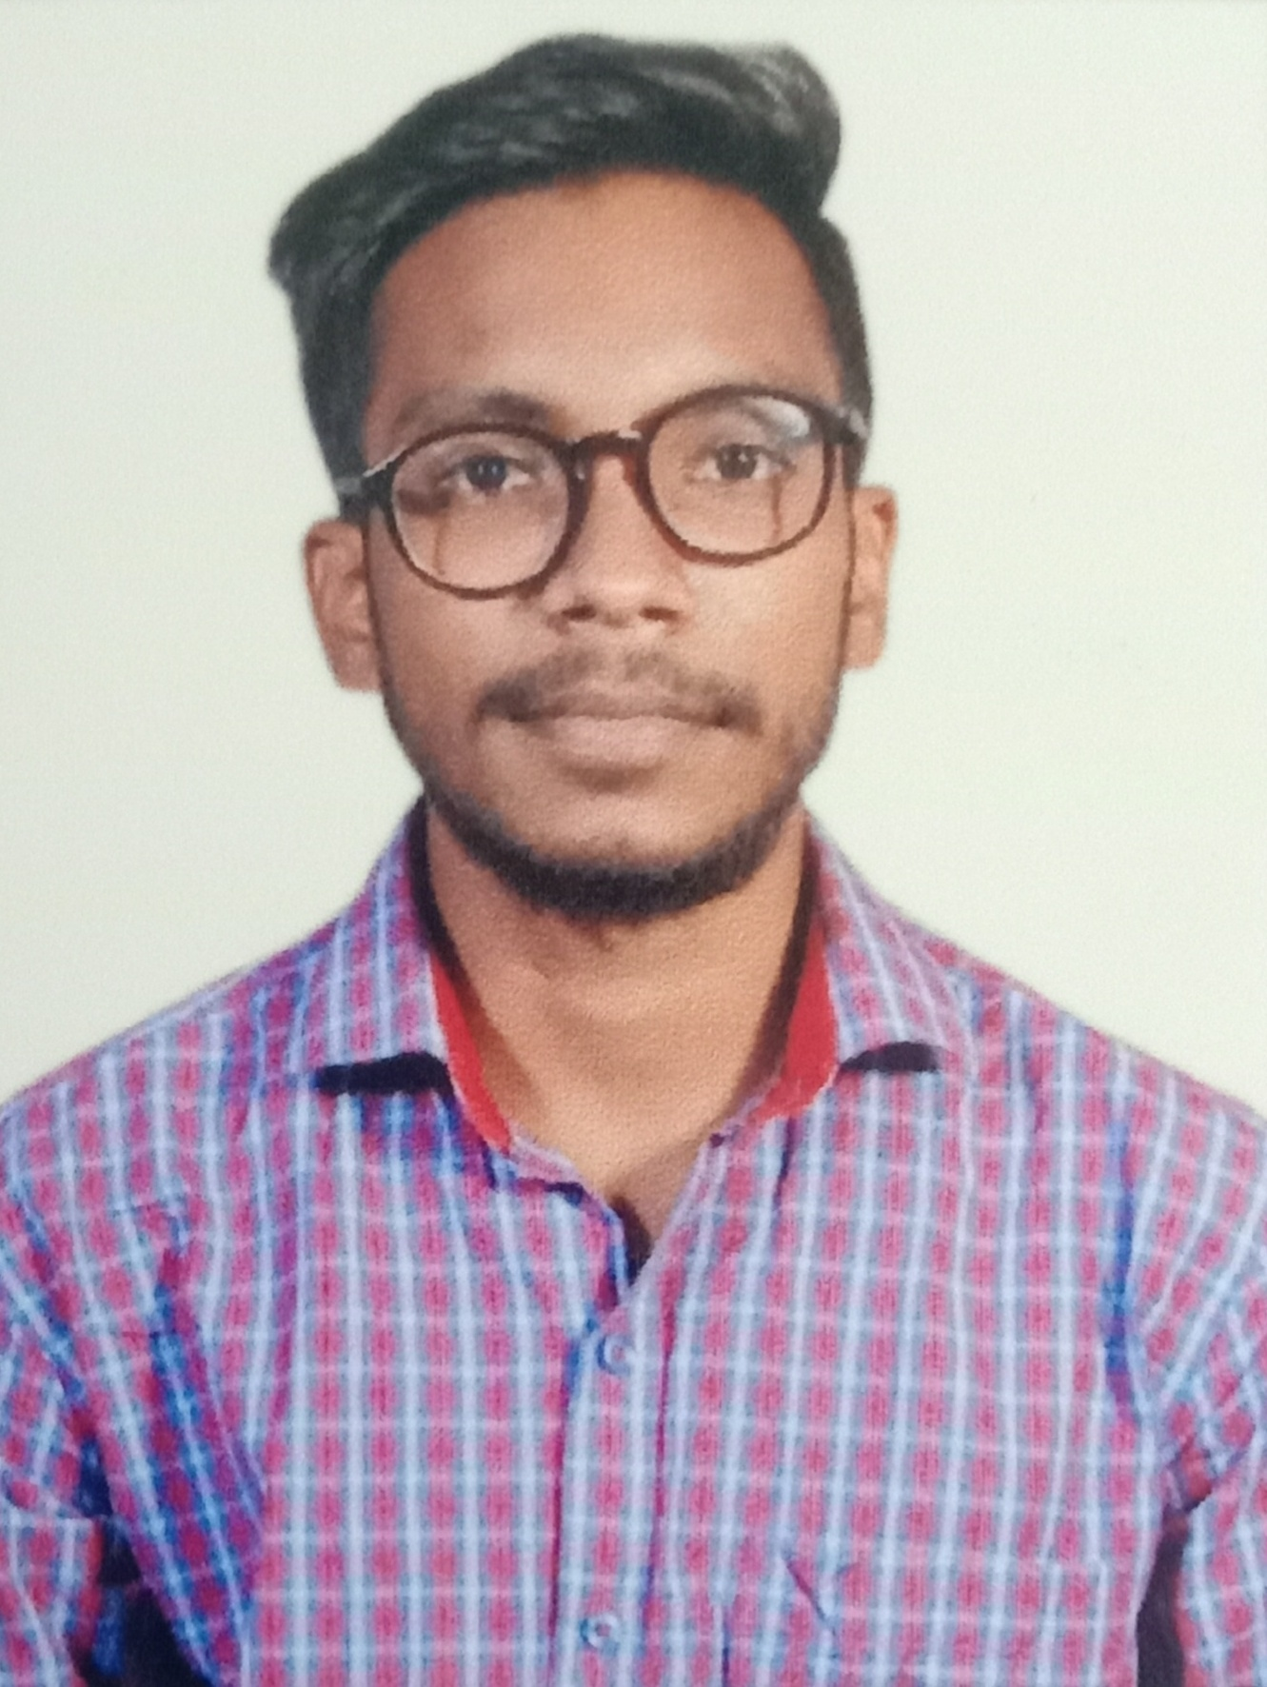
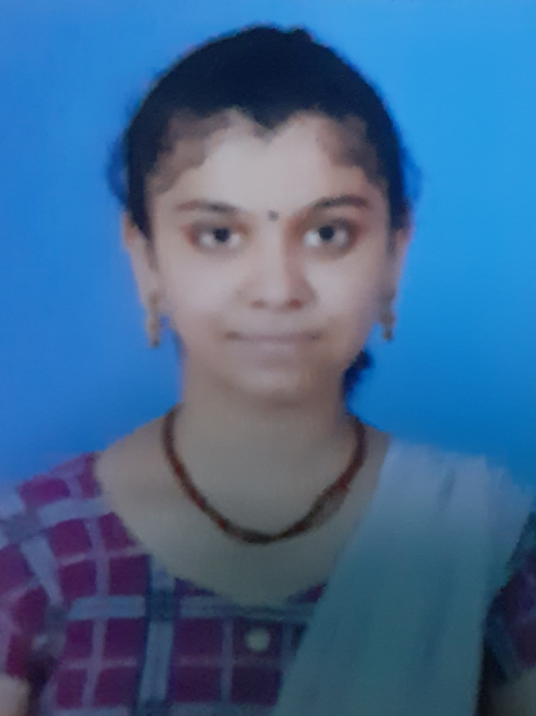
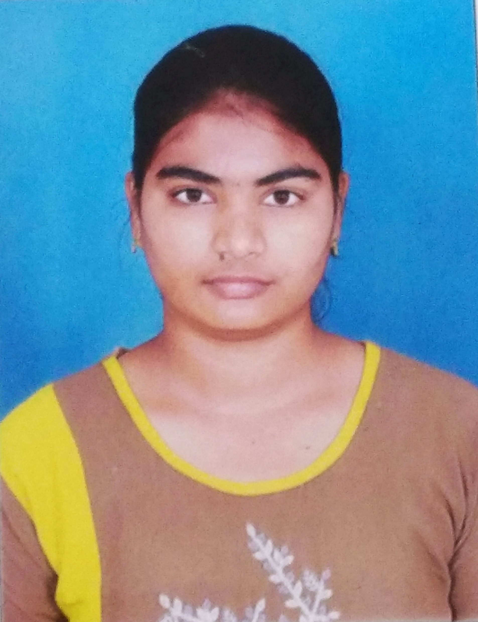
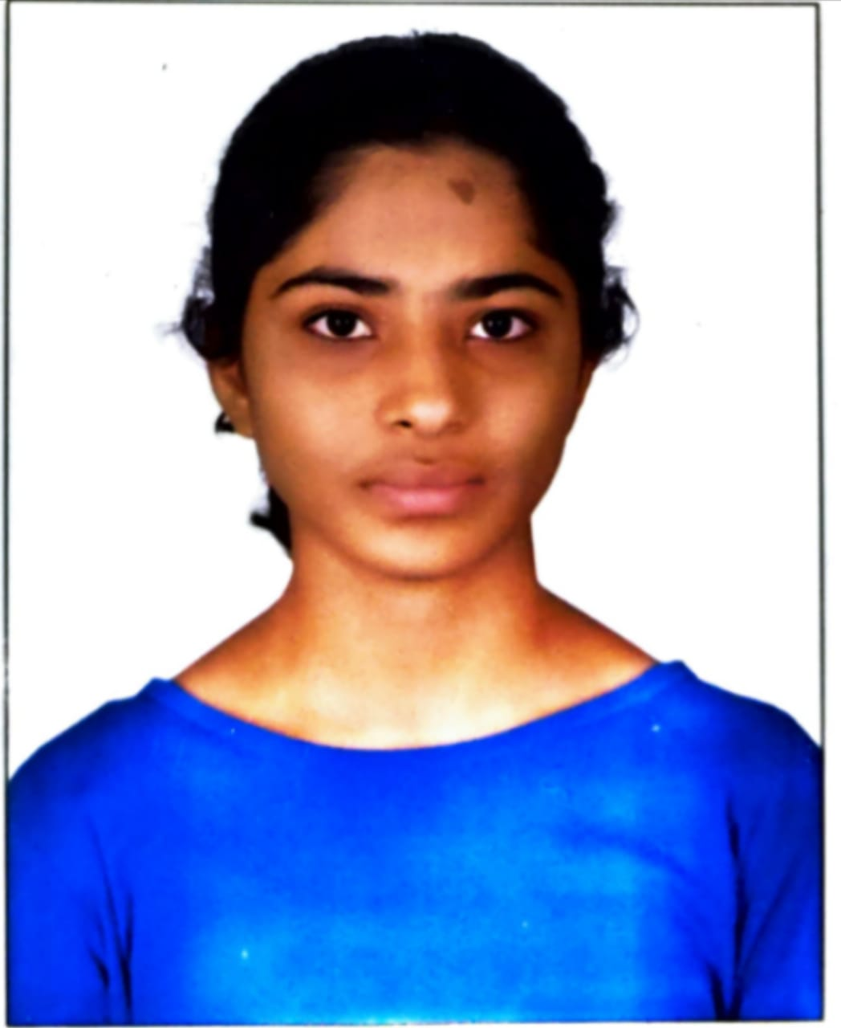
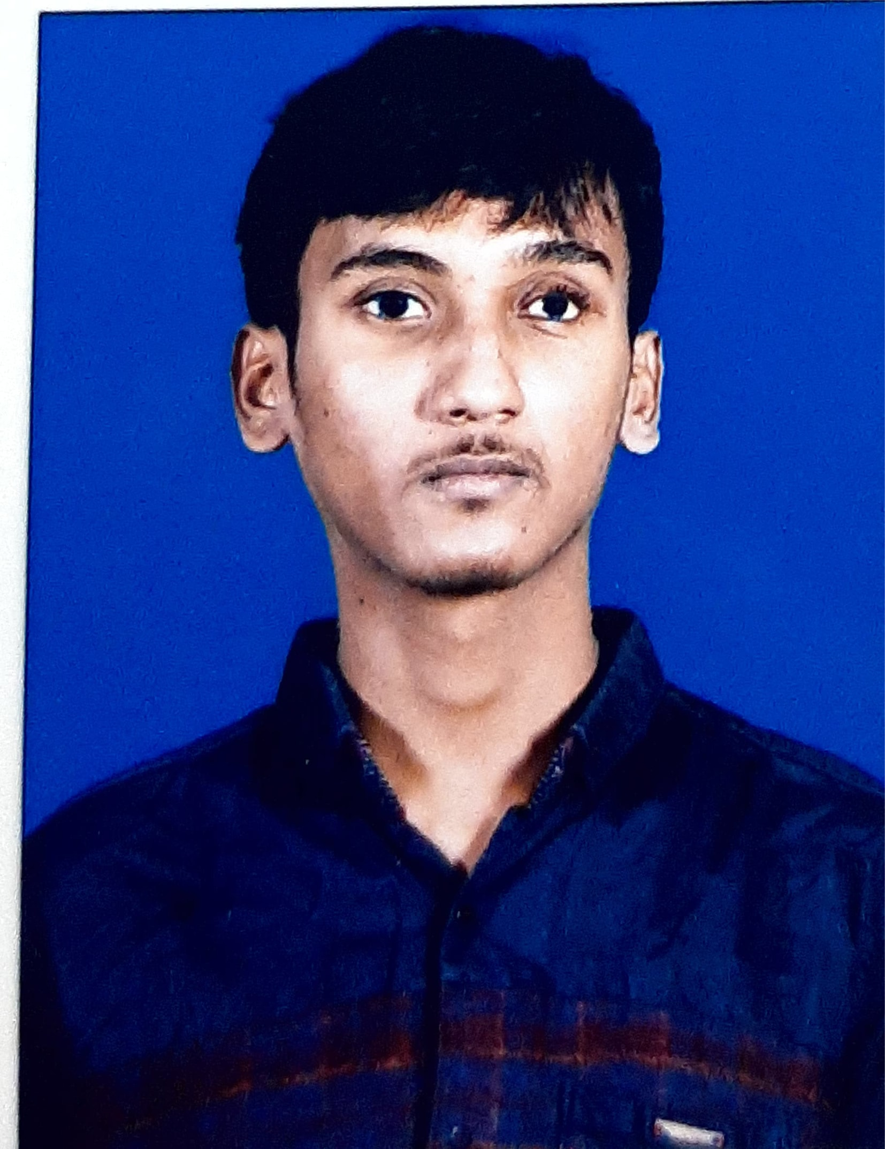
ACE
Engineering College
An AUTONOMOUS Institution
DEPARTMENT OF CSE (ARTIFICIAL INTELLIGENCE & MACHINE LEARNING)
Hearty Congratulations
2020-2024 Batch Students
Sutherland Global campus Drive
A. AKSHTHA
20AG1A6606
EASHWAR DUTT
20AG1A6606
B.SAI SRUJANA 20AG1A6610
D.JOASH
20AG1A6611
A. AKSHITHA
20AG1A6642
P. SINDHU
20AG1A6645
P. LAKSHMI PRIYA
20AG1A6646
T. ESHWAR
20AG1A6657
Best wishes from HOD, Faculty, Principal, Management

