Slide 1

WOLDIA UNIVERSITY
INSTITUTE OF TECHNOLOGY
SCHOOL OF ELECTRICAL AND COMPUTER ENGINEERING
COMPUTER ENGINEERING STREAM
TITLE: DESIGN AND IMPLEMENTATION OF SMART SIGNAGE SYSTEM FOR THE PURPOSE OF ORGANIZATIONAL INFORMATION DISCRIMINATION
DAWIT BERHAN WDU1304696
CHEREKA WAKSHUM WDU1300748
ARSEMA DANIEL WDU1300391

Slide 2
Abstract
Problem
Fixed brightness, no ambient adaptation
Independent node control
Unauthenticated IoT content delivery
High licensing costs ($1,000+/display)
Solution
Arduino sensor bridge + Raspberry Pi edge nodes
Adaptive brightness & occupancy detection
Emergency broadcast via hardware trigger
Node.js backend + React frontend with RBAC
Results
Verified with 55+ tests & hardware validation
60% cost reduction over 5 years

Slide 3
Introduction
Background
Digital signage is essential for modern organizations to disseminate information across campuses, hospitals, and public spaces. However, existing solutions suffer from critical gaps:
Energy waste from fixed-brightness operation
Disconnected, unmanaged display nodes
Unauthenticated IoT device communication
High total cost of ownership from commercial licensing

Slide 4
Project Scope
Institution: Woldia University, Institute of Technology
Scope: Campus-wide deployment architecture for 130 nodes
Prototype: 2 edge nodes (Debian 13 laptops) + Arduino sensor bridge
Duration: 8-month iterative development process

Slide 5
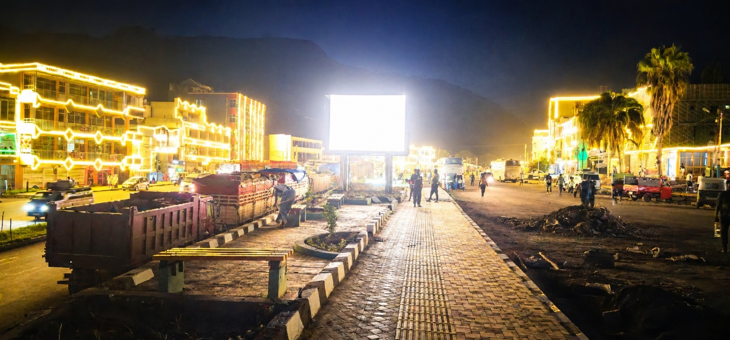
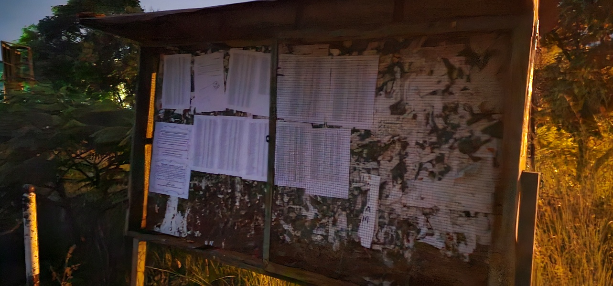
Problem Statement
P1: Energy Waste from Fixed-Brightness Operation
P2: Disconnected, Unmanaged Display Nodes
P3: Security Gap in Unauthenticated IoT Communication
P4: High Total Cost of Ownership

Slide 6
Objectives
General Objective
Design, implement, and validate an open-source Smart Digital Signage System that integrates environmental sensing, centralized content management with RBAC, real-time device command and control, live stream distribution, emergency broadcast with hardware trigger, and a hardened campus network.

Slide 7
Objectives
Specific Objectives
Embedded sensing layer (motion + ambient light + emergency button) with adaptive brightness
Centralized full-stack CMS with RBAC and real-time device control
Live stream distribution (HLS, RTSP, YouTube, RTMP) at zero licensing cost
Dual player architecture (Anthias + MPV) with per-device backend selection
Production-ready campus network (10.20.0.0/22, dual-NIC Layer 3 isolation)
Emergency broadcast system with hardware trigger and group-wide override
Concurrency control: control locks, priority synchronization, deadlock prevention
Automated testing (backend + frontend E2E) and hardware verification

Slide 8
Literature Review
Digital Signage Platforms
Commercial systems provide mature dashboards but require recurring licenses.
Open-source systems reduce software cost but often lack advanced sensing and security features.
Existing platforms usually treat displays as passive playback endpoints.
We identifies a need for an integrated sensing, CMS, and device-control system.

Slide 9
Literature Review
Power Management
Display brightness strongly affects power consumption.
Ambient light sensing can reduce unnecessary backlight use.
The Weber-Fechner law supports logarithmic brightness adaptation.
This project applies perception-aware brightness mapping to signage displays.

Slide 10
Literature Review
Research Gaps
No open-source platform combines sensing, CMS, RBAC, and adaptive brightness
Limited documented device-token authentication for signage nodes.
Limited campus-scale security and network design for signage IoT.
Limited zero-cost live streaming support in typical signage solutions.
Limited hardware-triggered emergency broadcast integration.

Slide 11
Methodology
The project follows iterative prototyping.
Requirements, architecture, implementation, and validation were developed in phases.
Hardware and software were integrated gradually.
Testing was performed at backend, frontend, hardware, and network levels.

Slide 12
Methodology
Non-Functional Requirements
System should be secure and role controlled.
System should support real-time updates through Socket.IO.
The design target supports campus scale with many display nodes.
The system should reduce cost through open-source software.
The system should be maintainable and documented.
Functional Requirements
User authentication and authorization.
Group, user, and device management.
Post and media management.
Playlist and signage deployment.
Sensor update processing.
Brightness control.
Emergency state override.
Live stream relay and monitoring.

Slide 13
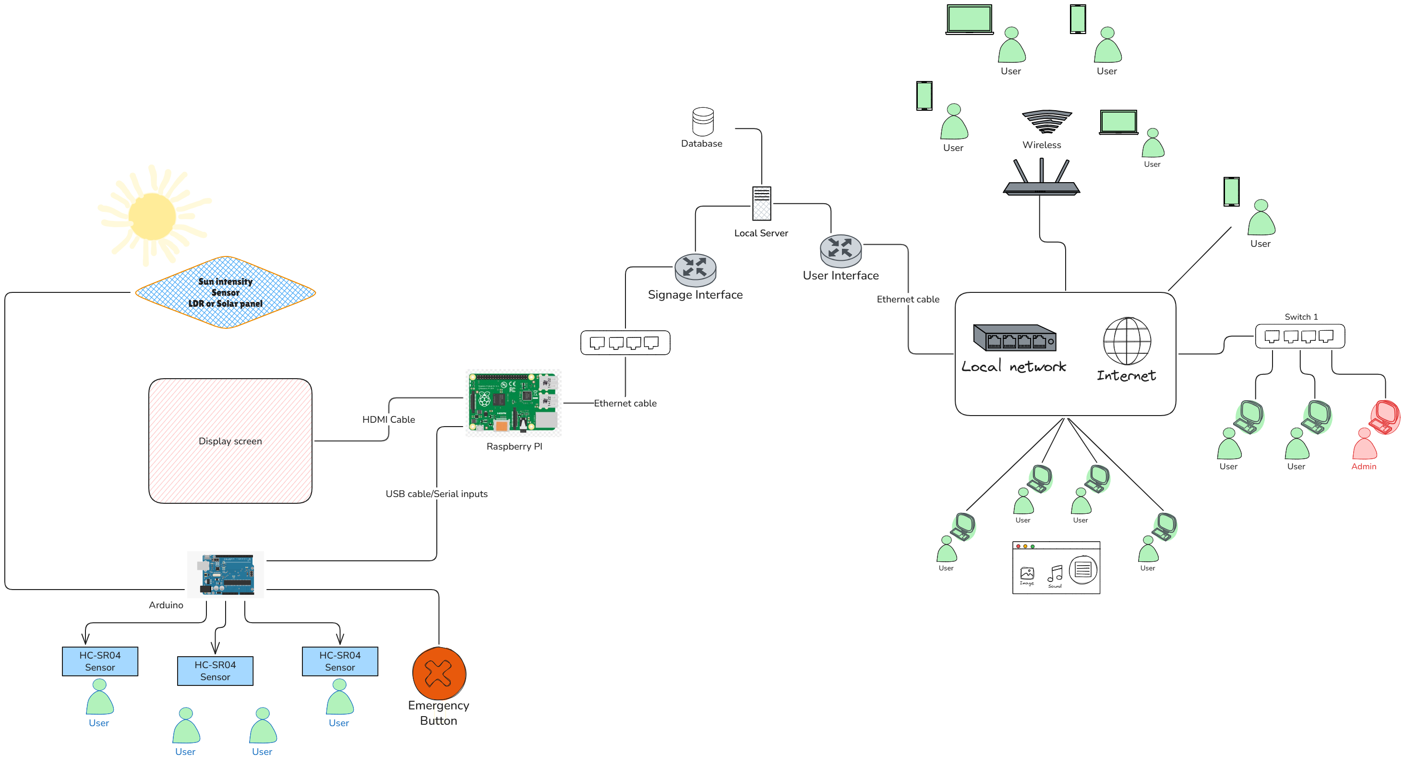
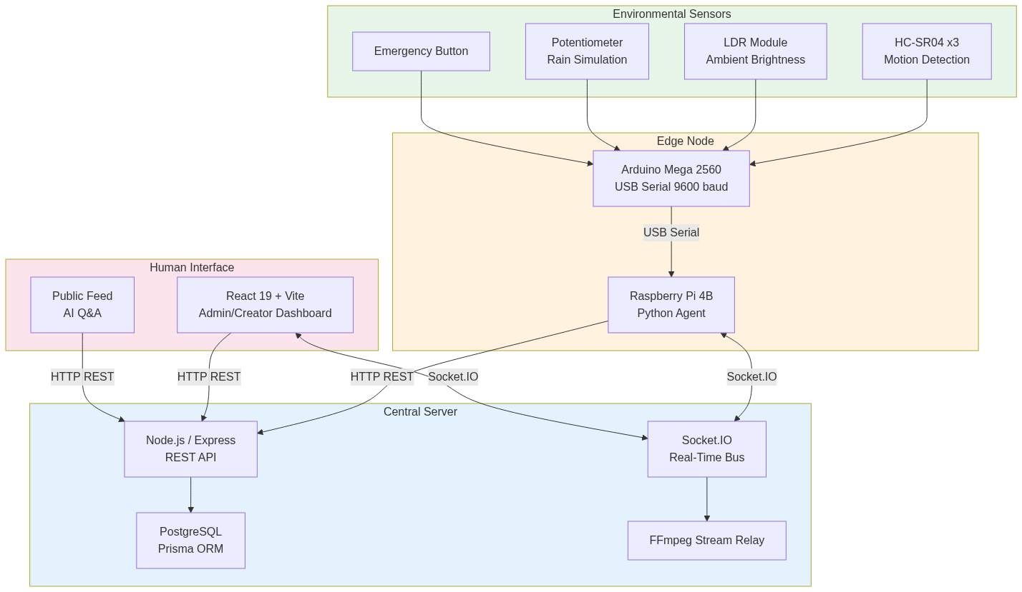
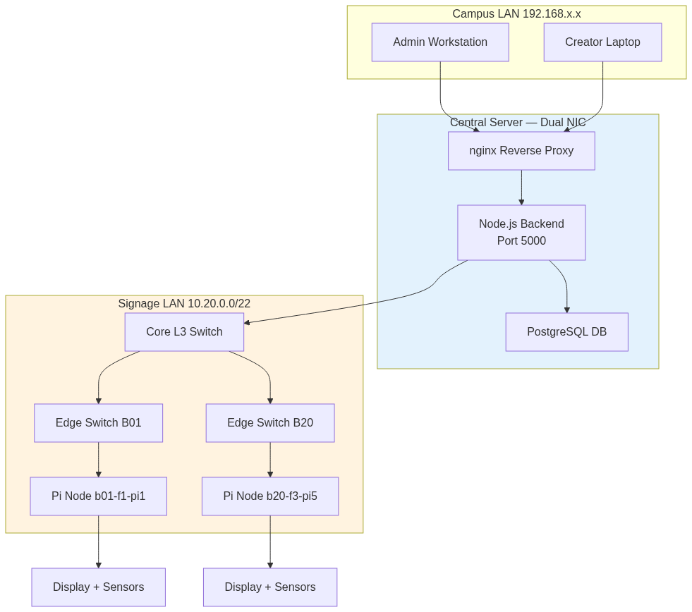
High-Level Architecture

Slide 14
Hardware Implementation
Component Selection
Component | Specification | Purpose
Arduino Mega 2560 | 8-bit microcontroller, 256 KB flash | Sensor acquisition and serial communication
HC-SR04 Ultrasonic Sensors | 3 units, 2-400 cm range | Motion detection (left, center, right coverage)
LDR Module | Light-dependent resistor, 10-bit ADC | Ambient light sensing for brightness control
Potentiometer | 10KΩ linear | Weather simulation (rain sensor proxy)
Emergency Push Button | Momentary switch | Hardware trigger for emergency broadcast
Debian 13 Laptops | 2 units, simulating Raspberry Pi 4B | Edge display nodes (screens as signage displays)

Slide 15
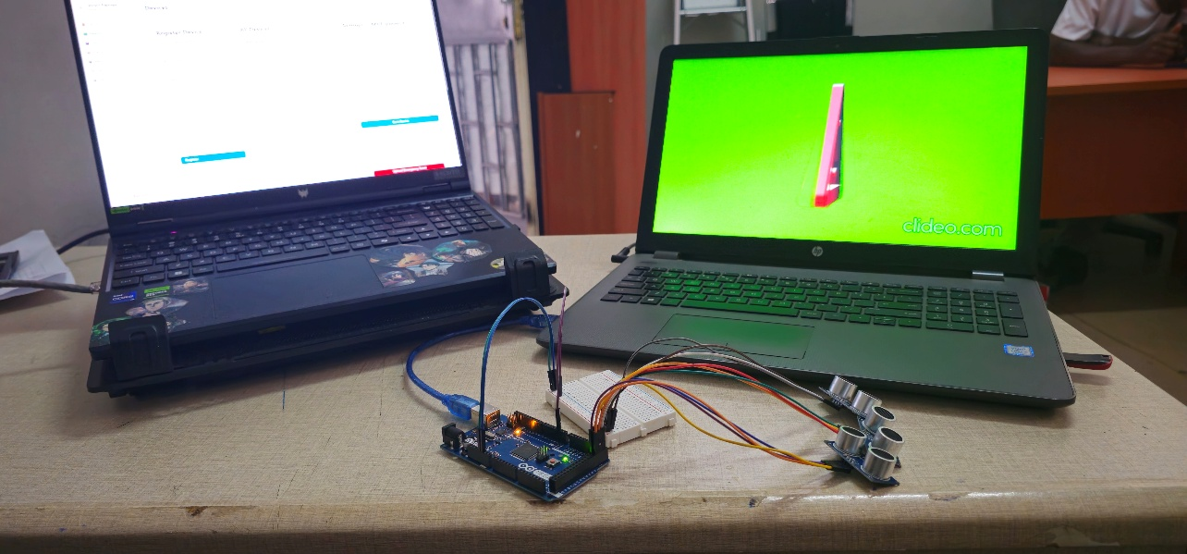
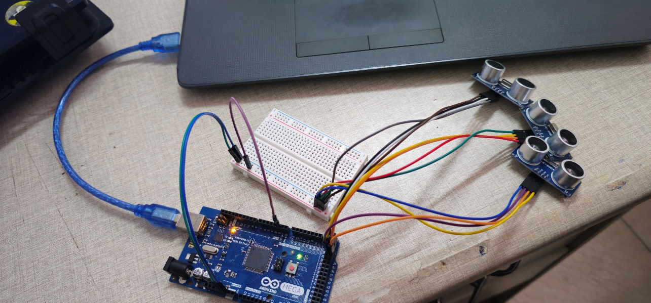
Cont…
Physical Assembly
Sensors mounted on solderless breadboard
Arduino connected to Debian nodes via USB serial (9600 baud)
Three HC-SR04 sensors positioned for 200 cm hallway coverage
Emergency button wired to digital pin D2
LDR and potentiometer connected to analog inputs

Slide 16
Hardware: Arduino Firmware
Sensor Data Transmission
The Arduino firmware reads sensors every 500ms and transmits a packet in the format:
SENSOR,motion,brightness,rain,emergency\n
motion: 0 or 1 (any sensor < 100 cm triggers motion)
brightness: Normalized LDR value (0–100)
rain: Normalized potentiometer value (0–100)
emergency: 0 or 1 (button press on pin D2)

Slide 17
Hardware: Adaptive Brightness Control
Weber-Fechner Logarithmic Mapping
We implemented logarithmic brightness mapping on the Debian node:
B_display = B_min + (B_max - B_min) × L_ambient
B_min: 10% (minimum readable brightness)
B_max: 100% (maximum brightness)
L_ambient: Normalized LDR reading (0–1023 mapped to 0–1)

Slide 18
Software Implementation: Overview
Technology Stack
Backend
Runtime: Node.js v20 LTS
Framework: Express.js 5.0
Database: PostgreSQL 15 with Prisma ORM
Real-time: Socket.IO 4.x
Media Processing: FFmpeg 7.0, Sharp 0.34
Authentication: JWT (users), Device Tokens (IoT nodes)
Frontend
Framework: React 19 with Vite 6.0
State Management: Zustand 5.x
Routing: React Router 7.x
Content Designers: Fabric.js 5.3 (visual), Markdown + KaTeX (textual)
HTTP Client: Axios 1.6
Testing: Playwright 1.48 (25 E2E tests, 55 screenshots)

Slide 19
Cont…
Technology Stack
Edge Node Software (Debian/Raspberry Pi)
Socket Client: Python socket_client.py (device authentication, heartbeat)
Content Sync: Python content_sync.py (incremental asset download)
Scheduler: Python scheduler.py (MPV playback scheduling)
Brightness Control: Python brightness_control.py (LDR → CEC mapping)
Service Manager: systemd unit files for auto-start

Slide 20
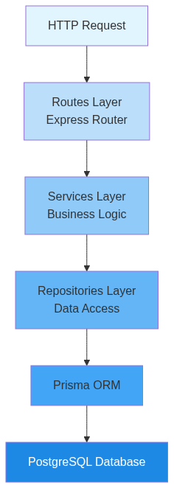
Software: Backend Architecture
Layered Architecture
Authentication & Authorization
Database Schema (PostgreSQL + Prisma)
Real-Time Communication (Socket.IO)
Concurrency Control

Slide 21
Software: Frontend & User Interface
React 19 Frontend Architecture
Role-Based Dashboards
Admin Dashboard
Creator Dashboard
Public Feed
State Management
Zustand stores for user auth, groups, devices, posts
Real-time updates via Socket.IO
Optimistic UI updates
Testing
25 Playwright E2E tests
55 automated screenshots covering all major features
Tests for login, admin operations, creator workflows, public feed, emergency handling

Slide 22
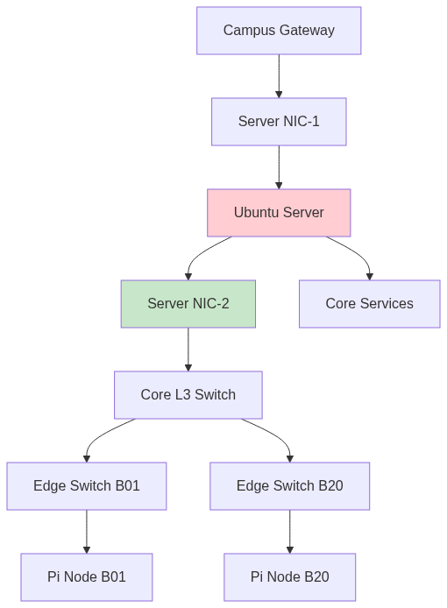
Network Architecture
Subnet Design
Signage Subnet: 10.20.0.0/22 (1,022 usable IPs)
Layer 3 Isolation with Dual-NIC Server
NIC-1 (Campus-facing):
NIC-2 (Signage-facing):
No direct routing between campus and signage subnets. All cross-subnet traffic traverses the server with firewall rules, TLS termination, and rate limiting.

Slide 23
Network: Core Services & Bandwidth
Core Services
Bandwidth Engineering
Service
dnsmasq
chrony
nginx
nftables
tc (traffic control)
Scenario | Concurrent Nodes | Per-Node Rate | Aggregate
Normal operation | 130 | 5 kbps (heartbeat) | 650 kbps
Content push (images) | 130 | 500 KB every 60 s | ~10.8 Mbps
Content push (videos) | 130 | 5 MB every 300 s | ~17.3 Mbps
Live stream (1080p HLS) | 130 | 4 Mbps | 520 Mbps
Emergency broadcast | 130 | 200 KB (one-time) | 26 Mbps

Slide 24
Security Implementation
Threat Model
Threat Actor | Motivation | Attack Surface
Malicious insider | Sabotage, unauthorized content | Admin dashboard, device tokens
External attacker | Content injection, service disruption | Public-facing API, Socket.IO
Compromised campus workstation | Lateral movement to signage network | Campus subnet → signage subnet
Physical access | Hardware tampering | Raspberry Pi, Arduino, displays

Slide 25
Security Implementation
Vulnerabilities Addressed (12 Total)
Priority P0 (Critical - 4 issues)
Default credentials in PiSignage → Bcrypt password hashing
Unauthenticated Socket.IO connections → Device token validation
SQL injection via unsanitized input → Prisma ORM parameterized queries
Missing HTTPS → TLS 1.3 termination via nginx
Priority P1 (High - 5 issues)
No RBAC for content management → Group-scoped permissions
Unrestricted file uploads → Multer validation + Sharp processing
Missing rate limiting → tc + nginx rate limits
Weak JWT secrets → 32-character cryptographically secure secrets
No input validation → Express-validator middleware
Priority P2 (Medium - 3 issues)
Missing CORS headers → Helmet.js CORS configuration
No security headers → Helmet.js security headers
Insufficient logging → Structured logging with Winston

Slide 26
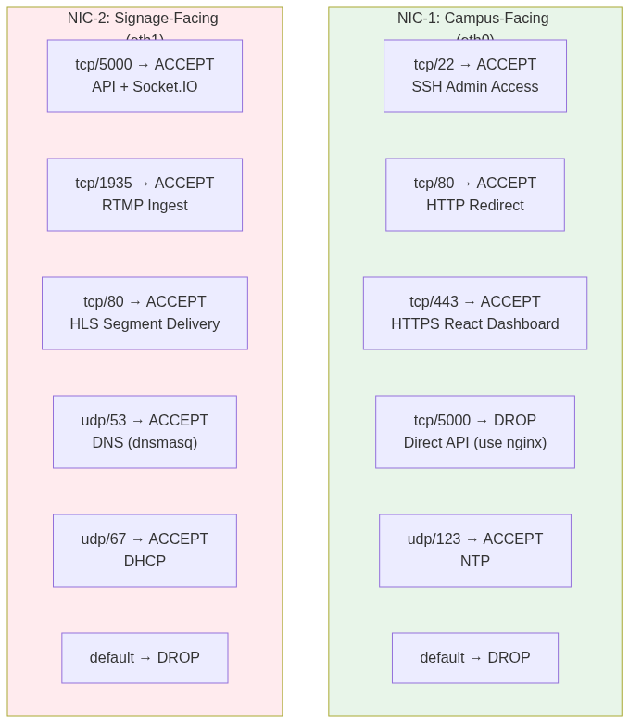
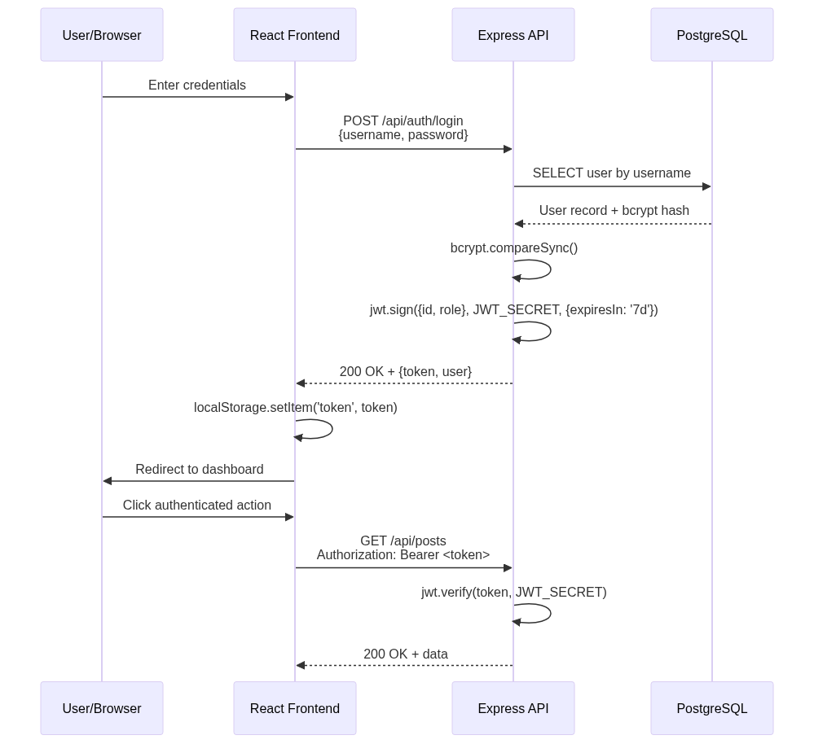
Security Implementation

Slide 27
Power Analysis
Component Power Specifications
Component | Power (W) | Duty Cycle | Notes
Raspberry Pi 4B | 5.0 | 16 hrs/day | Active during campus hours
Commercial Display (43”) | 80 | 16 hrs/day | Fixed brightness baseline
Arduino Mega 2560 | 0.2 | 24 hrs/day | Always on for sensing
Network Switch (per building) | 15 | 24 hrs/day | Infrastructure
Server (dual-NIC) | 150 | 24 hrs/day | Backend + database

Slide 28
Cont…
Per-Node Power Budget
Without adaptive brightness:
Display: 80 W × 16 hrs = 1,280 Wh/day
Pi: 5 W × 16 hrs = 80 Wh/day
Arduino: 0.2 W × 24 hrs = 4.8 Wh/day
Total per node: 1,364.8 Wh/day
With adaptive brightness (30% savings):
Display: 56 W × 16 hrs = 896 Wh/day
Pi: 5 W × 16 hrs = 80 Wh/day
Arduino: 0.2 W × 24 hrs = 4.8 Wh/day
Total per node: 980.8 Wh/day
Savings per node: 384 Wh/day (28% reduction)

Slide 29
Cont…
Campus-Wide Energy Scenarios
Scenario | Nodes | Daily kWh | Annual kWh | Annual Cost ($0.12/kWh)
Fixed brightness | 130 | 177.4 | 64,751 | $7,770
Adaptive brightness | 130 | 127.5 | 46,538 | $5,585
Savings | - | 49.9 | 18,213 | $2,185

Slide 30
Cost Analysis
Per-Node Bill of Materials (BOM)
Component | Unit Cost ($) | Quantity | Total ($)
Raspberry Pi 4B (4GB) | 55 | 1 | 55
MicroSD Card (64GB) | 12 | 1 | 12
Commercial Display (43") | 300 | 1 | 300
Arduino Mega 2560 | 25 | 1 | 25
HC-SR04 Sensors (3×) | 5 | 3 | 15
LDR Module | 3 | 1 | 3
Emergency Button | 2 | 1 | 2
Cabling & Enclosure | 20 | 1 | 20
Per-Node Total | - | - | 432

Slide 31
Cont…
Campus-Wide Procurement (130 Nodes)
Category | Cost ($)
Edge Nodes (130 × $432) | 56,160
Server (dual-NIC, 32GB RAM, 2TB SSD) | 2,500
Network Infrastructure (switches, cabling) | 15,000
UPS Units (server + switches) | 8,000
Hardware Total | 81,660

Slide 32
Cont…
5-Year Total Cost of Ownership (TCO) Comparison
Platform | Hardware (5 yr) | Software (5 yr) | Energy (5 yr) | Total (5 yr)
Yodeck | $81,660 | $109,120 | $38,850 | $229,630
NoviSign | $81,660 | $234,000 | $38,850 | $354,510
Rise Vision | $81,660 | $93,600 | $38,850 | $214,110
ScreenCloud | $81,660 | $156,000 | $38,850 | $276,510
Our System | $81,660 | $0 | $27,930 | $109,590
Savings: 46–70% TCO reduction compared to commercial alternatives

Slide 33
Testing & Validation
Backend Integration Testing (Jest + Supertest)
Test Suite: 30+ tests covering:
Frontend End-to-End Testing (Playwright)
Test Suite: 25 tests producing 55 screenshots
Result: All tests passing

Slide 34
Results: Objectives Achievement
# | Objective | Status | Evidence
1 | Embedded sensing layer with adaptive brightness | ✅ Achieved | Arduino firmware verified; brightness adaptation tested end-to-end
2 | Centralized CMS with RBAC and real-time control | ✅ Achieved | Admin/creator dashboards functional; 30+ backend tests passing
3 | Live stream distribution at zero licensing cost | ✅ Achieved | FFmpeg pipeline operational; Playwright E2E tests passing
4 | Dual player architecture with per-device selection | ✅ Achieved | Device comparison table; content sync verified
5 | Production-ready campus network design | ✅ Achieved | Network topology documented; nftables rules implemented
6 | Emergency broadcast with hardware trigger | ✅ Achieved | Physical button triggers playback; Socket.IO propagation tested
7 | Concurrency control with deadlock prevention | ✅ Achieved | Control lock flow tested; 423 Locked HTTP response validated
8 | Automated testing and hardware verification | ✅ Achieved | Jest (30+ tests), Playwright (25 tests, 55 screenshots), hardware checklist

Slide 35
Cont…
Key Metrics
Energy savings: 28% per-node reduction through adaptive brightness
Campus-wide energy savings: $2,185 annually
TCO reduction: 46–70% compared to commercial alternatives
Test coverage: 55 automated tests (backend + frontend E2E)
Hardware prototype: Fully functional with real Arduino + Debian nodes

Slide 36
Discussion
How the Problems Are Solved
P1: Energy Waste → Adaptive Brightness Control
P2: Disconnected Nodes → Centralized Management
P3: Security Gap → Device Token Authentication
P4: High TCO → Open-Source Architecture

Slide 37
Limitations
Out of Scope
Physical Deployment Scale
Power Measurements
Mobile Responsiveness
Advanced Features

Slide 38
Future Work
Research Directions (18+ Months)
Immediate Priorities (0–6 Months)
Federated Multi-Campus Deployment
Privacy-Preserving Occupancy Analytics
Edge Machine Learning
Physical Raspberry Pi Deployment
Per-Location Brightness Calibration
Mobile-Responsive Admin Dashboard
Touch-Screen Kiosk Mode
Medium-Term Enhancements (6–18 Months)
AI-Driven Predictive Content Scheduling
Predictive Maintenance
Campus Calendar Integration
Kubernetes Deployment

Slide 39
Conclusion
This capstone project presented the design, implementation, and validation of a Smart Digital Signage System that integrates:
Environmental sensing
Role-based content management
Real-time device control
Live stream distribution
Emergency broadcast
Security-hardened network
Adaptive brightness control

Slide 40
THANK YOU!!!

