Slide 1

What is Machine Learning?

Slide 2
Machine Learning
Before we jump into Neural Networks, Tensorflow, Keras API etc… its a good idea to understand a few fundamental ideas regarding machine learning.
In this section we’ll cover some important theory and concepts surrounding machine learning.

Slide 3
Machine Learning
Section Overview:
What is Machine Learning?
What is Deep Learning?
Difference between Supervised and Unsupervised Learning
Supervised Learning Process
Evaluating performance
Overfitting

Slide 4
What is Machine Learning?
Machine learning is a method of data analysis that automates analytical model building.
Using algorithms that iteratively learn from data, machine learning allows computers to find hidden insights without being explicitly programmed where to look.

Slide 5
What is it used for?
Fraud detection.
Web search results.
Real-time ads on web pages
Credit scoring.
Prediction of equipment failures.
New pricing models.
Network intrusion detection.
Recommendation Engines
Customer Segmentation
Text Sentiment Analysis
Customer Churn
Pattern and image recognition.
Email spam filtering.

Slide 6
What are Neural Networks?
Neural Networks are a way of modeling biological neuron systems mathematically.
These networks can then be used to solve tasks that many other types of algorithms can not (e.g. image classification)
Deep Learning simply refers to neural networks with more than one hidden layer.

Slide 7
Machine Learning
There are different types of machine learning we will focus on during the next sections of the course:
Supervised Learning
Unsupervised Learning

Slide 8
Machine Learning
Machine Learning
Automated analytical models.
Neural Networks
A type of machine learning architecture modeled after biological neurons.
Deep Learning
A neural network with more than one hidden layer.

Slide 9
Machine Learning
Let’s begin by learning about one of the most common machine learning tasks- Supervised Learning!

Slide 10
Supervised Learning

Slide 11
Supervised Learning
Supervised learning algorithms are trained using labeled examples, such as an input where the desired output is known.
For example, a segment of text could have a category label, such as:
Spam vs. Legitimate Email
Positive vs. Negative Movie Review

Slide 12
Supervised Learning
The network receives a set of inputs along with the corresponding correct outputs, and the algorithm learns by comparing its actual output with correct outputs to find errors.
It then modifies the model accordingly.

Slide 13
Supervised Learning
Supervised learning is commonly used in applications where historical data predicts likely future events.

Slide 14
Machine Learning Process
Test
Data
Model
Training &
Building
Data
Acquisition
Data
Cleaning
Model
Testing
Model
Deployment

Slide 15
Machine Learning Process
Get your data! Customers, Sensors, etc...
Data
Acquisition

Slide 16
Machine Learning Process
Clean and format your data (using Pandas)
Data
Acquisition
Data
Cleaning

Slide 17
Machine Learning Process
Test
Data
Training
Data
Data
Acquisition
Data
Cleaning

Slide 18
Machine Learning Process
Test
Data
Model
Training &
Building
Data
Acquisition
Data
Cleaning

Slide 19
Machine Learning Process
Test
Data
Model
Training &
Building
Data
Acquisition
Data
Cleaning
Model
Testing

Slide 20
Machine Learning Process
Test
Data
Model
Training &
Building
Data
Acquisition
Data
Cleaning
Model
Testing
Adjust
Model
Parameters

Slide 21
Machine Learning Process
Test
Data
Model
Training &
Building
Data
Acquisition
Data
Cleaning
Model
Testing
Model
Deployment

Slide 22
Supervised Learning
What we just showed is a simplified approach to supervised learning, it contains an issue!
Is it fair to use our single split of the data to evaluate our models performance?
After all, we were given the chance to update the model parameters again and again.

Slide 23
Supervised Learning
To fix this issue, data is often split into 3 sets
Training Data
Used to train model parameters
Validation Data
Used to determine what model hyperparameters to adjust
Test Data
Used to get some final performance metric

Slide 24
Supervised Learning
This means after we see the results on the final test set we don’t get to go back and adjust any model parameters!
This final measure is what we label the true performance of the model to be.

Slide 25
Supervised Learning
In this course, in general we will simplify our data by using a simple train/test split.
We will simply train and then evaluate on a test set (leaving the option to students to go back and adjust parameters).
After going through the course, you will be able to easily perform another split to get 3 data sets if you desire.

Slide 26
Overfitting and Underfitting

Slide 27
Machine Learning
Now that we understand the full process for supervised learning, let’s touch upon the important topics of overfitting and underfitting.

Slide 28
Machine Learning
Overfitting
The model fits too much to the noise from the data.
This often results in low error on training sets but high error on test/validation sets.

Slide 29
Machine Learning
Data
Y
X

Slide 30
Machine Learning
Good Model
Y
X

Slide 31
Machine Learning
Overfitting
Y
X

Slide 32
Machine Learning
Overfitting
Y
X

Slide 33
Machine Learning
Overfitting
Y
X

Slide 34
Machine Learning
Overfitting
Y
X

Slide 35
Machine Learning
Underfitting
Model does not capture the underlying trend of the data and does not fit the data well enough.
Low variance but high bias.
Underfitting is often a result of an excessively simple model.

Slide 36
Machine Learning
Data
Y
X

Slide 37
Machine Learning
Underfitting
Y
X

Slide 38
Machine Learning
This data was easy to visualize, but how can we see underfitting and overfitting when dealing with multi dimensional data sets?
First let’s imagine we trained a model and then measured its error over training time.

Slide 39
Machine Learning
Good Model
Error
Training Time

Slide 40
Machine Learning
Good Model
Error
Epochs

Slide 41
Machine Learning
Bad Model
Error
Epochs

Slide 42
Machine Learning
When thinking about overfitting and underfitting we want to keep in mind the relationship of model performance on the training set versus the test/validation set.

Slide 43
Machine Learning
Let’s imagine we split our data into a training set and a test set

Slide 44
Machine Learning
We first see performance on the training set
Error
Epochs

Slide 45
Machine Learning
Next we check performance on the test set
Error
Epochs

Slide 46
Machine Learning
Ideally the model would perform well on both, with similar behavior.
Error
Epochs

Slide 47
Machine Learning
But what happens if we overfit on the training data? That means we would perform poorly on new test data!
Error
Epochs

Slide 48
Machine Learning
But what happens if we overfit on the training data? That means we would perform poorly on new test data!
Error
Epochs

Slide 49
Machine Learning
This is a good indication of training too much on the training data, you should look for the point to cut off training time!
Error
Epochs

Slide 50
Machine Learning
We’ll check on this idea again when we actually begin creating models!
For now just be aware of this possible issue!

Slide 51
Evaluating Performance
CLASSIFICATION

Slide 52
Model Evaluation
We just learned that after our machine learning process is complete, we will use performance metrics to evaluate how our model did.
Let’s discuss classification metrics in more detail!

Slide 53
Model Evaluation
The key classification metrics we need to understand are:
Accuracy
Recall
Precision
F1-Score

Slide 54
Model Evaluation
But first, we should understand the reasoning behind these metrics and how they will actually work in the real world!

Slide 55
Model Evaluation
Typically in any classification task your model can only achieve two results:
Either your model was correct in its prediction.
Or your model was incorrect in its prediction.

Slide 56
Model Evaluation
Fortunately incorrect vs correct expands to situations where you have multiple classes.
For the purposes of explaining the metrics, let’s imagine a binary classification situation, where we only have two available classes.

Slide 57
Model Evaluation
In our example, we will attempt to predict if an image is a dog or a cat.
Since this is supervised learning, we will first fit/train a model on training data, then test the model on testing data.
Once we have the model’s predictions from the X_test data, we compare it to the true y values (the correct labels).

Slide 58
Model Evaluation
TRAINED
MODEL

Slide 59

Model Evaluation
TRAINED
MODEL
Test Image
from X_test

Slide 60
Model Evaluation
TRAINED
MODEL
Test Image
from X_test
DOG
Correct Label
from y_test

Slide 61
Model Evaluation
TRAINED
MODEL
Test Image
from X_test
DOG
Prediction on
Test Image
DOG
Correct Label
from y_test

Slide 62
Model Evaluation
TRAINED
MODEL
Test Image
from X_test
DOG
Prediction on
Test Image
DOG
Correct Label
from y_test
DOG == DOG ?
Compare Prediction to Correct Label

Slide 63
Model Evaluation
TRAINED
MODEL
Test Image
from X_test
CAT
Prediction on
Test Image
DOG
Correct Label
from y_test
DOG == CAT ?
Compare Prediction to Correct Label

Slide 64
Model Evaluation
We repeat this process for all the images in our X test data.
At the end we will have a count of correct matches and a count of incorrect matches.
The key realization we need to make, is that in the real world, not all incorrect or correct matches hold equal value!

Slide 65
Model Evaluation
Also in the real world, a single metric won’t tell the complete story!
To understand all of this, let’s bring back the 4 metrics we mentioned and see how they are calculated.
We could organize our predicted values compared to the real values in a confusion matrix.

Slide 66
Model Evaluation
Accuracy
Accuracy in classification problems is the number of correct predictions made by the model divided by the total number of predictions.

Slide 67
Model Evaluation
Accuracy
For example, if the X_test set was 100 images and our model correctly predicted 80 images, then we have 80/100.
0.8 or 80% accuracy.

Slide 68
Model Evaluation
Accuracy
Accuracy is useful when target classes are well balanced
In our example, we would have roughly the same amount of cat images as we have dog images.

Slide 69
Model Evaluation
Accuracy
Accuracy is not a good choice with unbalanced classes!
Imagine we had 99 images of dogs and 1 image of a cat.
If our model was simply a line that always predicted dog we would get 99% accuracy!

Slide 70
Model Evaluation
Accuracy
Imagine we had 99 images of dogs and 1 image of a cat.
If our model was simply a line that always predicted dog we would get 99% accuracy!
In this situation we’ll want to understand recall and precision

Slide 71
Model Evaluation
Recall
Ability of a model to find all the relevant cases within a dataset.
The precise definition of recall is the number of true positives divided by the number of true positives plus the number of false negatives.

Slide 72
Model Evaluation
Precision
Ability of a classification model to identify only the relevant data points.
Precision is defined as the number of true positives divided by the number of true positives plus the number of false positives.

Slide 73
Model Evaluation
Recall and Precision
Often you have a trade-off between Recall and Precision.
While recall expresses the ability to find all relevant instances in a dataset, precision expresses the proportion of the data points our model says was relevant actually were relevant.

Slide 74
Model Evaluation
F1-Score
In cases where we want to find an optimal blend of precision and recall we can combine the two metrics using what is called the F1 score.

Slide 75
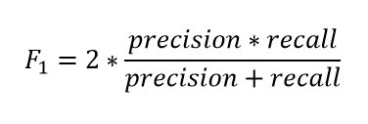
Model Evaluation
F1-Score
The F1 score is the harmonic mean of precision and recall taking both metrics into account in the following equation:

Slide 76
Model Evaluation
F1-Score
We use the harmonic mean instead of a simple average because it punishes extreme values.
A classifier with a precision of 1.0 and a recall of 0.0 has a simple average of 0.5 but an F1 score of 0.

Slide 77
Model Evaluation
We can also view all correctly classified versus incorrectly classified images in the form of a confusion matrix.

Slide 78
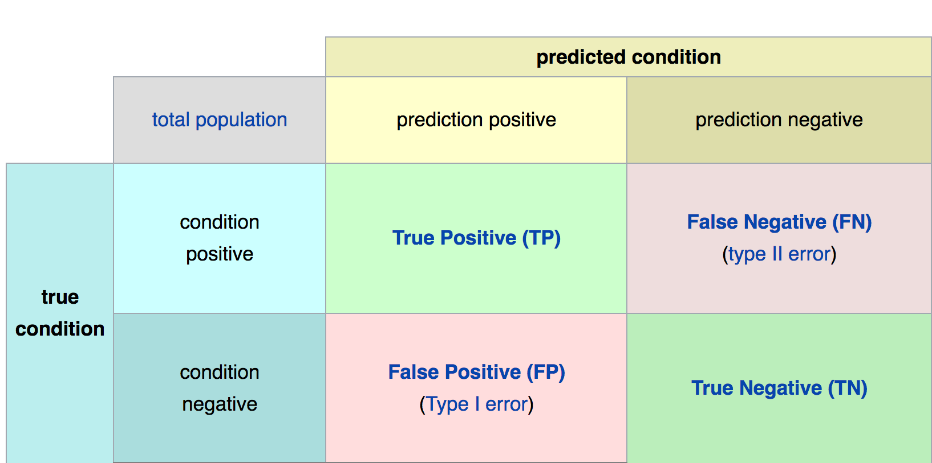
Confusion Matrix
Math &
Statistics
Machine Learning
DS
Software
Research
Domain
Knowledge

Slide 79
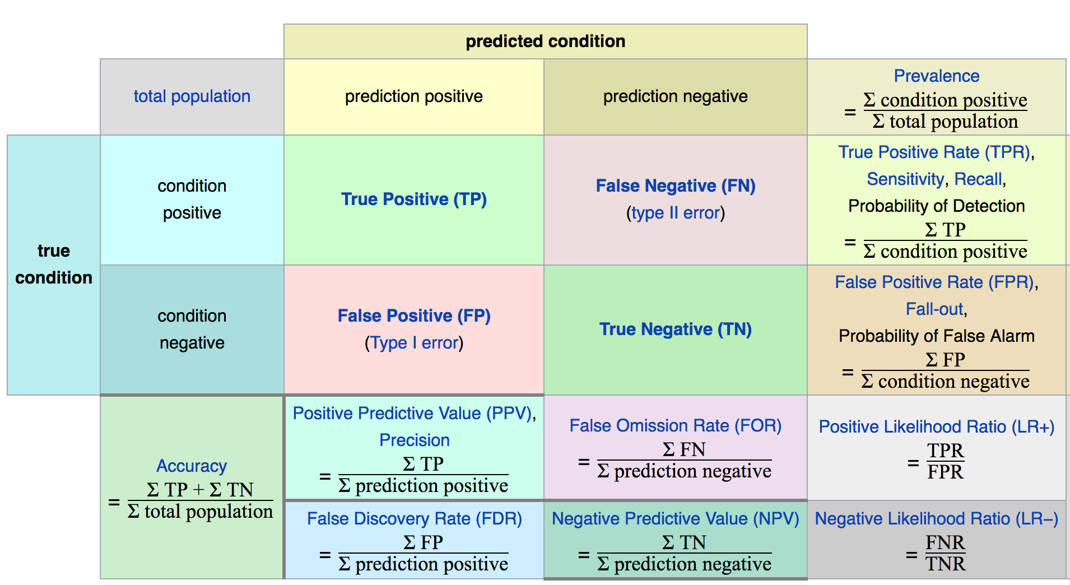
Confusion Matrix
Math &
Statistics
Machine Learning
DS
Software
Research
Domain
Knowledge

Slide 80
Model Evaluation
The main point to remember with the confusion matrix and the various calculated metrics is that they are all fundamentally ways of comparing the predicted values versus the true values.
What constitutes “good” metrics, will really depend on the specific situation!
Math &
Statistics
Machine Learning
DS
Software
Research
Domain
Knowledge

Slide 81
Model Evaluation
Still confused on the confusion matrix?
No problem! Check out the Wikipedia page for it, it has a really good diagram with all the formulas for all the metrics.
Throughout the training, we’ll usually just print out metrics (e.g. accuracy).
Math &
Statistics
Machine Learning
DS
Software
Research
Domain
Knowledge

Slide 82
Model Evaluation
Let’s think back on this idea of:
What is a good enough accuracy?
This all depends on the context of the situation!
Did you create a model to predict presence of a disease?
Is the disease presence well balanced in the general population? (Probably not!)
Math &
Statistics
Machine Learning
DS
Software
Research
Domain
Knowledge

Slide 83
Model Evaluation
Often models are used as quick diagnostic tests to have before having a more invasive test (e.g. getting urine test before getting a biopsy)
We also need to consider what is at stake!
Math &
Statistics
Machine Learning
DS
Software
Research
Domain
Knowledge

Slide 84
Model Evaluation
Often we have a precision/recall trade off, We need to decide if the model will should focus on fixing False Positives vs. False Negatives.
In disease diagnosis, it is probably better to go in the direction of False positives, so we make sure we correctly classify as many cases of disease as possible!
Math &
Statistics
Machine Learning
DS
Software
Research
Domain
Knowledge

Slide 85
Model Evaluation
All of this is to say, machine learning is not performed in a “vacuum”, but instead a collaborative process where we should consult with experts in the domain (e.g. medical doctors)
Math &
Statistics
Machine Learning
DS
Software
Research
Domain
Knowledge

Slide 86
Evaluating Performance
REGRESSION

Slide 87
Evaluating Regression
Let’s take a moment now to discuss evaluating Regression Models
Regression is a task when a model attempts to predict continuous values (unlike categorical values, which is classification)

Slide 88
Evaluating Regression
You may have heard of some evaluation metrics like accuracy or recall.
These sort of metrics aren’t useful for regression problems, we need metrics designed for continuous values!

Slide 89
Evaluating Regression
For example, attempting to predict the price of a house given its features is a regression task.
Attempting to predict the country a house is in given its features would be a classification task.

Slide 90
Evaluating Regression
Let’s discuss some of the most common evaluation metrics for regression:
Mean Absolute Error
Mean Squared Error
Root Mean Square Error

Slide 91
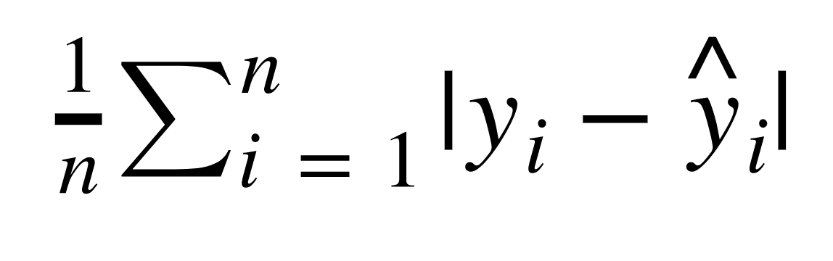
Evaluating Regression
Mean Absolute Error (MAE)
This is the mean of the absolute value of errors.
Easy to understand

Slide 92
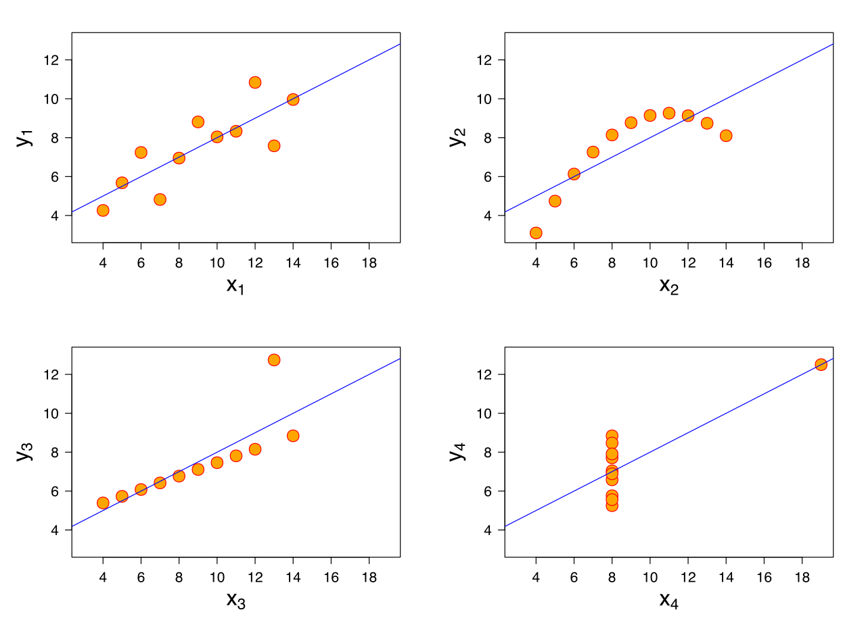
Evaluating Regression
MAE won’t punish large errors however.

Slide 93
Evaluating Regression
MAE won’t punish large errors however.

Slide 94
Evaluating Regression
We want our error metrics to account for these!

Slide 95
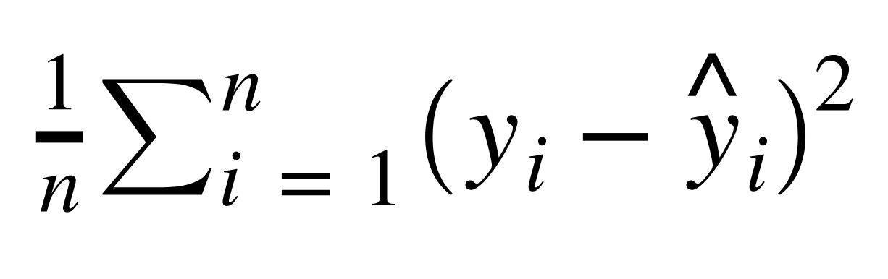
Evaluating Regression
Mean Squared Error (MSE)
This is the mean of the squared errors.
Larger errors are noted more than with MAE, making MSE more popular.

Slide 96
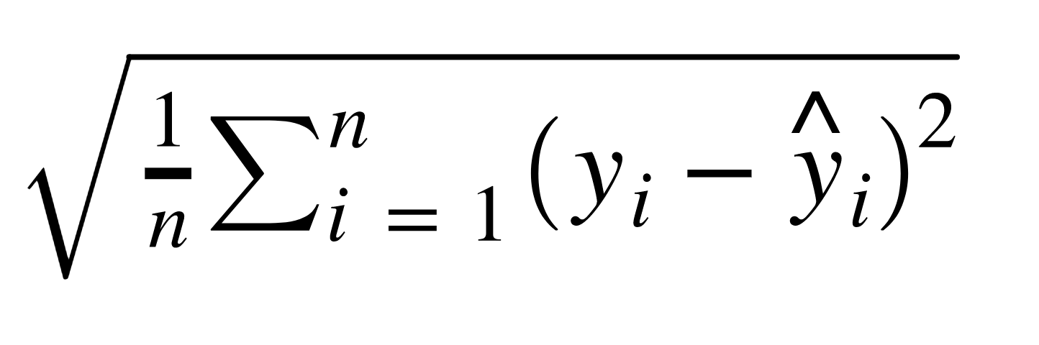
Evaluating Regression
Root Mean Square Error (RMSE)
This is the root of the mean of the squared errors.
Most popular (has same units as y)

Slide 97
Machine Learning
Most common question from students:
“Is this value of RMSE good?”
Context is everything!
A RMSE of $10 is fantastic for predicting the price of a house, but horrible for predicting the price of a candy bar!

Slide 98
Machine Learning
Compare your error metric to the average value of the label in your data set to try to get an intuition of its overall performance.
Domain knowledge also plays an important role here!

Slide 99
Machine Learning
Context of importance is also necessary to consider.
We may create a model to predict how much medication to give, in which case small fluctuations in RMSE may actually be very significant.

Slide 100
Evaluating Regression
You should now feel comfortable with the various methods of evaluating a regression task.

Slide 101
Unsupervised Learning

Slide 102
Machine Learning
We’ve covered supervised learning, where the label was known due to historical labeled data.
But what happens when we don’t have historical labels?

Slide 103
Machine Learning
There are certain tasks that fall under unsupervised learning:
Clustering
Anomaly Detection
Dimensionality Reduction

Slide 104
Machine Learning
Clustering
Grouping together unlabeled data points into categories/clusters
Data points are assigned to a cluster based on similarity

Slide 105
Machine Learning
Anomaly Detection
Attempts to detect outliers in a dataset
For example, fraudulent transactions on a credit card.

Slide 106
Machine Learning
Dimensionality Reduction
Data processing techniques that reduces the number of features in a data set, either for compression, or to better understand underlying trends within a data set.

Slide 107
Machine Learning
Unsupervised Learning
It’s important to note, these are situations where we don’t have the correct answer for historical data!
Which means evaluation is much harder and more nuanced!

Slide 108
Unsupervised Process
Test
Data
Model
Training &
Building
Data
Acquisition
Data
Cleaning
Transformation
Model
Deployment

Slide 109
Machine Learning
Later on in the course, we’ll explore unsupervised learning processes with specialized neural network structures, such as autoencoders.

