Slide 1





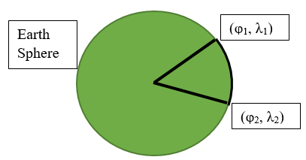
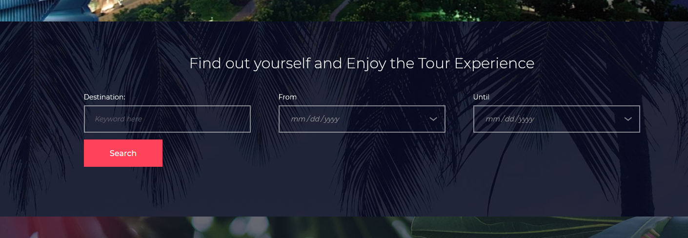
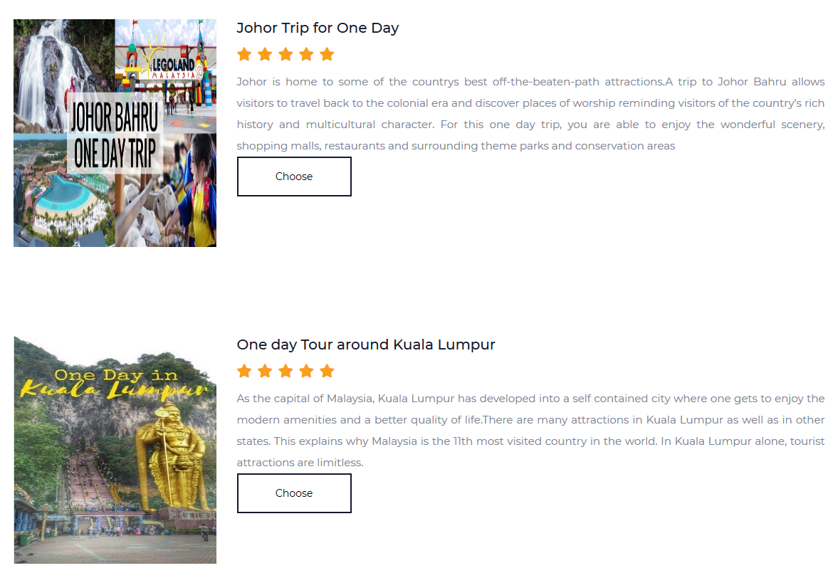

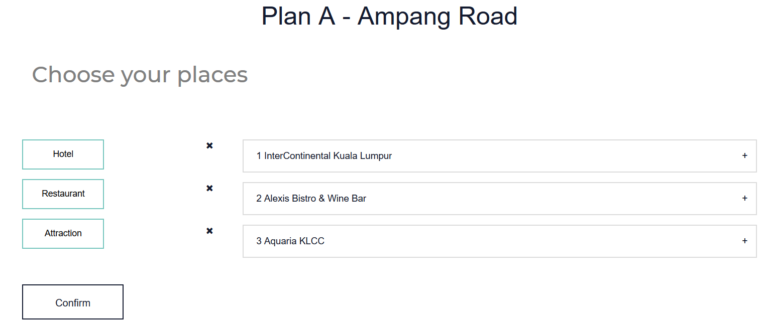
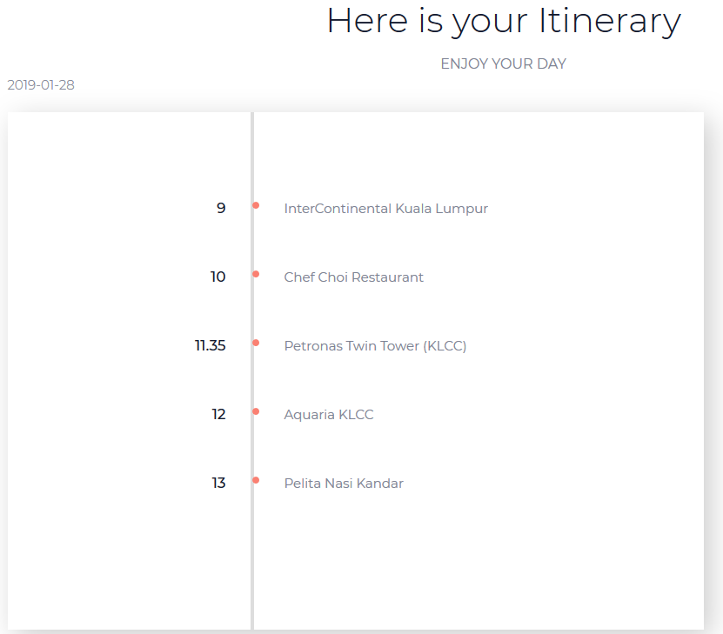
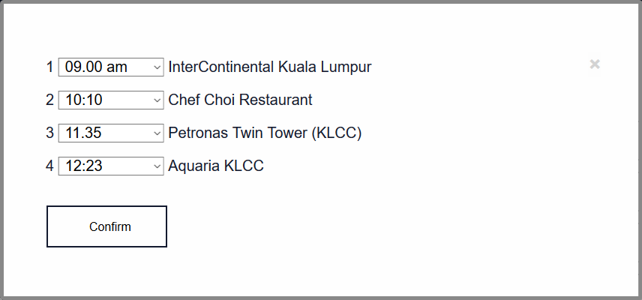
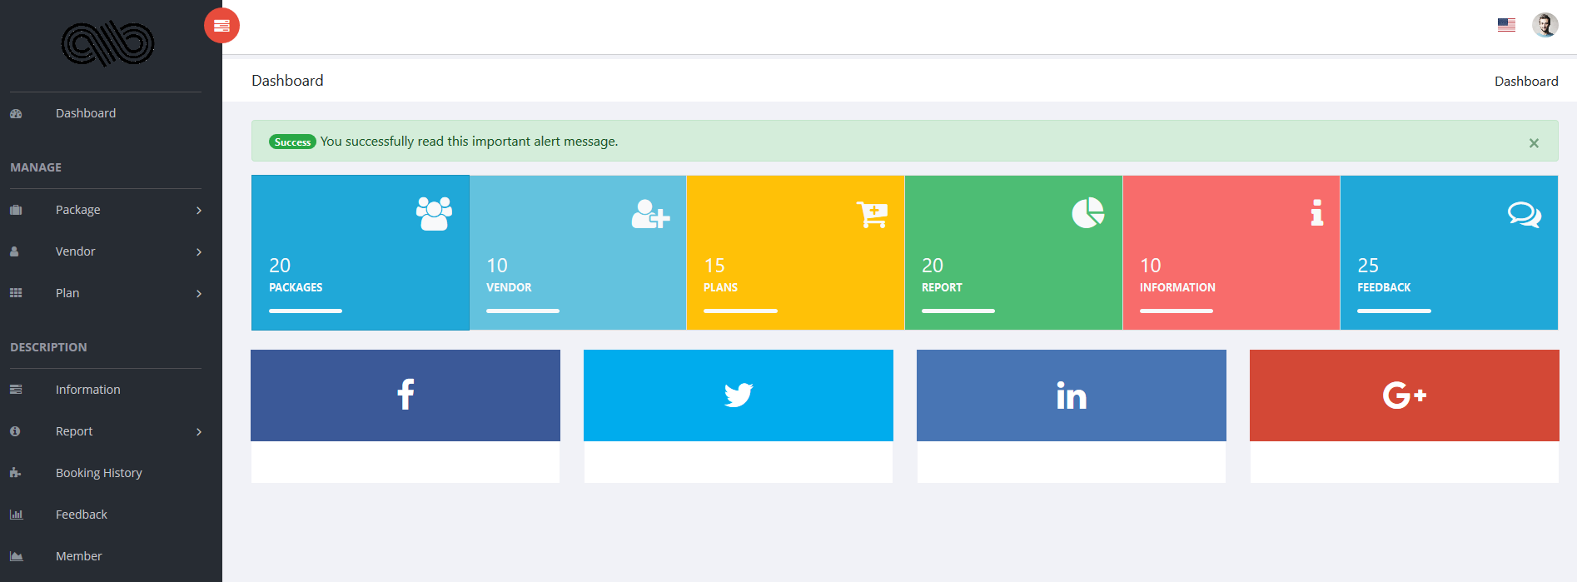

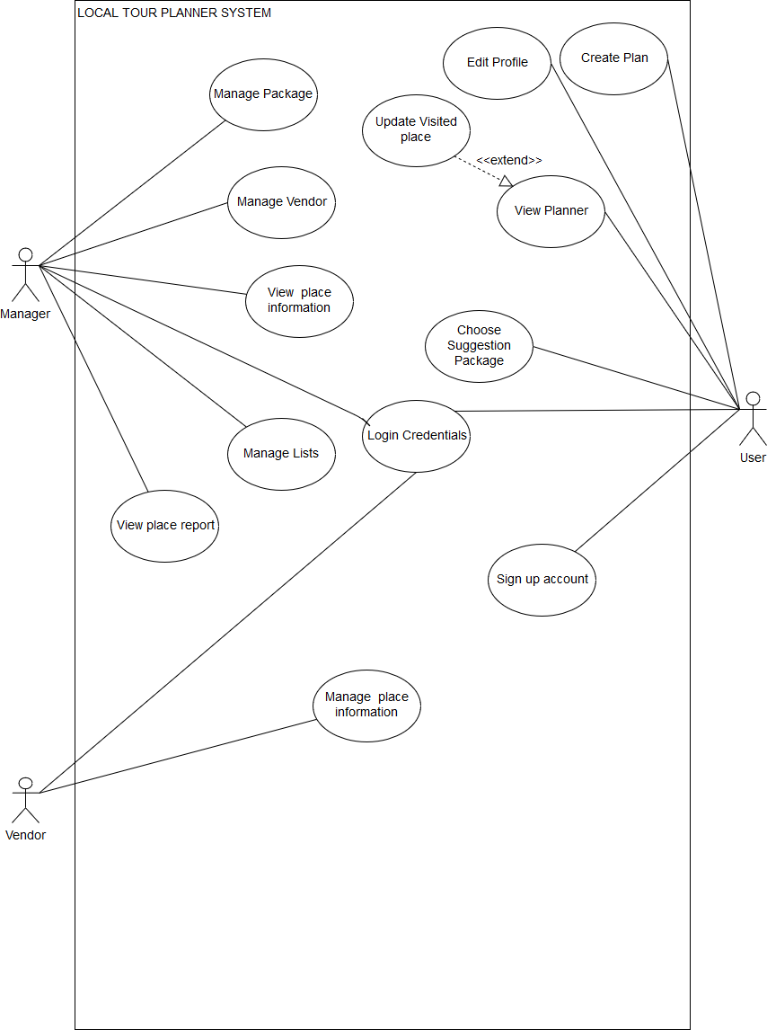
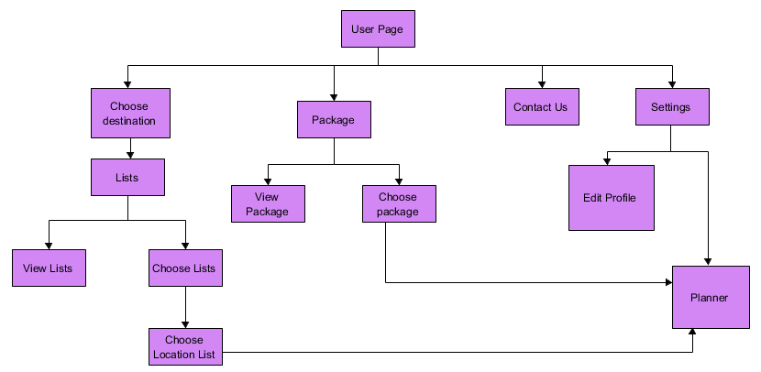
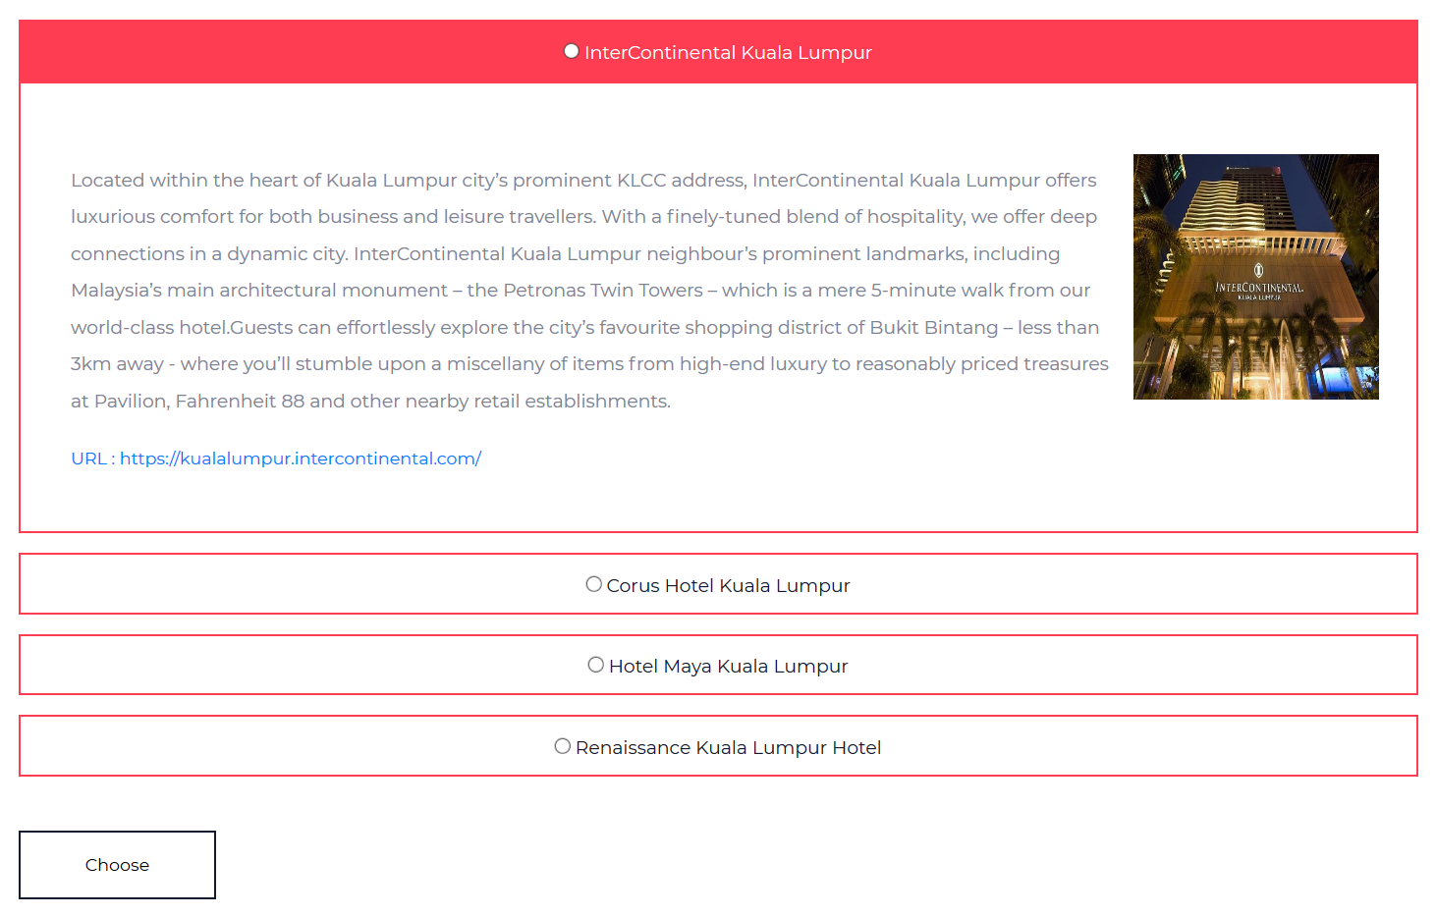
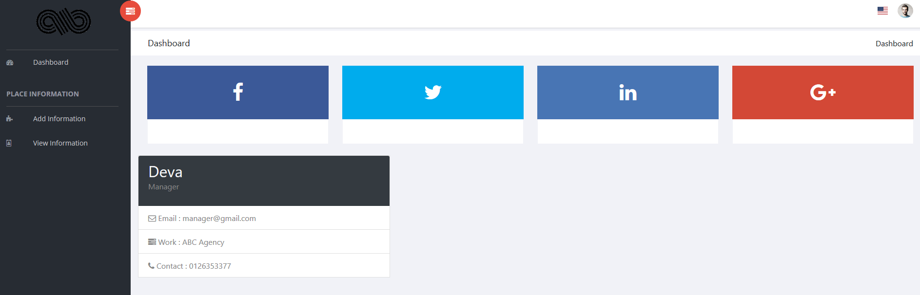
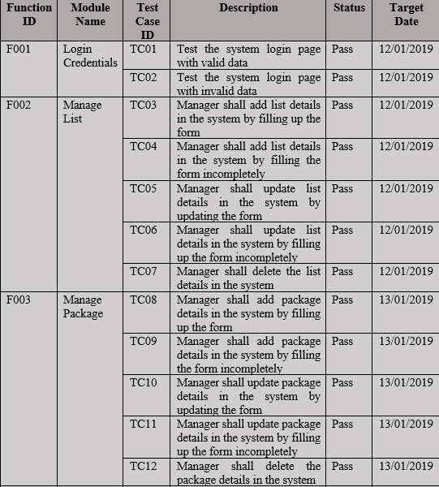
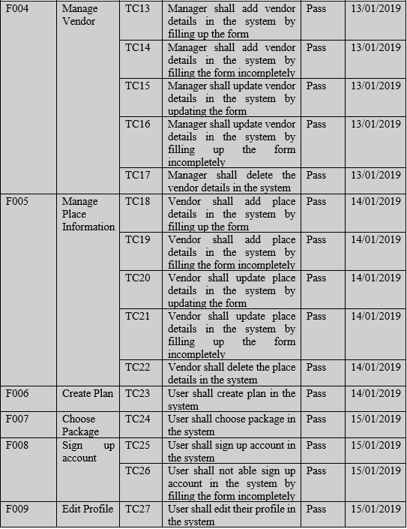
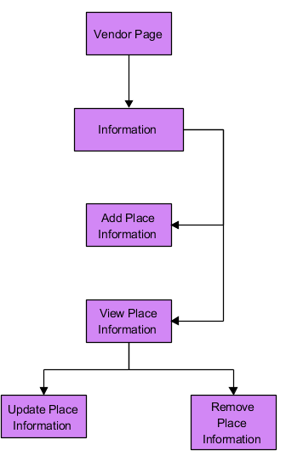
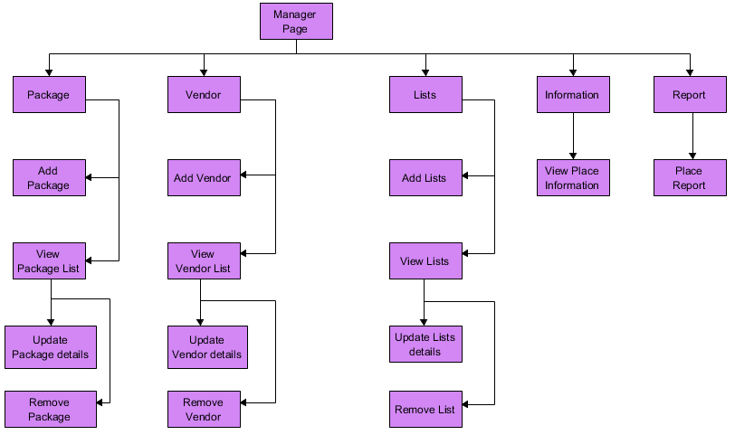

1109: Local Tour Planner System (Management Subsystem)
Dr. Yeoh Eng Thiam
Tong Gee Kok
DEVAANANDHAN A/L PRAKASH 1121115566
Abstract
Problem statement
Objective
In this modern world, we are using technologies in our daily life especially travelling to plan our trip. Hence, the purpose of this project is to build a Local Tour Planner System to help people plan their trips easily. This system shall provide people the availability to create a plan and providing itinerary list of the trip for them.
Problems planning a proper trip manually
Lack of itinerary feature in some system
To identify the requirements of a tour planner system
To design the system based on the requirements
To design an algorithm to calculate the trips and parameter
To develop a web application that demonstrates the tour planning activities
Background Study
Implementation / Testing
v
Existing systems (TripAdvisor , Traveloka & Lokalocal )
Haversine Formula
Get the distance and time between two points of the location with Latitude and Longitude
Get estimation arrival time (ETA) between two places
Get the ETA time and convert to actual time
Proposed System
Plan their trip by choosing hotel, restaurant and attraction
Time will be assigned for each places on the list
Place list stored in itinerary and able to download
Design
Modules
Manager | User | Vendor
Manage Package, List & Vendor details View Place Information View Place Report | Sign up account Choose suggestion package Create Plan View Planner | Manage Place information
Choose Destination and Date
Ready-Made Packages
Choose Hotel, Attraction and Restaurant
Itinerary List
Use Case Diagram
User
Assign Time to each place
Manager Dashboard
Place information
Vendor Dashboard
Testing Results
Vendor
Manager
Conclusion
Develop a web application that offer the user the ability of planning their trip and choose suggestion package with providing itinerary list. Having the Manager to manage the whole system and Vendor to send place information to manager
Future Work
Improve the time algorithm function assigned to each places
Improve planning features
FACULTY OF COMPUTING AND INFORMATICS

