Slide 1
DABB.ai
Milestone 2
What stays from Milestone 1
TF-IDF features, logistic regression, risk mapping, and clause highlighting remain intact.
Intelligent contract risk analysis with grounded reporting and public-host deployment
What Milestone 2 adds
Assistant explanations, PDF report export, comparison mode, and deployment-safe startup settings.
Birajit Saikia | Devaansh Kathuria | Abhey Dua | Bhavya Jain
Clause classifier
Grounded report
Public deployment
Ready for grading
The repo ships with tests, documented entrypoints, and a reproducible evaluation workflow.
Notes:
Open by framing Milestone 2 as a release-hardening step rather than a rewrite. Emphasize that the baseline model remains intact.

Slide 2
What Milestone 2 adds
The baseline classifier stays the same, but the product surface becomes demonstrably richer and easier to deploy.
Baseline preserved
Milestone 2 additions
Milestone 2 keeps the clause segmentation, TF-IDF vectorization, logistic regression classifier, severity mapping, and clause highlighting from Milestone 1.
The assistant layer uses the bundled legal guidance corpus to ground explanations, mitigation advice, and report generation without external API dependencies.
• Predict clause type per extracted clause
• Map clause type to severity and risk score
• Export structured outputs for grading
• Keep the deterministic screenable baseline
• Generate a structured legal assistance report
• Show supporting evidence and mitigation guidance
• Support multi-contract comparison
• Produce deployment-ready startup docs
2
3
4
100%
analysis layers: baseline + assistant
host paths: Streamlit, HF Spaces, Render
export formats: CSV, JSON, PDF, comparison
of Milestone 1 behavior retained
02
Notes:
Highlight that Milestone 2 is additive. It does not replace the earlier model path, only wraps it with stronger reporting and deployment support.

Slide 3
System architecture
The release is intentionally simple: local extraction and modeling on one side, grounded reporting on the other.
Upload
Extraction
Segmentation
Classifier
Risk
PDF or TXT
Text parsing
Clause units
TF-IDF + LogReg
Mapping layer
Local knowledge base
Assistant report
Comparison and exports
The assistant indexes a bundled legal guidance corpus with TF-IDF retrieval. This keeps the report grounded and reproducible without depending on external services during the demo.
Each clause gets an explanation, mitigation note, and any retrieved evidence. The report is serialized for the UI and also exported as PDF for submission.
The app keeps the clause table filterable and exportable. Multi-contract comparison summarizes repeated patterns across uploaded files.
03
Notes:
Walk left to right: ingest, classify, map risk, then ground the explanation layer. Emphasize that the retrieval corpus is local and deterministic.

Slide 4
User flow and public deployment
The hosted app is submission-ready and uses a single clear entrypoint.
How a user runs the app
Host entrypoint
1. Open the hosted Streamlit app.
2. Upload a PDF or TXT contract, or use the demo contract.
3. Review clause predictions, filters, and highlights.
4. Generate the assistant report.
5. Download CSV, JSON, or PDF outputs.
streamlit_app.py is the recommended public entrypoint. It is paired with .streamlit/config.toml, Procfile, and render.yaml so the deployment path stays simple across Streamlit Cloud, Hugging Face Spaces, and Render.
Deployment-safe configuration
Environment variables can override the model path, reports directory, and fallback training CSV. If a hosted filesystem blocks persistence, the model still loads and the app continues instead of failing on save.
streamlit run streamlit_app.py
Render start command
HF Spaces Streamlit SDK
04
Notes:
Keep this slide practical. Mention the exact start command and the fact that deployment fails closed only if the environment itself is unavailable.

Slide 5
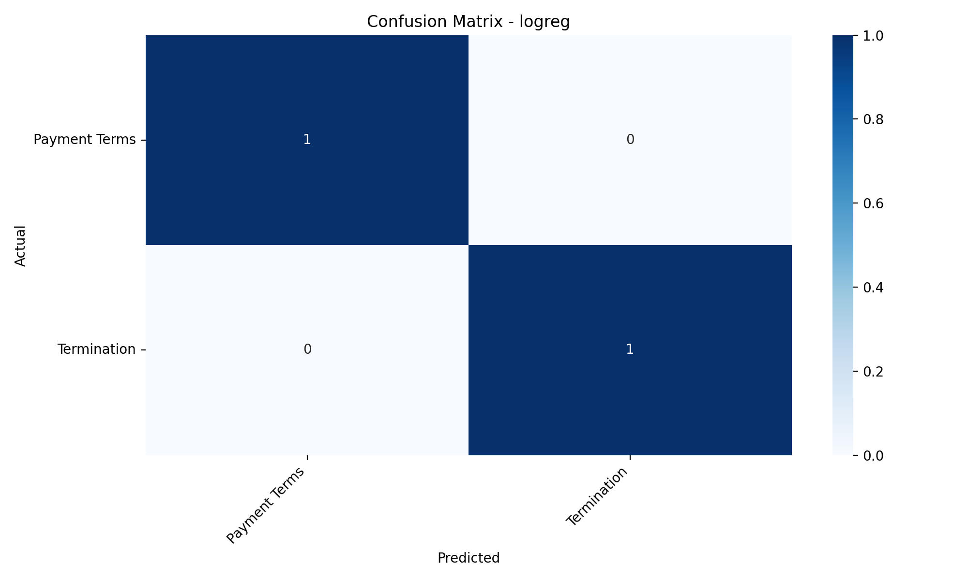
Evaluation and artifacts
The release includes repeatable evaluation outputs and a saved confusion matrix for the baseline model.
1.0
1.0
1.0
Interpretation
The fallback evaluation path is intentionally tiny, so the headline metric is best read as a correctness check on the bundled demo split rather than a benchmark claim.
Weighted precision
Weighted recall
Weighted F1
Generated artifacts
The evaluation command saves a summary metrics CSV, a classification report CSV, and a confusion matrix PNG. Those artifacts make the demo reproducible and easy to inspect during grading.
• reports/logreg_summary_metrics.csv
• reports/logreg_classification_report.csv
• reports/logreg_confusion_matrix.png
• reports/model_comparison.csv
05
Notes:
Be explicit that the repo now records metrics and the confusion matrix in files, not just in the terminal. That is the artifact story reviewers care about.

Slide 6
Limitations and release safeguards
The submission is intentionally conservative: safe defaults, a clear disclaimer, and no hidden dependency on external services.
Known limitations
Release safeguards
What to mention in the demo
Text extraction is only as good as the source PDF. Tiny fallback datasets are useful for smoke testing, but they are not a substitute for a real benchmark corpus. Risk scoring is rule-based and should be interpreted as screening guidance.
The hosted startup path is explicit, the model cache is optional, environment variables can override file paths, and the test suite covers the assistant, UI helpers, ingestion, PDF export, and workflow modules.
Say that Milestone 2 does not replace Milestone 1. It preserves the baseline classifier, adds grounded reporting, and packages the app so it can be hosted publicly without extra setup.
06
Notes:
Close by framing the work as a controlled extension of Milestone 1. Reviewers should hear that the system is safer, not just larger.

Slide 7
Final checklist
The repository now has a stable submission path from source code to hosted demo.
Submission-ready items
Last thing to verify
• Public-host entrypoints and deployment config
• Pinned dependencies and env-driven paths
• Milestone 2 README and deployment notes
• Milestone 2 report and presentation content
• CI smoke coverage and the existing unit test suite
Open the hosted app, upload a contract, generate the report, and confirm the download buttons work. If that path succeeds, the release is ready for grading.
Thank you
07
Notes:
Use this as the clean closing slide. The takeaway is simple: the app is stable, documented, and demoable.

Slide 8
Assistant report anatomy
The report is structured so a reviewer can trace each finding from summary to evidence.
1. Summary
2. Findings
3. Evidence
4. Export
The contract summary frames overall risk, counts of high/medium/low findings, and the fallback indicator.
Each clause gets a predicted type, severity, score, explanation, and mitigation note.
Retrieved passages are attached only when the support threshold is met, which keeps the report grounded.
The report is visible in the UI and also saved as a downloadable PDF for submission.
summary section
risk findings
evidence
PDF export
08
Notes:
Use this slide to walk the grader through the report sections from top to bottom.

Slide 9
Comparison and validation
The release includes a small but complete validation story for the assistant and the host path.
Multi-contract comparison
Smoke validation
Host checks
The app compares multiple contracts and highlights repeated risk patterns rather than treating each file in isolation.
The final smoke test checks entrypoint imports, environment overrides, and cache-write fallback behavior.
Deployment settings are documented for Streamlit Cloud, Hugging Face Spaces, and Render, with a single startup path.
• Shared risk pattern counts
• Per-contract summary table
• High-risk finding totals
• Import the hosted entrypoints
• Resolve config overrides
• Continue when save fails
• streamlit_app.py
• .streamlit/config.toml
• Procfile / render.yaml
46
3
10
1
unit tests passing
smoke checks
slides in final deck
public entrypoint
09
Notes:
Tie the validation story to the actual artifacts and explain that the smoke tests protect the release path.

Slide 10
DABB.ai
Ready for final submission
Milestone 2 keeps the baseline model intact, adds grounded reporting, and ships with a valid 10-slide presentation artifact.
What is ready
What to demo
What the grader sees
Public-host startup, reproducible tests, Milestone 2 README, report, and a working PPTX deck.
Upload a contract, generate the report, inspect evidence, and download the results.
A stable repo with a clear deployment path and a clean deck they can open immediately.
Notes:
End on a confident release note: the deck opens, the app runs, and the repo is ready for grading.

