Slide 1



Global Investment Partners.
STOCK MARKET TREND PREDICTION
Presented by
Date
A. Muinat Tijani
December 13th, 2025

Slide 2



Global Investment Partners.
Project Overview
This project focuses on understanding stock market behaviour and developing a predictive model to classify price trends into upward, downward, or sideways movements. It directly addresses a key challenge faced by Global Investment Partners: the inability to identify trend shifts consistently and early enough, which leads to weak market timing and missed trading opportunities.
Using more than three years of daily OHLCV data across 20 stocks from multiple sectors, together with technical indicators, we carried out exploratory analysis to uncover patterns, volatility regimes, and sector relationships.
These insights supported the development of a trend-classification model aimed at improving the clarity and reliability of market interpretation. The scope of the work is limited to data analysis and modelling, and does not extend to engineering tasks such as APIs, deployment, or MLOps.

Slide 3


Global Investment Partners.
Dataset Summary
This project analyses market behaviour across 20 stocks using daily OHLCV data from January 2021 to January 2024, drawn from the core datasets covering stock prices, technical indicators, market indices, and fundamental information. Our exploratory work examines price movements, volatility patterns, sector differences, and broader market influences, forming the foundation for developing a model to classify trends into upward, downward, or sideways regimes.
The predictive features used in the model include momentum_10, momentum_20, sma_20, sma_200, macd, macd_signal, bb_width, atr_14, volume_sma_20, and volume_ratio, each capturing different aspects of trend strength, volatility conditions, and volume dynamics.
By combining these data sources with focused analysis and modelling, the project aims to improve the consistency and clarity of trend identification, supporting more informed trading decisions while deliberately excluding engineering components such as APIs, MLOps, or deployment

Slide 4
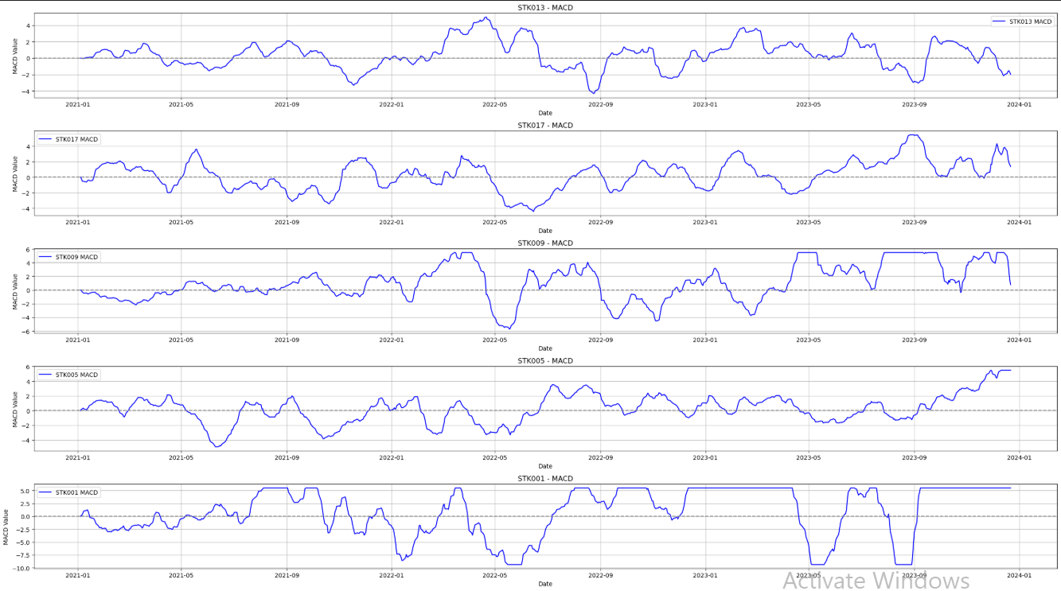
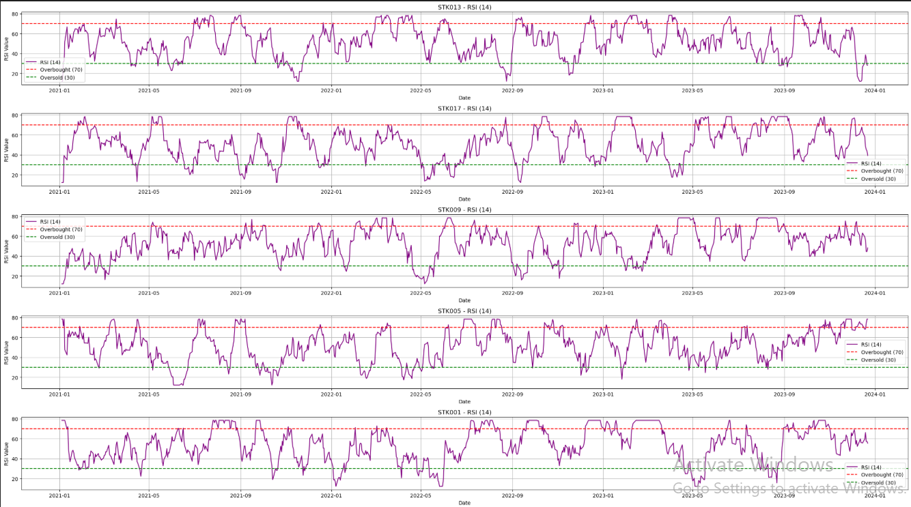
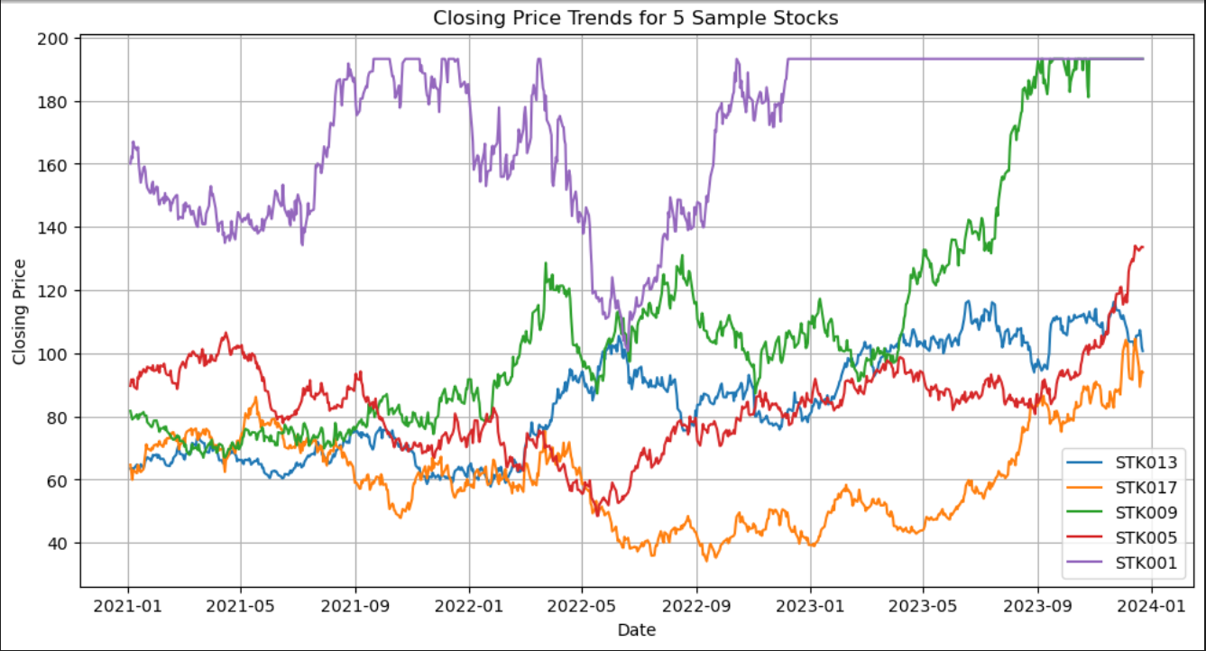
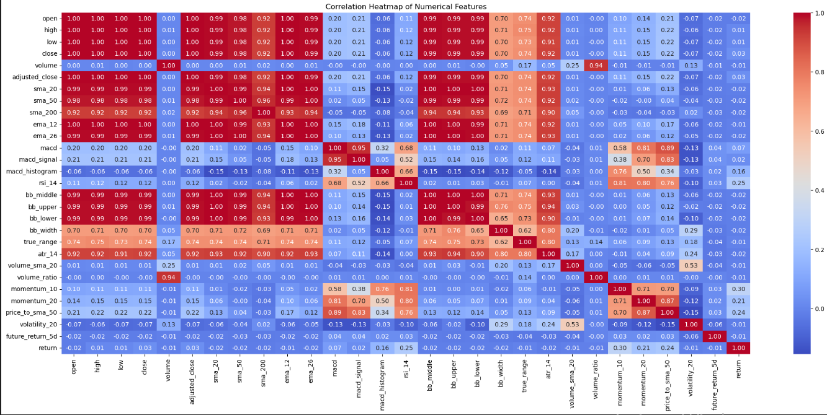
Global Investment Partners.
Key EDA Insights

Slide 5

Global Investment Partners.
Modelling Approach
Baseline: Logistic Regression is interpretable and transparent because each feature has a visible coefficient that directly shows the direction and strength of its influence on the prediction.
Improved: Random Forest captures not heavily non-linear market behaviour as it perform similar to logreg and also reduces over-reliance on any single signal which make the prediction reliable.
Supervised learning for trend classification
Time-based train/test split: This helps model predict the future using the past data and ensures performance results are realistic and trustworthy.

Slide 6
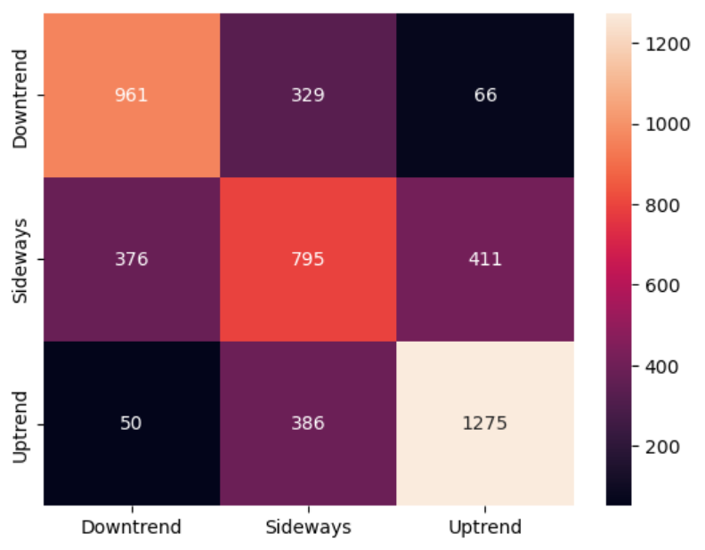
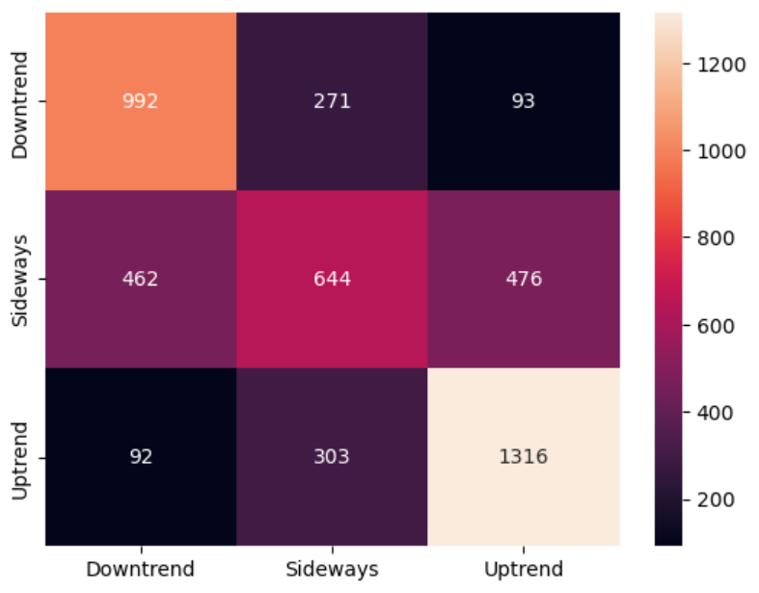
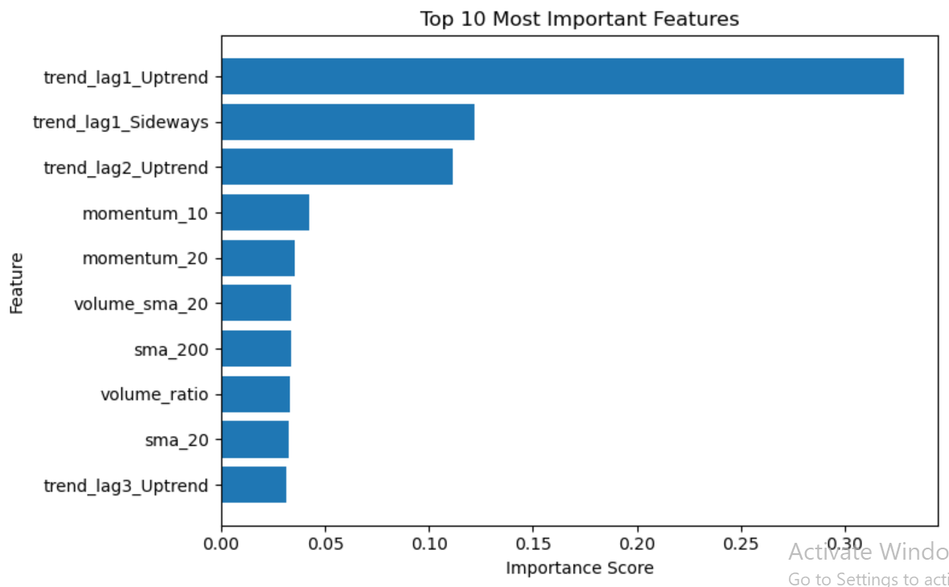
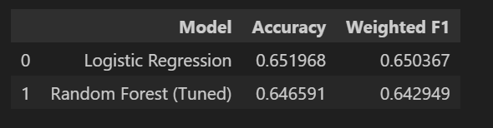
Global Investment Partners.
Model Result

Slide 7

Global Investment Partners.
Final insights
Stock markets are noisy and difficult to predict
The analysis shows that stock market trends are difficult to predict with high precision using technical indicators alone.
Exploratory analysis confirms that markets move in regimes, with momentum and volatility driving behaviour, but these signals react to price changes rather than anticipate them.
The Random Forest model captures non-linear relationships and improves prediction stability, but it does not materially increase accuracy, highlighting the limits of technical signals in noisy markets.
Overall, the model is most effective as a decision-support tool helping confirm trend direction and manage risk rather than as a price-forecasting system.

Slide 8

Global Investment Partners.
Limitations
No macroeconomic indicators included. Analysis only rely on price, volume, momentum, volatility, calendar, and lagged trend features only. Variables such as interest rates, inflation, GDP, or policy signals, which often explain large market moves are not captured in the model.
Technical indicators alone are weak predictors as RSI, MACD, and moving averages mostly react to price movements rather than predict them, which limits achievable accuracy.
Short prediction horizon limits foresight. Trend labels and lag structure focus on near-term market direction. This makes the model effective for confirming current trends, but not for long-term forecasting.

Slide 9

Global Investment Partners.
Recommended Next Step
Use price change and market condition signals that reflect how fast prices are changing and whether the market is stable or volatile.
Identify different market conditions such as trending, sideways, or unstable before making decisions.
Use a more refined learning method like Gradient Boosting / XGBoost that focuses on improving weak predictions.
Use models designed such as Long Short-Term Memory (LSTM) model to understand how recent market behaviour affects future movement.

Slide 10

Global Investment Partners.
This project shows the limits of technical indicators in isolation.
Thank you for your attention
Any Question Please?

