Slide 1
DEVADARSHINI M
Final Project
3/21/2024 Annual Review

Slide 2
PROJECT TITLE
GAN-Guided Medical Image Generation:
Enhancing Classification with Intelligent Scans
3/21/2024 Annual Review

Slide 3
AGENDA
Problem Statement
Project Overview
End Users
Solution and Value Proposition
GAN Architecture
System Approach
Algorithm and Deployment
The Wow in Your Solution
Modelling
Results
3/21/2024 Annual Review

Slide 4

PROBLEM STATEMENT
Due to the ability to distort scans, traditional data augmentation approaches are insufficient for medical imaging.
In order to overcome this, our goal is to intelligently produce unseen medical images by employing more advanced techniques like Generative Adversarial Networks (GANs).
In order to produce realistic and varied medical images for better classification and analysis tasks, the generator model must be trained to capture the hidden underlying properties of the training dataset.
3/21/2024 Annual Review

Slide 5

PROJECT OVERVIEW
The goal of this project is to generate chest X-ray images using a conditional GAN model, avoiding common GAN problems and guaranteeing ongoing training to achieve key features.
In the meantime, possible distortions render conventional data augmentation methods insufficient for medical imaging.
Our goal is to educate the generator to comprehend hidden dataset features so that it can intelligently produce unseen medical scans using Generative Adversarial Networks (GANs).
Overcoming the drawbacks of conventional augmentation techniques, this method produces realistic and diverse images that improve classification and analysis tasks in medical imaging.
3/21/2024 Annual Review

Slide 6

WHO ARE THE END USERS?
Chest X-ray images of varying quality are needed by medical professionals, researchers, and developers in the healthcare industry for a variety of purposes, including training diagnostic models, research, and improving medical education.
3/21/2024 Annual Review

Slide 7

YOUR SOLUTION AND ITS VALUE PROPOSITION
SOLUTION:This project creates intelligent chest X-ray images of pneumonia patients and normal subjects using a conditional Generative Adversarial Network (GAN) model. The suggested approach seeks to generate varied and high-quality medical images by tackling common issues with GAN models, such as training issues and mode collapse. In addition to recognizing the pathological conditions present in the generated images, the discriminator is trained to distinguish between real and generated images.
3/21/2024 Annual Review

Slide 8
YOUR SOLUTION AND ITS VALUE PROPOSITION
Value Proposition: Medical imaging may be distorted by conventional data augmentation techniques, rendering them useless for classification tasks. The intelligent generation of unseen medical scans through the use of GANs improves the efficiency of classification and analysis tasks in medical imaging. The suggested method offers a more dependable and accurate way to produce medical images by guaranteeing training continuity and concentrating on capturing key features found in the dataset.
3/21/2024 Annual Review

Slide 9
SYSTEM APPROACH
System Requirements:
1.Hardware:
CPU: The training code can be run on a multi-core CPU. However, GAN training can be computationally demanding, particularly for 30000 epochs, so training time could be greatly shortened by a faster CPU with more cores.
RAM, or memory: For managing large datasets and effectively training deep neural networks over 30000 epochs, at least 16GB of RAM is advised. Larger batch sizes and complex model architectures may benefit from higher RAM capacities, which lower the possibility of memory errors or slowdowns.
Internet Connection:
An internet connection is needed to load the dataset link and access online resources during development
3/21/2024 Annual Review

Slide 10
SYSTEM APPROACH-CONT.
Software Requirements:
Python: The project is implemented using Python programming language.
TensorFlow/Keras: TensorFlow and its high-level API, Keras, are used for building and training the GAN architecture.
Google Colab: These platforms can be used for interactive development, experimentation, and documentation.
NumPy: NumPy is used for numerical computations and array manipulation.
Matplotlib: Matplotlib is used for data visualization, including plotting loss curves and displaying generated images.
3/21/2024 Annual Review

Slide 11
ALGORITHM AND DEPLOYMENT
Extending the kernel size facilitates the investigation of core-regional correlations, which are essential for distinguishing pathological states in medical imaging. It looks at gradients that show the presence of disease or the state of health in particular regions. By substituting LayerNormalization for BatchNormalization, generator-generated images are more diverse and mode collapse is lessened. Filter-level normalization provided by LayerNormalization promotes image stability and variety, which improves the model's accuracy in identifying pathological features—a critical capability in medical image analysis.
In Colab, the trained Generative Adversarial Network (GAN) model can be deployed by loading the saved model file using TensorFlow or Keras libraries into Github repository. Utilizing the runtime environment of Colab, the model can generate chest X-ray images on demand by providing noise vectors and conditional labels as input to the generator network.
3/21/2024 Annual Review

Slide 12

THE WOW IN YOUR SOLUTION
Conditional Generation: To generate precise images, conditional GAN architecture is employed.
Overcoming GAN Difficulties: Techniques to Prevent Modal Collapse, Perceptual Quality Problems, and Training Issues.
High-quality image generation: It refers to producing realistic and medically relevant chest X-ray images.
3/21/2024 Annual Review

Slide 13
MODELLING
GAN Architecture Design:
Design a GAN architecture consisting of generator and a discriminator network using Keras
Generator:
A noise vector and conditional labels denoting the pathological state (pneumonia or healthy) are fed into the generator.
It expands the noise vector into a realistic chest X-ray image by applying a sequence of Convolutional Transpose layers.
In order to guarantee the diversity of generated images and prevent mode collapse, layer normalization is utilized.
The generator has been trained to concentrate on obtaining the key characteristics of the healthy and pneumonia cases that are included in the dataset.
3/21/2024 Annual Review

Slide 14
MODELLING
Discriminator:
The discriminator is in charge of identifying the pathological condition present in the generated images and differentiating between real and generated images.
To learn discriminative features, it consists of a sequence of convolutional layers followed by LeakyReLU activations.
With the goal of averting adversarial attacks, the discriminator is trained to correctly classify both generated and real images.
3/21/2024 Annual Review

Slide 15
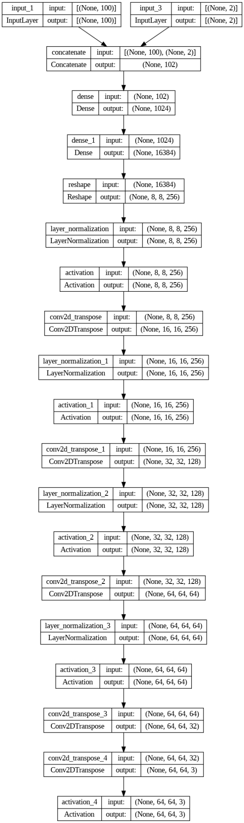
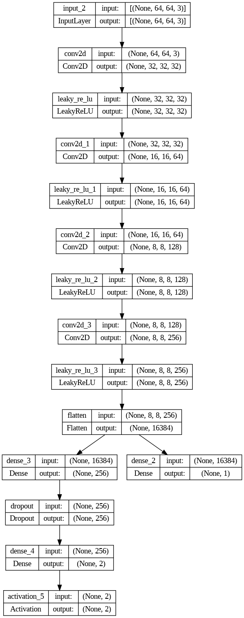
MODELLING
Generator Architecture
Discriminator Architecture
3/21/2024 Annual Review

Slide 16

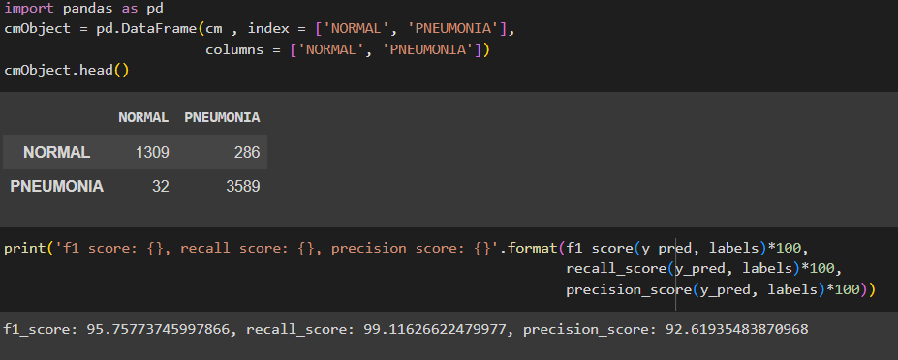
RESULTS
3/21/2024 Annual Review

Slide 17
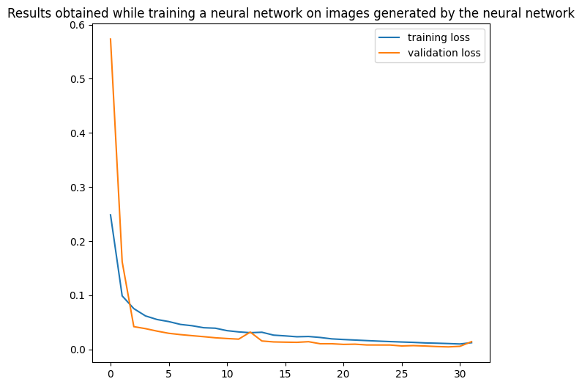
RESULTS
3/21/2024 Annual Review

Slide 18
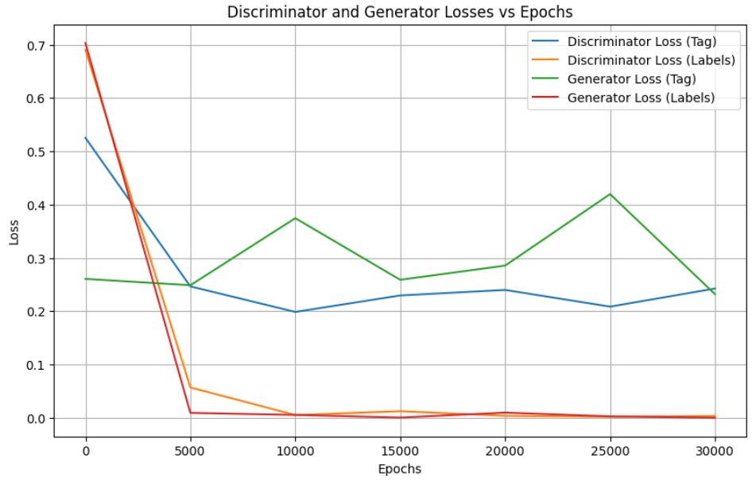
RESULTS
Tag Loss: Measures the discriminator's ability to distinguish between real and generated samples.
Labels Loss: Measures the discriminator's ability to classify the generated samples into different categories (e.g., different classes) based on additional information.
3/21/2024 Annual Review

Slide 19
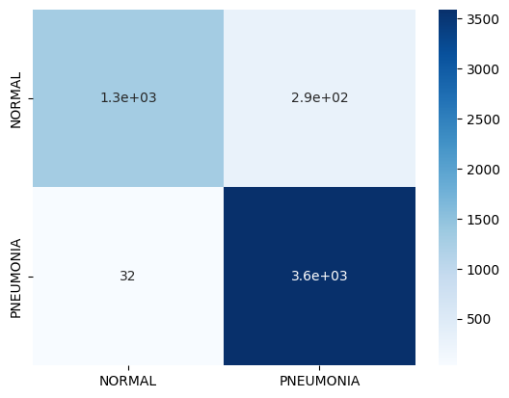
RESULTS
3/21/2024 Annual Review

