Slide 1
Competitive Programming
Introduction

Slide 2
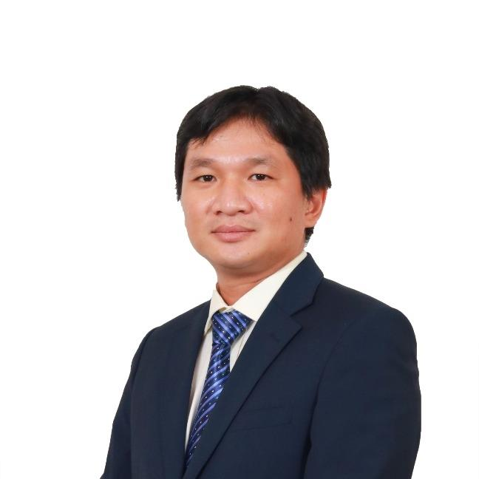
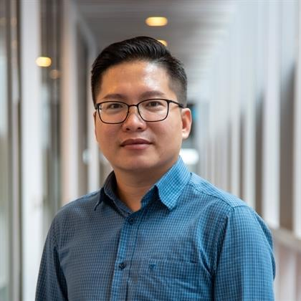

Welcome
Let's meet the teaching team
Long Nguyen
Linh Tran
Tri Dang

Slide 3
What is this course about?
A kind of sport
Solve challenging problems within a time duration
Correctness is the most (or the only) important properties
Then, efficiency: make sure your programs are fast enough
No need to apply software engineering stuff (clear code, easy to maintain, easy to extend, etc.)

Slide 4
Contests
Google Code Jam: Individual, anyone can register
https://codingcompetitions.withgoogle.com/codejam
Facebook Hacker Cup: Individual, anyone can register
https://www.facebook.com/codingcompetitions/hacker-cup
ACM – ICPC: Team of three, represent a college/university (our focus)
https://icpc.global/
Others: HackerRank, LeetCode, TopCoder, CodeForces, etc.

Slide 5
About this course
Coding-based course
Knowledge/skills of at least one programming language is required (C++ and Java are preferred)
Must know how to write conditional & looping statements
Knowledge of basic data structures such as array, string, linked list, etc. is necessary
Knowledge of basic algorithms such sorting, searching, counting, etc. is necessary
Recursion, greedy, tree/graph traversal, dynamic programming will be covered

Slide 6
Objectives of this course
Help you get familiar with competitive programming
Improve your coding skills
Enhance your knowledge of data structures & algorithm
Achieve a (possibly) better result in your chosen programming contests
Prepare RMIT VN for future ACM ICPC participation
Prepare you for coding interviews at tech companies

Slide 7
Content covered
This semester
Introduction (this session)
Basic data structures & sorting & searching (2nd session)
String, number theory (3rd session)
Tree & graph (4th session)
Greedy & dynamic programming (5th session)
Next semester (tentative)
Combinatorics
Geometry

Slide 8
Online judges
An online judge is an online system to test programs in programming contests
There are many online judges
You should practice using the most appropriate online judge for your chosen contests (e.g., Google Code Jam, TopCoder, HackerRank, etc.)
Usually, each online judge provides different requirements for input/output, so be careful and don't make assumptions. They may also provide a "template" for each language
https://www.udebug.com/ is an excellent site for debugging
VNOI Online Judge useful for ICPC regional, national contests preparation

Slide 9
The CSES problem set
UVa Online Judge is an online judge hosted by the University of Valladolid
I used it in the previous offering, but it has many problems
The CSES problem set is good enough: it has hundreds of problems, ranging from easy to difficult
It shows you the test cases as well! (not available in the real contests) => very good for educational purposes
https://cses.fi/problemset/
There is even a free book "Competitive Programmer's Handbook" from the same author of the CSES problem set
https://cses.fi/book/index.php

Slide 10
Program results
It is sad seeing our programs are not correct. But worse, most (or all) online judges don't let you know where/why your programs fail. So, try to think of many test cases yourself. Debugging in competitive programming is not as informative as other programming tasks
Accepted (AC): you should aim for this
Wrong Answer (WA): it's time for debugging
Time Limit Exceeded (TL): your program is not fast enough, use another data structure or algorithm
Others: Compile Error (CE), Runtime Error (RE), Presentation Error (PE), etc.

Slide 11
Virtual Judge
This is the online judge we use for the Filtering Test (week 5)
You need to register for an account there
Then, update us your username
We will add your account to the RMIT group so you can do the test
https://vjudge.net/
I will create a form to collect your student id, student name, vjudge username
The link will be announced via Teams

Slide 12
Let's get practical
Create a CSES account if you have not done so
I will wait
Launch your favorite editor/IDE

Slide 13
Weird Algorithm
Problem link
Input/output
Pay attention to data types
Java program
C++ program

Slide 14
Missing Number
Problem link
Algorithm complexity
Approximately, aim at algorithms that cost you less than 1 billion "basic operations"
N! complexity: only works for N <= 12
2^N complexity: only works for N <= 30
N^3 complexity: only works for N <= 1,000
N^2 complexity: only works for N <= 30,000
Linear complexity: works for N up to 10^9
Sqrt(N) complexity: works for N up to 10^18
Log(N) complexity: works for N up to 2^(10^9)

Slide 15
Permutations
Problem link
Consider some basic cases
When it is YES, when it is NO?
Generalize the solution
Similar problem: Two Sets

Slide 16
Permutations
Problem link
Consider some basic cases
When it is YES, when it is NO?
Generalize the solution
Similar problem: Two Sets

Slide 17
Trailing Zeros
Problem link
When there is a new zero added?
Let's use pictures
Generalize the solution
(Not quite) similar problem: Digit Queries
Also use integer division and modulo (remainder)

Slide 18
Apple Division
Problem link
Represent set members using binary digits

Slide 19
— Thank you
Tri Dang
tri.dangtran@rmit.edu.vn

