Slide 1




SMART INDIA HACKATHON 2026
  Problem Statement ID – 26092
  Problem Statement Title- AI-Driven Scheme
Matching for Marginalized Entrepreneurs
  Theme- Smart Automation
  PS Category- Software
  Team ID- MMP07765701
  Team Name- Lumiere

Slide 2

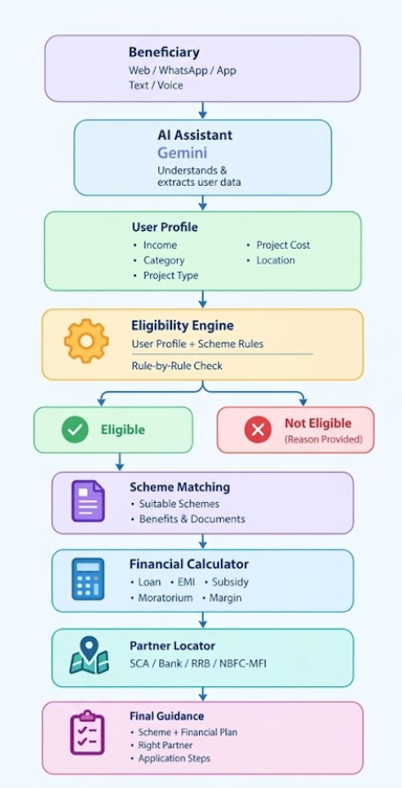

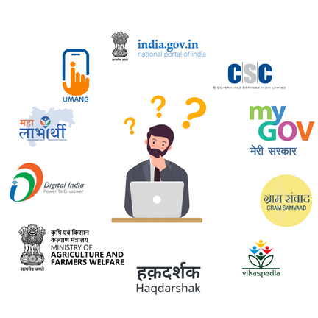
IDEA TITLE
PROBLEM EXISTING
  Scheme Awareness: People don't know which government scheme they are eligible for.
  Complex Eligibility: Scheme rules are scattered across different PDFs and portals.
  Application Confusion: People don't know where or how to apply for the scheme.
PROPOSED SOLUTION
PROPOSED SOLUTION
  Chat in Your Language: Build your profile through simple conversation — no long forms.
  Smart Eligibility Check: Checks every scheme rule and clearly explains why you qualify.
  Financial Calculator: Estimate loan, EMI, moratorium, and your contribution.
  Partner Locator: Find the nearest authorized bank or partner to apply.
UVP(UNIQUE VALUE PROPOSITION)
  Smart Matching: Matches people with the right schemes based on income, category, project type,
loan need etc..
l
  Clear Eligibility: Shows exactly why a person qualifies or doesn’t qualify.
  Right Partner, Right Route: Finds nearby authorized banks/partners for the selected scheme.
  AI With Limits: AI explains and translates; the rules engine makes the eligibility decision.
@Lumiere
2
Notes:
2

Slide 3
TECHNICAL APPROACH
Beneficiary (Citizen)
Access Platform
(Web/Whatapp/Message
Chat Intake
  Intent detection
  Language detection
  Conversation handling
Privacy Shield
Cloud Google DLP
  Mask sensitive data
AI Assistant
  Extract user image
  Ask missing questions
  Translate/explain
Structured User Profile
  Income
  Category
  Project type
  Age
  Location
  Loan requirement
1.DETERMINISTIC ELIGILIBILITY ENGINE
  SCHEME MATCHING AND SERVICES
  CHANNEL PARTNER ROUTER
  FINAL OUTPUT
ELIGIBLE
  Matched Scheme
  Benefits and Subsidy
  Reson for eligibility
Recommended scheme
Scheme Rules
  Income limits
  Category/reservation
  Project type
  Age/other condition
RAG + VECTOR SEARCH
  Scheme knowledge base
  Contextual Answer
Find Suitable Partner
  Scheme compatibility
  User location
  SCA/Bank/RRB
Eligibility status and reason
User
Profile
Financial plan(EMI/Subcidy)
Financial Calculator
  Loan amount
  Interest rate
  EMI/Subsidy
NOT ELIGIBLE
  Failed condition(s)
  Explanation
  Alternative suggestions
Required documents
Google Maps
  Nearest and relevant partner
Right channel partner
Rule-by-Rule Evaluation
Document and OCR
  Paddle OCR
  Extract data from certificates
Application steps
TECH STACK
React + VITE
Frontend
FastAPI + Python
Backend
Gemini
AI/LLM
MongoDB Atlas
Database
Vector Search/RAG
Semantic search
Google Cloud DLP
Privacy
Paddle OCR
Document processing
Google Maps
Location/Routing

Slide 4
FEASIBILITY AND VIABILITY
VIABILITY:
FEASIBILITY:
Accessibility :
Makes complex government schemes easier to understand for beneficiaries with low digital literacy through conversational and regional-language assistance.
Government Integration :
Designed to connect with verified scheme databases, Channel Partner/SCA systems and application-status services through APIs.
Scalability :
New central/state schemes, eligibility rules and Channel Partners can be added without redesigning the core application.
Long-Term Value :
Can evolve from scheme discovery into an end-to-end beneficiary platform covering document assistance, application guidance, status tracking and notifications.
Technical :
  Agentic Architecture – FastAPI + LLM function calling enables dynamic questioning and real-time scheme filtering.
  Deterministic Eligibility – Configurable rules handle income, category, project limits and scheme-specific conditions.
  Geo-Spatial Routing – Maps APIs enable location-based Channel Partner discovery and routing.
Innovation :
Agentic Interview – Instead of lengthy forms, the agent asks 1–2 context-aware questions at a time, continuously narrowing eligible schemes.
Operational :
Simple & Multilingual – Voice/text interaction reduces form complexity while automatically building the beneficiary profile in the background.
Economic :
Cloud-Based & Scalable – Uses existing digital infrastructure with centralized scheme-rule and partner-data updates, minimizing deployment and maintenance overhead.
TECHNICAL CHALLENGES
  Risk: Complex & frequently changing scheme rules.
  Mitigation: Version-controlled rule engine + verified scheme data.
  AI assists but cannot override eligibility decisions.
USER / DATA CHALLENGES
  Risk: Incomplete user data & limited live partner status.
  Mitigation: Dynamic questioning + OCR for missing information.
  Partner data is verified & timestamped; live status shown when available.
@Lumiere
4
Notes:
4

Slide 5

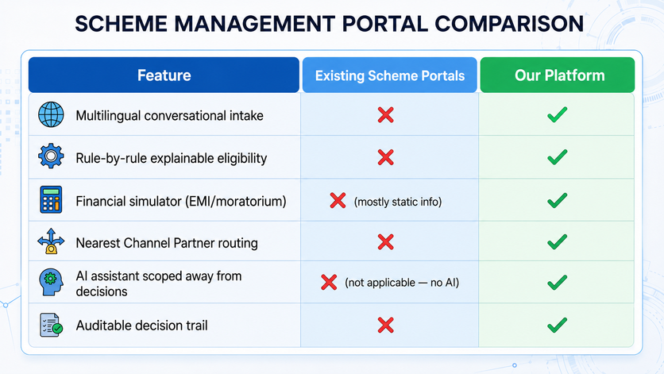
IMPACT AND BENEFITS
Economic Impact: Faster scheme discovery reduces reliance on intermediaries and agents,
while filtering ineligible applications before they reach Channel Partners,
reducing processing workload and improving overall efficiency.
Social & Governance Transformation:Makes government schemes easier to access for low digital-literacy beneficiaries through simple voice/text conversations instead of complex forms. Regional-language support reduces language barriers, while CSC-assisted access helps users who need additional guidance.
Digital Inclusion Gains: Supports Digital India and financial inclusion goals by making complex eligibility logic navigable for low digital-literacy users through conversation instead of forms. Pre-evaluating profiles against deterministic rules reduces misrouted and incomplete applications submitted to SCAs/banks by up to 80%, drastically shortening loan processing cycles.
HOW IT WORKS?
Mode 1: Self-Service (Web/App)
  For: Digitally comfortable beneficiaries
  Process: Chat intake → Eligibility result → Simulator → Partner locator
  Best for: Independent applicants with smartphone access
Mode 2: Assisted Mode (via Channel Partner/CSC)
  For: Low digital-literacy beneficiaries
  Process: Partner staff runs the same chat flow on the beneficiary's behalf
  Best for: Rural/remote beneficiaries relying on Common Service Centres
Mode 3: Voice/Regional Language Mode
  For: Beneficiaries more comfortable speaking than typing
  Process: Voice input → same extraction → eligibility → simulator flow
  Best for: Low literacy users, extending the same engine without new logic
@Lumiere
5
Notes:
5

Slide 6
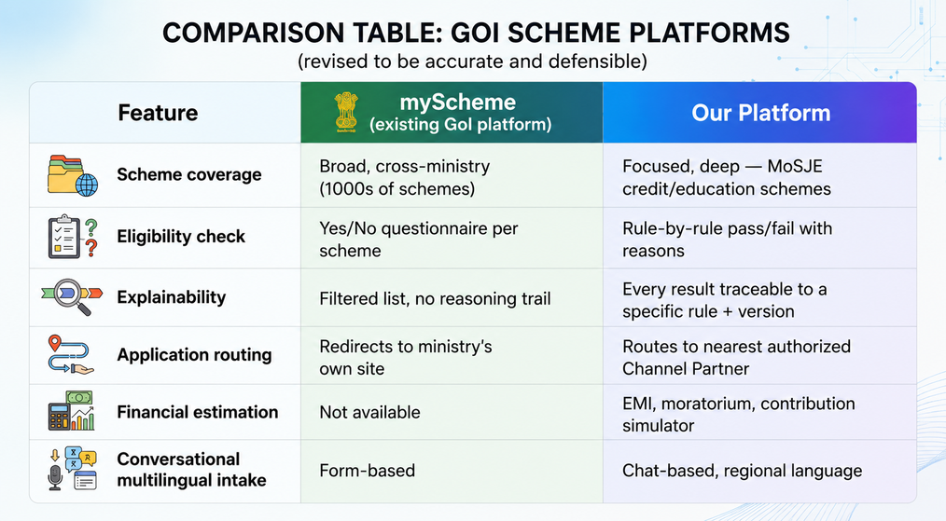

RESEARCH AND REFERENCES
Supporting research :
  Awareness gap is well-documented, not anecdotal: A study across 7 Indian states found 72% of rural households were unaware of MGNREGS, India's largest flagship welfare scheme. Graduate Institute — Project Connect
  A peer-reviewed cross-state study of PM-JAY (India's national health insurance scheme) found only 62% of the eligible population was even aware the scheme existed, and awareness was systematically lower among marginalized groups. PMC — Awareness of PM-JAY
  A 2024 review notes ~53% of India's salaried workforce lacks any social security coverage, much of it due to low scheme utilization despite eligibility. PMC — Bridging the Gap
  Registration ≠ uptake at scale: as of Aug 2025, 31+ crore workers registered on e-Shram, but scheme enrollment (e.g. PM-SYM) reached only a fraction of that. The India Forum
Independent studies consistently show 40-70%+ of eligible beneficiaries remain unaware of schemes they qualify for, hence the barrier is discoverability, not scheme availability.
Existing solutions:
  Static, form-heavy portals — the user must already know which scheme to look for
  No transparent eligibility reasoning — mostly informational, not evaluative
  No integrated financial estimation or partner routing
Our platform stands out:
  Conversational, not form-heavy: discovery works even if you don't know scheme names
  Explainable: every result comes with the specific rule and reason
  End-to-end: discovery → simulation → partner routing in one flow
  Auditable: decisions are traceable, not opaque AI output
@Lumiere
6
Notes:
6

