Slide 1
Breast Cancer Diagnosis
Using Machine Learning
A Classification Study on the Wisconsin Diagnostic Breast Cancer (WDBC) Dataset
REFERENCE PAPER
Nemade, V. & Fegade, V. (2023). Machine Learning Techniques for Breast Cancer Prediction.
Procedia Computer Science, Volume 218, Pages 1314–1320. DOI: 10.1016/j.procs.2023.01.110
PRESENTED BY:
DEVADHARSHINI S

Slide 2
OBJECTIVE & SUMMARY OF THE REFERENCE PAPER
OBJECTIVE
PAPER SUMMARY
Predict whether a tumor is malignant or benign
Use machine learning models for classification
Improve early detection of breast cancer
Support clinical decision-making
Problem:
Breast cancer is a leading cause of mortality in women. Automated ML-based prediction tools are needed to assist doctors in differentiating malignant from benign tumours.
Dataset:
Wisconsin Diagnostic Breast Cancer (WDBC) — 569 samples, 30 features from FNA biopsy images.
Approach:
8 ML classifiers (including ensemble methods) compared on accuracy, precision, recall and F1-score.
Best Result:
Decision Tree & XGBoost achieved the highest accuracy of 97% among all tested models.

Slide 3
METHODOLOGY
(Nemade & Fegade, 2023)
1
2
3
4
5
Data Collection
Preprocessing
Model Training
Evaluation
Comparison & Result
▶
▶
▶
▶
WDBC dataset sourced from UCI ML Repository
569 instances, 30 features, no missing values
Binary labels: Malignant / Benign
Feature normalization applied
Dataset split into training and testing sets
Class imbalance handled before modelling
Models evaluated on:
Accuracy, Precision
Recall, F1-Score
8 classifiers trained:
NB, LR, SVM, KNN, DT, RF,
AdaBoost, XGBoost
All 8 models compared
Decision Tree & XGBoost
achieved best accuracy: 97%
METHODOLOGY-Mini Project
1-DATASET
5-COMPARISON
569 samples, 30 features (no missing values)
Wisconsin Diagnostic Breast Cancer (WDBC)
2-PREPROCESSING
3-MODEL TRAINING
4-EVALUATION
Feature normalization using standard scaling
Train-test split: 80% training / 20% testing
Class imbalance handled
Implemented using Python (Scikit-learn)
Models used:
LightGBM
MLP Classifier
Gradient Boosting
Gaussian Process
Default + tuned hyperparameters
Metrics:
Accuracy
Precision
Recall
F1-score
AUC-ROC
Confusion matrix analysis
Cross validation Score
Compared 4 models with the original paper

Slide 4
DATASET & FEATURES (WDBC — Used in Reference Paper)
569
30
357
212
0
Total Samples
Total Features
Benign (62.7%)
Malignant (37.3%)
Missing Values
10 Nuclear Morphology Features × 3 Statistics = 30 Features Total
Radius
Texture
Perimeter
Area
Smoothness
Compactness
Concavity
Concave Points
Symmetry
Fractal Dimension
Each feature computed as:
Mean
Standard Error
Worst (Max)
Training Set: 455 samples (80%)
Test Set: 114 samples (20%)
Source: UCI ML Repository | Same dataset used by Nemade & Fegade (2023)

Slide 5
NEW ALGORITHMS — Mini Project Contribution
The following 4 algorithms were NOT used by Nemade & Fegade (2023) and form the original contribution of this mini project:
LightGBM
Gradient-Based Ensemble
MLP Neural Network
Deep Learning
A gradient boosting framework using tree-based learning with leaf-wise growth strategy. Faster and more memory-efficient than XGBoost. Uses histogram-based algorithms for speed.
Multi-Layer Perceptron with 2 hidden layers (100→50 neurons), ReLU activation. Learns non-linear feature interactions through backpropagation. Best AUC-ROC in our study.
Params: n_estimators=100, learning_rate=0.1, num_leaves=31
Params: hidden_layers=(100,50), activation=ReLU, max_iter=500
Gradient Boosting
Ensemble Method
Gaussian Process
Probabilistic Model
Builds trees sequentially where each tree corrects errors of the previous one. Uses depth-limited trees and shrinkage (learning rate) to prevent overfitting.
A non-parametric Bayesian classifier using RBF kernel. Provides probabilistic predictions with uncertainty estimates. Best accuracy (97.37%) in our study.
Params: n_estimators=100, learning_rate=0.1, max_depth=3
Params: kernel=RBF(1.0), max_iter_predict=100

Slide 6
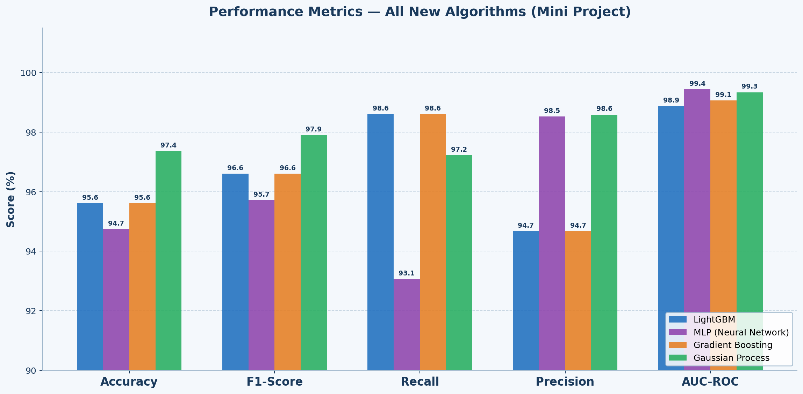
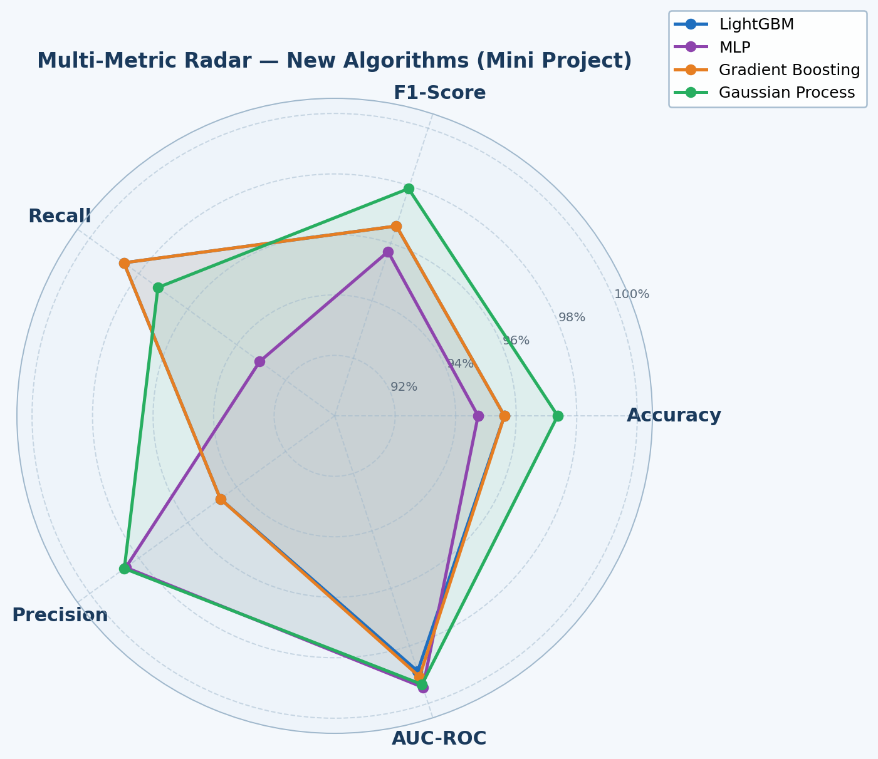
RESULTS — Mini Project (New Algorithms on WDBC)
Model | Accuracy | F1-score | Recall | Precision | AUC-ROC | CV score
LightBGM | 95.61% | 0.9660 | 0.9861 | 0.9467 | 0.9888 | 0.9648
MLP | 94.74% | 0.9571 | 0.9306 | 0.9853 | 0.9944 | 0.9802
GB | 95.61% | 0.9660 | 0.9861 | 0.9467 | 0.9907 | 0.9516
GP | 97.37% | 0.9790 | 0.9722 | 0.9859 | 0.9934 | 0.9934
CONFUSION MATRIX SUMMARY:
MODEL | TP | FN | FP | TN
LightBGM | 38 | 4 | 1 | 71
MLP | 41 | 1 | 5 | 67
GB | 38 | 4 | 1 | 71
GP | 41 | 1 | 2 | 70

Slide 7
COMPARISON — Reference Paper vs Mini Project Results
NEMADE & FEGADE (2023)
MINI PROJECT (NEW ALGORITHMS)
VS
Naïve Bayes
~91%
Algorithm
Accuracy
AUC-ROC
Logistic Regression
~94%
LightGBM
95.61%
0.9888
SVM
~95%
MLP (Neural Network)
94.74%
0.9944
★ Best AUC
KNN
~93%
Decision Tree
97%
★ Best
Gradient Boosting
95.61%
0.9907
Random Forest
~96%
Gaussian Process
97.37%
0.9934
★ Best Acc
AdaBoost
~95%
XGBoost
97%
★ Best
CONCLUSION
Gaussian Process Classifier (Accuracy focused deployment)matched the paper's best accuracy (97.37% vs 97%) without being used in the original study. MLP(Risk-sensitive clinical use) achieved the highest AUC-ROC (0.9944) — surpassing all algorithms in the reference paper — demonstrating stronger discriminative ability for clinical use.

