Slide 1

UNIVERSITY COLLEGE OF ENGINEERING
ANNA UNIVERSITY, BIT CAMPUS
TRICHY- 620024
BT3711-Industrial Training/Internship II
Name (Reg. No.): DEVADHARSHINI S(810021214012)
LOKESH S(810021214019)
PRIYADHARSHINI V(810021214023)
Class: B. Tech. Biotechnology (IV yr / VII sem)
Internship period: 24/06/2024 - 24/07/24
Internship Organization: Scinicorn Labs Private Limited, Marthandam

Slide 2

INFORMATION ABOUT THE COMPANY
Scinicorn Labs Private Limited is a cutting-edge biotechnology company specializing in comprehensive services across various domains, including food and agriculture testing, plant tissue culture production, biopolymer production, and omics services. With a strong commitment to quality and innovation, Scinicorn Labs aims to support and enhance the capabilities of the biotech industry through state-of-the-art facilities and expert services. The company is recognized by the Department for Promotion of Industry and Internal Trade (DPIIT) and registered with the Ministry of Corporate Affairs, underscoring its credibility and commitment to excellence. They provide advanced proteomic analysis to identify and quantify proteins in biological samples, conduct metabolomic studies to analyze the metabolic profiles of organisms, and utilize sophisticated bioinformatics tools and techniques to interpret complex omics data and provide actionable insights. We are also in to research in development and production of biodegradable polymers from renewable resources.

Slide 3
Role and Responsibilities as a Trainee
As a Trainee, My position involves gaining hands-on experience and developing expertise in:
Disease Analysis Using R-Programming: Learning to use R for analyzing health data, identifying disease trends, and creating visual representations to support research findings.
Phyto-Compound Analysis: Acquiring skills in analyzing plant-based compounds, understanding their properties, and exploring their potential applications in disease treatment.
Molecular Docking: Training in computational techniques to study molecular interactions, predict drug efficacy, and understand biological mechanisms at a molecular level.
This blend of computational and biochemical work contributes to advancements in healthcare and research.

Slide 4
OBJECTIVES
To leverage computational tools and methodologies, such as R-programming and molecular docking, for analyzing disease pathways and interactions.
To identify potential therapeutic phyto-compounds and understanding their molecular mechanisms, while enhancing my technical and analytical skills to contribute to innovative solutions in disease treatment and drug discovery.

Slide 5
Internship Reflections: Skills, Challenges
Sample data taken from GEO (https://www.ncbi.nlm.nih.gov/geo/),
Diabetes genes were identified using differentially expressed gene analysis in R-studio programming. Using R-studio, we assessed the quality of the genes and normalized the data.
Analyzed the review articles to select phyto-compounds and analyze them using IMPAT and ADMET tools to assess drug-likeness and pharmacokinetics. These compounds undergo molecular docking to evaluate their interactions with target proteins and potential therapeutic efficacy.
CHALLENGES ENCOUNTERED:
Initially, we mistakenly analyzed data from a previously published study. To resolve this, we identified a solution by intersecting data from three raw count papers using Excel, ensuring the accuracy and originality of our analysis.

Slide 6
DISEASE ANALYSIS USING R
The raw data obtained from GEO are further assessed to evaluate the quality of genes. After combining datasets, we extracted 24,159 common genes from the above datasets.
S.NO | ACCESSION ID | CONTROL | DISEASED
1 | GSE164416 | 16 | 41
2 | GSE228662 | 0 | 67
3 | GSE198922 | 56 | 74
4 | PROCESSED SAMPLES | 74 | 180
DEG Analysis using R-programming:
Normalization & Scaling
Preventing domination of genes with high expression.
Scaling is same as normalization.

Slide 7
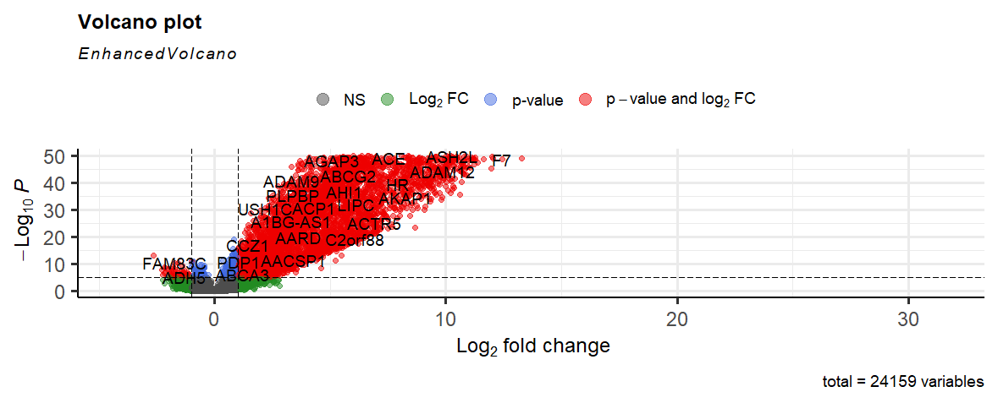
Fig 1 Volcano plot
Fig 1 represents Volcano plot of highly expressed genes in the samples. This shows the values of -log10 P and log2foldchange. Red color denotes the up-regulated genes whereas green color denotes down-regulated genes. The default line can be adjusted according to the p value.

Slide 8
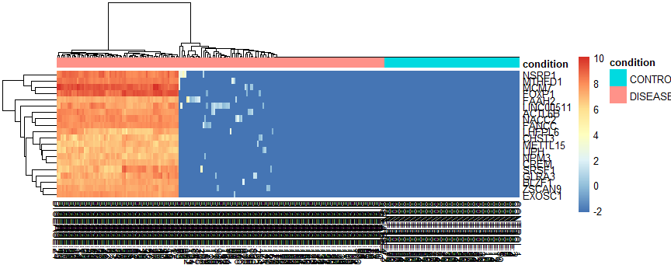
Fig 2 Heatmap
Heatmap depicts the variance of differentially expressed genes in different samples. This plot contains 20 genes. Diseased genes are denoted by dark orange to red color while control or healthy genes denoted as blue. The variation among these 20 genes helps to analyze the differentially expressed genes.

Slide 9
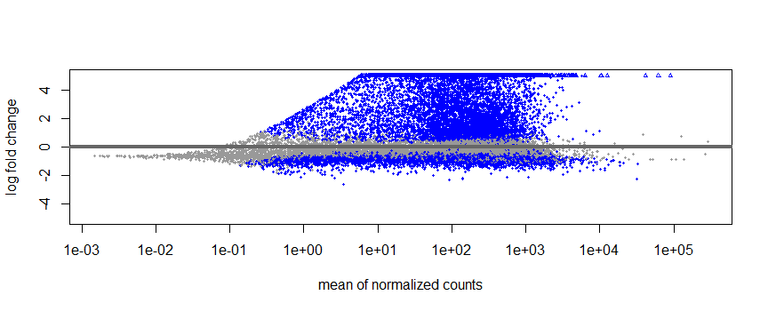
Fig 3 MA PLOT
MA plot can be used to display a difference in expression patterns between samples. On the Y-axis , it shows the difference in expression of the clusters and on the X-axis, it shows the average contribution of the clusters. Each dot is a gene, and the genes that show the most differential expression are highlighted in blue and labelled. The rest are grey and unnamed.

Slide 10
MOLECULAR DOCKING:
Ligand preparation:
All the plants were imported in IMPAT database to find the respective phytoconstituents. Among 1294 compounds only 44 phyto-constituents were selected by SwissADME.
Protein preparation:
From KEGG pathway and string analysis, one gene is highly expressed and linked with Diabetes Mellitus. (PDB ID- 6njs)
Gene | UniProt ID | Protein name
STAT3 | P40763 | Signal transducer and activator of transcription 3

Slide 11
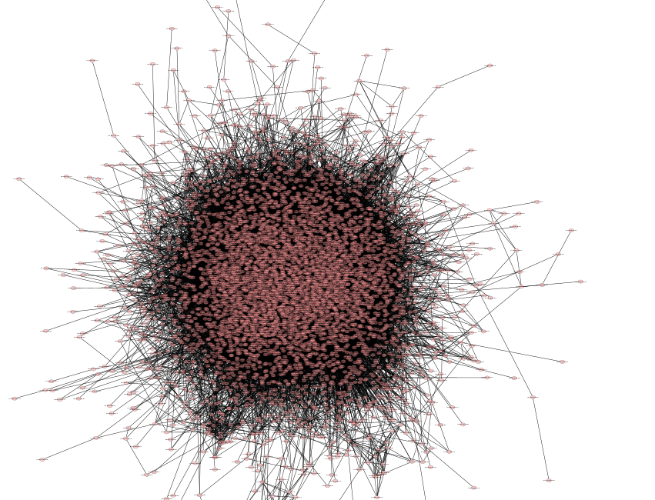
Fig 4 String network analysis
Protein-Protein interaction using String. Number of nodes: 5225, Number of edges:69809, Average local clustering coefficient:0.271, Number of neighbors:27.290.

Slide 12
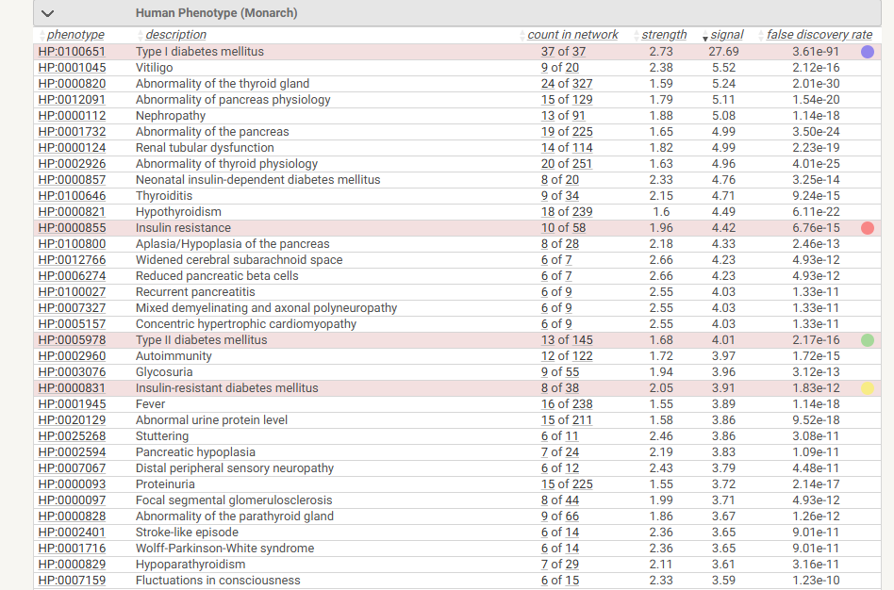

Slide 13
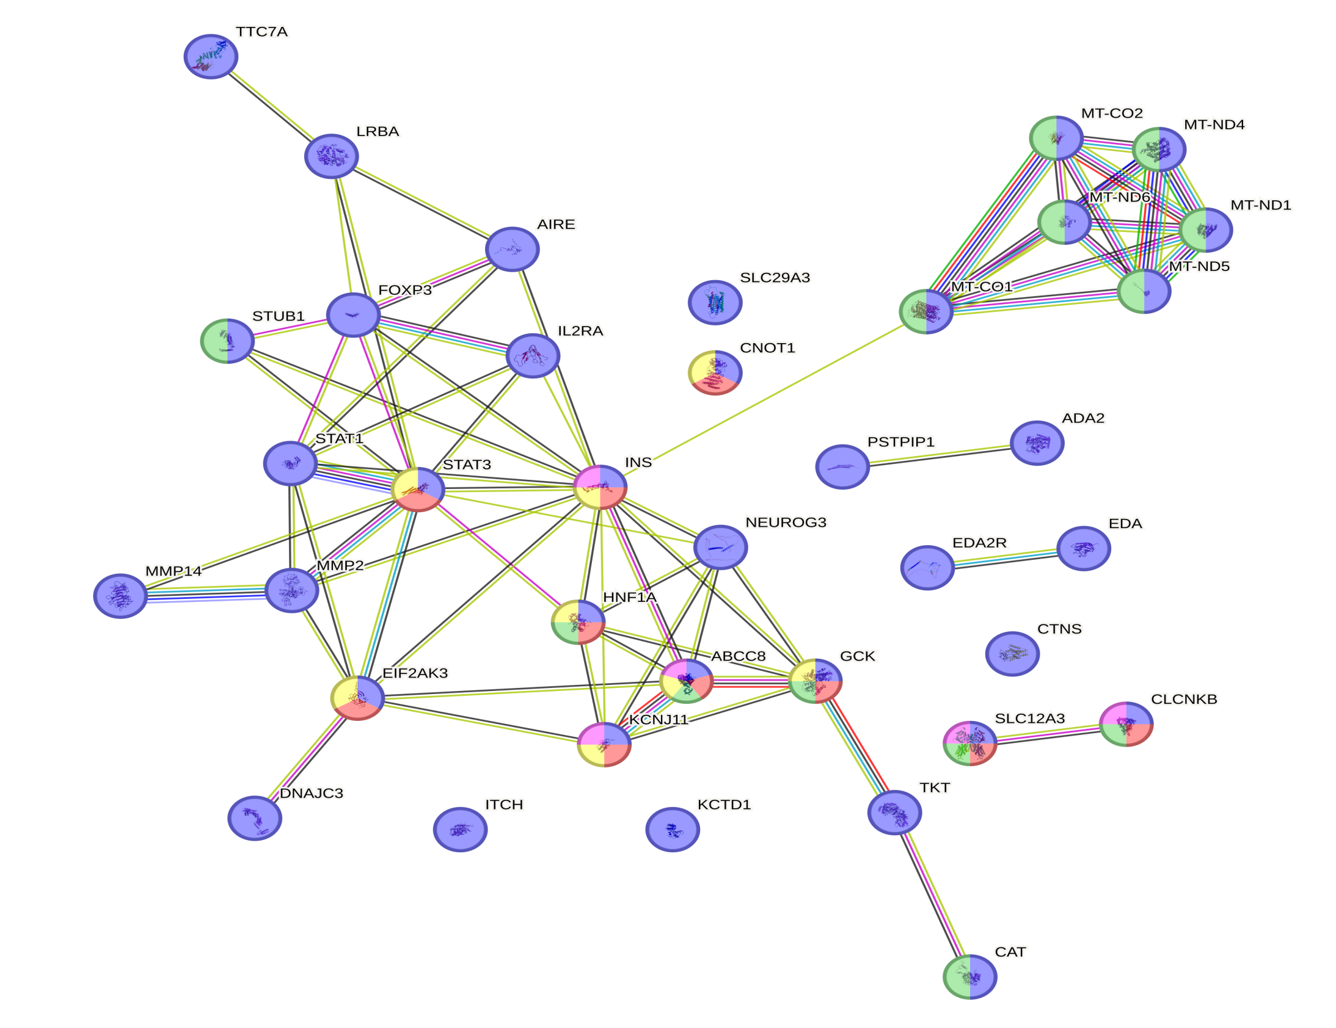
Number of nodes: 37
Number of edges: 70
Average node degree: 3.78
Avg. local clustering coefficient: 0.689
FIG 5- String network analysis of STAT3

Slide 14
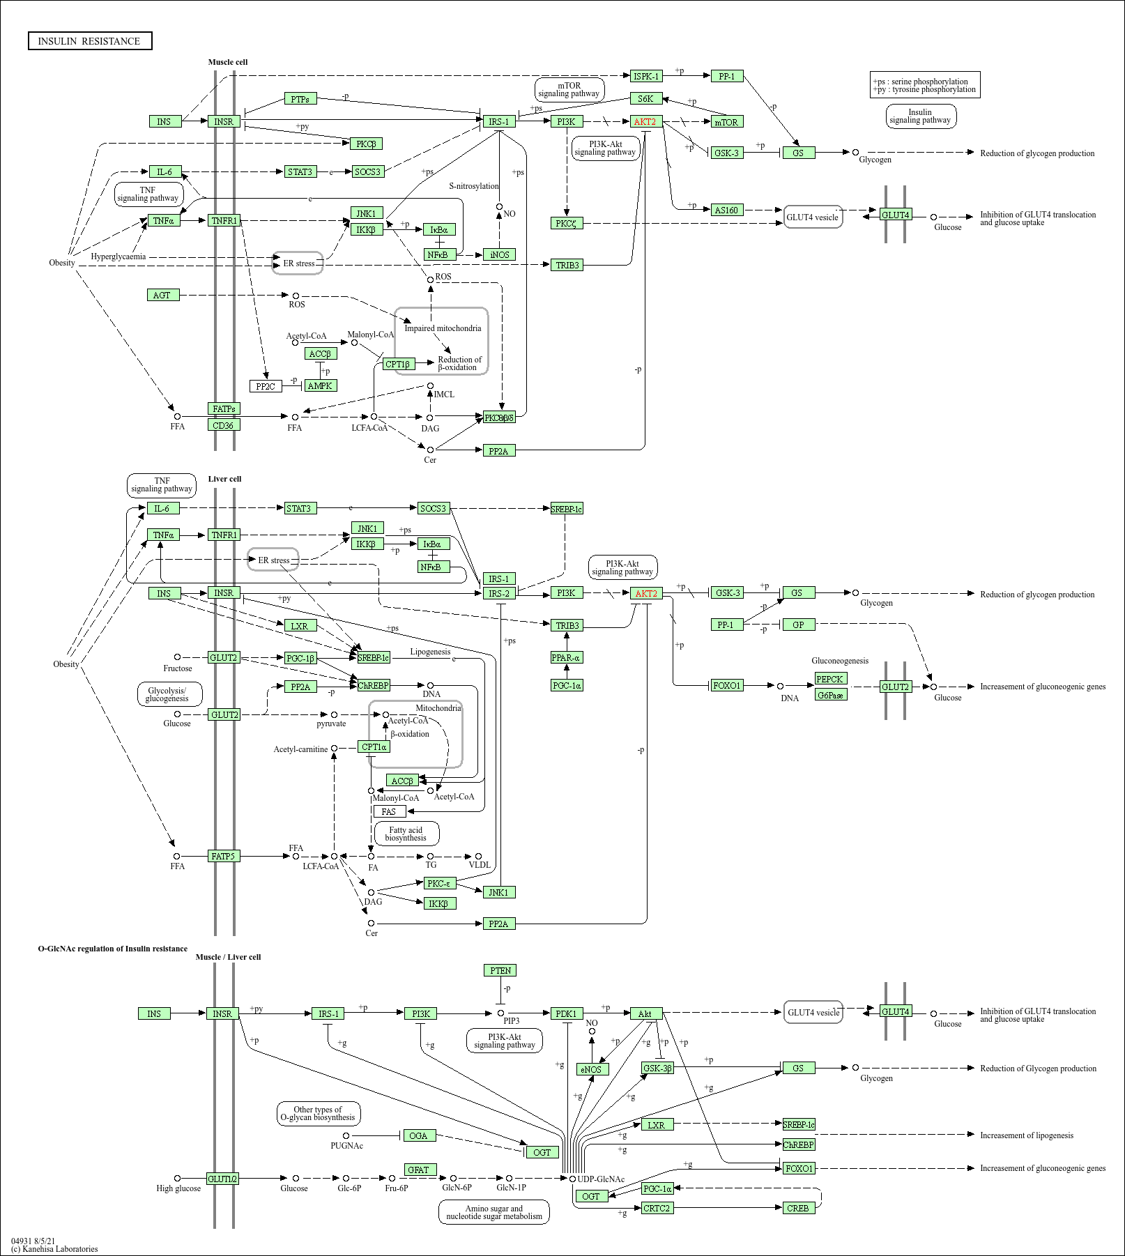
FIG 6 KEGG pathway- Insulin resistance pathway

Slide 15
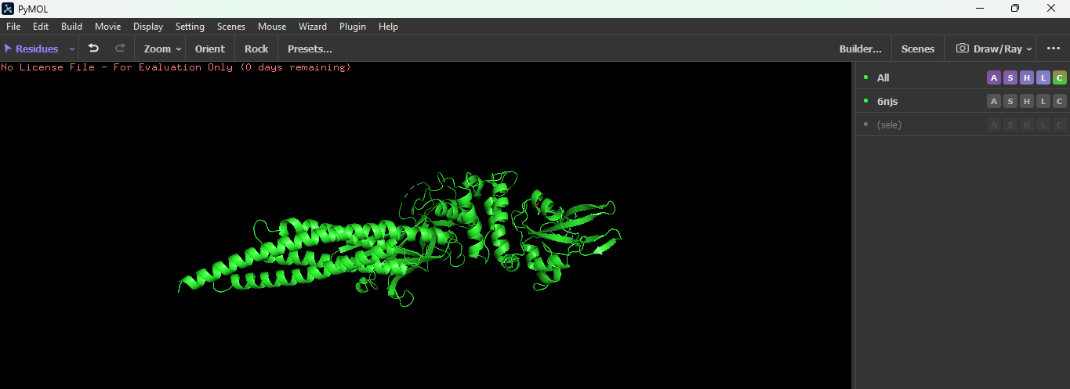
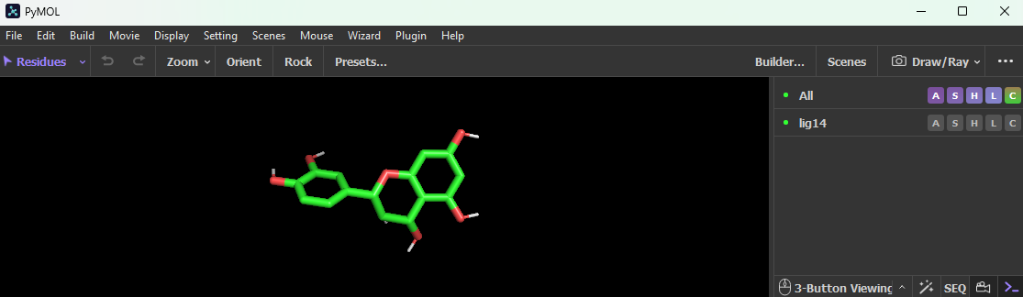
Fig 7 Visualization of protein and ligand

Slide 16
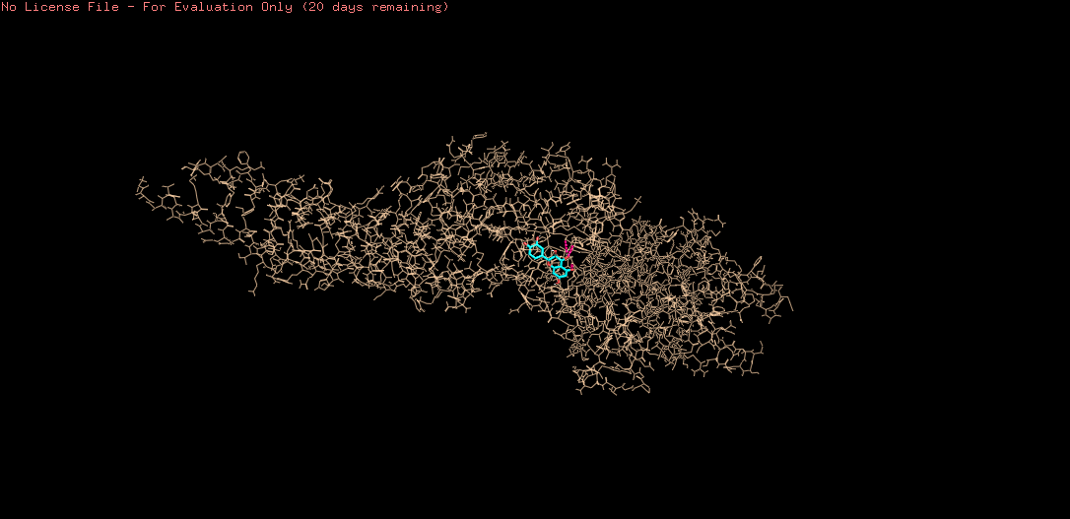
Visualization:
Visualization of protein with ligand is done by pyMol.
FIG 8 – Docking analysis using PyMOL

Slide 17
CONCLUSION
In the quest for effective treatments for diabetes mellitus, plant-based compounds offer promising potential due to their natural therapeutic properties. By leveraging tools like R-programming and molecular docking, I successfully analyzed disease pathways, identified potential phyto-compounds, and explored their therapeutic potential through protein-ligand interactions. This hands-on exposure has strengthened my technical skills, enhanced my problem-solving abilities, and provided valuable insights into the integration of computational techniques with biological research. The integration of docking studies with experimental validation could further establish its role in developing novel, plant-based therapeutics for diabetes mellitus, contributing to a more holistic and sustainable approach to diabetes treatment.

