Slide 1
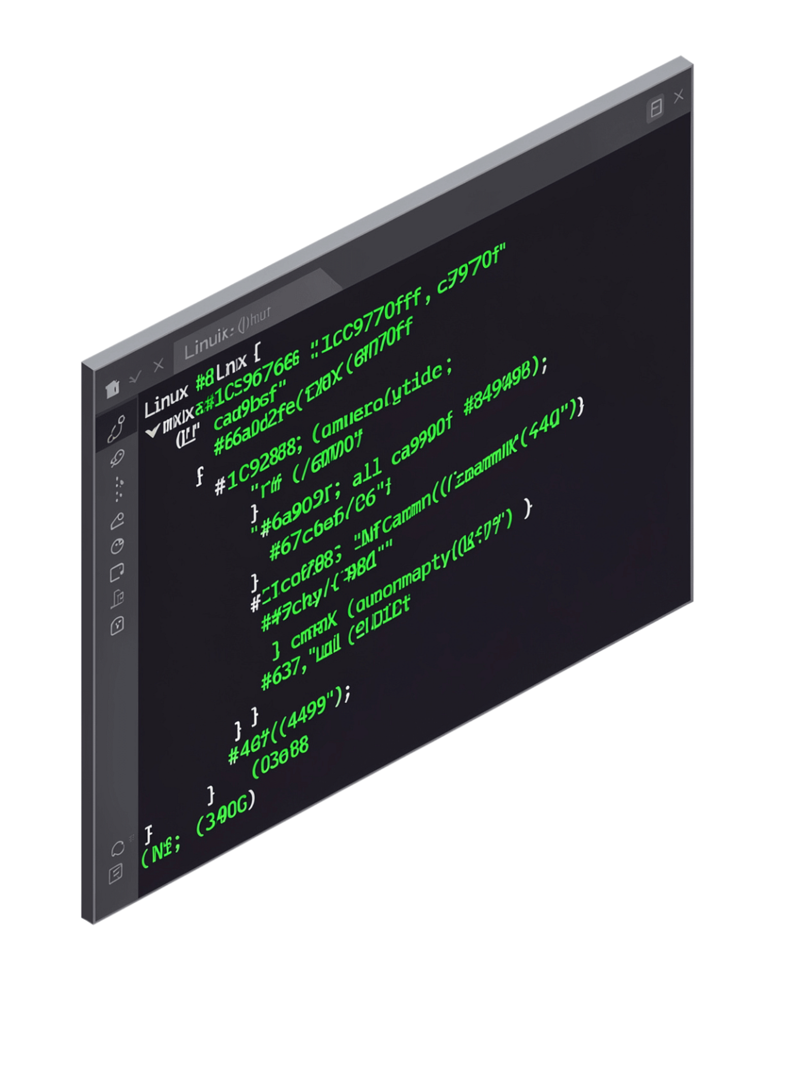
Linux File Descriptor and File I/O Management System
Operating Systems and Systems Programming | Course: 25CS2104E | Section: 13 | Team No.: 15
Team Members: Lahari | Varnika | Rashmika Faculty: Alekya

Slide 2
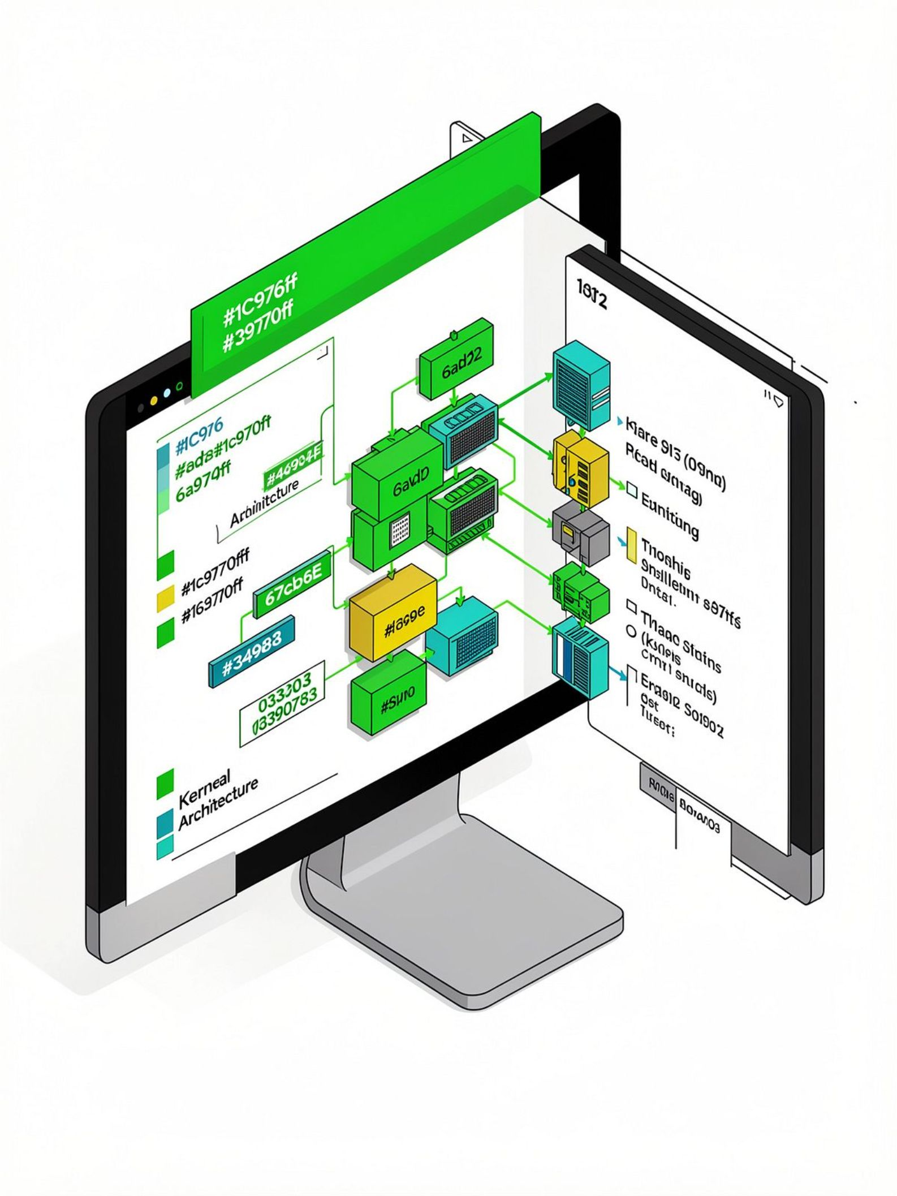
Introduction: How Linux Manages Files
Kernel-Managed
Linux manages all file operations through the kernel, the core layer of the OS.
System Calls
Programs interact with files using system calls — the bridge between user space and the kernel.
File Descriptors
Every opened file is represented by a file descriptor — a unique integer assigned by Linux.
This Project
We demonstrate these concepts practically through a hands-on C application.

Slide 3


Problem Statement
Understanding how Linux internally manages files and performs file I/O can be difficult for learners and developers alike.
High-level file operations hide the complexity of system-level interactions
The role of the kernel remains invisible during typical programming
There is a gap between OS theory and practical, low-level file I/O experience
This project provides a practical way to observe file descriptors and system calls while performing real file operations.

Slide 4
Objectives
Create & Open Files
1
Use system calls to create and open files at the OS level.
Read & Write
2
Perform low-level read and write operations on file content.
Display File Descriptors
3
Understand and visualize the integer identifiers assigned by Linux to open files.
Error Handling
4
Demonstrate robust error detection and meaningful feedback for failed operations.
Process–Kernel–File
5
Illustrate the full interaction chain between user process, kernel, and file system.

Slide 5
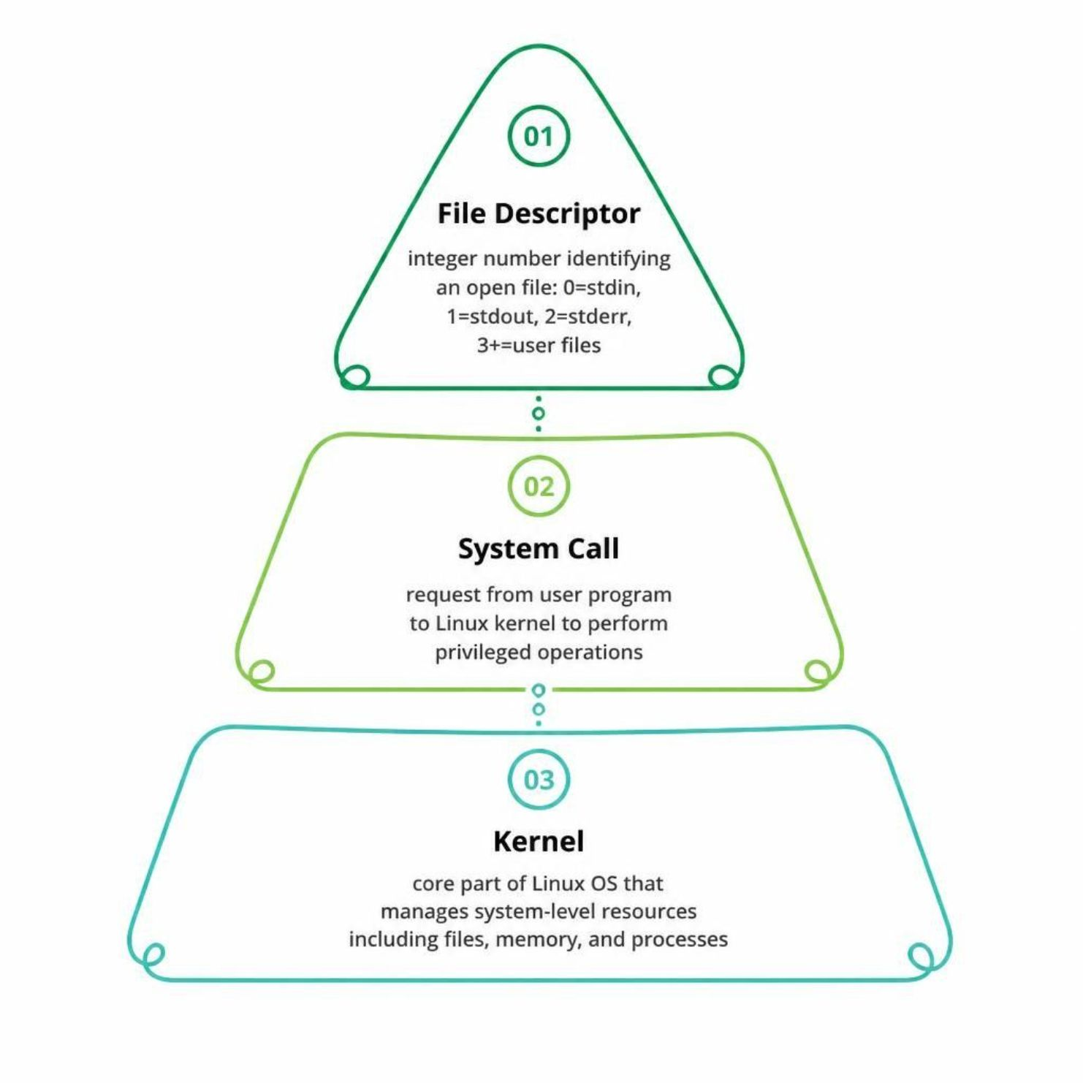
Key Concepts
File Descriptor
A non-negative integer used by Linux to identify an opened file within a process. Default descriptors: 0 = stdin, 1 = stdout, 2 = stderr. User files begin at 3.
System Call
A request made by a user-space program to the Linux kernel to perform privileged operations such as reading or writing files.
Kernel
The core of the Linux operating system that manages system-level resources — files, memory, and processes — on behalf of user programs.

Slide 6



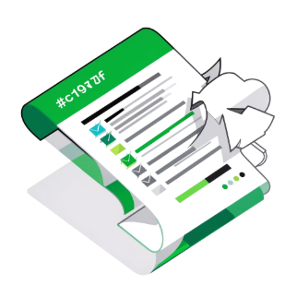
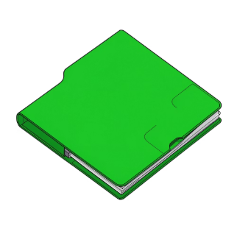
System Calls Used
open()
read()
write()
lseek()
Open or create a file. Returns a file descriptor on success.
Read a specified number of bytes from an open file into a buffer.
Write data from a buffer into an open file.
Reposition the file offset to read or write at a specific location.
close()
Release the file descriptor and free kernel resources associated with the file.

Slide 7

Methodology: Project Workflow
Select Operation
Call System Call
Kernel Processing
Execute File I/O
The application follows a clear request-response cycle — from menu selection through the kernel, back to the user — ensuring each operation is transparent and observable.

Slide 8
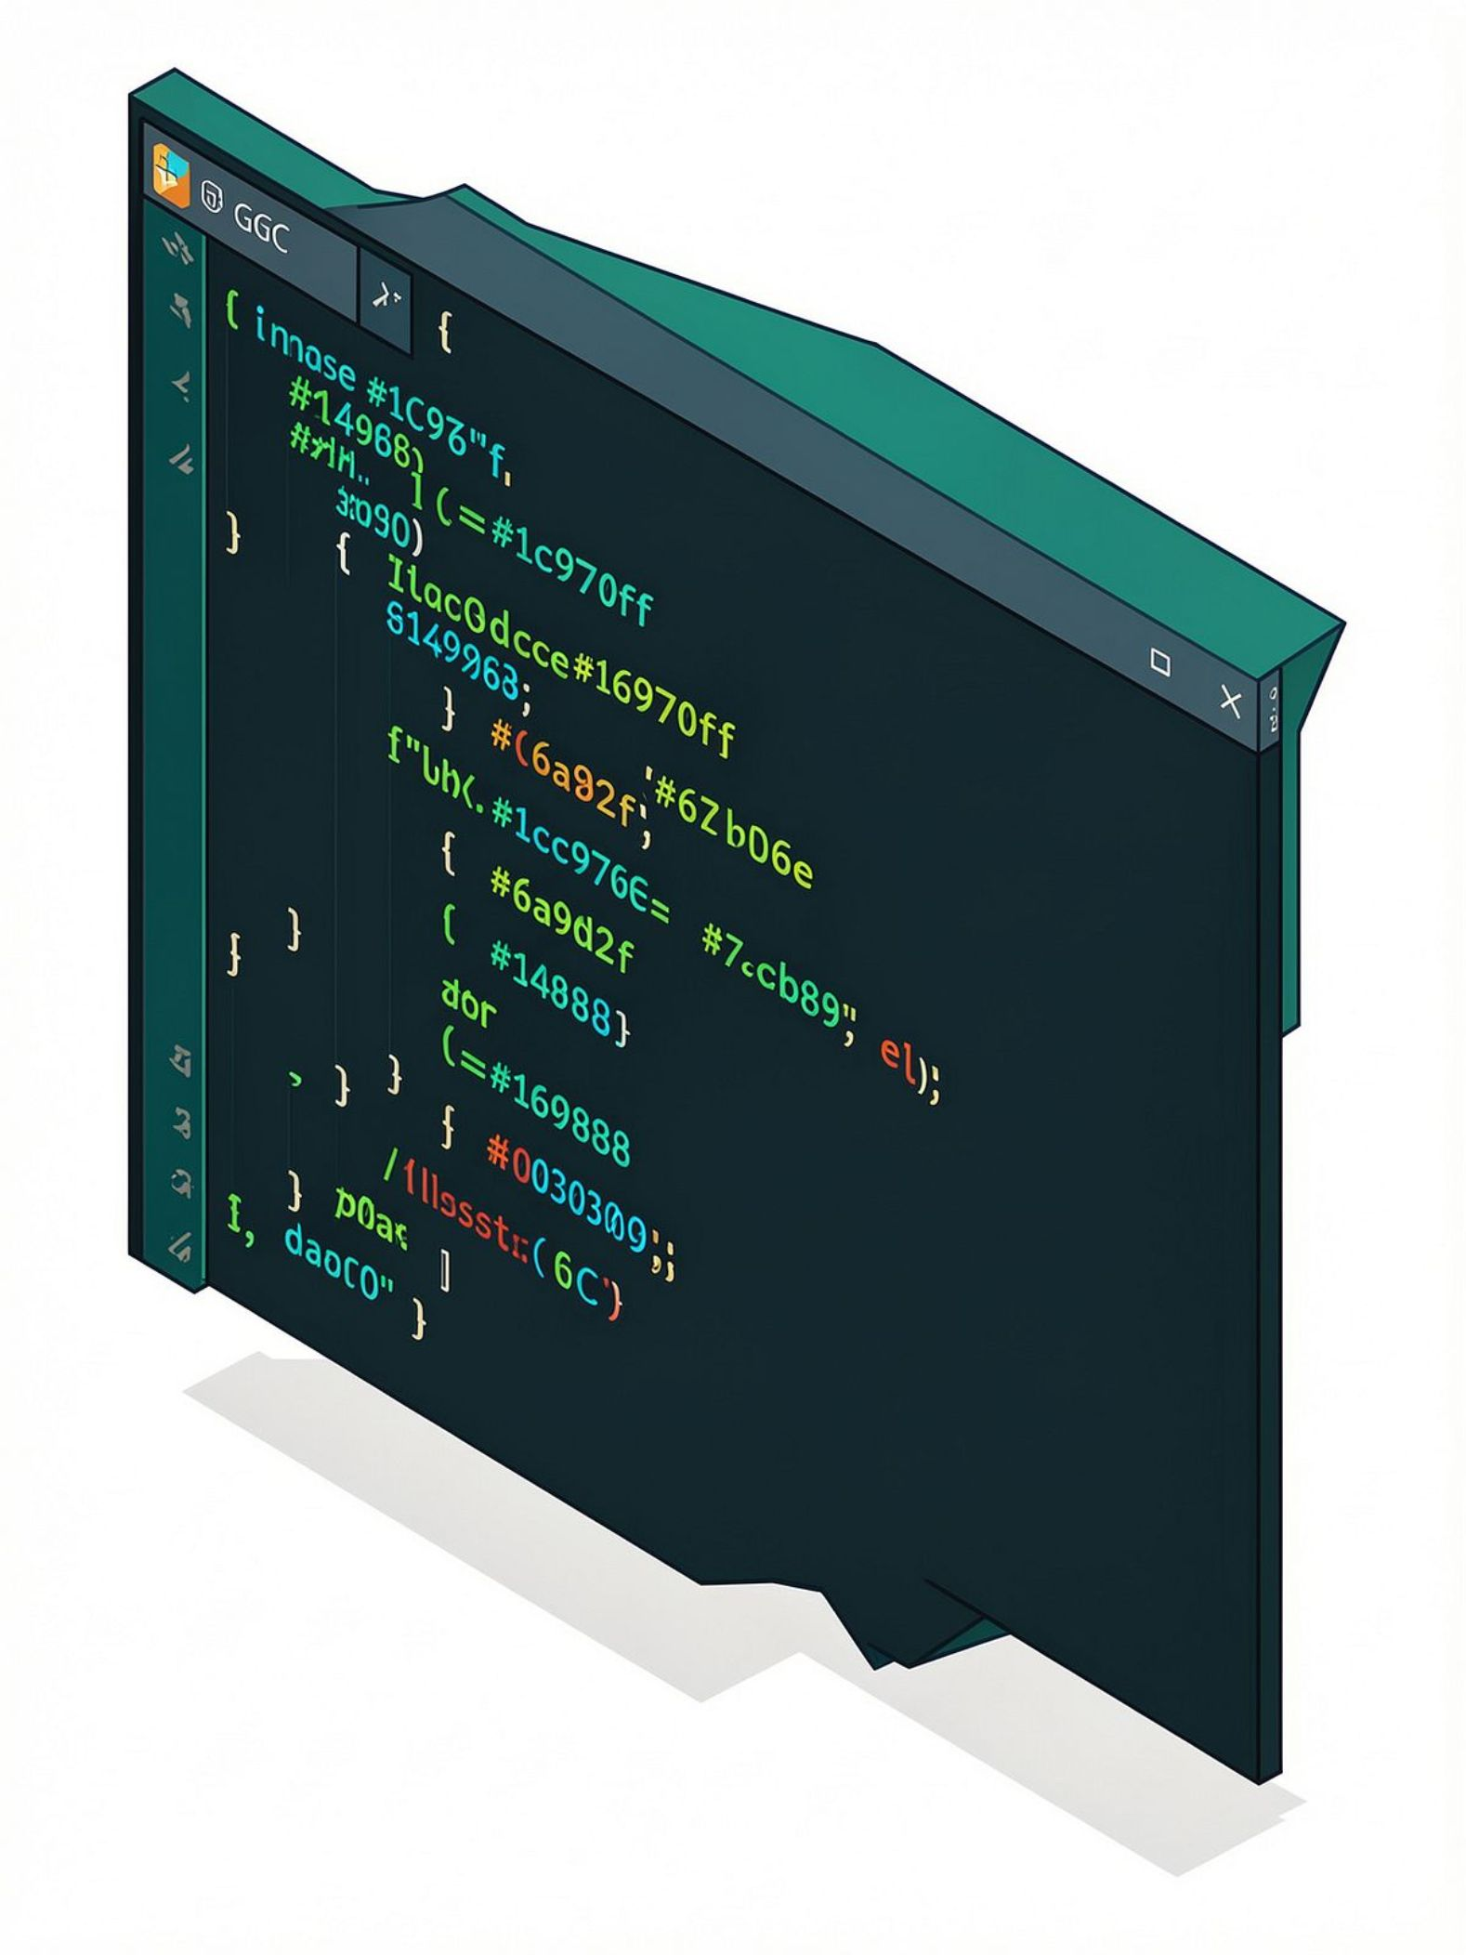
Implementation & Features
Tech Stack
Application Features
Create a new file
Open an existing file
Read file contents
Write to a file
Append data to a file
Seek to a file position with lseek()
Close file and release descriptor
Language
C
OS
Linux / Ubuntu
Compiler
Menu-driven interface enables easy, step-by-step operation selection for any user.
GCC

Slide 9
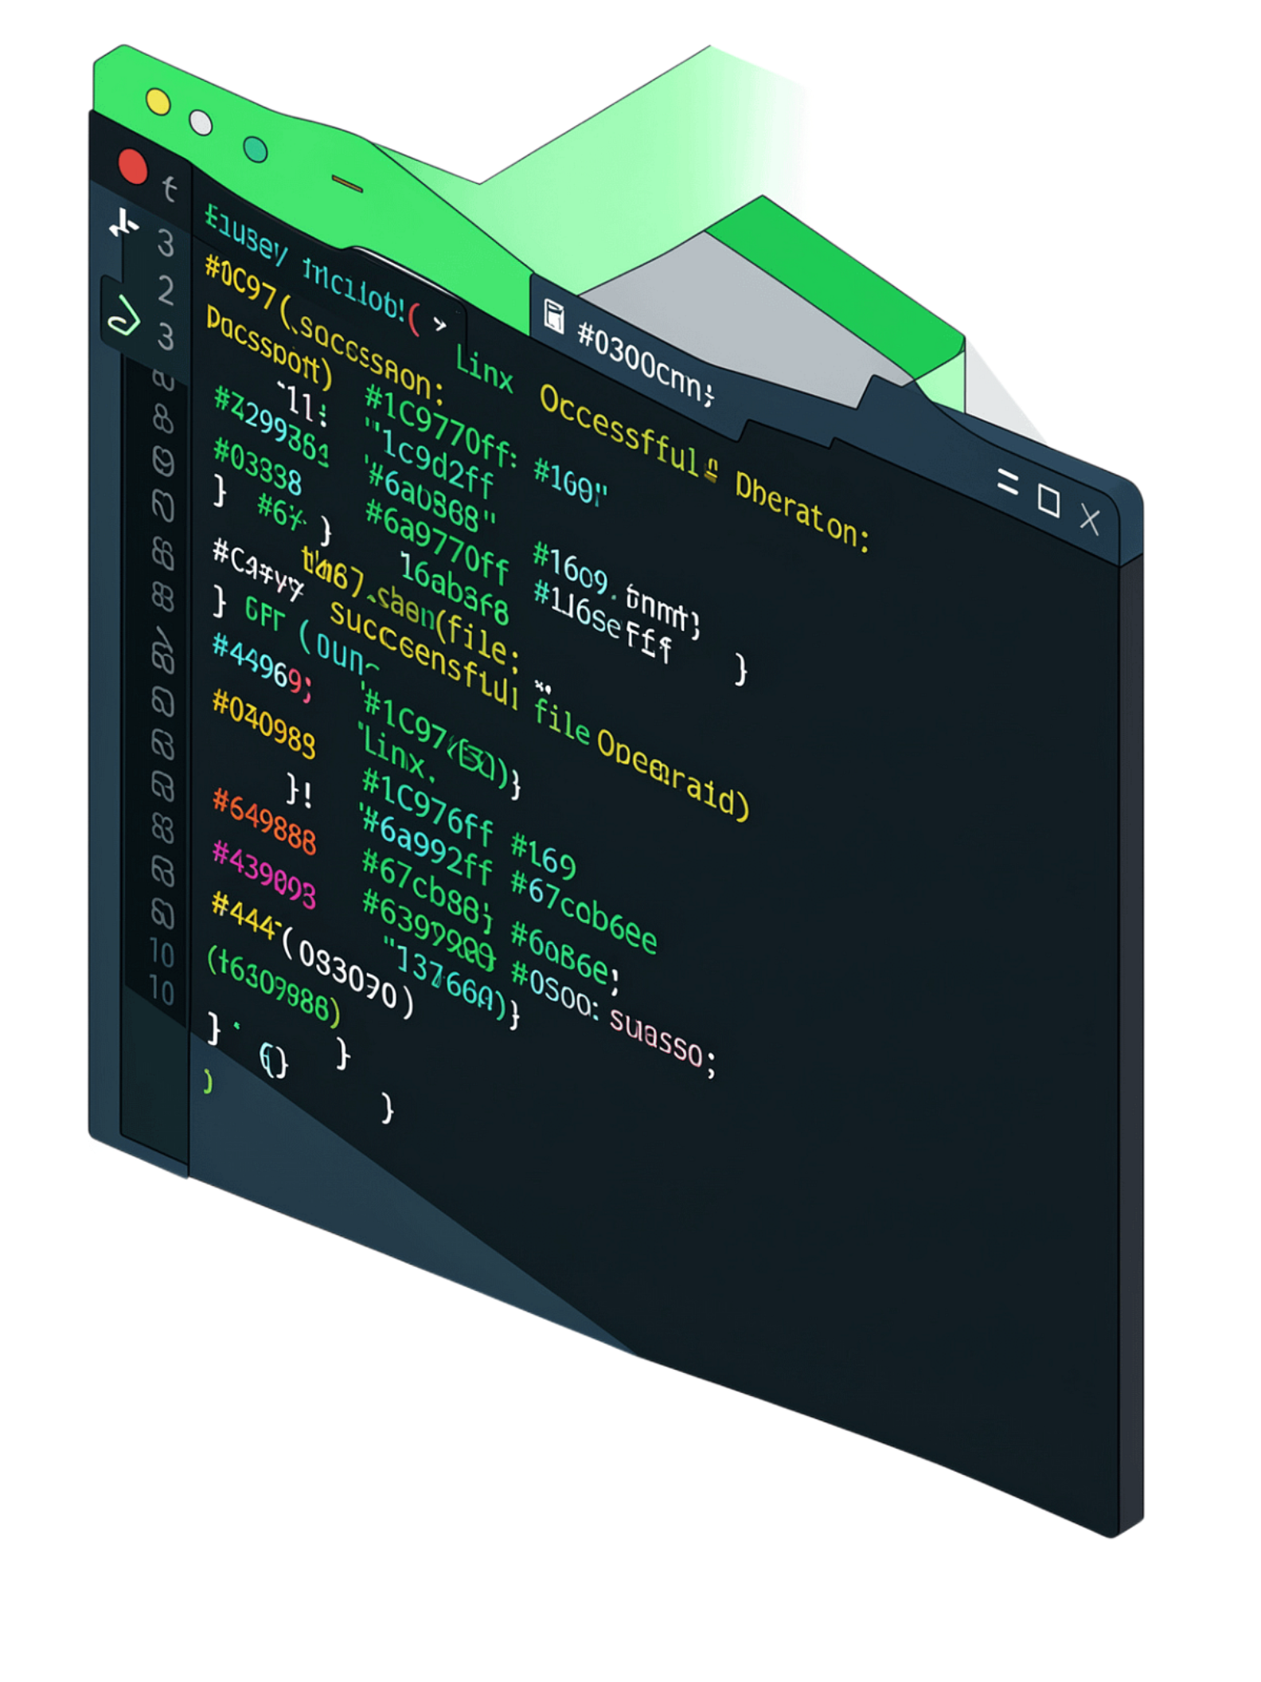

Expected Outcome & Conclusion
Working Application
A fully functional, menu-driven application performing low-level file operations using Linux system calls.
Real-Time Visibility
Users can observe file descriptors and operation status in real-time, demystifying OS internals.
End-to-End Demonstration
Clearly illustrates the interaction chain: User Program → Kernel → File System.
Theory Meets Practice
Bridges the gap between Operating Systems theory and hands-on Linux systems programming.

Slide 10
Thank You

