Slide 1

Word-Level Plagiarism Detection for Small Documents
A lightweight, transparent approach to identifying textual overlap in academic and professional documents.

Slide 2

The Plagiarism Problem
Easier Than Ever to Copy
Digital content makes verbatim and near-verbatim copying trivially simple, raising the stakes for detection.
Detection Is a Necessity
Academic institutions and professional environments demand efficient, reliable tools to safeguard originality.
A Wide Spectrum of Methods
Solutions range from simple string matching to computationally expensive machine learning models — each with trade-offs.

Slide 3
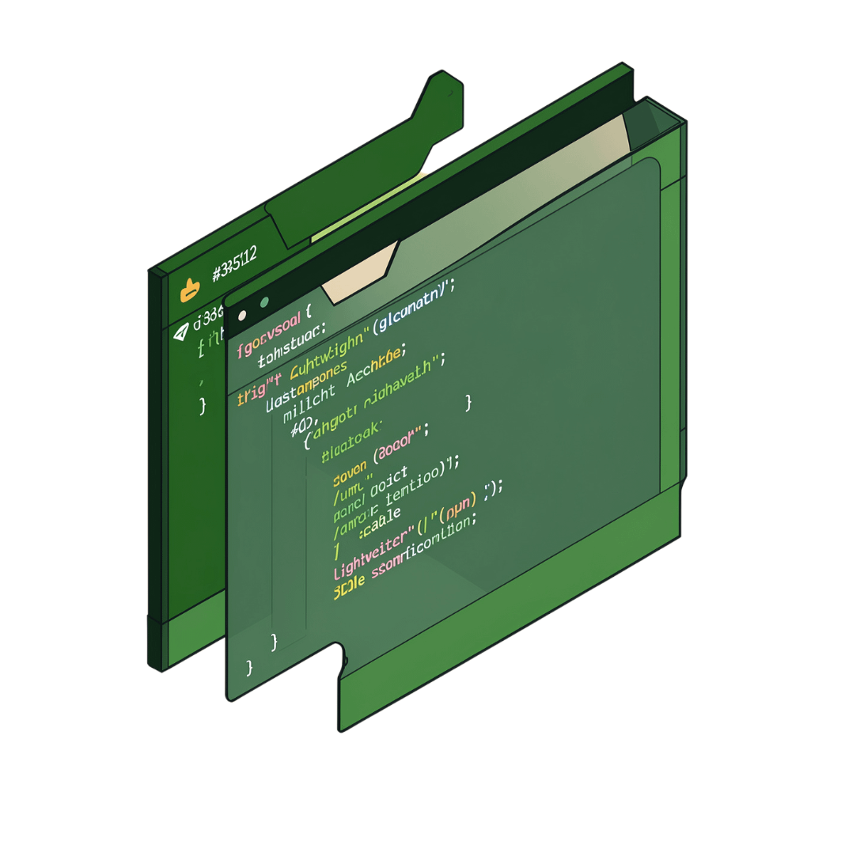
Our Approach: Lightweight & Practical
Rather than reaching for heavy ML infrastructure, this system achieves effective detection through fundamental computer science:
Word-level comparison instead of costly semantic analysis
Efficient for small documents — no GPU or cloud compute needed
HashSet and ArrayList for fast, duplicate-free word matching
Matching words displayed explicitly for full transparency

Slide 4
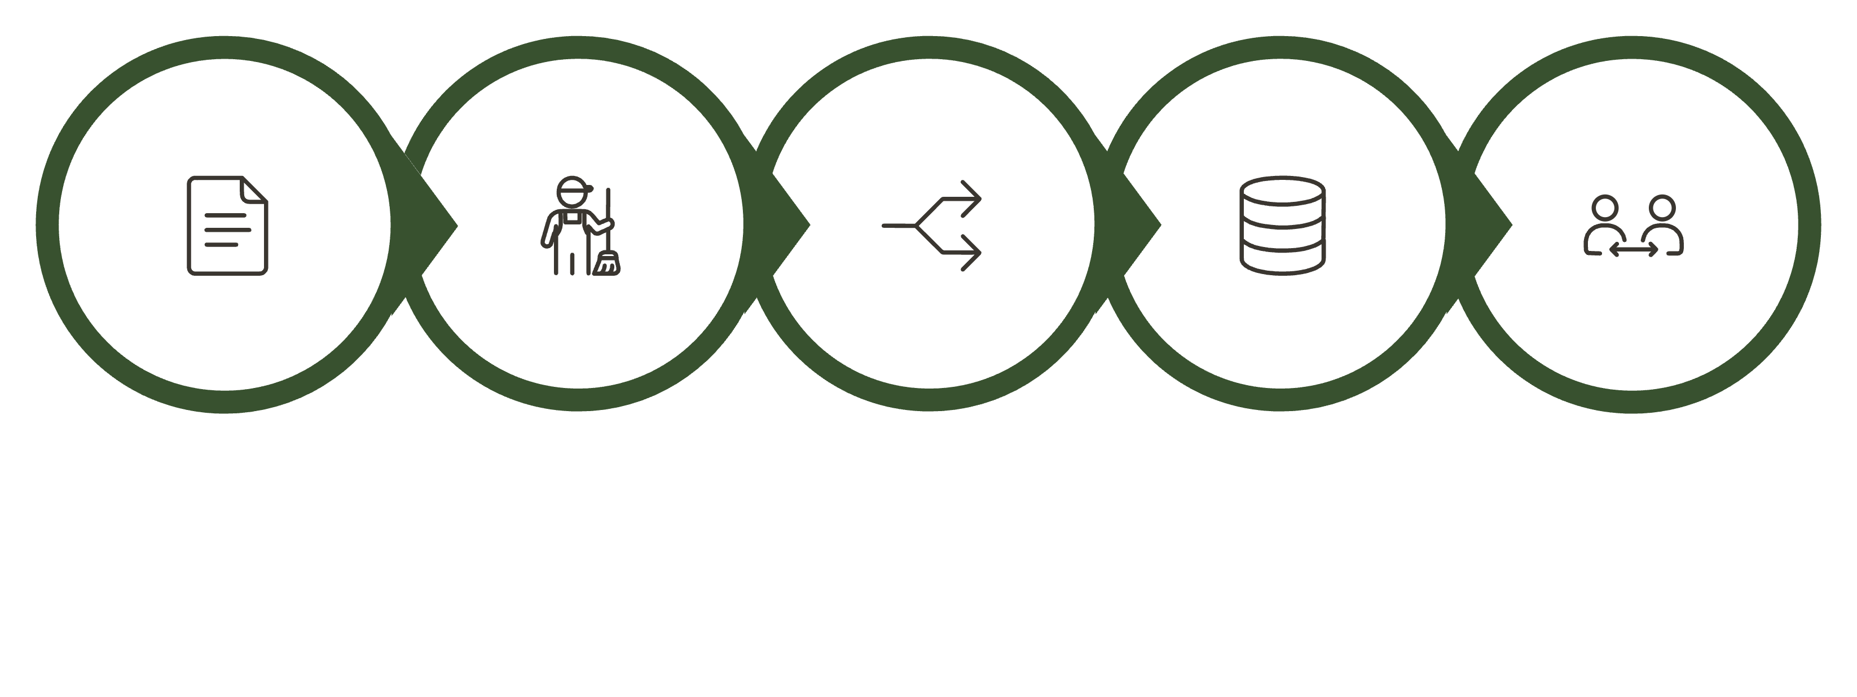
How It Works: 8-Step Process
Input Docs
Preprocess
Tokenize
HashSet
Compare
Each step is deliberately simple, making the pipeline easy to audit, modify, and extend for educational or practical use.

Slide 5

Similarity Calculation
The Formula
A Critical Distinction
Similarity % = (Common Words ÷ Unique Words in Reference) × 100
Example: 8 matching words out of 20 unique reference words = 40% similarity
The system deliberately reports "Similarity %" — not "Plagiarism %".
Word overlap alone is insufficient to prove plagiarism. Common vocabulary, shared terminology, and domain-specific language naturally inflate surface similarity without indicating intent to copy.
Final plagiarism determination always requires human judgment.

Slide 6

Literature Foundation
String Matching
Effective for detecting direct, verbatim copying. Struggles significantly when a source has been paraphrased or reworded.
Word-Based Similarity
Bag-of-Words and Jaccard Similarity methods offer simplicity and computational efficiency — the foundation of this project.
Semantic Approaches
Models like Word2Vec and BERT capture deeper meaning but demand substantially more computational resources.

Slide 7
Why This Approach Works
Simplicity Meets Function
Computationally Lean
Balances ease of implementation with genuinely practical detection capability.
Optimised for small documents — runs efficiently on everyday hardware without specialised infrastructure.
CS Concepts in Action
Introductory-Friendly
Demonstrates text processing, tokenisation, and data structures solving a real-world problem.
An ideal entry-point tool for academic courses in algorithms, NLP, or software engineering.

Slide 8
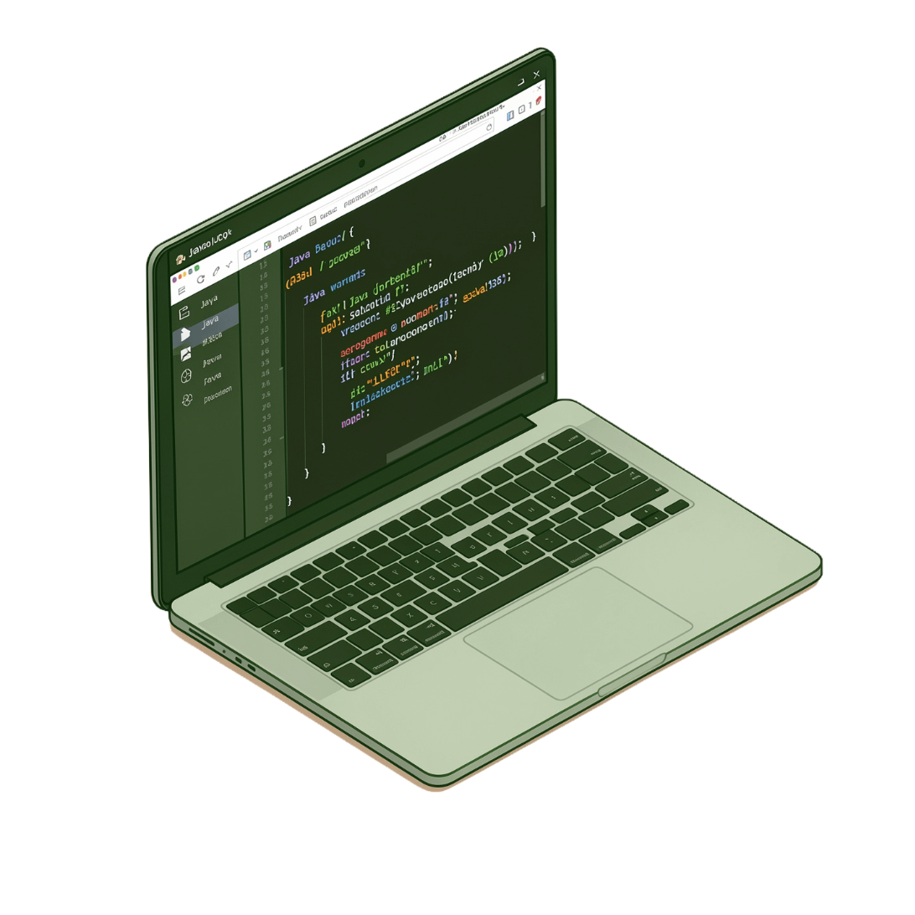

Technical Requirements
Software Stack
Java JDK 17 or higher
IDE of choice (IntelliJ, Eclipse, VS Code)
Core Java Collections: HashSet and ArrayList
Hardware — Minimal by Design
Intel Core i3 processor (or equivalent)
4 GB RAM
500 MB available storage
No GPU, no cloud, no machine learning models required.

Slide 9

Key Takeaway
A Practical, Transparent Foundation
Word-level detection provides a clear and auditable method for identifying textual overlap without a black-box model.
Human Review Remains Essential
Similarity scores are a signal, not a verdict. Context, intent, and domain knowledge require human interpretation.
Fundamental CS, Real-World Impact
This system shows how core concepts in data structures and text processing translate directly into meaningful applications.

