Slide 1






E-Commerce Real-Time Data Lake & Analytics Platform
Building a Modern Data Pipeline with Kafka, Spark & MinIO
Node.js
React
MongoDB
Apache Kafka
Apache Spark
MinIO
Notes:
1

Slide 2

Project Overview
This full-stack e-commerce platform integrates real-time event streaming and analytics capabilities. The system processes 30+ products, serves 50+ users, and handles 100+ orders with continuous event tracking across the customer journey.
30+
50+
100+
Products
Users
Orders
Catalog items with search and filtering
Active customer accounts
Processed transactions
5
Services
Integrated technologies
The platform combines a MERN stack frontend with Kafka for message brokering, Spark for stream processing, and MinIO for data lake storage—creating a complete real-time analytics solution.
Notes:
2

Slide 3

Application Features Implemented
Product Catalog
Search, filtering, and detailed product pages
Shopping Cart
Checkout system with order management
Authentication
Customer and Admin role-based access
Reviews & Ratings
Product feedback system
Admin Dashboard
Live metrics and system monitoring
Notes:
3

Slide 4
Backend Architecture
Express.js REST API
MongoDB Collections
Auto-Incrementing IDs
6 route handlers managing product, user, order, and review endpoints with request validation and error handling
5 collections: products, users, orders, order_items, and reviews with relationships and indexes for query optimization
Custom ID generation system with collision handling for sequential document identifiers
MinIO Integration
Kafka Producer
S3-compatible storage for product images with secure upload and retrieval
Event streaming implementation capturing user actions and system events
Notes:
4

Slide 5





Real-Time Event Streaming Pipeline
User Action
View, cart, purchase, or review event initiated
Backend Processing
API validates and processes the action
Kafka Broker
Message queued to clickStream topic
Spark Streaming
Real-time ETL transformation
MinIO Storage
Parquet files in data lake
Event Types
Scalable Processing
Real-Time Analytics
View, cart, purchase, and review tracking
High-throughput message handling
Immediate data availability
Notes:
5

Slide 6



Data Lake Implementation
Storage Architecture
MinIO provides S3-compatible object storage for the data lake, with Spark Structured Streaming handling ETL processes. Data is stored in Parquet format for efficient querying and analysis.
  Parquet format for columnar storage
  Checkpoint mechanism for fault tolerance
  Partitioned data structure: s3a://datalake/orders/
  Automated bucket creation
MinIO Storage
Spark Streaming
Parquet Format
S3-compatible object storage for scalable data lake implementation
Real-time ETL processing with structured streaming capabilities
Columnar storage for efficient compression and querying
Notes:
6

Slide 7

Admin Dashboard & Live Analytics
Real-Time KPIs
Revenue Trends
Top Analytics
Revenue, orders per second, active users, and events per second displayed with WebSocket updates
Live charts showing revenue patterns with historical comparison and anomaly detection
Categories and brands performance metrics with ranking and comparison views
System Health Monitoring
  Kafka lag tracking
  Spark batch processing time
  Resource utilization metrics
  Automatic alert system
Notes:
7

Slide 8
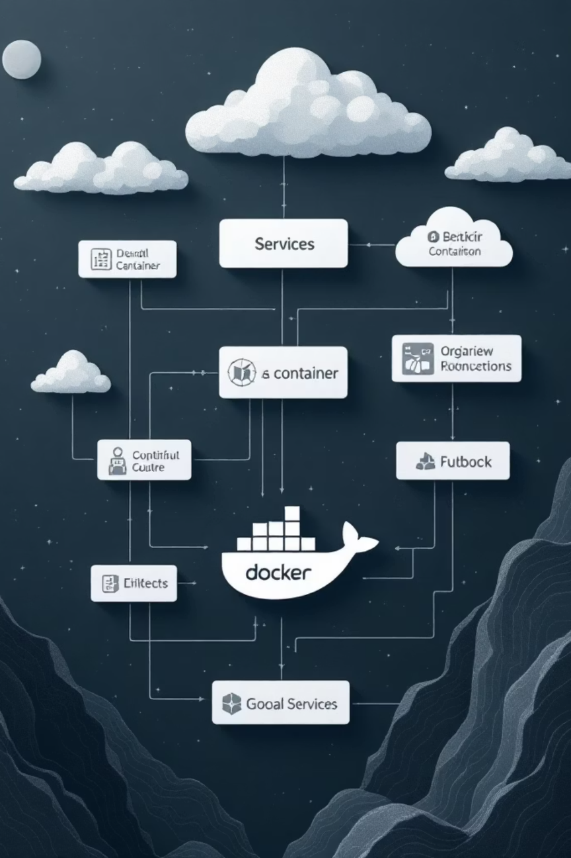




Infrastructure & DevOps
Docker Compose
Orchestration for MongoDB, Kafka, MinIO, and application services
KRaft Mode
Kafka cluster configuration with automatic topic creation
MongoDB
Persistent storage with collection initialization
MinIO
Auto-initialization with bucket creation and health checks
Complete containerized infrastructure with volume persistence for data durability. Automatic health checks ensure services are ready before application startup. Easy local development setup with single command deployment.
Notes:
8

Slide 9







Achievements & Current Status
✅ Completed Features
Full-Stack Application
Event Streaming
Complete e-commerce platform with authentication and authorization
Real-time Kafka integration with message brokering
Spark Streaming
Live Dashboard
Continuous job writing to data lake with fault tolerance
WebSocket-based real-time metrics and KPIs
Image Management
Docker Infrastructure
Upload and storage system with MinIO integration
Containerized services with automated orchestration
Order Management
Complete product, order, and review lifecycle management
Notes:
9

Slide 10









Future Roadmap & Enhancements
🚀 Planned Features
Advanced Analytics
Customer segmentation, product recommendations, and predictive modeling for customer behavior
ML Models
Demand forecasting with time series analysis and inventory optimization algorithms
Inventory Management
Real-time stock tracking with automated alerts for low inventory levels
BI Integration
Enhanced visualization with Apache Superset or Metabase for business intelligence
Data Warehouse
Integration with Snowflake or BigQuery for enterprise-scale analytics
A/B Testing
Framework for product feature experimentation and conversion rate optimization
Caching Layer
Performance optimization with Redis for reduced database load
Mobile App
Native iOS and Android applications for enhanced customer engagement
Payment Gateway
Secure payment processing integration with Stripe or PayPal
Notes:
10

