Slide 1
Programming with Java
Introduction to OOP’s,
Classes and Objects
Unit - 1
Notes:
First Class: Introduction, Prerequisites, Advices, Syllabus
Lab 1: Create a Java Project, Compile, and Run.
Show syntax errors
Print program
Capture screen shots, and save it in Word, and print it.
Homework One: Check in the class randomly.

Slide 2
Points to be covered
  Introduction to OOP’s:
    What is OOP
    Difference between Procedural and Object-oriented programming
    Basic OOP concept - Object, classes, abstraction, encapsulation, inheritance, polymorphism
    History of Java
    Features of Java
    Difference between C++ & JAVA
    JDK Environment
    Java Virtual Machine
    Java Tokens
    Data Types
    Type Conversion and type casting
    Garbage Collection
    Array (One Dimensional, Rectangular and Jagged Array)
    Conditional Statements (if, switch)
    Looping Statement (while, for, do-while)
    Command Line Arguments

Slide 3
Continue…
  Class and objects:
    Define class with instance variables and methods
    Object creation of class
    Accessing member of class
    Argument passing
    Constructors
    Method overloading
    static data, static methods, static blocks
    this keyword

Slide 4
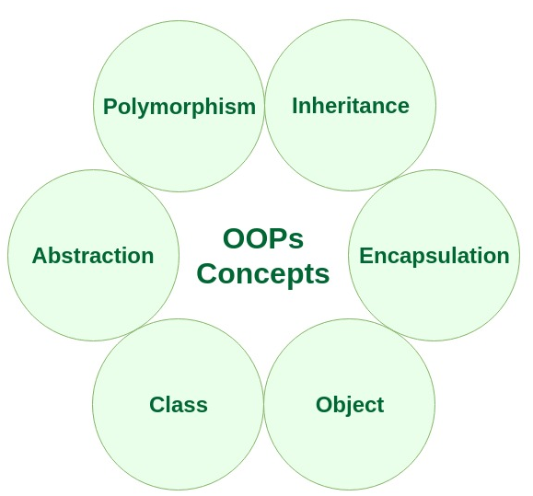
What is OOP?
OOP : Object Oriented Programming
Uses objects in programming.

Slide 5
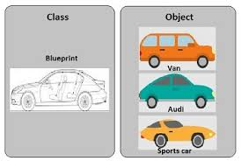
Class and Object

Slide 6
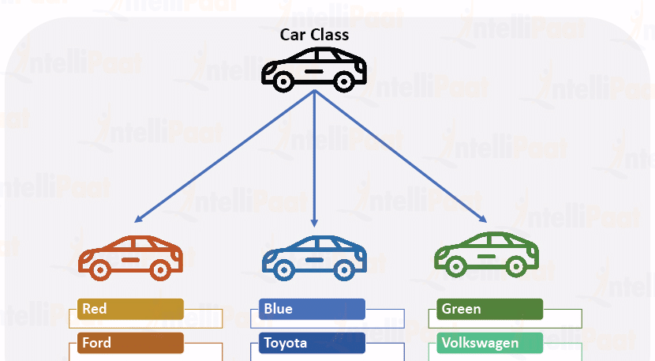
Class and Objects
Class is user defined data type.
An object is an instance of a class.
A class is a template or blueprint from which
objects are created.
An object is the instance(result) of a class.

Slide 7
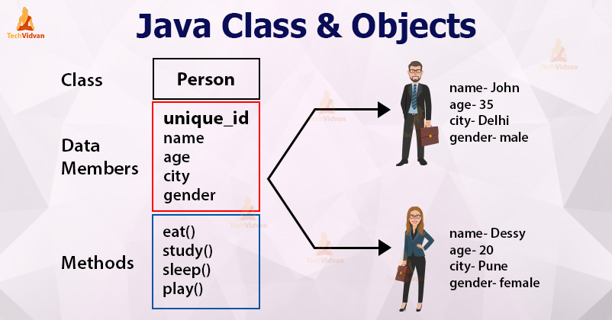
Class and Objects

Slide 8
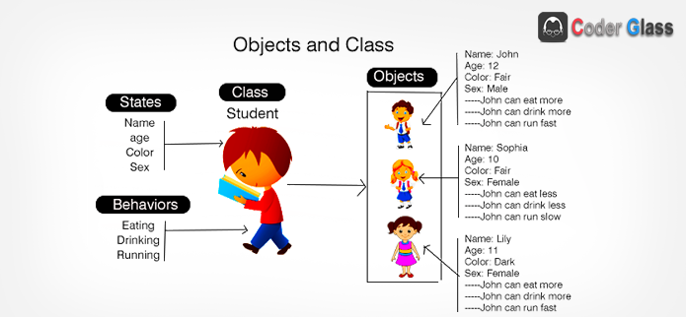
Class and Objects

Slide 9
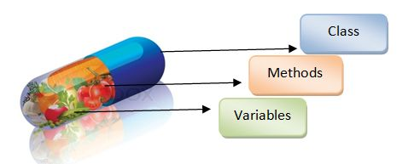
Encapsulation
Encapsulation in Java is a mechanism of wrapping the
data (variables) and code acting on the data (methods)
together as a single unit.

Slide 10
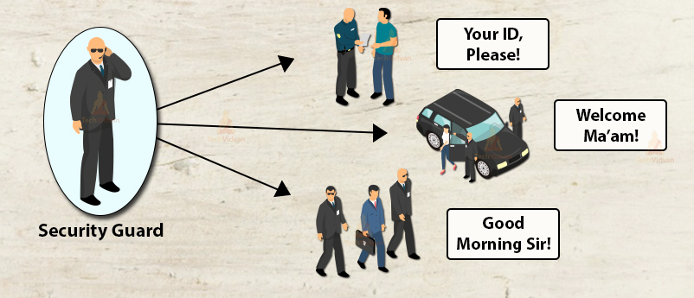
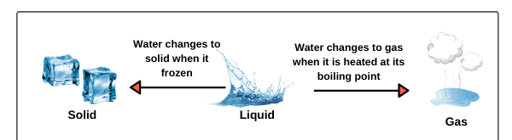
Polymorphism

Slide 11
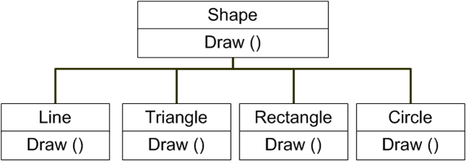
Polymorphism
Polymorphism means more than one forms
One name many forms – Polymorphism
Polymorphism is the ability of an object to take on many forms.

Slide 12
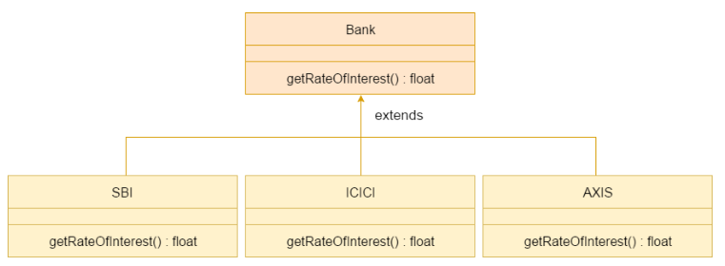
Polymorphism

Slide 13
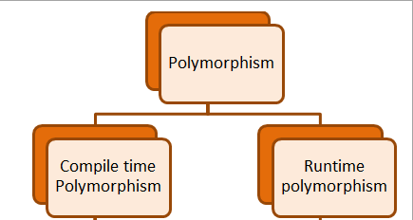


Types of polymorphism
Dynamic
or
late binding
Static
or
early binding
Method Overloading
Method Overriding

Slide 14
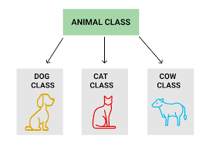
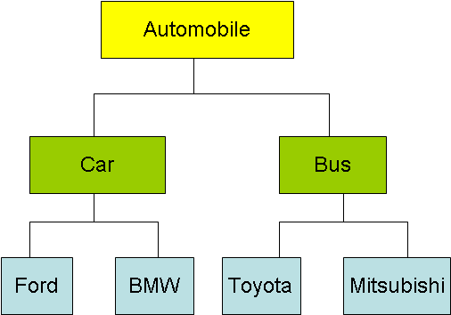
Inheritance
Inheritance in Java is a
Mechanism in which one object acquires all the properties and behaviors of a parent object.
Example 1
Example 2

Slide 15
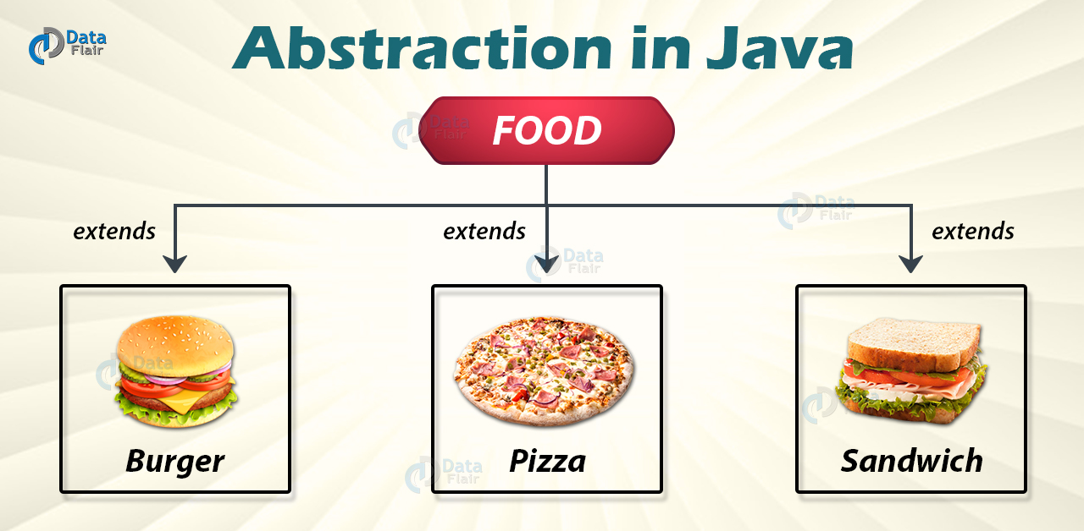
Abstraction
Abstraction is the process of identifying only the relevant details and ignoring the non-essential details.

Slide 16
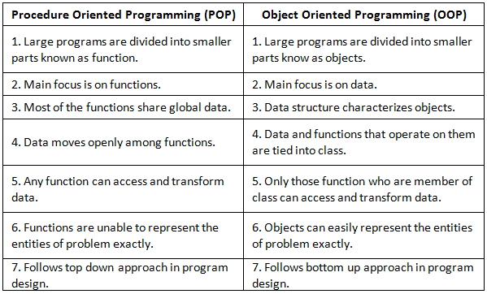
POP v/s OOP

Slide 17
Java v/s C++
Java | C++
Doesn't support Pointer concept | Support pointer concept.
Doesn’t support multiple inheritances | Support multiple inheritance
Does not include structures or unions | It have structure and union concept
Includes automatic garbage collection | Requires explicit memory management
Java has method overloading, but no operator overloading | C++ supports both method overloading and operator overloading
Platform independent programming language | Platform dependent programming language
It is mainly used for design web based application, desktop application | It is used for design only desktop application like OS, Compiler etc.
Java uses compiler and interpreter | C++ use only Compiler

Slide 18
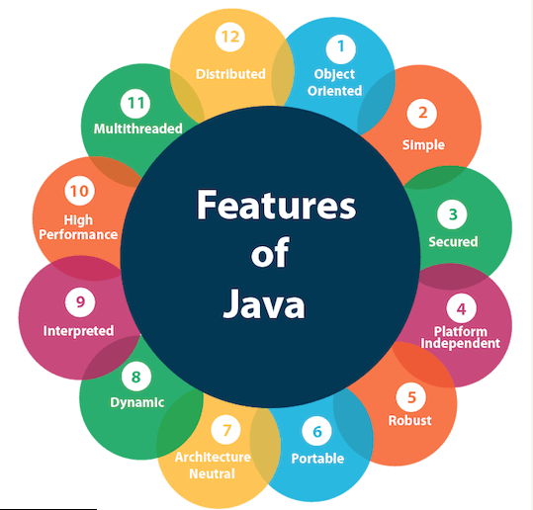

Slide 19
Simple
Object Oriented
Everything in Java is an object.
Object-oriented means we organize our software as a
combination of different types of objects that deals with both data and behaviour.
Java syntax is based on C++ so easy for who know C++.
Many complicated and rarely-used features are removed
Ex. explicit pointers, operator overloading, etc.
There is no need to remove unreferenced objects because
there is an Automatic Garbage Collection in Java.

Slide 20
Platform Independent
A platform is the hardware or software environment in which a
program runs.
There are two types of platforms
  Software-based
  Hardware-based.
Java provides software-based platform.
It has two components:
    Runtime Environment
    API(Application Programming Interface)
Java code can be run on multiple platforms e.g. Windows, Linux,
Sun Solaris, Mac/OS etc.
Java code is compiled by the compiler and converted into
byte code.
This bytecode is a platform independent code because it can be
run on multiple platforms
i.e. Write Once and Run Anywhere(WORA).

Slide 21
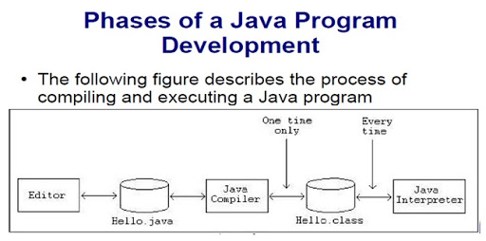

Slide 22
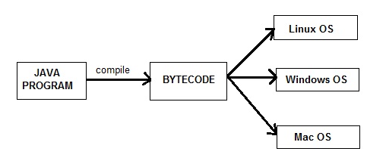
Platform independent

Slide 23
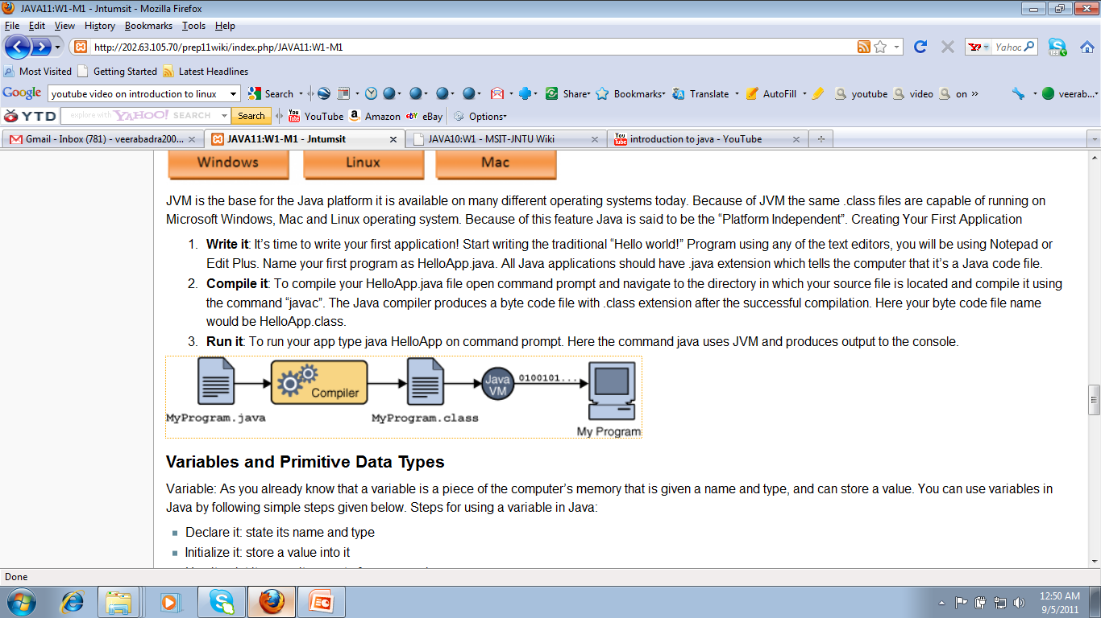
WORA(Write Once Run Anywhere)

Slide 24
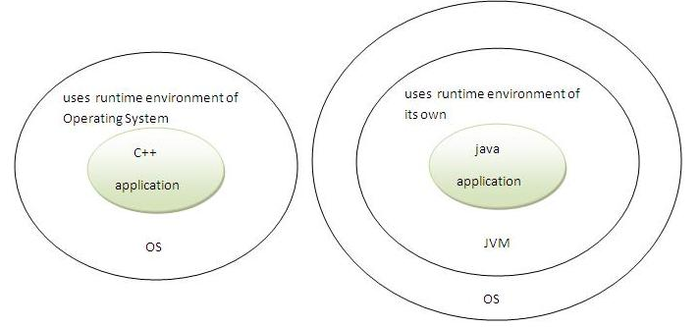
Secured
Java is secured because:
  No explicit pointer
  Programs run inside virtual machine sandbox.

Slide 25
Rubust
Robust simply means strong.
Java uses strong memory management.
There are lack of pointers that avoids security problem.
There is automatic garbage collection in Java.
There is exception handling and type checking
mechanism in java.

Slide 26
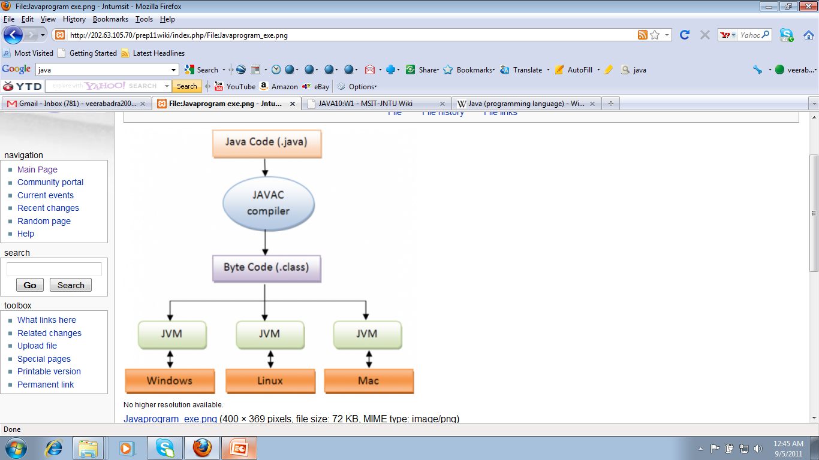
Java is architecture-neutral
JAVA PROGRAM EXECUTION

Slide 27
Other….
Portable
  We may carry the java bytecode to any platform.
High-performance
  Java is faster than traditional interpretation since byte code is "close" to
  native code still somewhat slower than a compiled language (e.g., C++)
Distributed
  We can create distributed applications in java.
  RMI and EJB are used for creating distributed applications.
  We may access files by calling the methods from any machine on the
  internet.
Multi-threaded
  A thread is like a separate program, executing concurrently.
  The main advantage of multi-threading is that it shares the same memory.
  Threads are important for multi-media, Web applications etc.

Slide 28
Java Environment
Java environments includes :
  JDK
  JSL
  Java Development Kit (JDK):
  includes Development tools
  Java Standard Library (JSL):
  Also known as Application Programming Interface (API)
  It includes classes and methods.
JDK includes tools like java compiler(javac),
java interpreter(java)
API includes hundreds of classes and methods grouped into
several packages according to their functionality.

Slide 29
JDK tools
Tool | Description
javac | Java compiler
java | Java interpreter
javadoc | API documentation generator
appletviewer | Run and debug applets without a web browser
jar | Manage Java Archive (JAR) files
jdb | Java Debugger.
javah | C header and stub generator. Used to write native methods.
javap | Class file disassembler

Slide 30
JSL / API
Packages :
  java.lang
  java.util
  java.applet
  java.awt
  java.io
  java.awt.event etc…..

Slide 31
JVM
JVM (Java Virtual Machine) is an abstract machine.
It is a specification that provides runtime environment in which Java byte code can be executed.
JVMs are available for many hardware and software platforms.
JVM, JRE and JDK are platform dependent because
configuration of each OS differs.
But, Java is platform independent.
The JVM performs following main tasks:
  Loads code
  Verifies code
  Executes code
  Provides runtime environment

Slide 32
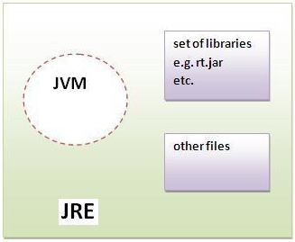
JRE (Java Runtime Environment)
It is used to provide runtime environment.
It is the implementation of JVM.
It contains set of libraries + other files that JVM uses at
runtime.

Slide 33
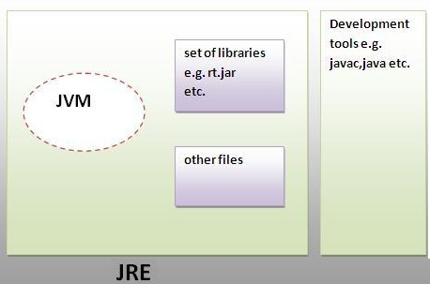
JDK (Java Development Kit)
It contains JRE + development tools.

Slide 34
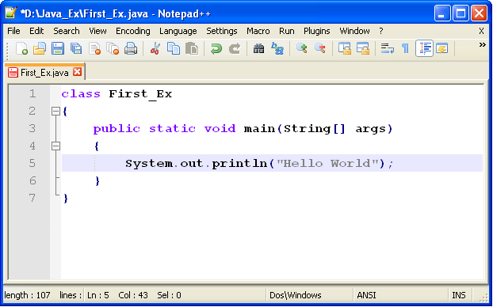
Hello world Program in java

Slide 35
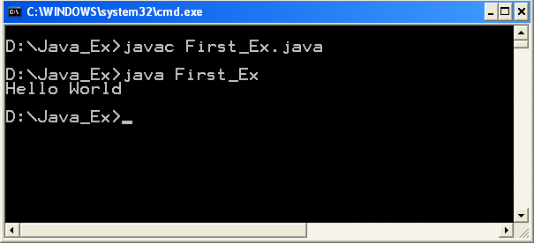
Execution of Hello world Program

Slide 36
Example….
main( ) is the entry point of your Java program.
The main method has to have this exact signature in order
to be able to run your program.
public: means that anyone can access it.
static: means that you can run this method without creating an instance of that class.
void: means that this method doesn't return any value.
main is the name of the method.
System: is a pre-defined class that Java provides us and it
holds some useful methods and variables.
out: is a static variable within System that represents the
output of your program.
println: is a method of out that can be used to print given
text and point to next line.
print: is a method of out that can be used to print a given
text.

Slide 37
Program structure
Syntax:
Example :
[Definition section]
[package declarations if
needed]
[import statements by
default java. lang ]
[class declaration]
:
[class declaration]
// First Example of java Program
package abc;
import java.lang.*;
class Demo
{
public static void main(String[ ]
args)
{
Sytem.out.println("Hello! World");
}
}

Slide 38
History of Java
Founder : James Gosling - Sun Microsystems
Co founder – Vinod Khosla
Oak - Java, May 20, 1995, Sun World
JDK Evolutions
  JDK 1.0 (January 23, 1996)
  JDK 1.1 (February 19, 1997)
  J2SE 1.2 (December 8, 1998)
  J2SE 1.3 (May 8, 2000)
  J2SE 1.4 (February 6, 2002)
  J2SE 5.0 (September 30, 2004)
  Java SE 6 (December 11, 2006)
  Java SE 7 (July 28, 2011)
  Java SE 8 (March 18, 2014)
  Java SE 9 (May be relesed in July 2017)
  Java SE 13.0.1 (released on September 2019)
  Java 17 is the latest released Java version.(September 2021)

Slide 39
Language Building Blocks(Tokens)
Comments
Keywords
Identifiers
Literals
White spaces
Separator

Slide 40
Comments
Block comments
  Can span several lines
  Begin with /*
  End with */
  Compiler ignores all text between /* and */
Line comments
  Start with //
  Compiler ignores text from // to end of line

Slide 41
Keywords
Keywords or Reserved words are words that have
a specific meaning to the compiler and cannot be
used as identifiers (e.g., variable names, function
names, class names).
For example, when the compiler sees the word class, it understands that the word after class is the name for
the class.
The list of reserved words in Java is provided below.

Slide 42
abstract assert boolean break byte case catch char class const default do double | else enum extends false final finally float for goto if implements import instanceof | int interface long native new null package private protected public return short static | super switch synchronized this throw throws transient true try void volatile while continue

Slide 43
Identifiers - symbolic names
Identifiers are used to name classes, variables, and methods
Identifier Rules:
  Must start with a "Java letter"
    A - Z, a - z, _, $...
  Can contain essentially any number of Java
  letters and digits, but no spaces
  Case sensitive!!
    Number1 and number1 are different!
  Cannot be keywords or reserved words

Slide 44
Literals
All values that we write in a program are literals.
Each belongs to one of Java's four primitive types (int, double, boolean, char) or belongs to the special
reference type String.
All primitive type names are keywords in Java
Literal | Type
1 | int
3.14 | double
True | boolean
‘3‘ | char ('P' and '+' are char too)
“Std ID“ | String
Null | any reference type

Slide 45
Literals
int, short, byte:
  Optional initial sign (+ or -) followed by digits
  0 – 9 in any combination.
long:
  Optional initial sign (+ or -) followed by digits 0–9
  in any combination, terminated with an L or l.
  Note: Use the capital L because the lowercase
  l can be confused with the number 1.

Slide 46
Floating-Point Literals
float:
  Optional initial sign (+ or -) followed by a
  floating-point number in fixed or scientific format,
  terminated by an F or f.
double:
  Optional initial sign (+ or -) followed by a
  floating-point number in fixed or scientific format.
Note: Commas, dollar signs, and percent signs (%) cannot be used in integer or floating-point literals

Slide 47
char and boolean Literals
char:
  Any printable character enclosed in single quotes
boolean:
  true or false

Slide 48
String Literals
String is actually a class, not a basic data type.
String variables are objects
String literal: text contained within double
quotes.
Example of String literals:
"Hello"
"Hello world"
"The value of x is "

Slide 49
Building Blocks - White Space
Space, tab, newline are white space characters
At least one white space character is required
between a keyword and identifier
Any amount of white space characters are
permitted between identifiers, keywords,
operators, and literals.

Slide 50
Separators
There are exactly 7 single character (separators) in Java
Separator | Use
; | Terminate statement
, | Declare more then one variable or pass argument in UDF
. | Used to access variable or method of a class.
: | Used to specify a label.
() | Used in method ,if condition and loops.
{ } | Enclose statement of methods, class or any block.
[ ] | Used in array.

Slide 51
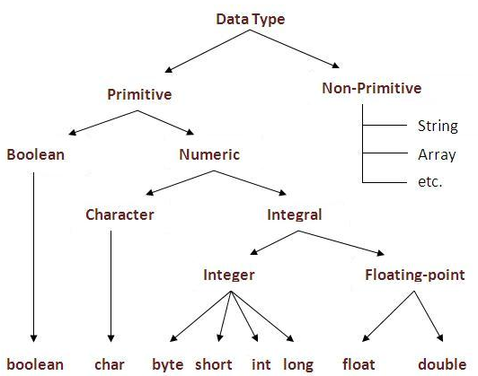
Data Types

Slide 52
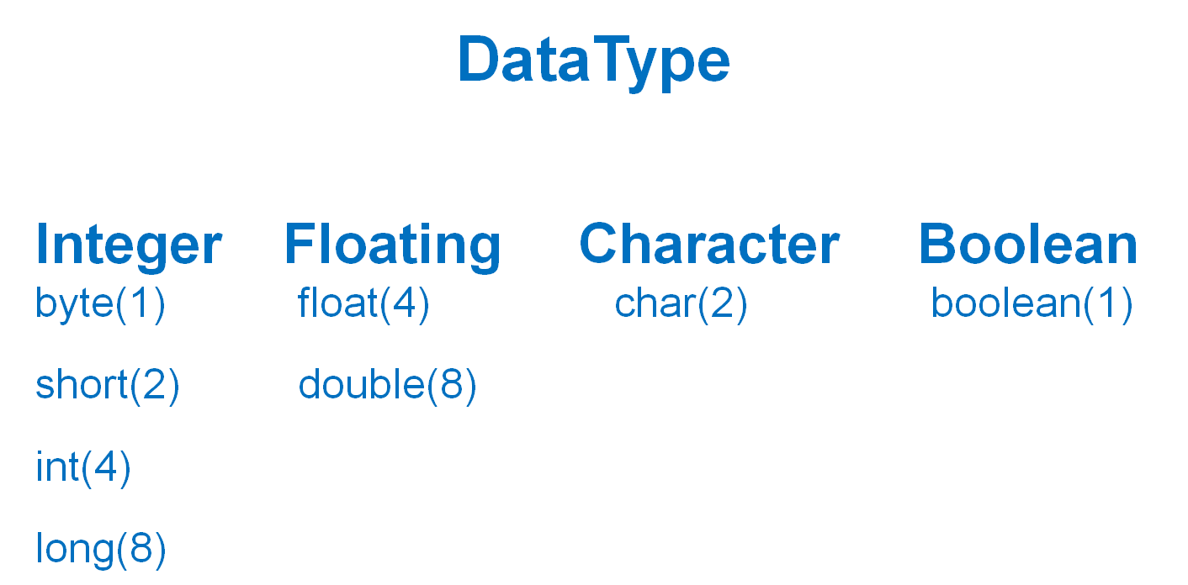

Slide 53
Type Casting...
Implicit casting
double d = 3; (type widening)
Explicit casting
int i = (int)3.0; (type narrowing)
What is wrong? int x = 5/2.0;
Needs explicit casting: int x=(int) 5/2.0;

Slide 54
Casting between char & Num Types
int i = 'a'; // Same as int i = (int)'a';
char c = 97; // Same as char c = (char)97;

Slide 55
Identifiers
An identifier is a sequence of characters that
consist of:
  letters
  digits
  underscores (_)
  dollar signs ($)
An identifier must start with a letter, an underscore (_), or a dollar sign ($).
It cannot start with a digit.
An identifier cannot be a keyword.
An identifier cannot be true, false, or null.
An identifier can be of any length.

Slide 56
Declaring & Assignment of variable
Variables
int x;
double radius;
char a; // Declare a to be a char;
x = 1; // Assign 1 to x;
radius = 1.0; // Assign 1.0 to radius;
a = 'A'; // Assign 'A' to a;

Slide 57
Declaring and Initializing in One Step
int x = 1;
double d = 1.4;
float f = 1.4f;
OR
float f = 1.4F;

Slide 58
Types of Variables
Local variable:
  A variable that is declared inside the method is called local
  variable.
Instance Variable:
  A variable that is declared inside the class but outside the
  method is called instance variable .
  It is not declared as static.
Static variable:
  A variable that is declared as static is called static variable.

Slide 59
Constants with final keyword
Syntax:
  final datatype CONSTANTNAME= VALUE;
Example:
  final double PI = 3.14159;
  final int SIZE = 3;

Slide 60
Input from User (Scanner Class)
import java.util.*;
class ScannerTest
{ public static void main(String args[])
{ Scanner sc=new Scanner(System.in);
System.out.println("Enter your rollno");
int rollno=sc.nextInt(); //Integer value
System.out.println("Enter your name");
String name=sc.next(); //String value
System.out.println("Enter your fee");
double fee=sc.nextDouble(); //Double value
System.out.println("Rollno:"+rollno+“ name:"+name+"
fee:"+fee);
}
}

Slide 61
Input from User (Using Console)
import java.io.*;
class Test
{ public static void main(String[ ] args)
{ Console co=System.console();
System.out.println("Enter a Rollno:");
String rno=co.readLine();
int roll = Integer.parseInt(rno); //Convert to integer
System.out.println("Enter a Name:");
String name=co.readLine();
System.out.println("Enter Fees:");
String f=co.readLine();
double fees=Double.parseDouble(f);
System.out.println("Roll no:"+roll+" Name:"+ name+" Fees:"+fees);
}
}

Slide 62
Operators in Java

Slide 63
Operators
Assignment Operators
Increment Decrement Operators
Arithmetic Operators
Bitwise Operators
Relational Operators
Logical Operators
Ternary Operators (Conditional Operators)
Special Operators

Slide 64
Operator
Arithmetic Op. : + - * / %
Relational Op. : > >= < <= == !=
Logical Op. : && || !
Operators
Inc/Dec Op. : ++ --
Bit Op. : & | ^ << >>
Conditional Op. : ?:
Assign Op. : = += -= *= /= %= &= ^= |= >>= <<=
Instanceof Op. : instanceof

Slide 65
Arithmetic Operators
Operator | Use | Description
+ | op1 + op2 | Adds op1 and op2; also used to concatenate strings
- | op1 - op2 | Subtracts op2 from op1
* | op1 * op2 | Multiplies op1 by op2
/ | op1 / op2 | Divides op1 by op2
% | op1 % op2 | Computes the remainder of dividing op1 by op2

Slide 66
Arithmetic Operators…
+, -, *, /, and %
5/2 yields an integer 2.
5.0/2 yields a double value 2.5
5 % 2 yields 1 (the remainder of the division)
5.0 % 2 is not defined : modulo is defined only for
integers.

Slide 67
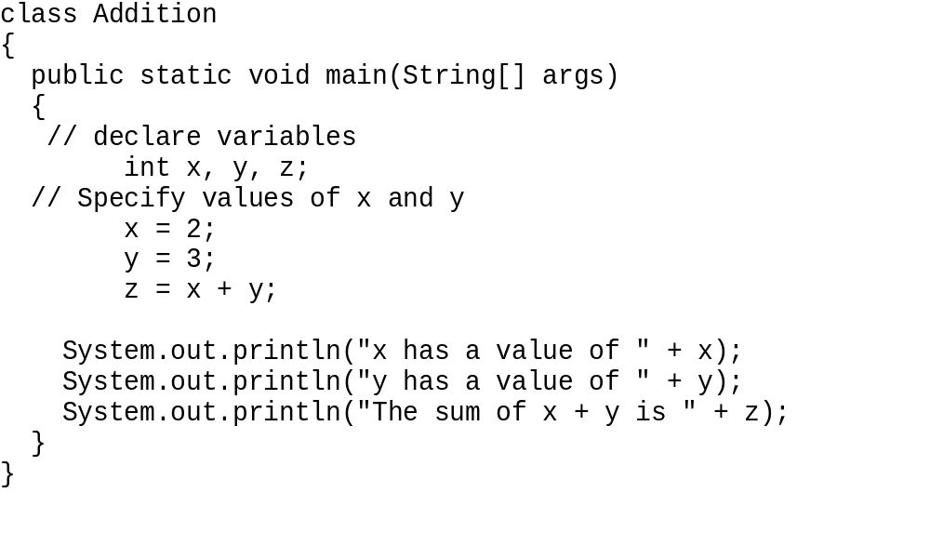
Example: Addition

Slide 68
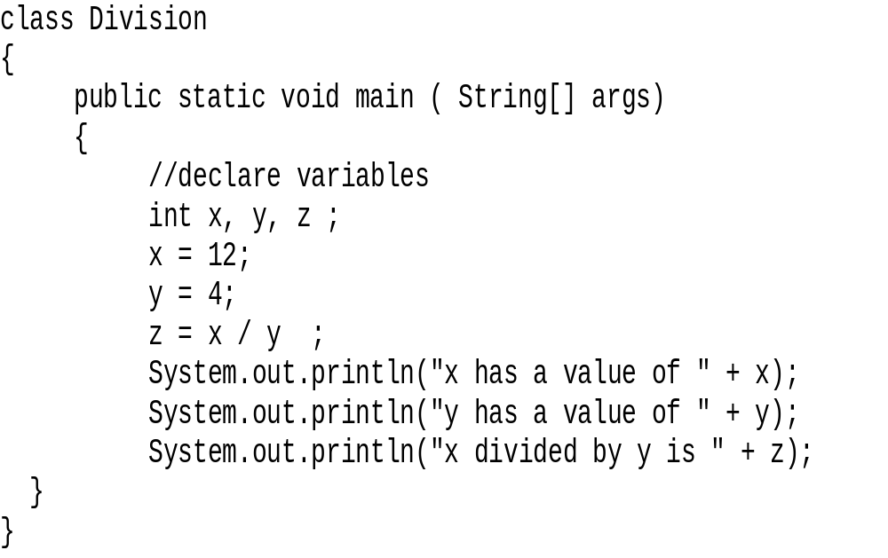
Example: Division

Slide 69
Relational Operators
Operator | Meaning | Example
== | Equals | a == b
!= | Not equals | a != b
> | Greater than | a > b
< | Less than | a < b
>= | Greater than or equals | a >= b
<= | Less than or equals | a <= b

Slide 70
Logical Operators
Symbol | Condition
&& | AND
|| | OR
! | NOT

Slide 71
Assignment/Shorthand Assignment Operators
Operator | Example | Equivalent
= | i=10
+= | i+=8 | i = i+8
-= | f-=8.0 | f = f-8.0
*= | i*=8 | i = i*8
/= | i/=8 | i = i/8
%= | i%=8 | i = i%8

Slide 72
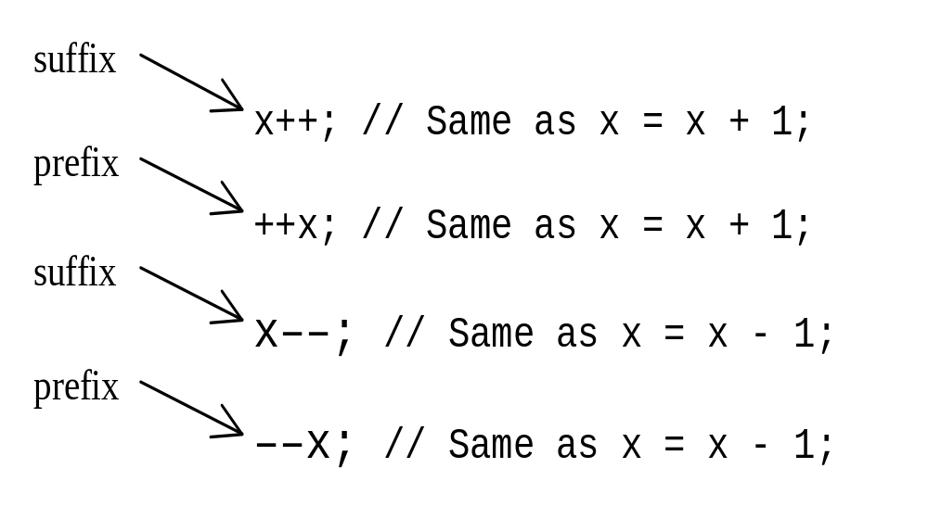
Increment and Decrement Operators

Slide 73
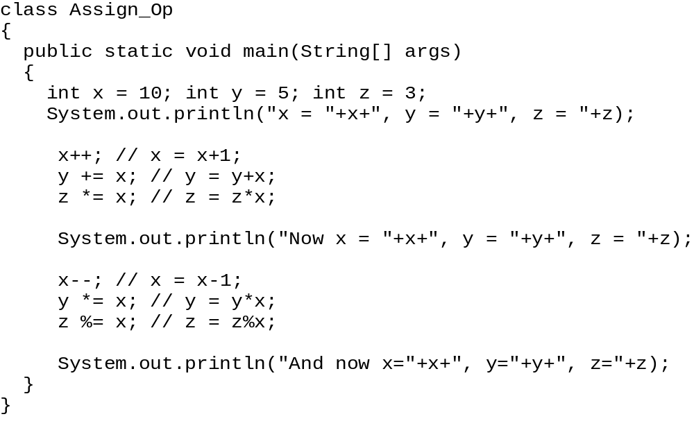
Example….

Slide 74
Conditional Operator (? :)
Boolean-expression ? expression-1 : expression-2
Example
if (a > b)
max = a;
else
max = b;
OR
max = (a > b) ? a : b;

Slide 75
Special Operators : .(dot), instanceof
. (dot) operator :
  It is used to access the instance variables and
  methods of class objects.
  Ex: stud.age, stud.salary()
Instanceof :
  It is used only for object reference variables.
  The operator checks whether the object is of a
  particular type(class type or interface type).
  instanceof operator is written as:
  (Object) instanceof (class/interface type)
  Ex: stud instanceof student

Slide 76
Programming Errors
Syntax Errors
  Detected by the compiler
Logical Errors
  Produces incorrect result
Runtime Errors
  Causes the program to abort

Slide 77
Compilation Errors
ShowSyntaxErrors
{
public static void main(String[] args)
{
i = 30
System.out.println(i+4);
}
}

Slide 78
Runtime Errors
class ShowRuntimeErrors
{
public static void main(String[] args)
{
int i = 1 / 0;
}
}

Slide 79
Logical Errors
class ShowLogicalErrors
{
public static void main(String[] args)
{
  int sum=0;
  for(int i=1; i>10; i++)
  { sum= sum + i;}
  System.out.println(“Sum of 1-10 is “+sum);
}
}

Slide 80
Garbage Collection
In Java, garbage means unreferenced objects.
Garbage Collection is process of reclaiming the
runtime unused memory automatically.
In other words, it is a way to destroy the unused
objects.
To do so, we were using free() function in C
language and delete() in C++. But, in Java it is
performed automatically. So, java provides
better memory management.

Slide 81
Advantages…
Programmer doesn't need to worry
about dereferencing an object.
It is done automatically by JVM.
Increases memory efficiency and
decreases the chances for memory leak.

Slide 82
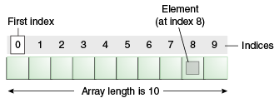
Java Array
Array is a collection of similar type of elements that have contiguous memory location.
Java array is an object the contains elements of similar
data type.
We can store only fixed set of elements in a Java array.
Array in Java is index based, first element of the
array is stored at 0 index.

Slide 83
Java Array…
Advantage of Java Array:
  Code Optimization: It makes the code optimized,
  We can retrive or sort data easily.
  Random access: We can get any data located at any index position.
Disadvantage of Java Array:
  Size Limit: We can store only fixed size of elements in the array.
  It doesn't grow its size at runtime.
  To solve this problem, collection framework is used in
  java.
Types of Array :
  Single Dimensional Array
  Multidimensional Array
  Jagged Array

Slide 84
Single Dimensional Array
Syntax :
  dataType[] arr;
  or
  dataType []arr;
  or
  dataType arr[];
For ex: int[] primes;
All syntaxes are equivalent
No memory allocation at this point

Slide 85
Array..
Define an array as follows:
  variable_name=new <type>[Size];
  Ex : primes=new int[10];
Declaring and defining in the same statement:
  int[] primes=new int[10];
Note : In JAVA, int is of 4 bytes, total space=4*10=40 bytes

Slide 86
Example
class Test_Array
{ public static void main(String args[])
{ int a[]=new int[5];//declaration and instantiation
  a[0]=10;//initialization
  a[1]=20;
  a[2]=70;
  a[3]=40;
  a[4]=50;
  for(int i=0;i<a.length;i++)//property of array
    System.out.print(“\t”+a[i]);
}
}
Output: 10 20 70 40 50

Slide 87
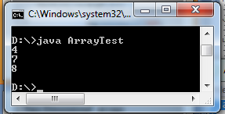
One Dimensional Array
class ArrayTest
{ public static void main(String args[])
{
int a[]={4,7,8};
for(int i=0;i<a.length;i++)
System.out.println(a[i]);
}
}

Slide 88
Multidimensional Array:Array of Array
Two-Dimensional array :
  int[][] marks=new int[60][3];
  60 arrays each having 3 elements
  First index: specifies array (row)
  Second Index: specifies element in that array (column)
  In JAVA int is 4 bytes,
    total Size=4*60*3=720 bytes

Slide 89
Array of Array…
marks[0]
0 | 1 | 2
marks[1]
0 | 1 | 2
marks[2]
0 | 1 | 2

Slide 90
Initialize Array of Array
int[][] marks= { {99, 42, 74}, {90, 91, 72}, {88, 61,74}};
//3 arrays with 3 elements each
marks[0]
0 | 1 | 2
99 | 42 | 74
marks[1]
0 | 1 | 2
90 | 91 | 72
marks[2]
0 | 1 | 2
88 | 61 | 74

Slide 91
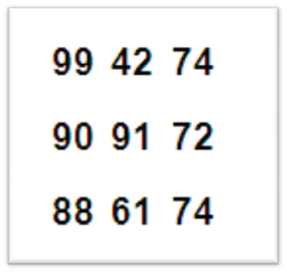
Example…
class Test_Array2D
{ public static void main(String args[])
{
int[][] marks= { {99, 42, 74}, {90, 91, 72}, {88, 61, 74}};
for(int i=0;i<3;i++)
{ for(int j=0;j<3;j++)
{
System.out.print(marks[i][j]+" ");
}
System.out.println();
}
}
}

Slide 92

Jagged Array
A 2-D array in which the sizes of the second dimension are unequal is
known as Jagged Array
In Jagged Array each row has different number of columns.
It is also know as Variable Length Array.
class Test_Jagged
{ public static void main(String args[])
{ int k;
int twoD[][] = new int[4][];
twoD[0] = new int[1];
twoD[1] = new int[2];
twoD[2] = new int[3];
twoD[3] = new int[4];
for (int i = 0; i < 4; i++)
{ k=1;
for (int j = 0; j < i + 1; j++) {
twoD[i][j] = k++;
System.out.print(twoD[i][j] + " "); }
System.out.println();
}
}
}
Output:

Slide 93
Conditional Statements
Branching Statements:
if condition
switch-case

Slide 94
if condition (Simple If-Else) :
Structure:
if ( condition_to_test )
{
Statement Blocks;
}
else
{
  Statement Blocks;
}
Nested If-Else
Structure:
if ( condition_to_test 1)
{
  if ( condition_to_test 1.1)
  {Statement Blocks;}
  else {Statement Blocks;}
}
else
{
if ( condition_to_test2 )
{ Statement Blocks; }
else
{ Statement Blocks;}
}

Slide 95

Example…
To check number is zero, positive or negative
import java.util.*;
class CheckNumber
{ public static void main(String args[])
{ Scanner sc = new Scanner(System.in);
System.out.println("Enter a number :");
int x = sc.nextInt();
if(x == 0)
System.out.println("x is a zero number);
else
if(x < 0)
System.out.println("x is a negative having value " + x);
else
System.out.println("x is a positive having value " + x);
}
}
Output:

Slide 96
Example…
import java.util.*;
class Test_If
{ public static void main(String args[])
{
Scanner sc = new Scanner(System.in);
System.out.println("Enter age of user:");
int user = sc.nextInt();
if(user>18)
{ System.out.println("User is older than 18"); }
else
{System.out.println("User is younger than 18"); }
}
}

Slide 97
Types of Loop
for loop
while loop
do…while loop
for loop (Advanced)
Break and Continue with loop

Slide 98

Ex: Refer Array using for loop
public class Test
{ public static void main(String args[])
{ int [] numbers = {10, 20, 30, 40, 50};
for(int x : numbers )
{ System.out.print( x + “ , ” );
}
System.out.println();
String [] names ={"James", "Larry", "Tom", "Lacy"};
for( String name : names )
{
System.out.print( name+”,” ); }
}
}
Output:

Slide 99
break keyword
The break keyword is used to stop the entire loop.
The break keyword must be used inside any loop or a switch
statement.
The break keyword will stop the execution of the innermost loop
and start executing the next line of code after the block.
Example :
public class Test_Break
{ public static void main(String args[])
  { int[] numbers = {10, 20, 30, 40, 50};
      for(int x : numbers )
      { if( x == 30 )
      { break; }
      System.out.println( x );
      }
    }
}

Slide 100
continue Keyword
The continue keyword can be used in any of the loop control structures.
It causes the loop to immediately jump to the next iteration of the loop.
Example :
public class Test_Continue
{ public static void main(String args[])
{ int [] numbers ={10, 20, 30, 40, 50};
for(int x : numbers )
{ if( x == 30 ) { continue; }
System.out.println( x ); }
}
}

Slide 101
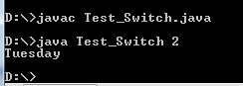
Command Line Arguments & Switch Case
class Test_Switch
{ public static void main(String args[])
{ int x=Integer.parseInt(args[0]);
switch(x)
{ case 1: System.out.println("Monday"); break;
case 2: System.out.println("Tuesday"); break;
case 3: System.out.println("Wednesday"); break;
case 4: System.out.println("Thursday"); break;
case 5: System.out.println("Friday"); break;
case 6: System.out.println("Saturday"); break;
case 7: System.out.println("Sunday"); break;
default :System.out.println("Invalid Number of Day");
}
}
}

